Slide 1
AI-Powered Resume Analyzer & Career Guidance Agent
SDG 8 - Decent Work and Economic Growth
Full Name: Roshani Ramesh Kadu
College Name: G. N. Khalsa College, Matunga, Mumbai -19
Registered Email ID: roshanikadu388@gmail.com
IBM SkillsBuild Platform Email ID: roshanikadu388@gmail.com
Internship: CSRBOX – IBM SkillsBuild Applied AI Internship

Slide 2
INTRODUCTION
Unemployment and underemployment remain major global challenges.
Many job seekers struggle to align their skills with suitable job roles.
Lack of personalized career guidance leads to poor employment outcomes.
AI can help bridge the gap between skills and job market requirements.

Slide 3
PROBLEM STATEMENT
Skill–job mismatch among students and job seekers.
Lack of accessible employment readiness assessment tools.
Absence of personalized career guidance systems.
Difficulty in identifying missing skills for desired job roles.

Slide 4
PROJECT OBJECTIVES
Analyze user skills, education and experience.
Recommend suitable job roles using AI logic.
Identify skill gaps and employment readiness.
Provide salary insights for different experience levels.
Build an interactive AI-powered career guidance system.

Slide 5
SUSTAINABLE DEVELOPMENT GOAL (SDG)
Promotes employment readiness.
Reduces skill-job mismatch.
Encourages upskilling and career planning.
Supports inclusive and sustainable economic growth.

Slide 6
PROPOSED SOLUTION
An AI-powered resume analysis and career guidance agent.
Skill-based job role recommendation system.
Employment readiness scoring and skill gap analysis.
Salary insights based on experience level.
Implemented as a web-based application.

Slide 7
AI SOLUTION DESIGN & WORKFLOW
Input: Skills, education, years of experience
Processing:
Skill Normalization, Job-Skill Matching, Readiness Score Calculation, Skill Gap Analysis
Output:
  Recommended Job Rules, Missing Skill, Employment Readiness Status, Salary Expectations

Slide 8
TOOLS & TECHNOLOGIES
Python
Streamlit (Web Application Framework)
Rule-based AI logic
Local Execution
Git & GitHub for version Control

Slide 9
MODEL IMPLEMENTATION
Implemented as a Streamlit web application.
Frontend collects user inputs via interactive UI.
Backend processes inputs using AI-based logic.
Real-time analysis and recommendations are displayed.

Slide 10
DEPLOYMENT & EXECUTION
The project is implemented as a local executable prototype.
Application runs using Streamlit framework.
Command used to run the project:
streamlit run app.py
The application opens as a web interface in the browser.

Slide 11
MODEL OUTPUT
Resume / profile score
Employment readiness status
Recommended job roles
Missing skills for each role
Salary insights for:
  Fresher
  2–3 years experience
  10+ years experience

Slide 12
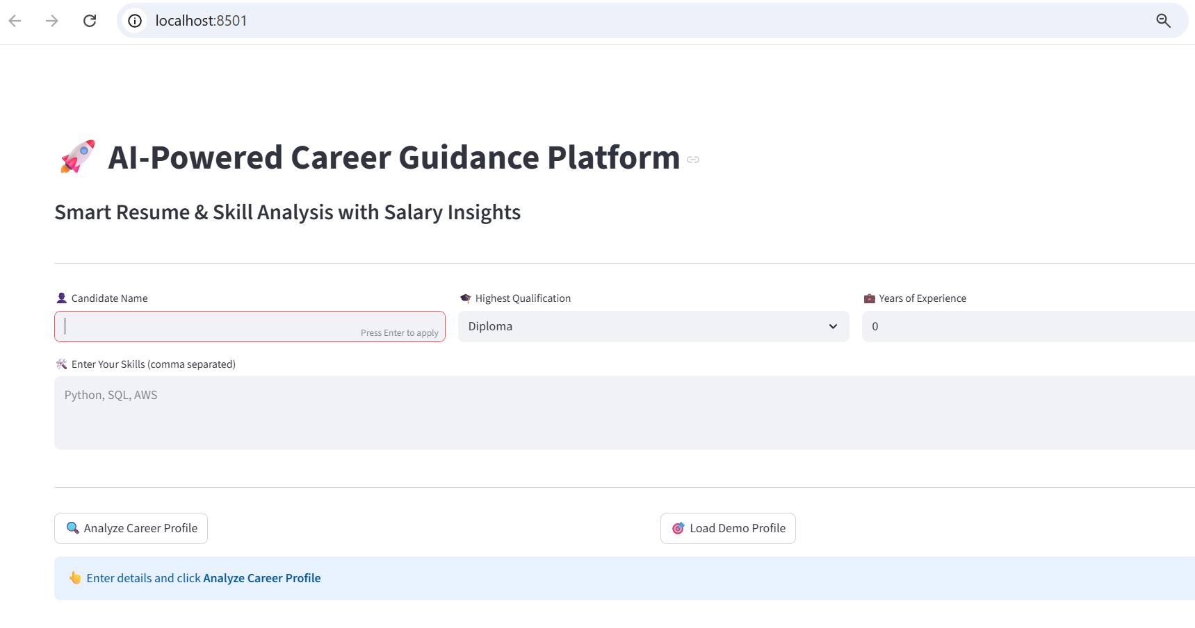

Slide 13
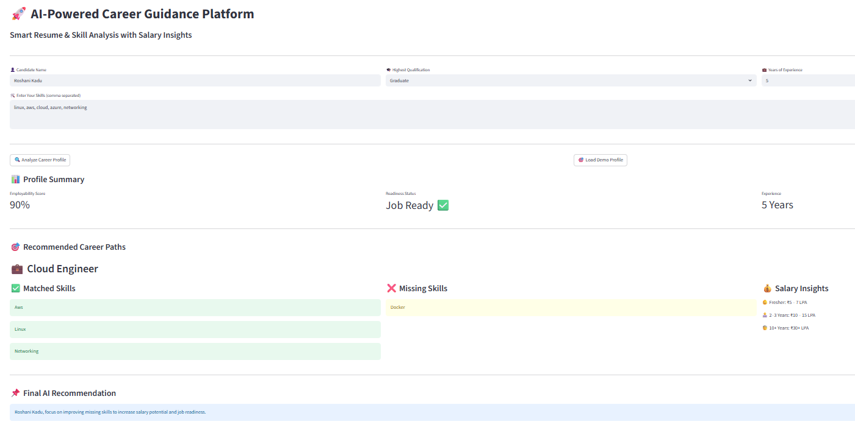

Slide 14
MODEL LINK & CODE ACCESS
GitHub Repository Link:
https://github.com/RoshaniKadu/ai-career-guidance-agent
Model Type:
Executable Stramlit Web Application
The GitHub repository contains:
  Source code
  README file
  Instructions to run the model

Slide 15
ETHICAL & RESPONSIBLE AI
No personal data storage.
Transparent rule-based recommendations.
Supports informed decision-making.
Avoids biased or discriminatory outputs.
Designed for education and guidance purposes only.

Slide 16
EXPECTED OUTCOMES & IMPACT
No personal data storage.
Transparent rule-based recommendations.
Supports informed decision-making.
Avoids biased or discriminatory outputs.
Designed for educational and guidance purposes only.

Slide 17
CONCLUSION
Developed an AI-powered career guidance system.
Successfully aligned with SDG 8.
Demonstrates applied AI and agentic workflow skills.
Provides a scalable and impactful solution.
Portfolio-ready capstone project.

