Slide 1

E-COMMERCE SALES ANALYSIS
Submitted By: Roshani Shinde
Batch: (B.N.065/25 DA and DS)
Date :14-06-2025

Slide 2

AGENDA
Problem Statement
Data Descriptions
Data Cleaning
Exploratory Data Analysis (EDA)
Feature Engineering
Power BI Dashboard
Total Sales by Product category
Revenue Distribution
Monthly Sales: Current Year vs Previous Year
Reports

Slide 3
Problem Statement
You are working as a Data analyst at Ecommerce, a company currently performing well. The stakeholders wish to maintain this level of performance and seek improvement. For this purpose, they want to devise new strategies.
You are part of a team exploring new ways to benefit customers, such as offering more discounts and Prime membership perks. Could you suggest additional methods to identify and reward customers and enhance their shopping experience?

Slide 4
Problem Statement
This project focuses on analyzing e-commerce sales data to uncover patterns, evaluate performance, and generate actionable insights that support better decision-making and business growth.
Analyze e-commerce sales data to identify trends, improve performance, and drive business growth.
Key Business Questions
What is the total sales and profit performance?
Which products and categories generate the highest revenue?
What are the monthly and yearly sales trends?
Which regions contribute the most to sales?
Who are the top customers and their buying behavior?
How do discounts impact profit?

Slide 5
Data collection
Data Source: The dataset was obtained from Kaggle, a popular platform for data science projects.
Database Details:
Platform: Kaggle
DataSet Name: Ecommerce_sales_dataset
Format: CSV File
Data Loading Process:
Imported dataset into MySQL database
Connected database using Python
Retrieved data using SQL queries
Loaded into Pandas DataFrame for analysis

Slide 6
DATA DESCRIPTION
OrderDate: The date when the order was placed.
OrderID: A unique identifier for each order.
Product Category: Represent the types of Product
ProductID: A unique identifier for each product.
Price: Original price of Product.
Discount Percent: Discount applied for Product Cost before Discount.
Region: The geographical area where the customer is located.
Quantity Sold: Number of Unit Sold
Payment Method: mode of Payment (UPI, Card).
Total Revenue: Revenue Generated from each order
Product ID: Unique identifier for each product
Product: The name or description of the product ordered.
Discounted Price: Price after discount
Year / Month / Day: Extracted from order date for trend analysis
Day Name: Day of the week (Mon–Sun)
Order Quantity: The quantity of the product ordered.
Discount Category: Grouped discount levels (Low, Medium, High)
Rating Category: Grouped ratings (Poor, Average, Good).
Review count: Number of customer reviews.
Rating: Customer rating for the order on a scale (e.g., 1 to 5).

Slide 7
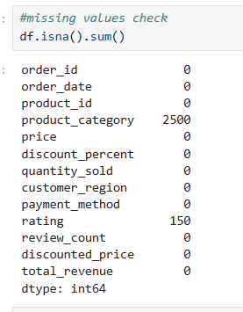
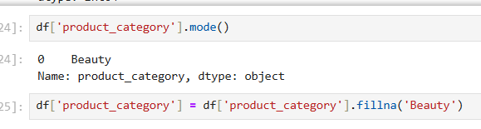
Data Cleaning (Python)
Problems in Raw Data
Missing values detected using df.isna().sum()
Removed rows with missing rating
Filled missing product_category using mode (Beauty)
Converted order_date to datetime format
Checked and removed duplicate records
Validated numeric columns for consistency

Slide 8
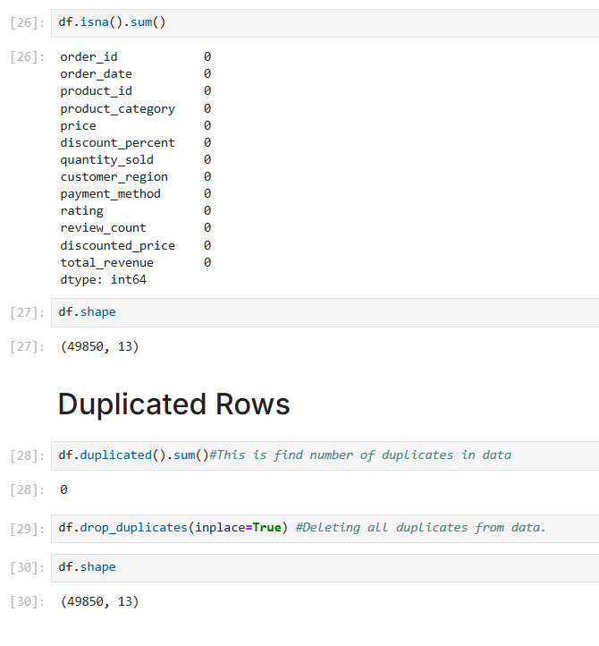
No duplicate records found in the dataset (0 duplicates). Data is clean and consistent.

Slide 9
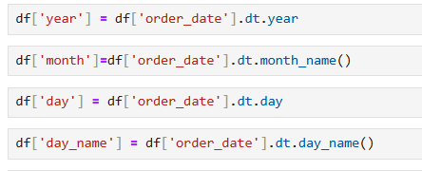
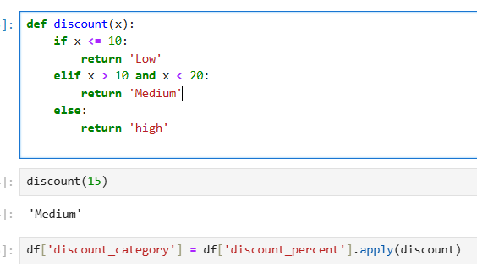
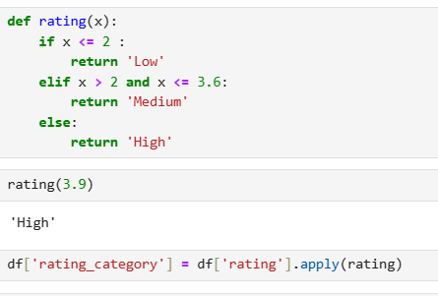
Feature Engineering
Extracted Year, Month, Day from order_date
Created Day Name (Monday–Sunday)
Created Discount Category (Low, Medium, High)
Created Rating Category (Low, Medium, High)
Helps analyze monthly & yearly trends
Identifies best performing days
Segments data based on discount levels
Improves understanding of customer satisfaction
Enhances data for better insights and visualization

Slide 10


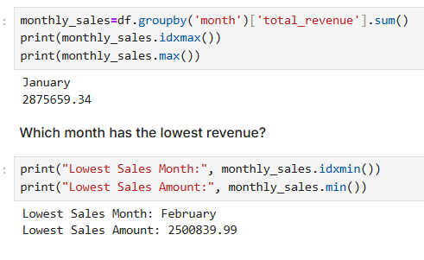
EDA (Exploratory Data Analysis)
1) Sales Overview (KPIs
Total Orders: 49,850
2) Total Revenue: ~32.7M
3) High Revenue but Low Rating Products
• Identified products generating high revenue despite low ratings
4)Revenue by Day of Week
• Friday (~4.86M) has the highest sales • Monday (~4.59M) has the lowest sales
4. Average Sales Trend by Day
• Sales remain relatively consistent across all days (~650 avg revenue)

Slide 11
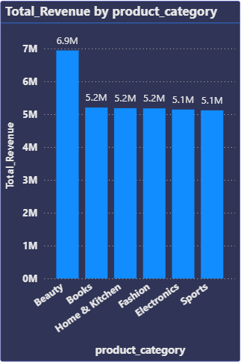
Total Revenue By Product Category
Beauty (~6.9M) is the highest revenue-generating category, making it the top-performing segment. This indicates strong customer demand, and focused marketing efforts in this category can further drive sales growth.
Books (~5.2M), Home & Kitchen (~5.2M), and Fashion (~5.2M) show consistent and moderate performance. These categories contribute significantly to overall revenue and can be improved further through targeted promotions and seasonal campaigns.
Electronics (~5.1M) and Sports (~5.1M) generate slightly lower revenue compared to other categories. This suggests opportunities for growth through better pricing strategies, discounts, and improved marketing visibility.

Slide 12
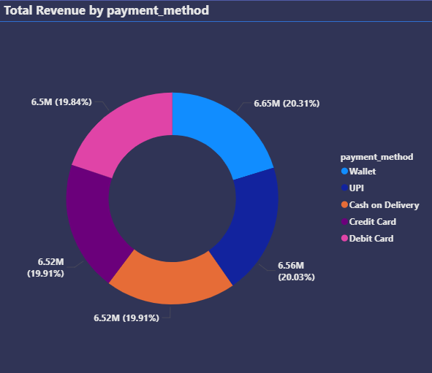
Total Revenue By Payment Method
Wallet (20.31%) generates the highest revenue, making it the most preferred payment method among customers. This indicates a growing trend toward digital wallet usage.
UPI (20.03%) and Cash on Delivery (19.91%) show strong and consistent performance. These methods remain popular due to convenience and trust among customers.
Credit Card (19.91%) and Debit Card (19.84%) also contribute significantly, with very similar revenue distribution.

Slide 13
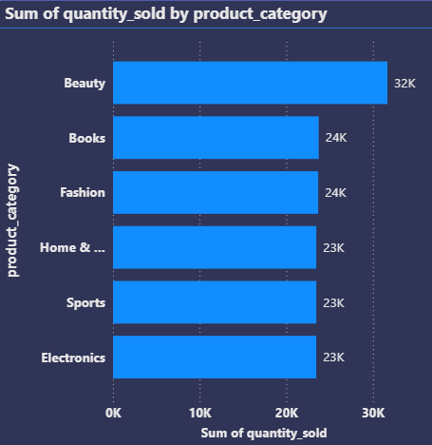
Product Quantity Sold By Product Category
Beauty (~31.5K units) has the highest quantity sold, making it the most in-demand category.
Books (~23.6K), Fashion (~23.8K), and Home & Kitchen (~23.5K). show consistent and moderate demand. These categories contribute steadily to overall sales and can be improved through targeted promotions.
Electronics (~23.4K) and Sports (~23.4K) have slightly lower demand compared to other categories. This suggests opportunities to increase sales through discounts, better pricing, and marketing strategies.

Slide 14
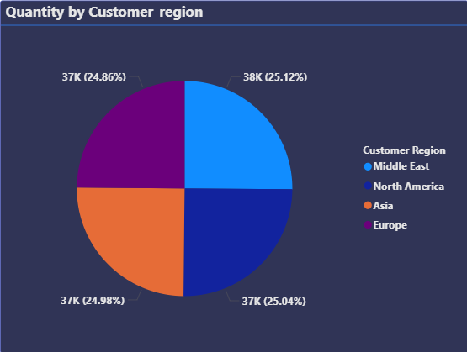
Quantity Sold By Customer Region
Regional Performance Overview:-
The analysis shows that sales are almost equally distributed across all customer regions, indicating a well-balanced and diversified market presence. Each region contributes approximately 25% of total quantity sold, demonstrating consistent demand globally.
Middle Eastx(~25.12%) leads slightly, making it the top-performing region.
North America (~25.04%) closely follows, showing strong and stable demand.
Asia (~24.98%) contributes nearly the same, indicating growing market potential
Europe (~24.86%) has the lowest share, but the difference is very minimal

Slide 15
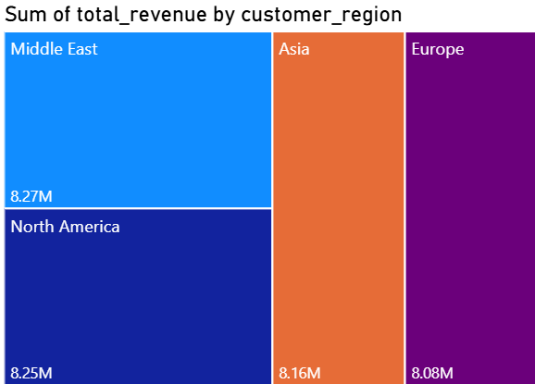
Total Revenue by Customer_region
Middle East (~8.27M) generates the highest revenue, making it the top-performing region. This indicates strong customer demand and effective market presence in this region.
North America (~8.24M), Asia (~8.16M), and Europe (~8.07M) show very similar revenue distribution. This reflects a balanced global sales performance across regions.

Slide 16
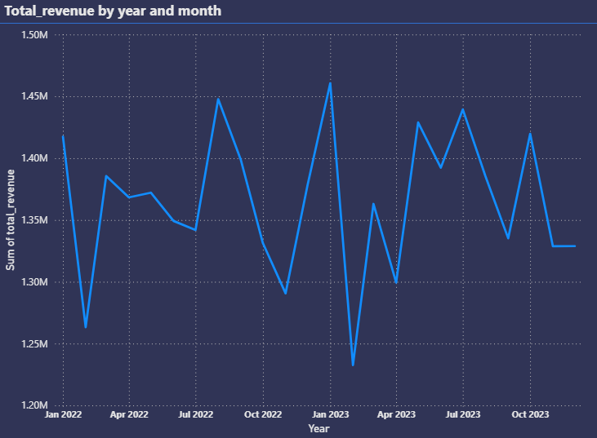
Total Revenue By Year
Revenue Fluctuations (2022-2023):
Total revenue remained relatively stable across months, ranging between 1.23M and 1.46M.
The trend shows regular fluctuations without any long-term decline, indicating consistent business performance.
Minor ups and downs are observed, with early 2023 showing both the highest peak and lowest dip, reflecting short-term volatility.
Highest revenue peak observed in early 2023 (~1.46M)
Lowest revenue dip also in early 2023 (~1.23M)
Mid-2023 shows strong recovery and stable growth pattern
Overall trend indicates seasonal variations rather than instability

Slide 17
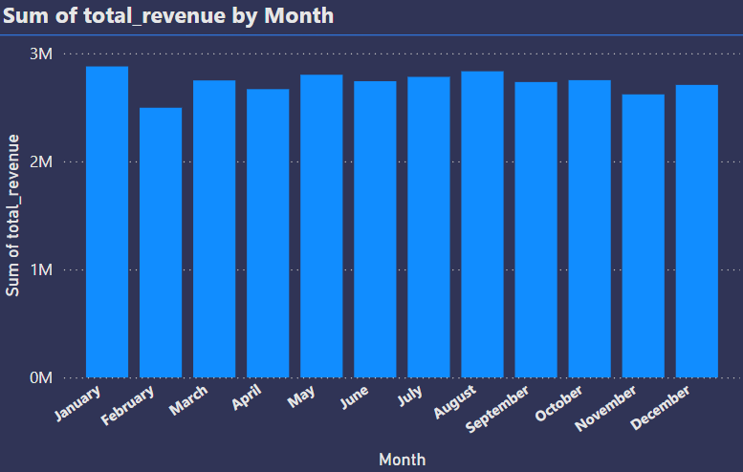
Total Sales By Month
Monthly Revenue Trend Analysis:
The chart shows that revenue remains relatively stable throughout the year, with only slight fluctuations across months. This indicates a consistent sales performance without major seasonal drops.
January (~2.9M) records one of the highest revenues, indicating a strong start to the year
February (~2.5M) shows the lowest revenue, suggesting a short-term dip
Revenue steadily recovers from March to August, with August (~2.85M) being another peak
The remaining months maintain stable performance around 2.6M–2.8M

Slide 18
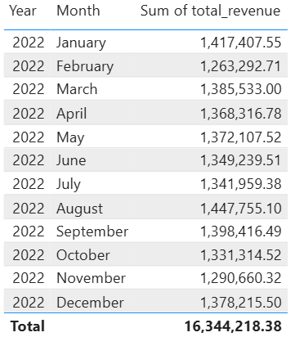
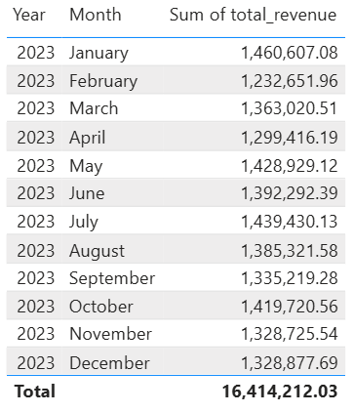
Year wise Monthly Sales
Compared monthly revenue for 2022 and 2023
Total Revenue:
2022 → 1.63 Cr+
2023 → 1.64 Cr+
Sales performance remained stable across both years
January started strong in both years, showing high initial demand
February recorded a noticeable dip, indicating lower customer activity Monthly Trends
March & July showed strong growth → possibly due to marketing campaigns or increased demand
May & October recorded high sales → indicating peak or festive seasons
August 2022 had the highest sales performance
July & October 2023 were peak months for that year

Slide 19
REPORTS

Slide 20
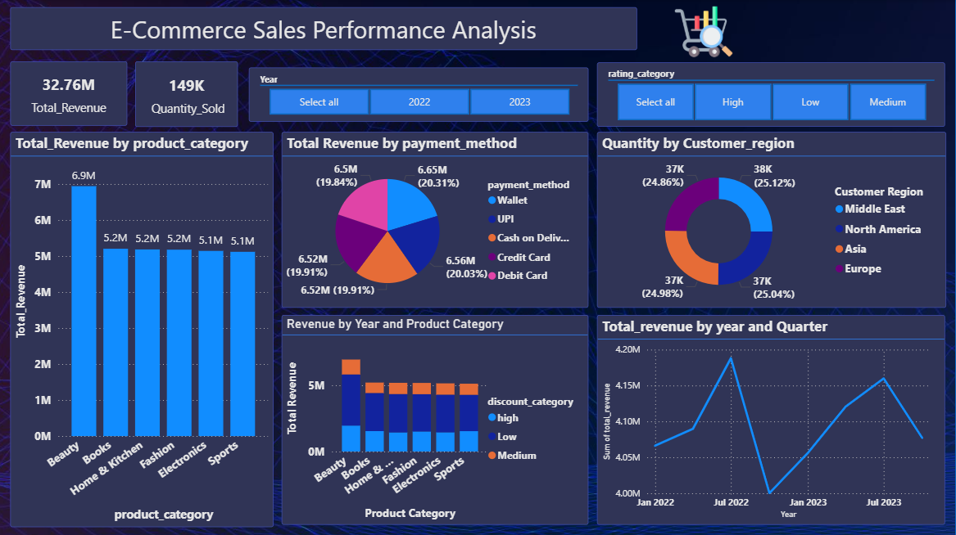
E-Commerce Sales AnalysisS

Slide 21
Key Insights from Dashboard
• Beauty category generates the highest revenue (~6.9M) and also has the highest demand, making it the most profitable segment.
• Home & Kitchen shows highest average revenue per order (~662), indicating higher-value purchases despite moderate demand.
• Revenue is evenly distributed across regions, with Middle East slightly leading (~8.27M), showing strong global market presence.
• Low discount category contributes the highest revenue, suggesting heavy discounts are not always required to drive sales.
• January records the highest sales while February shows the lowest, indicating seasonal fluctuations in customer purchasing behavior.
• Wallet and UPI are the most preferred payment methods (~20% each), highlighting a shift towards digital payment adoption.

Slide 22
Challenges Faced & Solutions
Connecting MySQL Database with Jupyter Notebook → Faced issues in establishing connection and importing data → Resolved using MySQL Connector (mysql-connector-python) and proper configuration of host, user, and database
Missing Values in Product Category & Rating Solved using mode imputation and removing critical missing rows.
Incorrect Date Format (order_date) → Converted to datetime format for time-based analysis.
Handling Duplicate Records → Identified using df.duplicated() and removed duplicates.
Visualization & Chart Selection Issue → Selected appropriate visuals (bar chart, pie chart, treemap)
Feature Selection Challenge → Identified important features like month, day_name for better insights

Slide 23

Recommendations
1.) Product Strategy: Focus on High-Performing Categories
Customize marketing efforts to promote Beauty category (~6.9M revenue) as it drives maximum sales. Introduce premium product lines and bundles to increase profitability. Ensure sufficient inventory to avoid stock-outs in high-demand categories.
2.) Improve Low-Performing Categories
Apply targeted promotions for Electronics & Sports categories to boost demand. Enhance product visibility using better listings, ads, and recommendations.Re-evaluate pricing strategy to stay competitive.
3.) Pricing & Discount Optimization Avoid excessive discounts as low discount category generates highest revenue. Focus on value-based pricing instead of heavy discounting. Use strategic discounts only during low-performing periods.
4.) Customer Experience & Payment Optimization
Encourage digital payments like Wallet & UPI (~20% each) through cashback and offers. Simplify checkout experience to reduce cart abandonment. Introduce loyalty rewards for repeat customers.
5.) Seasonal Sales Strategy
Leverage peak sales month (January) with aggressive campaigns. Introduce special offers during low-sales periods (February) to maintain consistency. Plan marketing campaigns aligned with seasonal trends.

Slide 24

Conclusion
Successfully analyzed large-scale e-commerce sales data (~49K+ records) to uncover meaningful business insights
Identified key drivers of revenue such as product category (Beauty), pricing strategy, and payment methods
Discovered seasonal trends (January peak, February dip) and balanced regional performance
Applied data cleaning, feature engineering, and EDA techniques in Python, followed by visualization in Power BI
Future Sope:
Delivered data-driven insights to support better decision-making in sales, marketing, and operations
Develop machine learning models for sales forecasting and demand prediction
Implement real-time data pipeline (MySQL → Power BI) for live dashboard updates
Perform customer segmentation (RFM / clustering) for targeted marketing
Expand dataset with customer demographics, reviews, and multi-year data for deeper analysis
Deploy dashboard on Power BI Service with automated refresh and sharing capabilities

Slide 26
Conclusion
In conclusion, this project demonstrates how data analysis can help businesses understand trends, improve strategies, and increase revenue.
This shows the importance of data-driven decision making in modern businesses.
Thank you.”

