Slide 1

INTERNSHIP PRESENTATION
Web Development Internship
Submitted to the School of Computer Science and Engineering, IILM University, Greater Noida, U.P.
BY
ROLL NO.
CLASS
BATCH
Roshani Singh
2410030802
3 CSE 5
2026–27
ORGANIZATION
ROLE
DURATION
Prodigy Infotech
Web Development Intern
01 – 30 August 2026
B.Tech CSE • IILM University, Greater Noida

Slide 2








INTERNSHIP OVERVIEW
A Five-Task Web Development Internship
ORGANIZATION
ROLE
DURATION
Prodigy Infotech
Web Development Intern
01 – 30 August 2026
Five Practical Applications — One Internship
TASK 01
TASK 02
TASK 03
TASK 04
TASK 05
Responsive Landing Page
Stopwatch Web App
Tic-Tac-Toe Web App
Personal Portfolio
Weather Web App
All five applications were built using native HTML5, CSS3 and Vanilla JavaScript — no frameworks, no external UI libraries.
WEB DEVELOPMENT INTERNSHIP | PRODIGY INFOTECH
2

Slide 3

ORGANIZATION PROFILE
Prodigy Infotech
About the Internship Program
Scope of This Profile
Prodigy Infotech offers structured, project-based internship programs in technology domains, including web development.
This profile is limited to information directly relevant to the internship experience. Details such as founding history, office locations, leadership, clients, awards or revenue are not established by the available internship material and are intentionally not included here.
Its Web Development track is organised around a series of practical, task-based assignments rather than a single long-term project.
The internship was conducted remotely, with task briefs, evaluation criteria and submission requirements communicated through the program's standard task structure.
No individual company mentor or faculty supervisor was formally assigned; the five tasks were completed on a self-directed basis.
WEB DEVELOPMENT INTERNSHIP | PRODIGY INFOTECH
3

Slide 4











INTERNSHIP OBJECTIVES
What the Internship Aimed to Build
Strengthen HTML5 & CSS3 skills
Build interactive UIs with Vanilla JavaScript
Understand DOM manipulation
Build responsive interfaces
Apply accessibility practices
Implement & integrate browser and external APIs
Practice JavaScript state management
Develop algorithmic problem-solving skills
Practice testing and debugging
Use Git & GitHub for version control
Improve technical documentation
Deliver five complete, working applications
WEB DEVELOPMENT INTERNSHIP | PRODIGY INFOTECH
4

Slide 5



TECHNOLOGY STACK
Core Technologies Used Across All Five Tasks
HTML5
CSS3
JavaScript ES6+
Git
GitHub
VS Code
Task-Specific Technologies & Browser APIs
Task 01
IntersectionObserver • Responsive Media Queries • Google Fonts • Inline SVG
Task 02
performance.now() • requestAnimationFrame() • SVG
Task 03
Minimax Algorithm • WAI-ARIA • CSS Grid
Task 04
HTML Canvas API • Google Fonts
Task 05
Open-Meteo Geocoding API • Open-Meteo Forecast API • Geolocation API
WEB DEVELOPMENT INTERNSHIP | PRODIGY INFOTECH
5

Slide 6
DEVELOPMENT METHODOLOGY
A Consistent Web Development Workflow
Rather than a formal methodology such as Agile or Scrum, each of the five tasks followed the same logical, progressive workflow — applied independently and with depth varying by task complexity.
Requirement Understanding
HTML Structure
CSS Styling & Layout
JS Interactivity
Advanced / APIs
Testing & Debugging
Documentation & Git
Review the task brief and plan the page or application structure.
Build a semantic, accessible markup skeleton.
Apply design tokens, Flexbox/Grid and responsive breakpoints.
Implement core application and state logic.
Integrate browser and external APIs.
Manual, browser-based verification.
Code comments, README, GitHub commits.
WEB DEVELOPMENT INTERNSHIP | PRODIGY INFOTECH
6

Slide 7
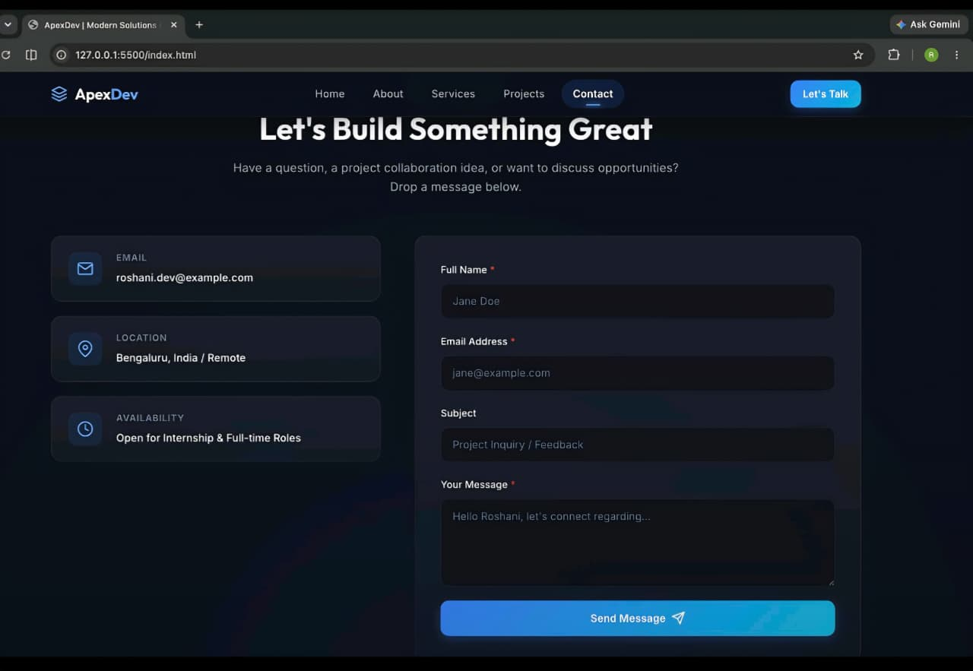
TASK 01
Responsive Landing Page
Key Features
Fixed, scroll-aware navigation bar
Responsive layout (mobile / tablet / desktop)
Mobile navigation drawer
Active-section scrollspy
Smooth anchor scrolling
Client-side form validation
[ INSERT ACTUAL SCREENSHOT HERE ]
Technical Highlight
IntersectionObserver powers efficient active-section tracking — detecting which section is in view without expensive scroll polling.
WEB DEVELOPMENT INTERNSHIP | PRODIGY INFOTECH
7

Slide 8
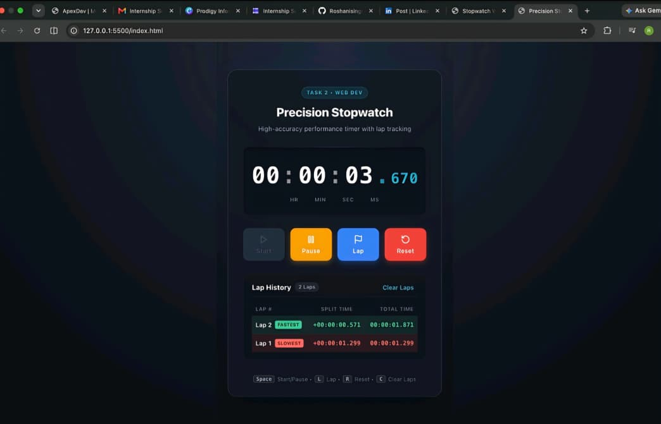
TASK 02
Stopwatch Web Application
Key Features
Start / Pause / Reset controls
Lap tracking with split-time calculation
Fastest / slowest lap indicators
Keyboard shortcuts
Responsive interface
DocumentFragment-based lap rendering
[ INSERT ACTUAL SCREENSHOT HERE ]
Technical Highlight
Elapsed time uses performance.now() + requestAnimationFrame() (timestamp-delta), not a plain setInterval() counter — avoiding drift under variable browser load.
WEB DEVELOPMENT INTERNSHIP | PRODIGY INFOTECH
8

Slide 9
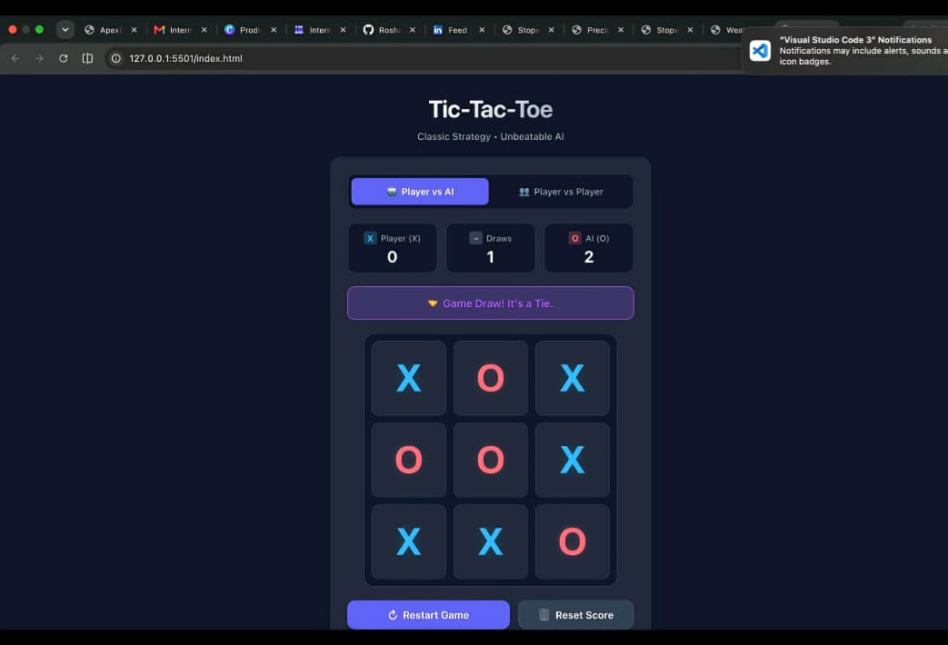
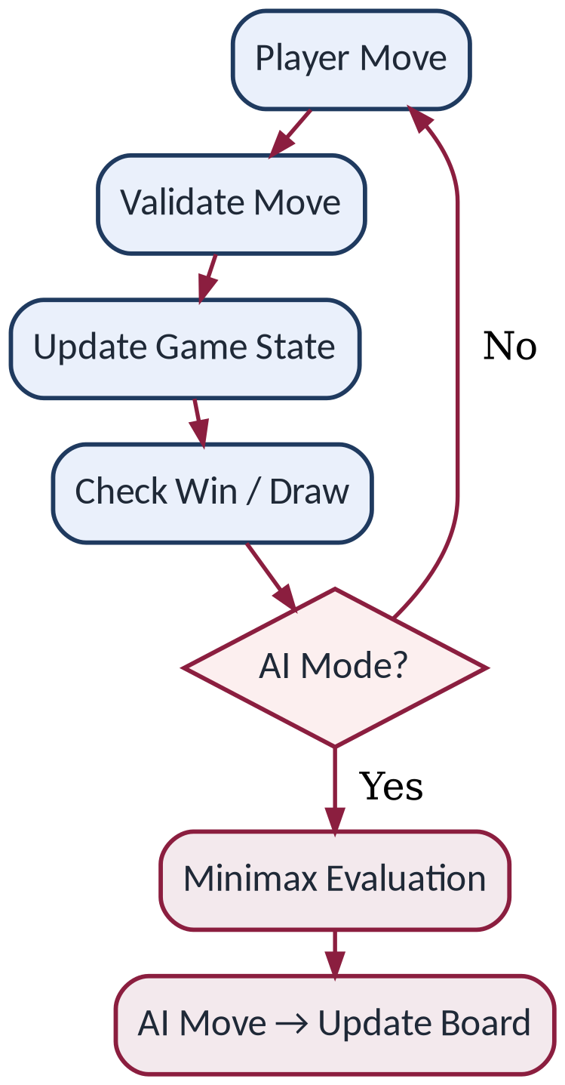
TASK 03
Tic-Tac-Toe Web Application
Key Features
Game Logic Flow
Player vs Player mode
Player vs AI mode
Scoreboard with restart / reset score
Win & draw detection (all 8 lines)
[ INSERT ACTUAL SCREENSHOT HERE ]
Keyboard-accessible board
Responsive 3×3 grid
Technical Highlight: Minimax Algorithm
Recursively evaluates available game states to select an optimal move within the implemented game model.
WEB DEVELOPMENT INTERNSHIP | PRODIGY INFOTECH
9

Slide 10
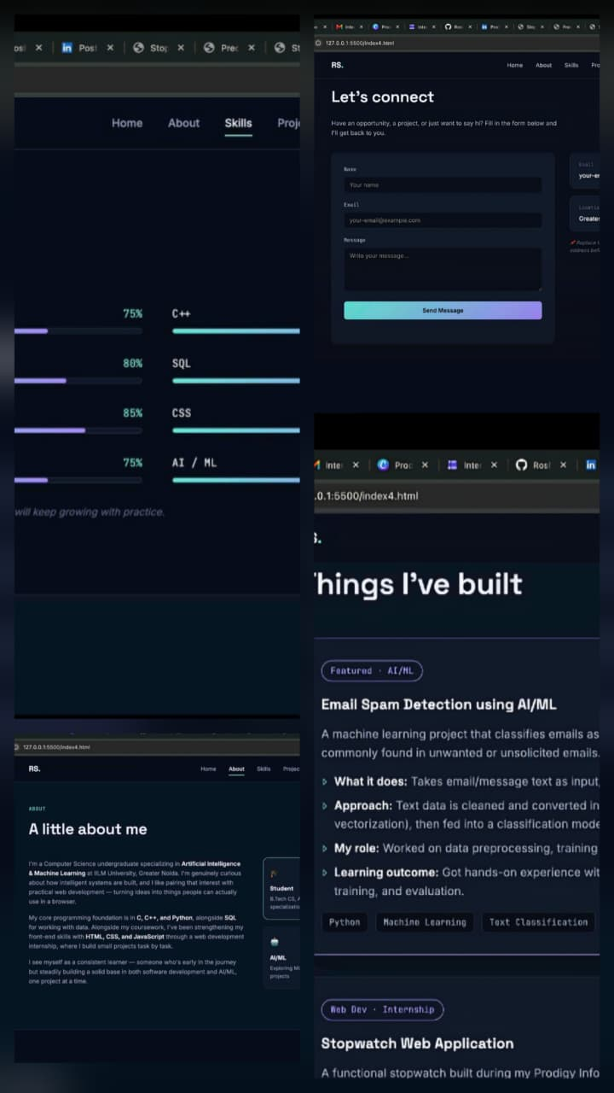
TASK 04
Personal Portfolio Website
Key Features
Home, About, Skills, Projects sections
Experience & Education timeline
Responsive, scroll-aware navigation
Animated skill-level bars
Back-to-top button
Frontend-only contact form (demo)
[ INSERT ACTUAL SCREENSHOT HERE ]
Technical Highlight
The hero section features an animated neural-network-style background — moving connected nodes drawn with the HTML Canvas API. Fonts: Space Grotesk, Inter, JetBrains Mono.
Note: The contact form is frontend/demo functionality only — no backend submission is implemented.
WEB DEVELOPMENT INTERNSHIP | PRODIGY INFOTECH
10

Slide 11
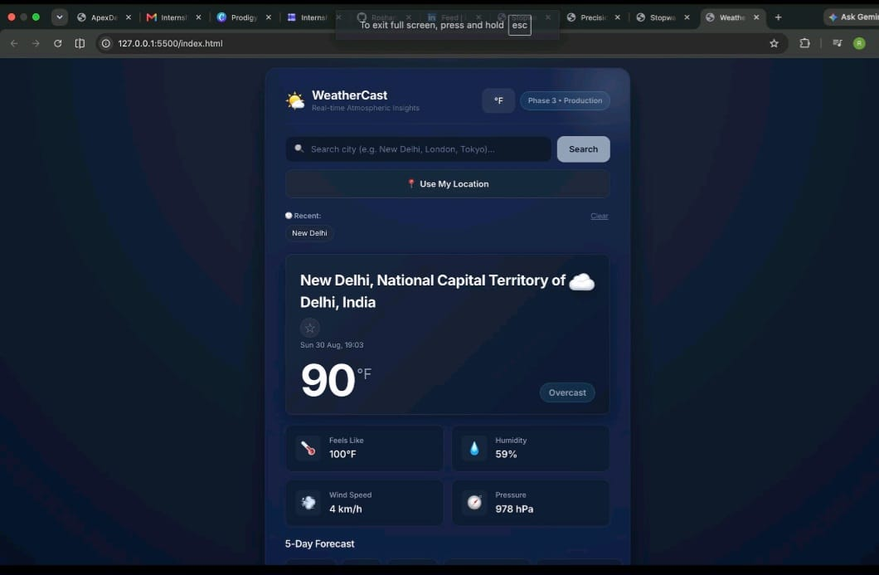
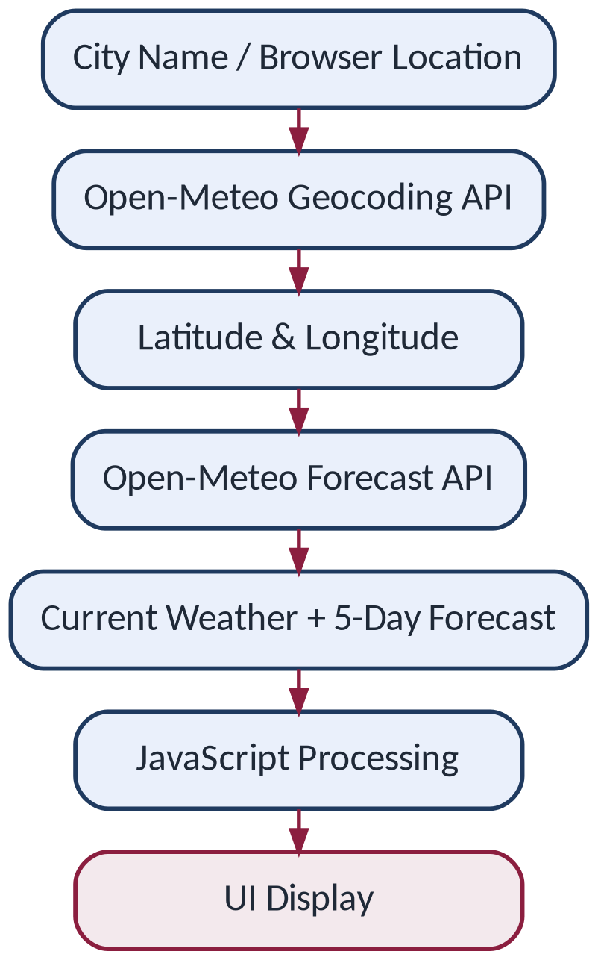
TASK 05
Weather Web Application
Key Features
API Data Flow
User-entered location search
Browser/device location (permission-based)
Current weather conditions
Five-day forecast
[ INSERT ACTUAL SCREENSHOT HERE ]
Responsive UI
Asynchronous API integration
Important
Browser geolocation is permission-based — location is never obtained without explicit user consent.
WEB DEVELOPMENT INTERNSHIP | PRODIGY INFOTECH
11

Slide 12
TECHNICAL CONCEPTS
Technical Concepts & Browser APIs
HTML5
CSS3
JavaScript
• Semantic structure
• Accessibility attributes
• Grid & Flexbox
• Variables & media queries
• Animations
• DOM manipulation
• State management
• Event handling
• Async API calls
Browser APIs
Algorithms
External APIs
• IntersectionObserver
• Canvas API
• Geolocation API
• requestAnimationFrame
• performance.now()
• Minimax (Tic-Tac-Toe AI)
• Open-Meteo Geocoding
• Open-Meteo Forecast
WEB DEVELOPMENT INTERNSHIP | PRODIGY INFOTECH
12

Slide 13
ARCHITECTURE
Application Architecture / Data Flow
Common Client-Side Architecture (All Five Applications)
No server-side component, database or backend framework is used in any of the five applications; all logic executes entirely within the browser.
Task-Specific Integration
Landing Page
Stopwatch
Tic-Tac-Toe
Portfolio
Weather App
DOM + IntersectionObserver
State + Timing APIs + DOM
Game State + Minimax + DOM
DOM + Canvas + IntersectionObserver
User Input/Location + APIs + DOM
WEB DEVELOPMENT INTERNSHIP | PRODIGY INFOTECH
13

Slide 14

ENGINEERING PRACTICES
Testing, Debugging, Accessibility & Responsiveness
Testing / Validation
Debugging
• Functional behaviour checking
• Responsive UI testing
• Form validation
• API behaviour checking
• Browser-based testing
• UI & layout issues
• JavaScript logic issues
• Responsive layout issues
• API integration issues
Accessibility
Responsive Design
• Semantic HTML
• ARIA attributes
• Keyboard interaction
• Focus-visible states
• Live announcements (where implemented)
• Mobile, tablet, desktop layouts
• Flexible CSS Grid / Flexbox
• Media queries
No fabricated test counts, coverage percentages, bug counts or performance benchmarks are claimed — all testing was manual and browser-based.
WEB DEVELOPMENT INTERNSHIP | PRODIGY INFOTECH
14

Slide 15
WORKFLOW
Git, GitHub & Documentation
Visual Studio Code
Git
README / Documentation
Writing, editing and debugging all five applications
Tracking changes to project files during development
Code comments and per-task documentation
Official Project Repositories (GitHub)
Task 01
PRODIGY_WD_01
https://github.com/Roshanisingh01/PRODIGY_WD_01
Task 02
PRODIGY_WD_02
https://github.com/Roshanisingh01/PRODIGY_WD_02
Task 03
PRODIGY_WD_03
https://github.com/Roshanisingh01/PRODIGY_WD_03
Task 04
PRODIGY-WD-4
https://github.com/Roshanisingh01/PRODIGY-WD-4
Task 05
PRODIGY_WD_5
https://github.com/Roshanisingh01/PRODIGY_WD_5
WEB DEVELOPMENT INTERNSHIP | PRODIGY INFOTECH
15

Slide 16
OUTCOMES
Key Outcomes & Learning
HTML5 semantic development
CSS3 responsive design
JavaScript programming
DOM manipulation
Application state management
Browser APIs & API integration
Accessibility practices
UI/UX implementation
Algorithmic problem solving
Git / GitHub workflow
Testing and debugging
Technical documentation
These outcomes reflect skills and understanding gained — not claims of expert-level mastery or guaranteed job readiness.
WEB DEVELOPMENT INTERNSHIP | PRODIGY INFOTECH
16

Slide 17
FUTURE SCOPE
Possible Future Enhancements
Landing Page
Stopwatch
Tic-Tac-Toe
Portfolio
Weather App
• Backend-connected contact form
• CMS / content management
• Further accessibility refinements
• Persistent session storage
• Exportable lap records
• Additional timing modes
• Additional game modes
• Difficulty options
• Online multiplayer
• Backend-powered contact form
• Content management
• Additional integrations
• Extended forecasts
• Weather history
• More location/search options
These are FUTURE POSSIBILITIES only — none of these enhancements have been implemented.
Every application remains a fully functional, self-contained client-side project as delivered during the internship.
WEB DEVELOPMENT INTERNSHIP | PRODIGY INFOTECH
17

Slide 18
CONCLUSION
Successfully completed the Web Development Internship at Prodigy Infotech
Developed five practical web applications
Applied HTML5, CSS3 and Vanilla JavaScript
Worked with browser APIs and external APIs
Practiced responsive design and accessibility
Improved debugging, testing and Git/GitHub workflow
Gained practical frontend development experience
THANK YOU
Q & A
Roshani Singh • 2410030802 • B.Tech CSE • IILM University, Greater Noida

