Slide 1

Mood Music Player
Submitted By :
Your Name (Roll No : ..)
Faculty

Slide 2



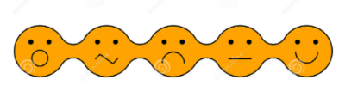
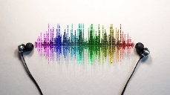
Introduction
Take Pic from WebCam
Generate Songs List Base on Mood
Detect the Mood from Pic
User
Response to user (list of songs)
List the top loved songs ACC to emotion
Analyze Reviews
Reviews of Songs
A Music Player application play a music with handful of playlist. Web application will generate a list of music and play according to user choice.
Mood Music Player is a very handy WebApp where user will capture photo via webcam of computer or android device from using familiar browser and will get the music playlist according to the mood .Furthermore, A user can review the songs that is exactly match or not.
The primary goal of this site is to provide music with mood

Slide 3
Problem Statement
Analyzing various site there are a lot of Music Player and face emotion detection webapp such as ganna.com, Spotify.com and Emotion detector app, morphcast.com respectively they do have a lot of features searching songs, reviewing it and detection gender, age and many more. However, this feature aren’t integrated to play music implementing a feature like taking picture via browser sending image to server and get relevant mood music.
Objective
It shows the correct category and enable the listener to list a song and play songs according to their mood that are available in server.
To increase efficiency and improve services provided to the customers through better application of technology.
It is designed to decrease time of user for searching music as per current mood.

Slide 4
Scope
Understand and prepare detailed requirement and specifications
Prepare detailed design specifications of the system
Develop the system and coding.
Demonstrate a music web application using facial mood using different tools.
Demonstrate a bug free application after suitable modification if needed
Limitation
The device must have webcam to take photo.
The device must contain Speaker.

Slide 5
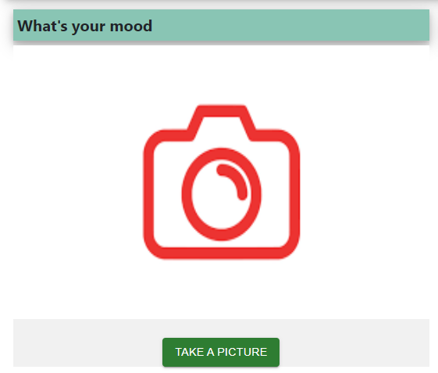
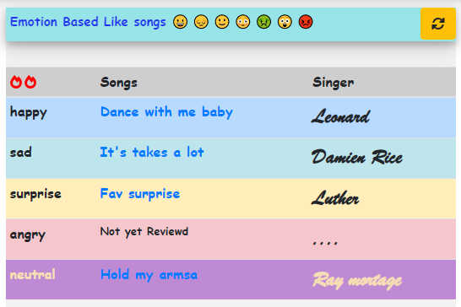
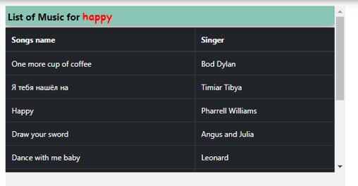
Background Study
The main objective of “Mood Music Player” is to provide an essence of playing music via a simple and yet powerful medium.
Mood Music Player allows you to browse and listen music through endless possibilities, and even offers list of music according to your mood.
Literature Review
Gone thoroughly that has relevant features to my webapp
Such as :
https://gaana.com/
https://www.spotify.com/np-en/
Lack the features that had been implemented in this site
Firstly, with image data generate a songs list.
Secondly , the reviews will be analyze by server and top songs
which suits the mood will be listed as top

Slide 6
Requirement Analysis
Functional Requirements :
The system will enable the admin to add songs and songs details with category.
The system will enable admin to see the user details( such as remaining days of subscription, email, profile_pic etc. ) and admin can also BAN user.
Keeping records of registration of customers.
The system will enable the User to take photo and upload and get the list of songs that matches the mood.
The system will display the List of songs and its reviews and can add reviews.
The system will provide customer to add profile and change password via email confirmation and many more.
The System will generate a report base of top emotions relevant songs validating reviews.
The System will give a trail version for week (for testing purposes now it’s for 8 second).
Non-Functional Requirements :
Availability: It will be available online whenever the client needed.
Performance: It will be fast with good response if the face is cleared.
Security: webcam photo will not be publicly available. Furthermore, to get rid of common vulnerability like xss and cookie hijacking there is httpOnly Cookie which makes difficult to hijack or get authorized token.
Usability: Good GUI easy to use.

Slide 7
Feasibility Study
Technical Feasibility:
In order to design this system, it doesn’t require additional hardware, software and the technical expertise. In short, it doesn’t require any additional hardware and software it uses off-self and existing technologies, hardware and software.
Economical feasibility:
Development of this application is highly economically feasible because this system doesn’t require any extra software and hardware i.e. it uses open-source technologies. So, there is no recurring cost than just the internet connection and just making an environment for the development.
Operational feasibility:
This system uses simple technologies to design. So, it is user friendly and easy to use. The system is operational feasible since the user are familiar with the technologies.

Slide 8






System Requirements Study
Hardware Requirement
The hardware requirement are:
Processor: Intel dual core or above
Hardware : Webcam , Speaker
Processor Speed: 1.0GHZ or above
RAM: 4 GB RAM or above
Hard Disk: 50 GB hard disk or above
Software Requirement
The hardware requirement are:
Operating system: Windows or Linux (with Python 3.10.2)
Server: WSGI
Front-end: React
Back-end: Django (Server side code) with python ( 3.10.2 or above) and My SQLite (Database)
DeepFace ( for emotion detection ) and TextBlob ( for text sentiment analysis ) library integrated in python.
Server
Back-End
Front-End

Slide 9
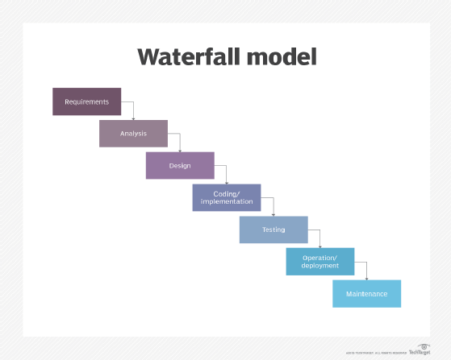
Feasibility Study
Waterfall model is used . Requirement are very well-known, clear and fixed.
Technology is understood.
This project took 3-4 week to build.
Application is not complicated and big.

Slide 10
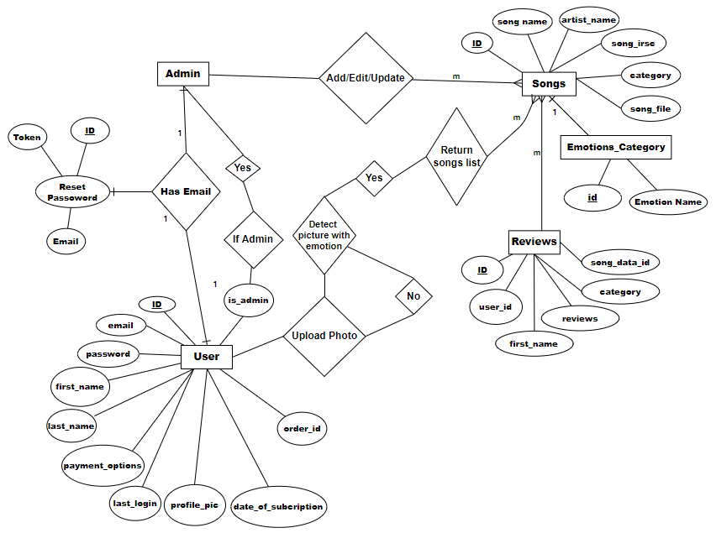
Data Modelling (ER-Diagram)

Slide 11
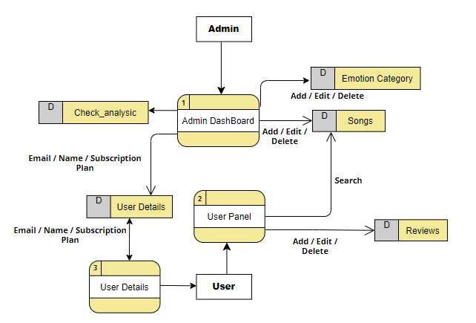
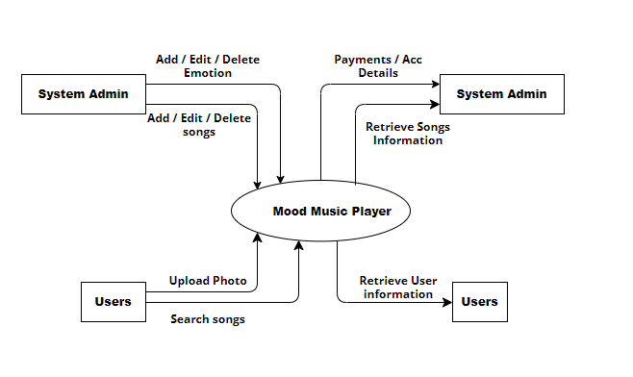
Process Modelling (DFD)
DFD level-0
DFD level-1

Slide 12
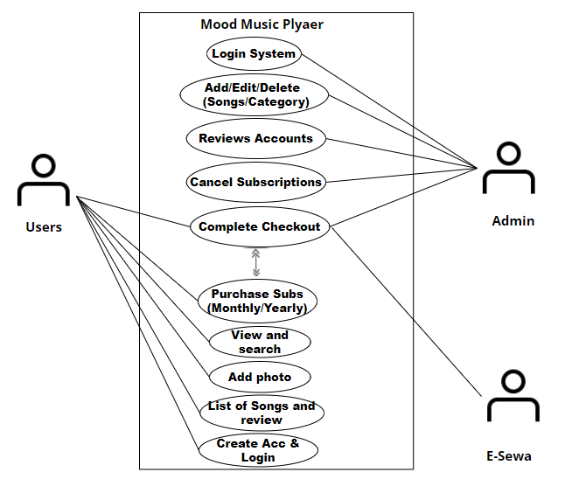
Use Case Diagram
Use Case Diagram

Slide 13
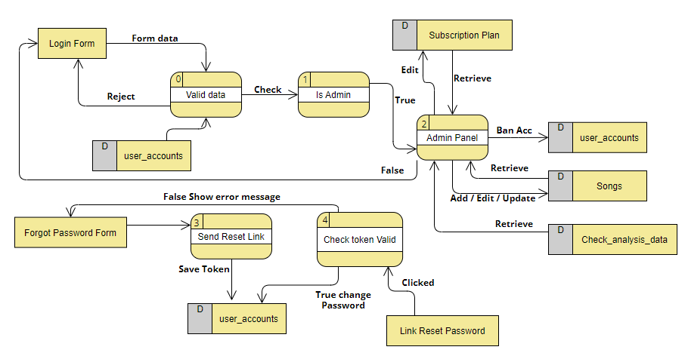
Physical Modelling (P-DFD)
Physical DFD – Admin Panel

Slide 14
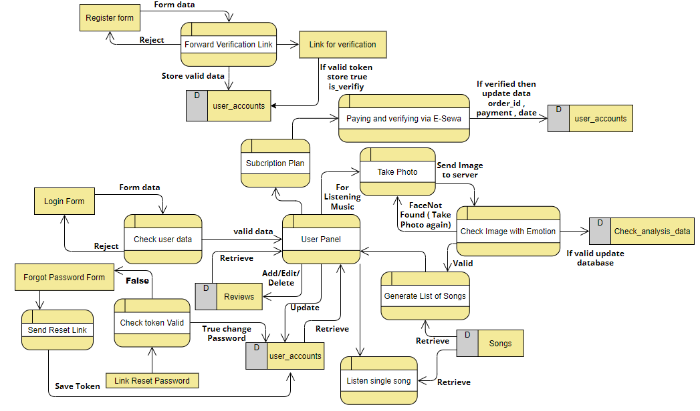
Physical Modelling (P-DFD)
0
7
6
3
1
2
4
5
9
10
8
Physical DFD-User Interaction

Slide 15
System Design
System design represent the overall concept on how the system works. In our system there are two modules. They are Admin module and User module
Admin Module:
Admin can Add, Edit and update Songs with cover picture using ISRC number.
System will automatic take down reviews if they are didn’t have meaning.
Admin can verify Client who subscribed with all details such as Email, name, days remaining of subscription to end.
Admin Can revoke Ban user and cancel the subscription.
The system will analyze the emotion requested by user and generate a report to Admin.
The system will generate list of relevant emotions base songs analyzing reviews from users
User Module:
Only verified register user can login into the application.
User can listen and read the songs and songs name, artist name, cover picture respectively.
User can also review Songs which will be filter by system and can read Reviews of other users.
User can use subscription package for monthly and yearly and can listen unlimited for time.

Slide 16
Implementation and Testing
Implementation :
Admin Module:
In this module only admin can have access to login and able to Add Songs details. Admin can also Update, Delete Songs if necessary .Moreover, Admin can see the list of User Subscription with User Details to verify to make purchase successful. Admin can also Ban account if necessary. The report is generated in admin dashboard as how many percentage user are being requesting a certain emotions.
Profile Module :
In this module a log in user can set his profile picture, username, change password and read the subscription plan. Incase user forgot there password then they can reset it using email verification module.
User can also request a songs capturing a photo with emotions and get list of songs from server.
Payment Module :
In this module the payment is done. After listening for couples of minute as feature if liked then user can subscribe to the plan and can pay via E-Sewa ( Nepali payment service).
Testing :
Every module was tested and finally implemented. Every module that consist of form with validation was thoroughly checked. For instance valid email , username and a profile image should be valid and etc.

Slide 17
EXPECTED WORKING SCHEDULE
Time Phase | Jan | Feb | March-April | May
Study and analysis | 1 week | 1 week
Data Fetching and Scrapping | 1 week
Coding and Implementation |  |  | 1 week
Testing |  |  | 1 week
Documentation |  |  | 1 week
Reviews |  |  |  | 1 week
Presentation |  |  |  | 9 th
Fig : Gantt chart

Slide 18
Conclusion
The ‘Mood Music Player’ is designed to provide a web based application that would make listening music easier and more convenient. User don’t have to search songs remembering.
Just take a snap and send it to server, get the lists of songs. Furthermore, songs can be reviews and read reviews of other user. The phase for newly user trail version , user will be provided more or less couple of minutes to
listen then need to subscribe for more time.
Where payment is done via E-Sewa.

Slide 19


