Slide 1
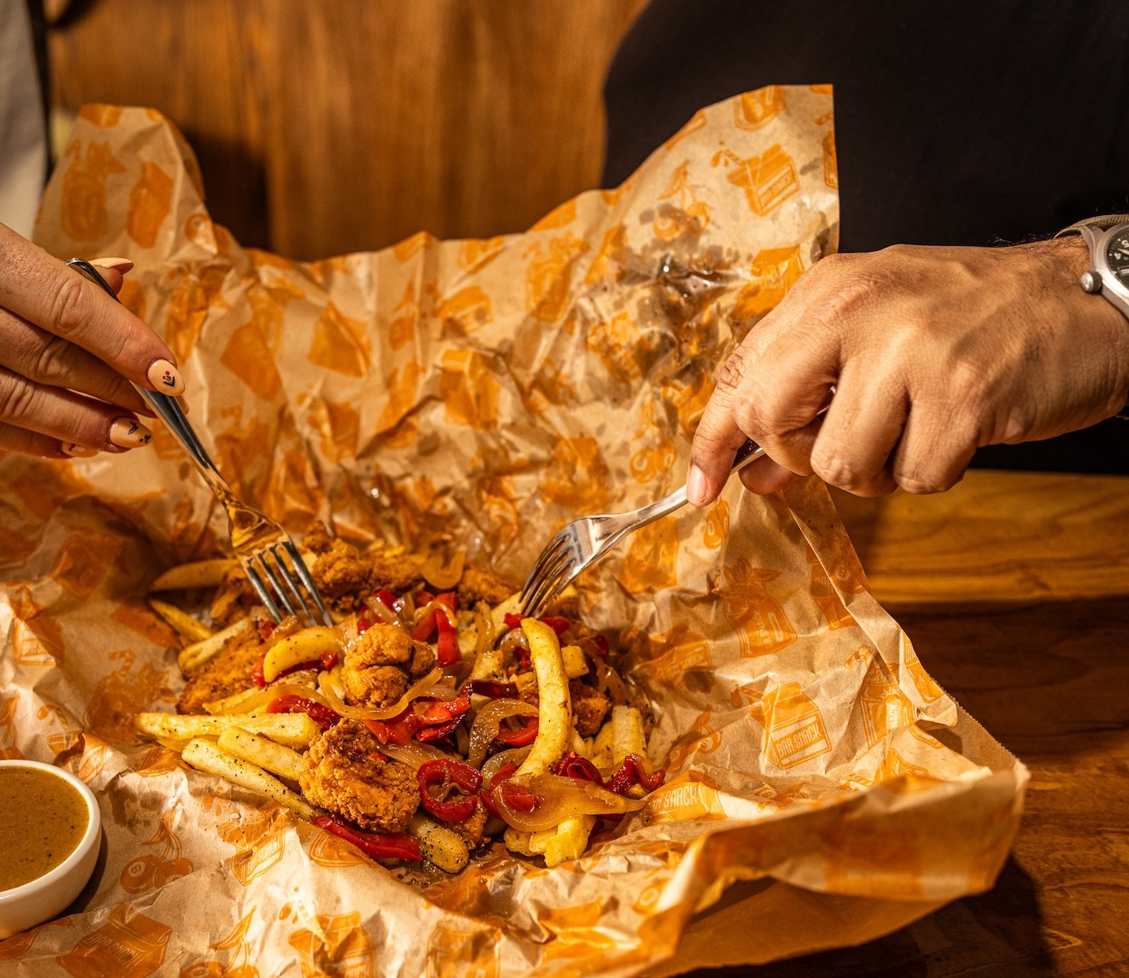
Project_ET4132_Group10
Title: CroMaccies Takeaway
Group members:
George Giannakitsidis (24354791)
Cormac Buckley (24404691)
Roshen Rony Jacob(24306444)

Slide 2
OVERVIEW OF OUR BUSINESS
Our business is a simple takeaway/food-ordering service
Users can browse menu items by category
The website displays item names, prices, and categories
Admin/manager pages allow the editing of menu items from the website
Takeaway / ordering system
Website connects to a strucured database

Slide 3
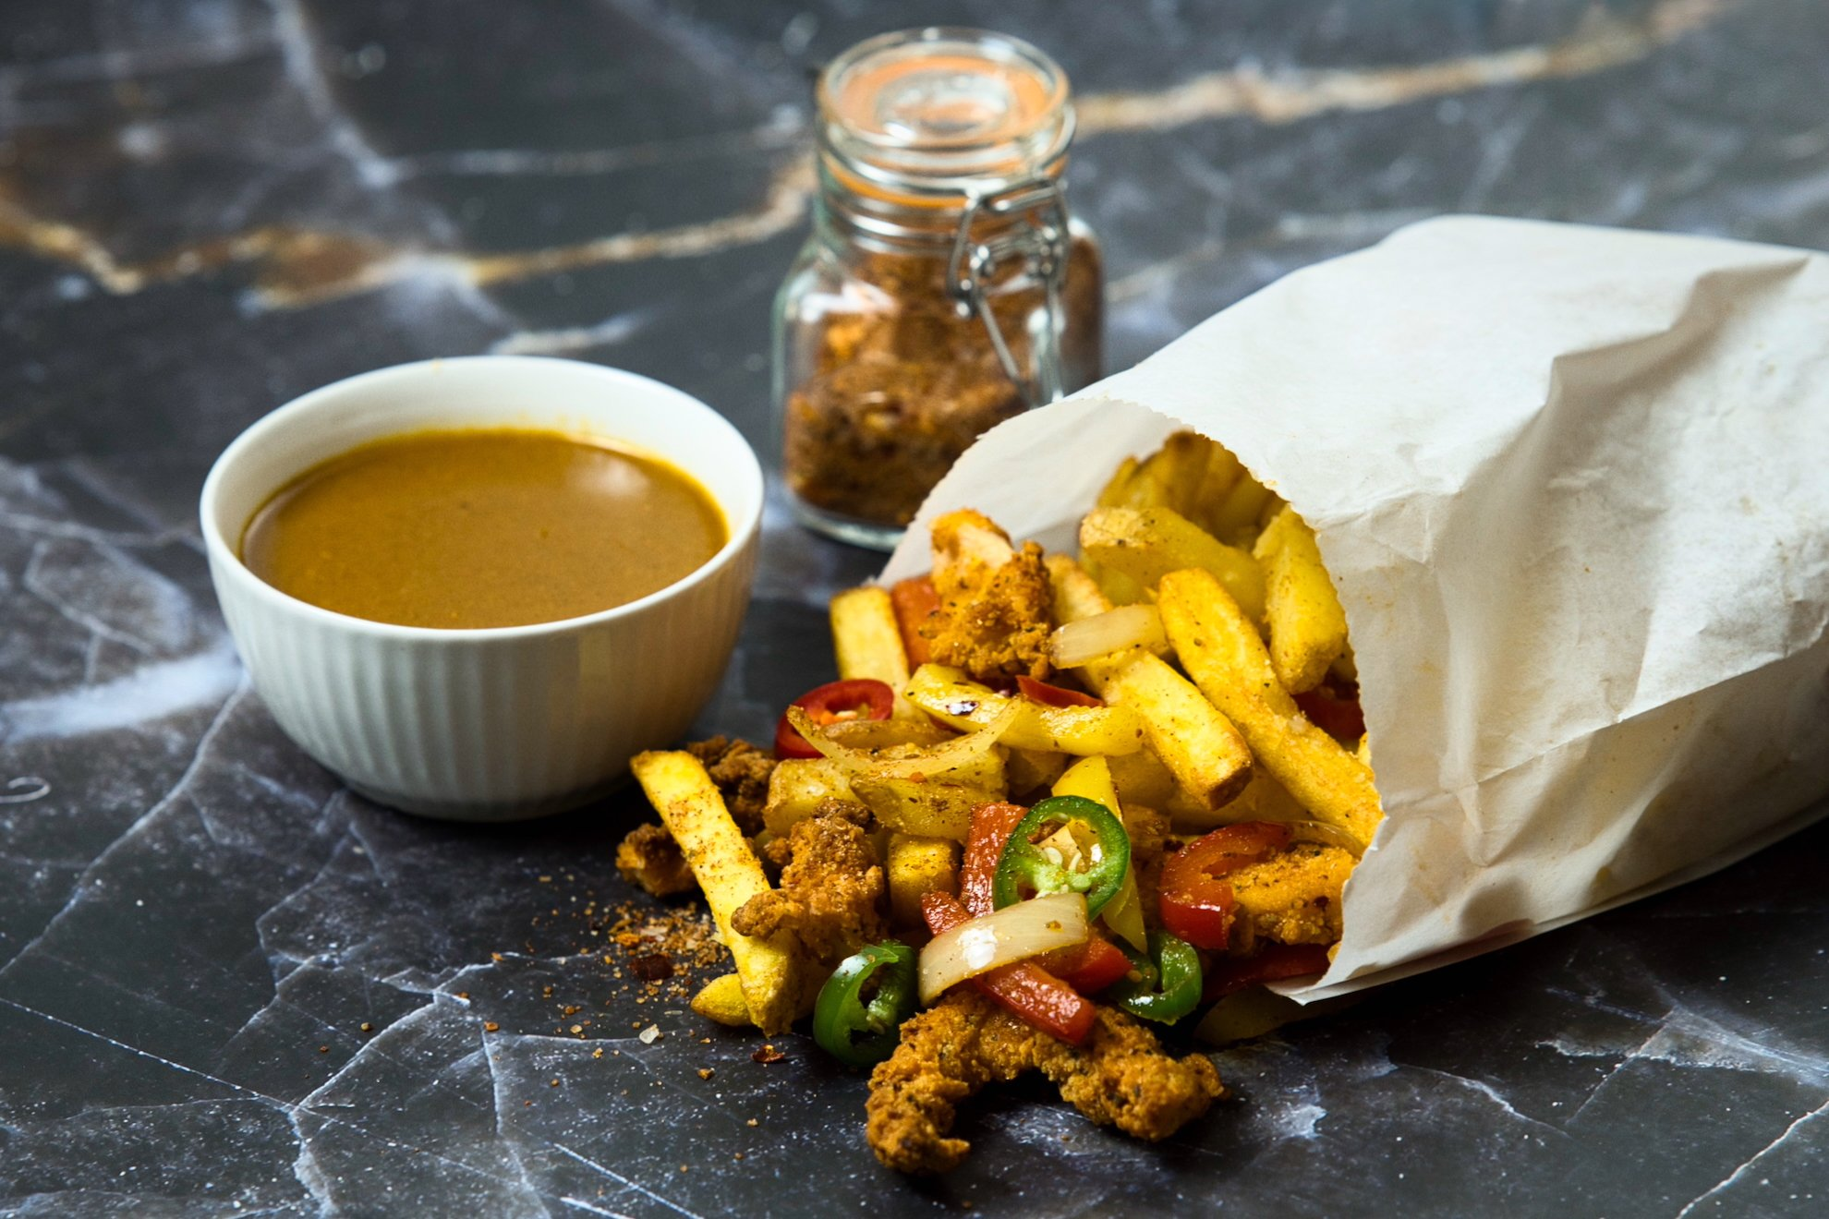
Why We Chose CroMaccies Fast Food Takeaway?
We belived it was a simple bussiness model that would be suitable for a project website
It also had clear easy stracuted data (catigores ,menu items etc)
Fits the scope of the project with the time given

Slide 4

OUR ROLES
Cormac
-Database design and setup
-ER diagram and MYSQL connection
George
-Designed website layout(HTML and CSS)
Roshen
-Implemented the PHP code to retrieve menu items from the database
-Created a admin page for editing of the items
All Members
-Presentation work
-Debugging and testing

Slide 5
Data Collected
Here is the raw data collected before design. We used this for our ER modelling
Categories (burgers, drinks and deserts)
Menu items (name ,price ,cateigory )
Item details used for display on website
Data needed for future use (customers and orders)

Slide 6
ER Diagram
categories
PK: item_id
FK: category_id
item_name
Item_description
Item_price
PK: category_id
category_name
menu_items
PK: order_item_id
FK: order_id
FK: item_id
quantity
order_items
customers
orders
PK: customer_id
customer_name customer_phone customer_email
PK: order_id
FK: customer_id
order_date
total
This is our ER model showing primary keys, foreign keys, and the relationships

Slide 7
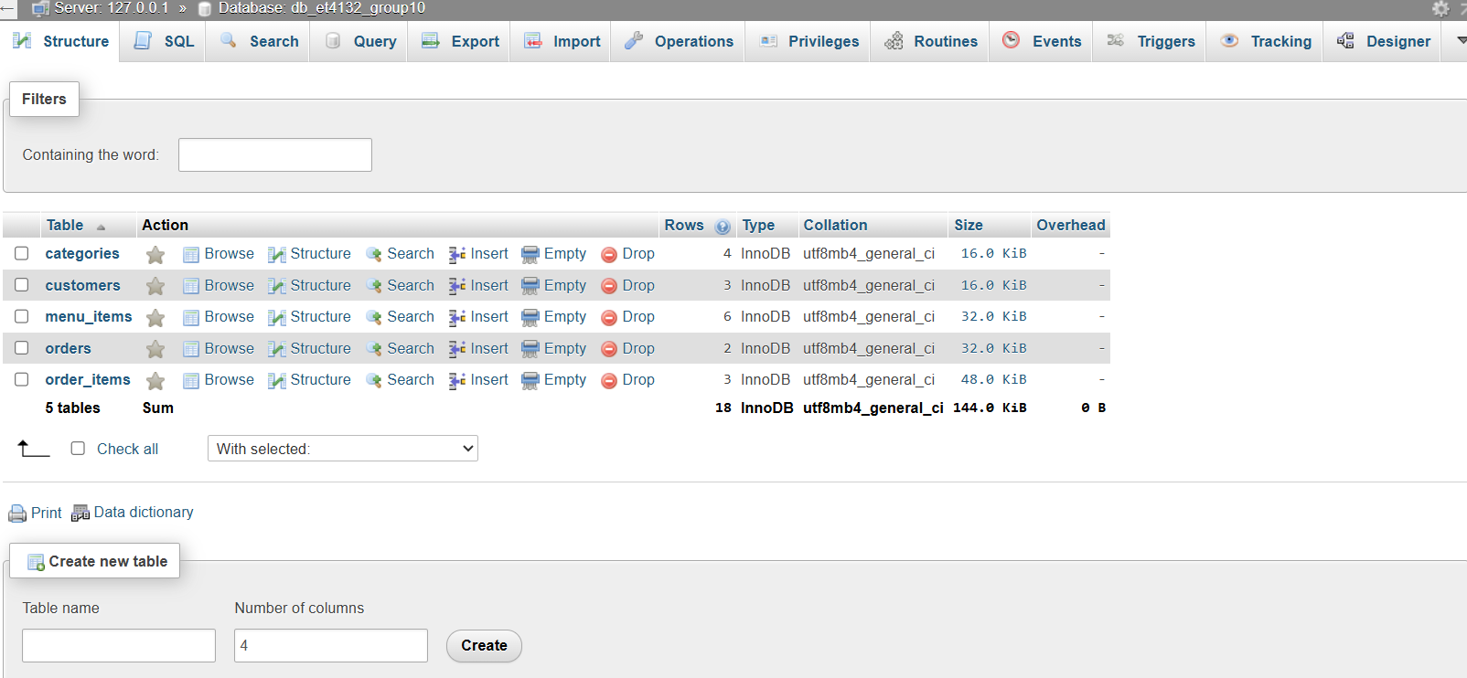
Final Database Structure

Slide 8
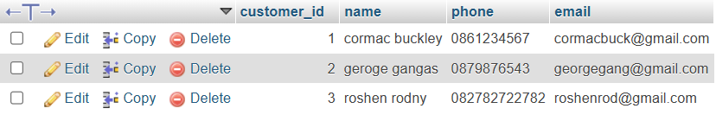
DATABASE Structure-Customers
customer_id – Primary key
name – Customer’s full name
phone – Contact number
email – Customer email address
Stores customer details and links to the orders table through customer id

Slide 9
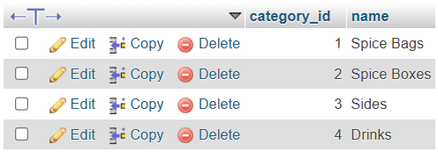
DATABASE Structure-category's
category_id – Primary key
name – Name of the category
Groups menu items into categorys

Slide 10
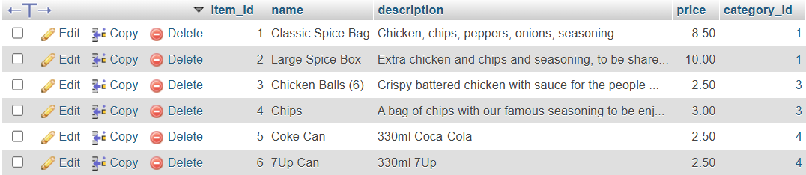
DATABASE Structure-Menu_items
item_id – Primary key
name – Menu item name
description – Details about the item
price – Price of the item
category_id –(fk) Category the item belongs to

Slide 11

DATABASE Structure-orders
order_id – Primary key
customer_id – Foreign key
order_date – Date and time of the order
total – Total cost of the order
Records the users information and the information of the order

Slide 12
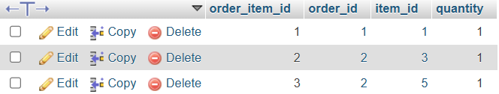
DATABASE Structure-order_items
order_item_id – Primary key
order_id – Foreign key linking to orders
item_id – Foreign key linking to menu_items
quantity – Number of each item in the order
Connects menu items to orders

Slide 13
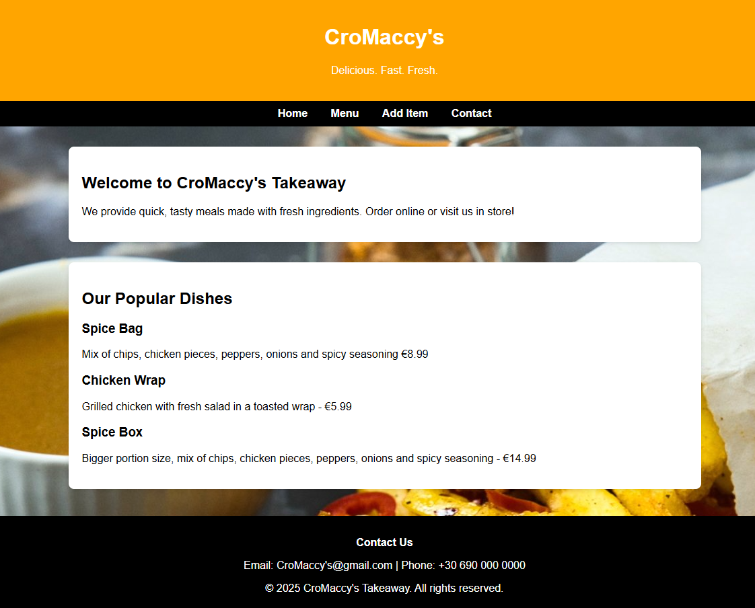
Website Overview
Home Page
Features a navigation menu, the featured dishes, and the branding of CroMaccies Takeaways
Menu Display Page
Displays the items retrieved from the database
Add Item Page
This page allows the users of the staff to add new menu items directly into the database

Slide 14
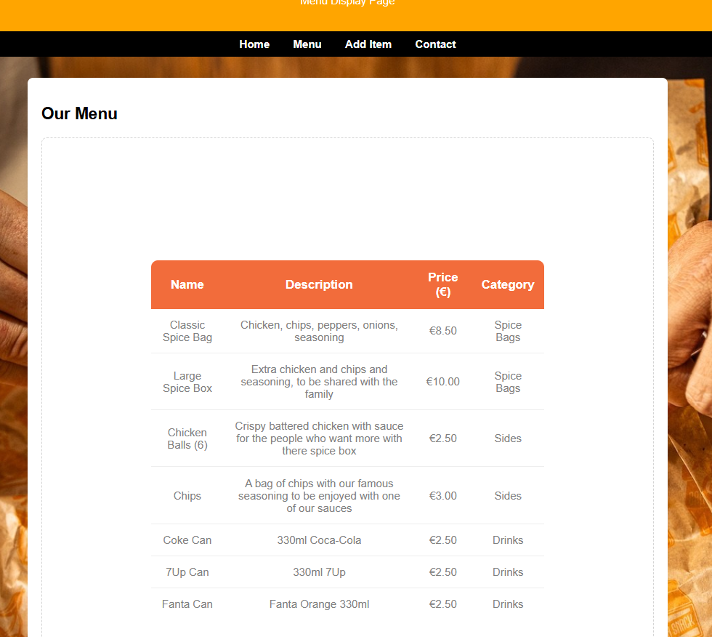
Menu Page
Purpose Of The Page
Shows all the menu items that are stored in the database
Updates immediately when entering a new menu item
Displays the name, price, category the item belongs to and a small description of the item
How It Functions?
Menu page includes the db_connect.php to gain access to the database
Provides a live connection between the database and the website

Slide 15
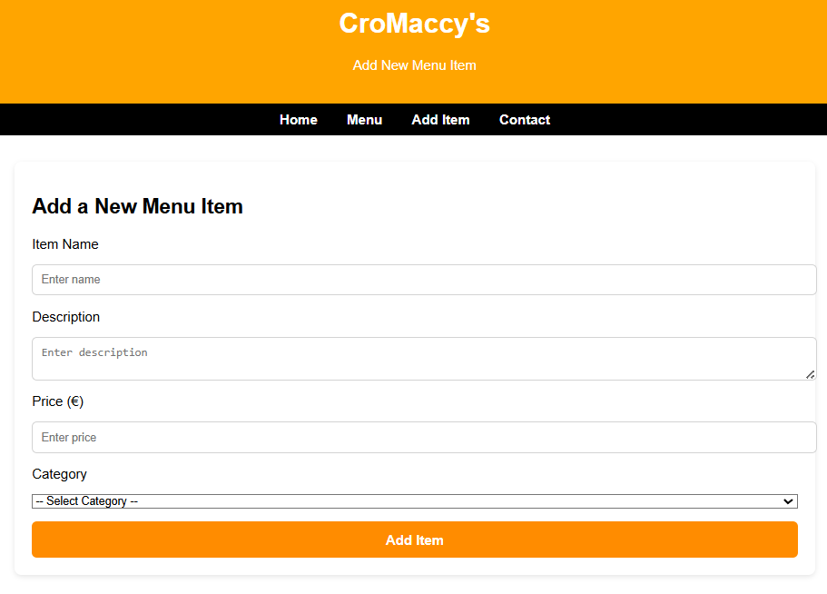
ADD ITEMS Page
Purpose Of The Page
Provides a form in which the staff can use to input the details of an item
Instead of manually editing the database, the menu stays up to date with the add items page
Form Contains:
1. Item Name
2. Description
3. Price
4. Category
How It Functions?
Staff fills HTML form and sneds data to the same page using "POST".
The values will then be inserted the mneu items table

Slide 16
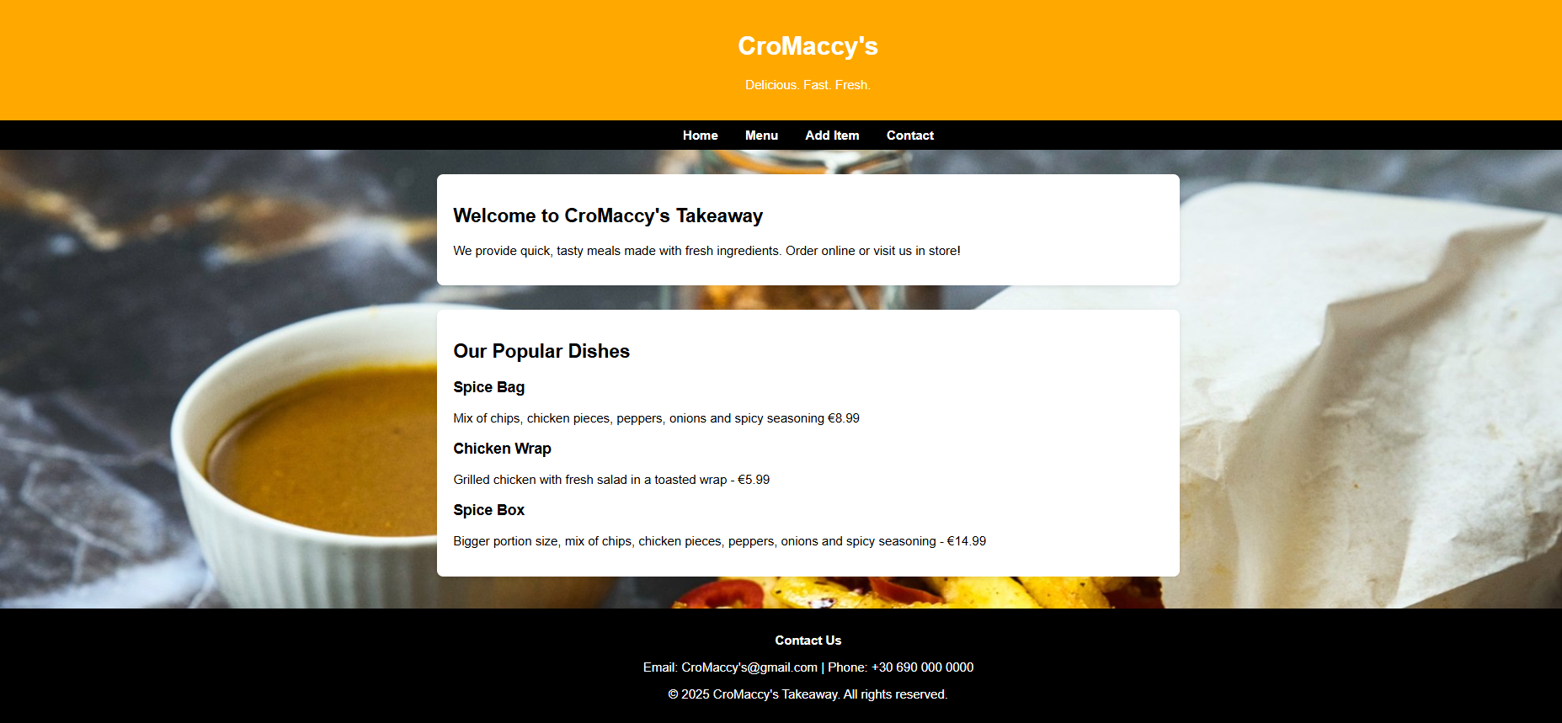
Overall APPEAL & DESIGN
Black Navigation bar makes reading page links easy
Background image of food creates an appetising and atmospheric authentic takeaway restaurant.
Consistent layout for all pages, same fonts and colour scheme for branding.
Simple and easy navigation, users can understand easily and find information quickly
Clicking links are responsive with no delay
Overall the Webpage is very welcoming towards all types of audience

Slide 17
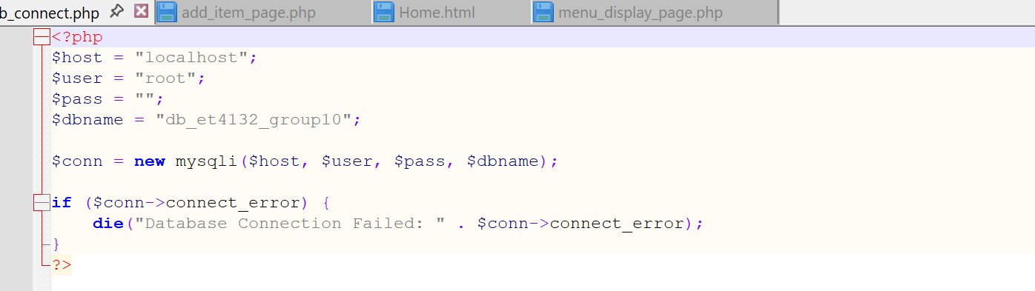
Code Snippet(Database Connection)
Creates the connection to SQL database

Slide 18
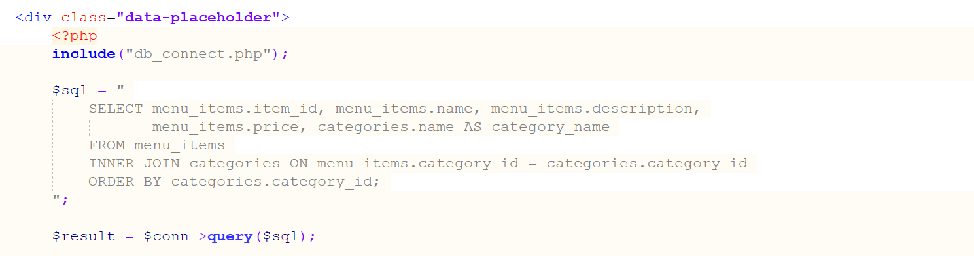
Code Snippet(PHP Code to Display Menu Items)
Retrieves the menu items from the database to be displyed in the webpage

Slide 19
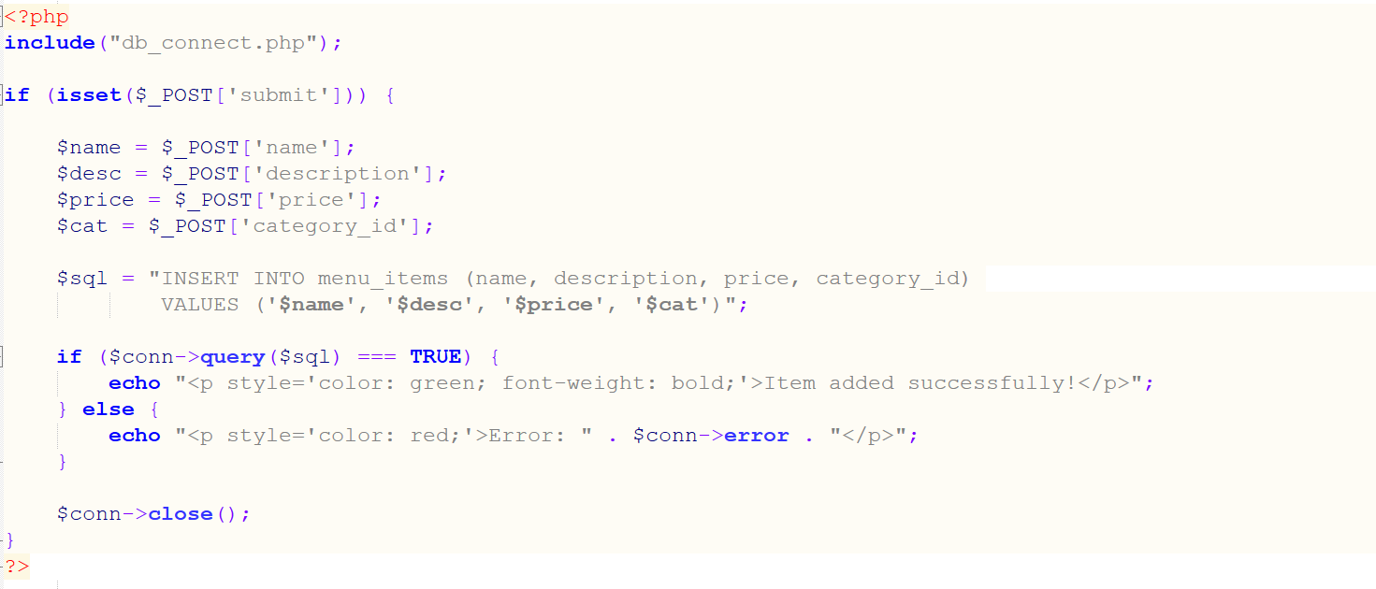
Code Snippet (Query Execution)
Collects the data from the form and adds it to the menu

Slide 20
Achievements
A fully functional website which adders to the needs of the management
Clean layout and style for better usability
PHP backend to display and add items in the menu
New items are added immediately to the menu from the form
Learnt how backend and frontend integrate and connect to make the website

Slide 21

Problems Encountered
Issues connecting the MYPHP to MY SQL
Difficulty displaying the items correctly from the database
Styling the website correctly across pages
Issues to make the website better suited for the customers rather than the management
Time constraits meant we didn’t get to implement every feature we were hoping for the database

Slide 22
Conclusions / Future Improvements
The website successfully displays menu items directly from the database
The admin page allows staff to add new items easily and keep the menu updated
Our database structure supports future expansion (customer orders, category selection, etc)
We could add a full customer ordering system
We could add a login feature to track each customer’s past and future orders
We could add a tracking feature that shows where a customer stopped in the ordering process (homepage, menu page, payment page)

