Slide 1


IILM University
GREATER NOIDA, U.P.
INTERNSHIP PRESENTATION
AI-Powered Creative Generation Platform
for Jewellery Marketing
A three-month internship report on the Prism platform — building multi-modal generative AI pipelines that preserve product identity.
STUDENT NAME
ENROLLMENT NUMBER
Kunal Sharma
CS-2341057
PROGRAM & SEMESTER
BATCH
B.Tech CSE · 7th Semester
2026–27
ORGANIZATION OF INTERNSHIP
Intelytica Business Analytics Pvt. Ltd.

Slide 2
INTERNSHIP PRESENTATION · KUNAL SHARMA
02 / 12
IN THIS PRESENTATION
Agenda
Twelve slides, organized as: the host organisation, the product, the problem it solves, the architecture, the intern's specific contributions, the methodology, and the takeaways.
01
02
03
Cover & identification
Agenda
About Intelytica
Student, program, organisation, and internship topic.
This slide.
Host organisation profile and the team I joined.
04
05
06
The Prism platform
Problem statement
System architecture
What the product is and the value it delivers.
Four sub-problems the platform solves.
Layered view of the platform.
07
08
09
My contributions
Tech stack
Methodology
The AI/ML and generative-services work I owned.
Technologies and tools used.
Four phases over twelve weeks.
10
11
12
Outcomes
Learnings & reflections
Thank you
Six tangible deliverables shipped.
Engineering and professional takeaways.
Closing slide and contact.
IILM UNIVERSITY · B.TECH CSE · 2026–27
INTERNSHIP AT INTELYTICA BUSINESS ANALYTICS PVT. LTD.

Slide 3
INTERNSHIP PRESENTATION · KUNAL SHARMA
03 / 12
HOST ORGANISATION
About Intelytica
A Hyderabad-based technology firm building data-science and AI products for the Indian retail sector — and the team that owns the Prism platform.
3months
5days/wk
₹8K/mo
DS& AI
INTERNSHIP DURATION
WORKING RHYTHM
MONTHLY STIPEND
DEPARTMENT
01 June – 31 August 2026
Mon–Fri, 10 AM – 6 PM, hybrid
Per offer letter INTELYTICA/HR/INTERN/2026/003
Cross-functional product engineering team
What the company does
The team I joined
Intelytica Business Analytics Pvt. Ltd. operates at the intersection of business analytics, machine-learning engineering, and applied generative AI. Its commercial offering spans customer analytics, marketing-resource-management platforms, and bespoke AI agent workflows that translate business problems into deployable decision-support systems for retail and consumer brands.
The Data Science and AI department owns the Prism platform. The team is structured as a small, cross-functional product engineering unit: backend engineers (Python/FastAPI), frontend engineers (React/TypeScript), AI/ML engineers (model integration and prompt engineering), and a product lead. Interns are inducted into the same engineering rhythm as full-time engineers — daily stand-ups, weekly sprints, code reviews via pull requests, and structured mentorship.
INTELYTICA BUSINESS ANALYTICS PVT. LTD. · HYDERABAD, TELANGANA

Slide 4
INTERNSHIP PRESENTATION · KUNAL SHARMA
04 / 12
THE PRODUCT
Prism — a creative generation platform for jewellery retail
A web application that lets a jewellery retailer's marketing team turn a one-line campaign idea into a complete, ready-to-post creative package — in minutes, not days.
INTELLIGENCE
COPY
VISUALS
Market + Strategy
Channel-ready text
Scripts, Images, Video
Trends, competitor moves, local catchment insight, moodboard direction, campaign themes, and per-segment customer journeys.
Instagram hooks/carousels/stories, WhatsApp broadcasts, catalogue narrative, and Meta ad copy — brand voice baked in.
5 editable reel scripts, hero/model/catalog product shots, cinematic scene images, animated reels, and jewellery ad videos.
“The system's defining trait is jewellery identity preservation — the exact uploaded piece, its metal, gemstones, proportions and design, must survive through every AI generation without being redesigned.”
PRISM · BRANDED IN LEAD DEPLOYMENT AS JD SOLITAIRES MARKETING PLATFORM
CREATIVE GENERATION MODULE · QUICK ANALYSIS FAST-LANE

Slide 5
INTERNSHIP PRESENTATION · KUNAL SHARMA
05 / 12
THE BUSINESS PROBLEM
Four problems Prism was built to solve
The jewellery retail vertical in India presents a marketing problem unusually well-suited to generative AI — and unusually poorly served by the existing creative-supply chain.
PROBLEM 01
PROBLEM 02
Cadence
Product identity
A jewellery retailer services 8–10 festival peaks per year, each requiring fresh IG carousels, WhatsApp broadcasts, catalogue narrative, Meta ads, and reels. Agencies, priced for monthly retainers and 3–5 day turnarounds, structurally cannot keep pace.
Generic text-to-image models redesign the jewellery every time. For a category where the specific design is the hero and the purchase driver, this is fatal. The exact uploaded piece must survive every generation.
PROBLEM 03
PROBLEM 04
Creative-director judgement
Multi-provider orchestration
Marketing teams at jewellery stores are excellent at merchandising, not at specifying lighting, composition, mood, and cultural targeting. The system must encode creative-director judgement in software — brand voice, size discipline, occasion theming, North-Indian domestic localisation.
No single image/video model is right for every need. OpenAI wins on identity, Grok on style, Gemini on size, Veo on video. The system must orchestrate these behind one interface with provider-specific prompt engineering and continuity across scenes.
PROBLEM DECOMPOSITION · THE FOUR SUB-PROBLEMS DROVE THE ARCHITECTURE
ADDRESSED IN SECTION 4.3 OF THE REPORT

Slide 6
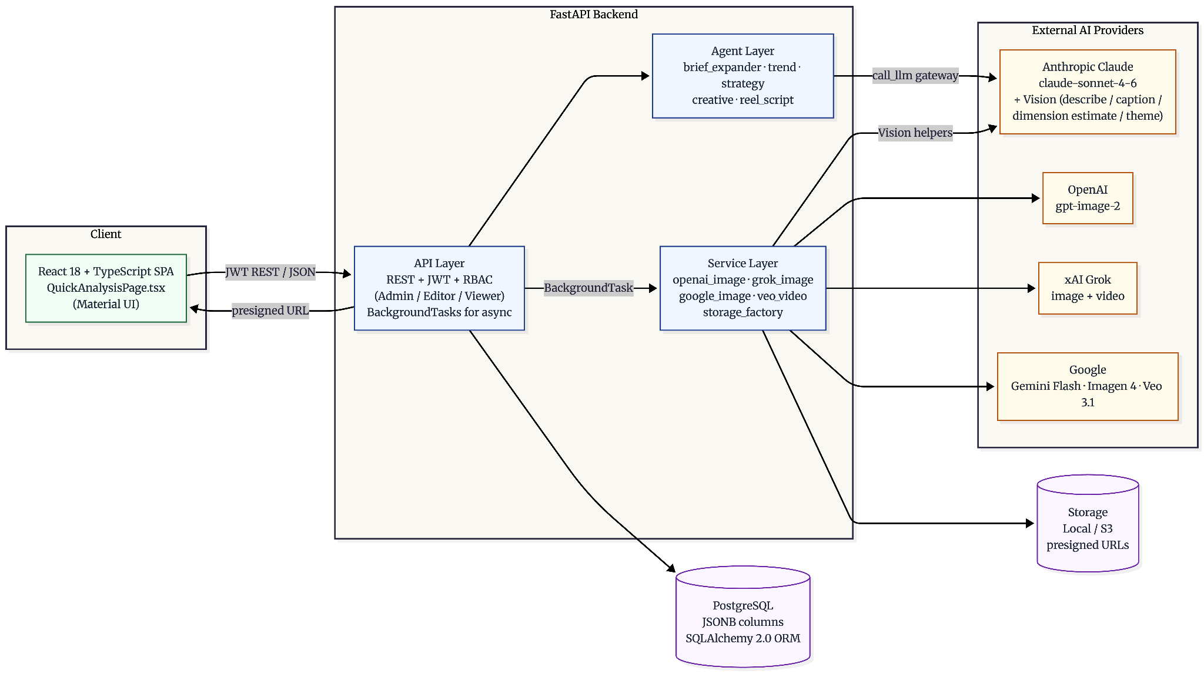
INTERNSHIP PRESENTATION · KUNAL SHARMA
06 / 12
HOW IT IS BUILT
System architecture
A layered architecture: a React SPA talks over REST to a FastAPI backend, which orchestrates an agent layer (Claude), a service layer (image + video providers), and a persistence layer of PostgreSQL and pluggable storage.
LAYERED ARCHTECTURE · SEE SECTION 4.7 OF THE REPORT FOR FULL DESCRIPTION

Slide 7
INTERNSHIP PRESENTATION · KUNAL SHARMA
07 / 12
MY WORK — AI/ML & GENERATIVE SERVICES
What I personally contributed
The frontend and the gated pipeline were owned by other members of the team. My contributions were concentrated in the AI integration, prompt engineering, and image/video generation services of the Creative Generation module.
01
Layered prompt builder
02
Claude Vision pipeline
Authored build_reel_scene_prompt — 11 priority-ordered layers (mandatory scene → outfit lock → jewellery identity → size anchor → continuity → style → person → occasion → negatives → edit-lock).
Four vision helpers: jewellery description (set-aware), dimension estimation, occasion-theme authoring (7-point MANDATORY block), and image captioning to replace guessed captions with what is actually rendered.
03
OpenAI two-pass identity
04
Multi-provider dispatch
For worn jewellery with no base scene: Pass 1 renders the model with no jewellery, Pass 2 edits the exact piece on with input_fidelity="high" and jewellery image passed first.
Unified interface for OpenAI, Grok, Gemini Flash, Imagen 4 — each with provider-specific identity preservation (reference editing, system-instruction size calibration, text-to-image with negatives).
05
Grok reel video pipeline
06
Veo 3.1 jewellery ad
Character anchor via Claude Vision → 3×5s clips generated sequentially → ffmpeg -c copy stitch → upload. Progress reported via nested status objects.
Three source modes (photo, photo+script, scene-image) → Claude-authored prompt → fast/quality tier selection → 10-min hard timeout → fresh-session error writeback to avoid poisoned transactions.
07
Social export & inset
08
JSON repair & LLM gateway
Resize to 6 social sizes (Grok reframe + PIL fallback), composite product-inset badge that overlays the actual uploaded photo pixel-exact as a corner element. InsufficientCreditsError → HTTP 402.
Co-developed the call_llm gateway with 3× retry + exponential back-off, token-usage tracking, and a 4-stage parse_llm_json repair pipeline (fences, control chars, unescaped quotes, truncation).

Slide 8
INTERNSHIP PRESENTATION · KUNAL SHARMA
08 / 12
TOOLS OF THE TRADE
Technologies and tools used
A polyglot stack pairing a Python backend with a React frontend and an external layer of foundation-model APIs.
Layer | Technology | Role in the platform
Backend | Python 3.11 + FastAPI | Application code, REST API, async background tasks, dependency injection.
Database | PostgreSQL + SQLAlchemy 2.0 | JSONB columns for agent outputs; typed Mapped[...] ORM; Alembic migrations.
LLM | Anthropic Claude (sonnet-4-6) | Text generation for 5 agents + Vision (describe, caption, dimension estimate, theme).
Image AI | OpenAI / Grok / Gemini / Imagen 4 | Multi-provider image generation with identity preservation techniques per provider.
Video AI | xAI Grok video + Google Veo 3.1 | Grok: 3×5s stitched reels. Veo: single jewellery ad (fast/quality tiers).
Media | Pillow + ffmpeg | Resize, contain-and-pad, product-inset compositing; stream-copy video stitch.
Storage | Local / S3 (factory pattern) | Pluggable binary asset storage with presigned 24-hour download URLs.
POLYGLOT STACK · BACKEND + AI ORCHESTRATION OWNED BY DATA SCIENCE & AI TEAM

Slide 9
INTERNSHIP PRESENTATION · KUNAL SHARMA
09 / 12
HOW THE WORK WAS DONE
Methodology — four phases over twelve weeks
An agile, research-driven methodology combining weekly sprints with hypothesis-driven experimentation, structured code review, and continuous documentation.
WEEKS 1–2
WEEKS 3–7
WEEKS 8–10
WEEKS 11–12
Discovery
Implementation
Refinement
Documentation
Read the codebase end-to-end. Set up local dev env with Docker. Walk every module with the senior engineer. Deliver: written architecture summary + draft objectives.
Two-week sprints with planning, daily stand-ups, and pull-request code reviews. Concentrated on image + video service modules and the layered prompt builder.
Hypothesis-driven prompt engineering. Formulate hypothesis → design eval corpus → A/B test with/without change → measure → document in experiment log → review with mentor.
Docstrings, README updates, architecture notes. Knowledge-transfer session for next intern cohort. This internship report.
AGILE + RESEARCH-DRIVEN · SEE SECTION 4.8 OF THE REPORT

Slide 10
INTERNSHIP PRESENTATION · KUNAL SHARMA
10 / 12
WHAT WAS SHIPPED
Six tangible outcomes
Concrete deliverables, with explicit attribution of individual vs co-developed work. Documented in Section 4.9 of the report.
01
Layered prompt builder
02
Claude Vision integration
11-layer priority-ordered prompt assembler. The intern's largest individual contribution. Ensures scene content cannot be overridden by style instructions, and product identity is always preserved.
Four helpers: jewellery description, dimension estimation, occasion-theme authoring, image captioning. The single source of truth for product identity throughout the pipeline.
03
Multi-provider image service
04
Video generation pipelines
Co-developed with senior engineer. Intern's individual work: OpenAI two-pass, Gemini system-instruction size calibration, Grok reference editing with text-only fallback.
Grok reel (3×5s + character anchor + ffmpeg stitch) and Veo 3.1 jewellery ad (3 source modes, fast/quality tier). Fresh-session error writeback to avoid poisoned transactions.
05
Post-processing & social export
06
Documentation & knowledge transfer
Resize to 6 social sizes (Grok + PIL fallback), product-inset badge compositing, 24-hour presigned download URLs, InsufficientCreditsError → HTTP 402.
Docstrings on every public function, internal architecture note on the layered prompt system, write-up of multi-provider dispatch pattern, knowledge-transfer session for next intern cohort.
TANGIBLE OUTCOMES · DOCUMENTED IN SECTION 4.9 OF THE REPORT

Slide 11
INTERNSHIP PRESENTATION · KUNAL SHARMA
11 / 12
WHAT I TAKE AWAY
Learnings & reflections
Six takeaways — three technical, three professional — that will outlast the specific code I wrote.
psychology
hub
visibility
Prompt engineering is systems engineering
Multi-provider abstraction pays off
Vision models are connective tissue
A good prompt is not a clever sentence; it is a layered, priority-ordered system with explicit guards, fallbacks, and measurable behaviour. Treat prompts as code: versioned, reviewed, tested.
No single AI provider is universally best. Abstracting providers behind a dispatch surface lets you A/B test, swap per use case, and avoid lock-in — at the cost of more integration code.
Claude Vision did not just describe jewellery — it estimated dimensions, authored themes, and captioned results. Vision became the verification layer for every image the system produced.
groups
science
menu_book
Code review is a learning loop
Hypothesis-driven beats intuition-driven
Write the post-mortem even when you succeed
Pull-request feedback from senior engineers was the single highest-bandwidth learning channel. Treat review comments as a curated reading list, not a critique.
For prompt changes especially: formulate a hypothesis, design an eval corpus, measure with and without the change, document the result. Intuition alone produces confident wrong decisions.
The team's culture of honest post-mortems — including for successes — built a durable knowledge base that the next engineer could learn from. Documentation is engineering, not paperwork.
THREE TECHNICAL + THREE PROFESSIONAL TAKEAWAYS

Slide 12
END OF PRESENTATION
Thank you.
Kunal Sharma
B.TECH CSE · 7TH SEMESTER · CS-2341057 · 2026–27
IILM UNIVERSITY, GREATER NOIDA · INTELYTICA BUSINESS ANALYTICS PVT. LTD.

