Slide 1

A Project Presentation On Pneumonia Detection System
using CNN Algorithm Submitted By Roshik Maharjan(41002143)
A Final Project Presentation Submitted in partial fulfillment of the requirement of Bachelor in Computer Applications(BCA) 6th semester of Tribhuvan University, Nepal April, 2026 A.D.

Slide 2
Table of Content
Introduction.................................................................................................................................................................................................................................................... 3
Objective of the Project ………………...................................................................................................................................................................................................... 4
Scope of Project ………………......................................................................................................................................................................................................................5
Functional Requirement(Use Case diagram) ……………….......................................................................................................................................................................6
Feasibility Study ……………….....................................................................................................................................................................................................................7
Technical ………………................................................................................................................................................................................................ 7
Operational ………………...............................................................................................................................................................................................9
Economical ……………….............................................................................................................................................................................................10
Schedule ……………….................................................................................................................................................................................................11
Methodology ………………....................................................................................................................................................................................................................... 12
Literature Review ………………................................................................................................................................................................................................................13
System Design ………………....................................................................................................................................................................................................…………..14
Class diagram ………………....................................................................................................................................................................................... 15
Sequence Diagram ………………................................................................................................................................................................................ 16
State diagram…………………......................................................................................................................................................................................17
Activity diagram ………………................................................................................................................................................................................... 18
Component diagram…………………………………………….……………………................................................................................…………..19
Deployment diagram………………………………………………………................................................................................……………………..20
Tools used ………………........................................................................................................................................................................................................................... .21
Testing…………………………………………………………………………………………..……………….........................................................……………………27
Conclusion ……………….......................................................................................................................................................................................................................... .32
References ………………............................................................................................................................................................................................................................33
Demo

Slide 3
Introduction to project
A web-based system that uses artificial intelligence to detect pneumonia from chest X-ray images.
Employs Convolutional Neural Networks (CNNs) and the VGG16 model to identify pathology-specific patterns like lung opacity and consolidation.
Built using PHP, Python (Flask), and MySQL to provide a robust, efficient platform.
Designed to support clinicians in resource-limited settings by providing rapid triage and preliminary screening.

Slide 4
Objective of the Project
To develop an automated system for the detection of pneumonia from chest X-ray images using CNN.
To alleviate patient stress by reducing waiting times for preliminary assessments.
To provide an intelligent, web-based platform for accurate and accessible diagnosis.

Slide 5
Scope of Project
Helps doctors make faster decisions through automated pixel and texture analysis.
Works automatically with minimal human effort to handle high case volumes.

Slide 6
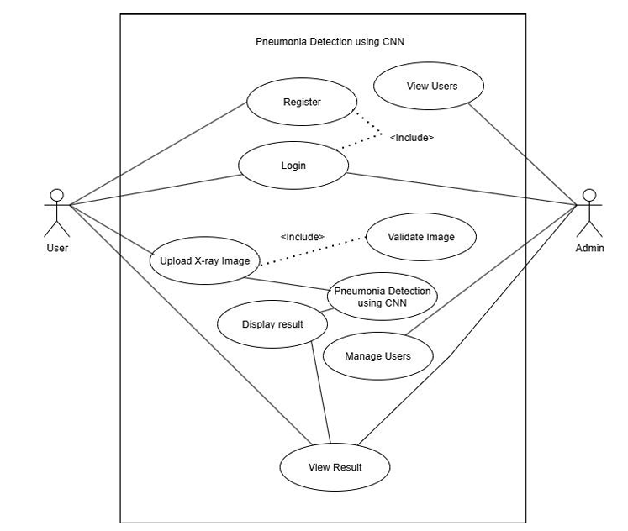
Functional Requirement
Figure: Use Case Diagram

Slide 7
Feasibility Study
Technical Feasibility
- Hardware Requirements:
RAM Size: The system requires a minimum of 8GB RAM to ensure smooth operation as we are working with python, php and using CNN algorithm. It is currently feasible within the available hardware options.
Processor Size: A quad-core processor (something like an Intel i3 or i5) is good enough to handle what the system needs to do which is mostly the training and running the VGG16 CNN model.
Storage Space: The system requires a minimum of 4GB of storage space to accommodate all the application files, database, and future growth which is feasible within the available storage options in our system.

Slide 8
-Software Requirements:
Operating System: The system is compatible with modern operating systems, such as Windows 10, macOS, or Linux distributions which is feasible within the supported operating system options.
Development Environment:We're using Visual Studio Code for development—it’s free, lightweight, and widely supported. It’s a good choice for handling this projects and works well across different systems. Easy to install and use.
Core Technologies: This project is built on the Php, Python, js. All of these tools are open-source and free, which keeps development cost-effective and flexible. Fits perfectly with our project needs.

Slide 9
Operational Feasibility
User-Friendliness: The interface is designed to be intuitive, allowing medical staff with basic computer knowledge to upload X-rays and receive results instantly.
Workflow Integration: The system acts as a decision-support tool, fitting into the existing diagnostic workflow by providing a "second opinion" or rapid triage.
Accessibility: Being web-based, it can be accessed from any department within a hospital network without complex local installations.

Slide 10
Economic Feasibility
Minimal Hardware Requirement: A basic laptop or PC with the minimum required specifications is sufficient for development and use.
Development Costs: Low, as it relies on open-source libraries (TensorFlow, Keras) and languages (PHP, Python) that do not require licensing fees.
Resource Savings: By automating the initial screening, the system reduces the workload on radiologists and potentially lowers the cost of diagnosis for patients in resource-limited areas.

Slide 11
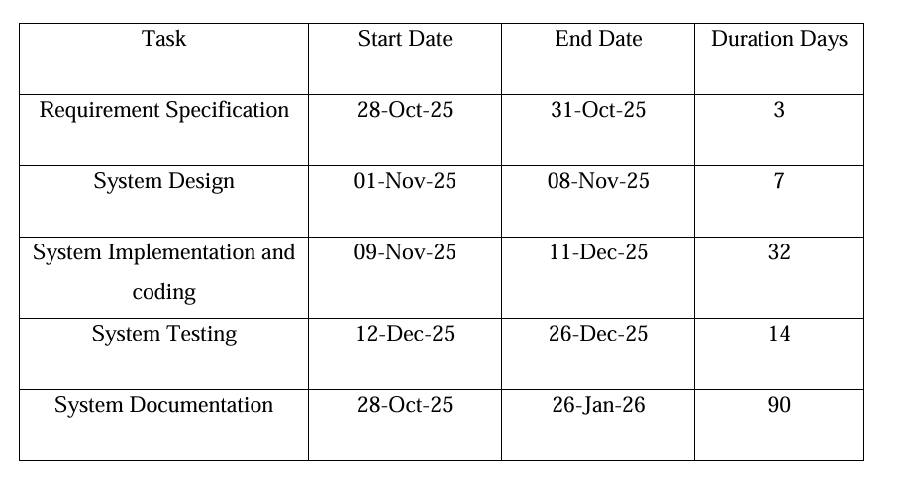
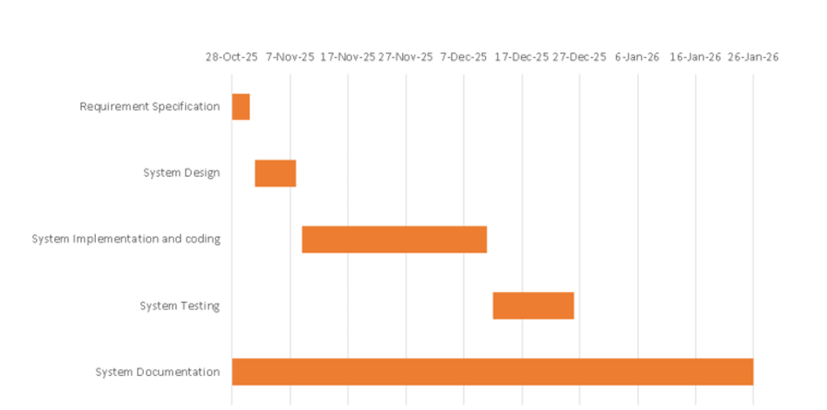
Schedule

Slide 12
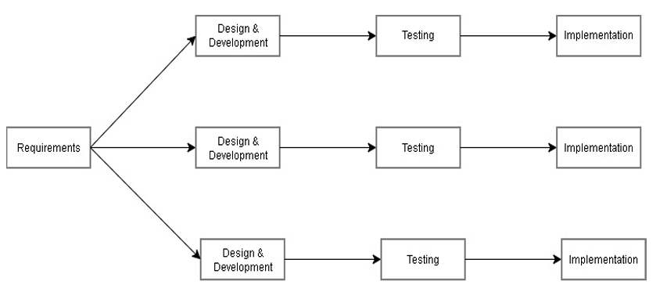
Methodology
Incremental Methodology

Slide 13
Literature Review:
Sukendra et al. (2026): Explored Vision Transformers (ViT) for global relationship capturing in X-ray images.
Chen et al. (2021): Surveyed deep learning techniques, highlighting how CNNs process pixel intensity and shape variations.
Kumar et al. (2022): Utilized ResNet101 to overcome training issues like vanishing gradients.
Stephen et al: Proposed web-based diagnostic platforms for resource-limited environments.
Marrie [5] provided important clinical insights into Community-acquired Pneumonia (CAP), including its causes, symptoms, risk factors, and complications.

Slide 14
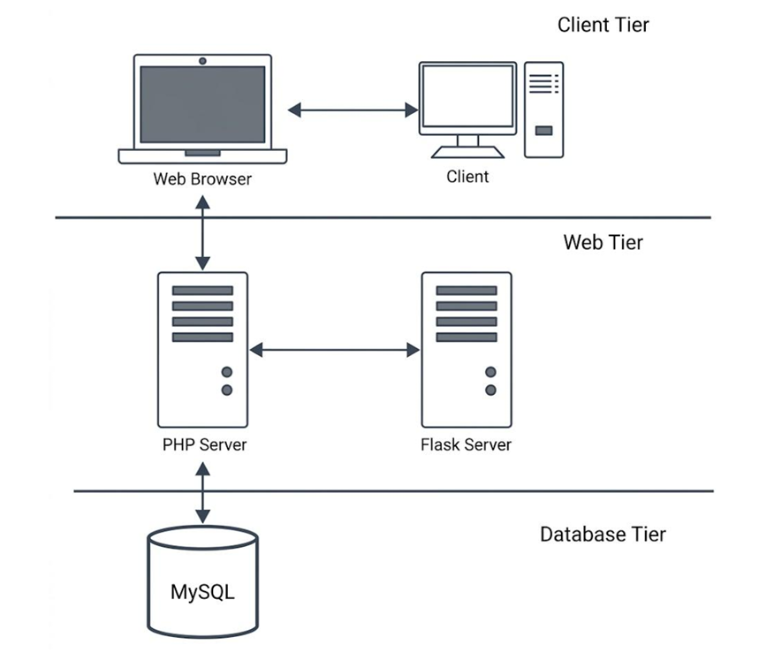
System Design

Slide 15
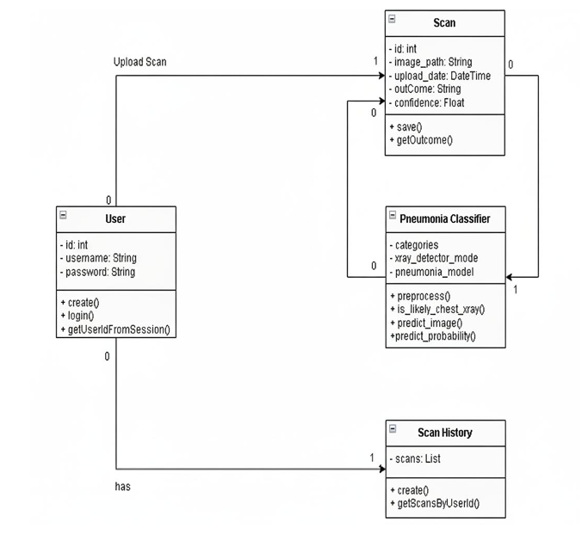
Class diagram

Slide 16
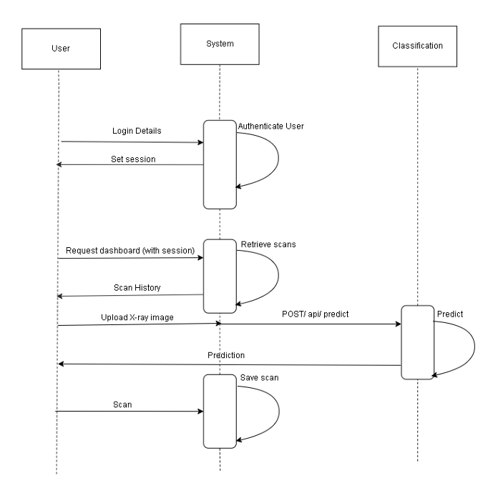
Sequence diagram

Slide 17
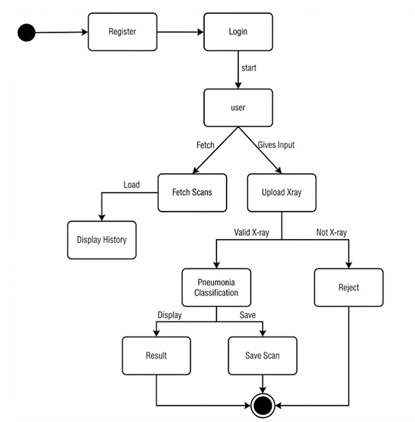
State Diagram

Slide 18
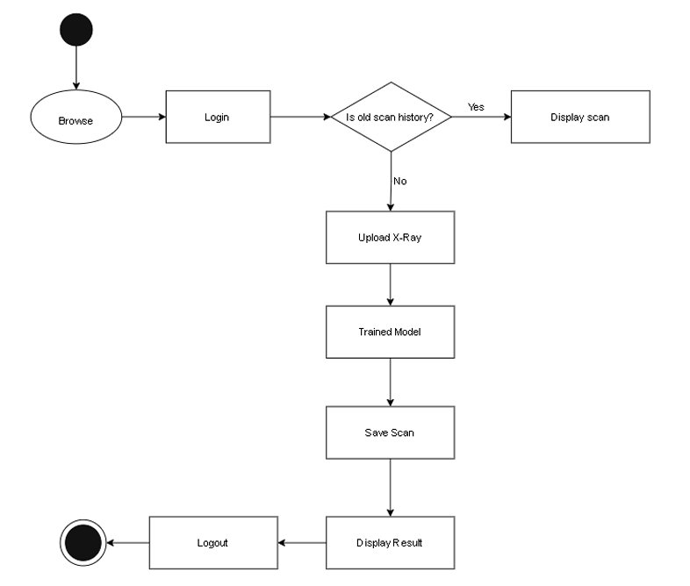
Activity Diagram

Slide 19
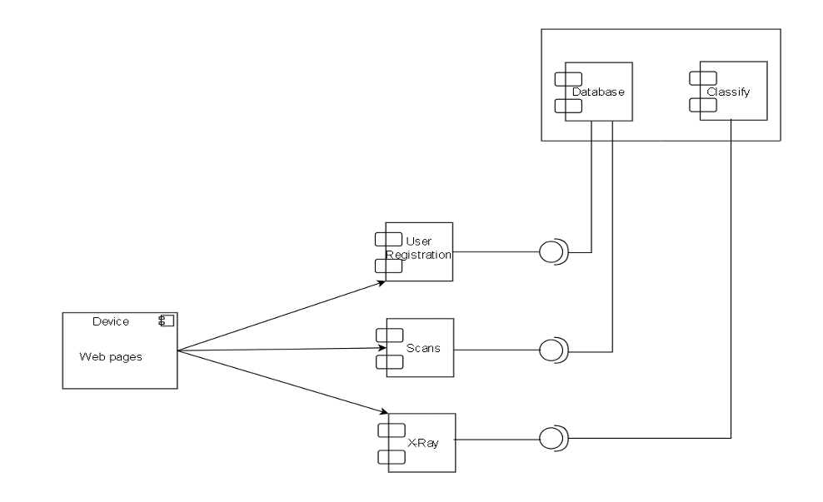
Component Diagram

Slide 20
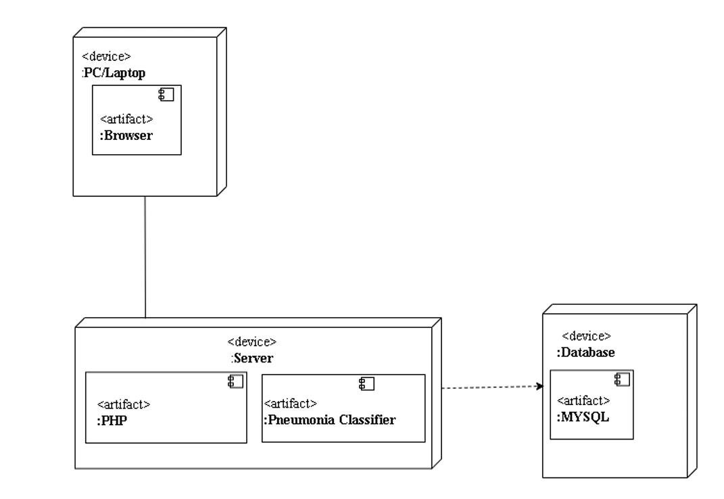
Deployment Diagram

Slide 21
Tools Used
Backend Tools:
PHP
Python (Flask)
Front-End Tools:
Html
CSS
Javascript
Database:
MySql

Slide 22
Modules
Login Module
Scan Module
Pneumonia Detection Module
CNN Algorithm

Slide 23
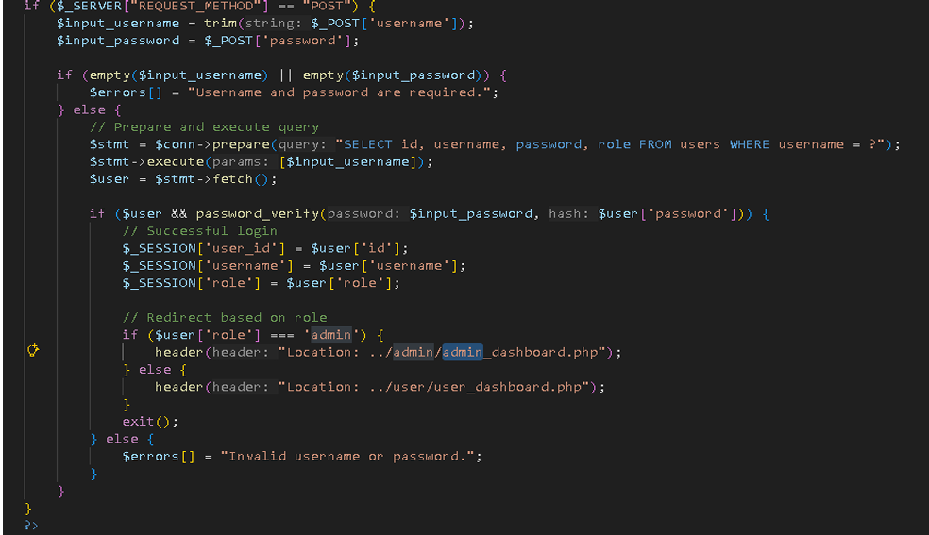
Login Module
Secure access for authorized personnel(admin).
Different access levels (e.g., Admin can manage users, while Doctors can perform and view scans).
Users can manage their personal information and credentials.

Slide 24
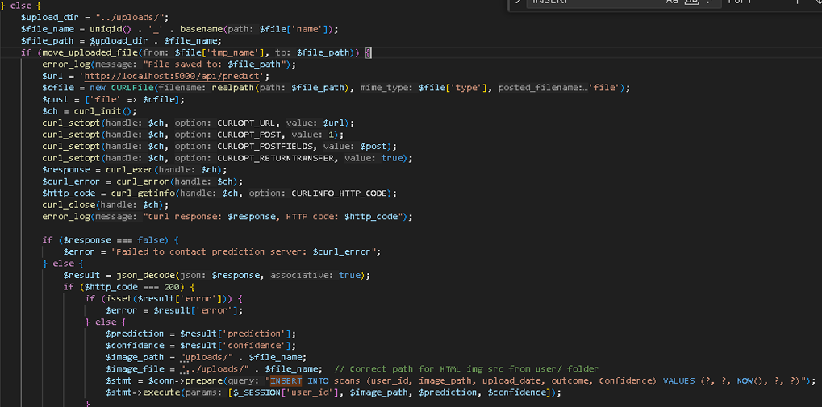
Scan Module
A secure interface for uploading chest X-ray images in standard formats (JPEG/PNG).
A specialized AI model checks if the uploaded image is actually a chest X-ray to prevent incorrect data processing.
Images are resized and processed to match the input requirements of the VGG16 model.

Slide 25
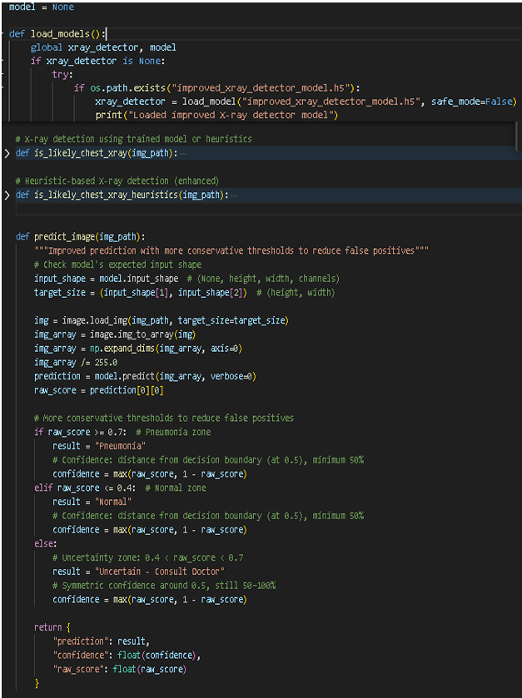
Pneumonia Detection System
The VGG16-based model analyzes the pixel intensities and textures of the lungs.
The system identifies patterns associated with pneumonia, such as lung opacity or consolidation.
The model generates a prediction (Pneumonia vs. Normal) along with a confidence score.

Slide 26
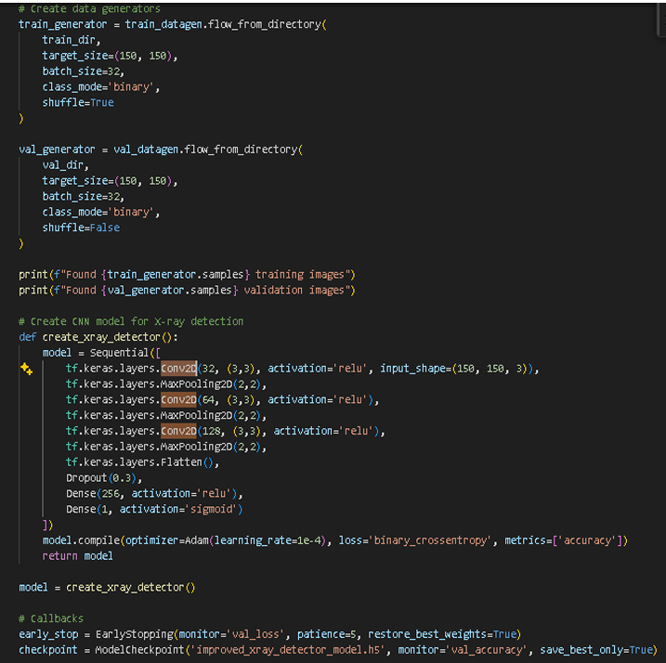
CNN Algorithm
Unlike traditional algorithms, CNNs are inspired by the human visual cortex and excel at identifying spatial hierarchies in medical images (edges -> shapes-> lung textures).
Steps in CNN Algorithm for Pneumonia Detection System:
Use 3x3 filters to extract fine details like lung consolidation or fluid patterns.
Reduces the image dimensions while retaining critical diagnostic features, making the system faster.
Introduces non-linearity, helping the model learn the complex differences between viral and bacterial pneumonia signatures.
The final Dense Layer uses a Sigmoid activation function to output a probability between 0 and 1.
If the score is >0.5, the system classifies it as pneumonia; otherwise,it is Normal.

Slide 27
Testing
Unit Testing
System Testing

Slide 28
User Registration
SN | Action | Input | Expected Outcomes | Actual Outcomes | Test Results
1 | Submit without any details | Null | Username and password Required Error | Username and password Required Error | Pass
2 | Register new user with valid details | Username: user123 Password: 123456 | Registered successfully | Registered successfully | Pass
3 | Enter Already Existed Username | Username: user123 Password: 123456 | Error Message | Error Message | Fail

Slide 29
User Login
SN | Action | Input | Expected Outcomes | Actual Outcomes | Test Results
1 | Enter all detail correctly | Username: user123 Password:123456 | Logged In successfully | Logged In successfully | Pass
2 | Enter not existed Username | Username: user123 Password: 123456 | Error Message | Error Message | Pass

Slide 30
Unit Testing
SN | Action | Input | Expected Outcomes | Actual Outcomes | Test Results
1 | Upload Image | Chest X-ray | Prediction of pneumonia. | Prediction of pneumonia. | Pass
2 | Upload non x-ray image | Some random image | Error Message | Error Message | Pass

Slide 31
System Testing
SN | Action | Input | Expected Outcomes | Actual Outcomes | Test Results
1 | User Registration | Username: user123 Password:123456 | Registered successfully | Registered successfully | Pass
2 | User Login | Username: user123 Password:123456 | Logged In successfully | Logged In successfully | Pass
3 | Upload random Image | Some random image | Error Message | Error Message | Pass
4 | Upload X-ray image | Chest X-ray image | Prediction of pneumonia. | Prediction of pneumonia. | Pass
5 | Presses Logout | Null | Logged out successfully | Logged out successfully | Pass

Slide 32
Conclusion
The developed system successfully bridges the gap between complex Deep Learning models and practical healthcare delivery through a user-friendly web interface.
By integrating the VGG16 architecture with a PHP/Flask backend, the system achieves high diagnostic accuracy (90%+) in detecting pneumonia patterns from Chest X-rays.
Reduces the time required for preliminary screening in high-volume or resource-limited clinical settings.
Ensures data integrity and historical tracking via a structured MySQL database
The system meets all functional and non-functional requirements set during the analysis phase, proving to be a viable decision-support tool for modern healthcare.

Slide 33
References
S. Sukendra, et.al, “Efficient pneumonia detection using Vision Transformers on chest X-rays” (January 2026) Available: Efficient pneumonia detection using Vision Transformers on chest X-rays | Scientific Reports
J. Chen et al., ”Deep Learning for Pneumonia Detection: A Comprehensive Survey,” Journal of Medical Imaging, vol. 8, no. 2, pp. 1-15, 2021
R. Kumar et al., ”Application of ResNet101 for Pneumonia Detection in Chest X-Rays,” Medical Image Analysis, vol. 72, pp. 123-135, 2022
O. Stephen, et.al, “An Efficient Deep Learning Approach to Pneumonia Classification in Healthcare” Available: An Efficient Deep Learning Approach to Pneumonia Classification in Healthcare
Marrie, T. (1994). Community-acquired pneumonia. Clinical Infectious Diseases. 18(4), 501-513
“Chest X-Ray Images (Pneumonia)”, www.kaggle.com Available https://www.kaggle.com/datasets/paultimothymooney/chest-xray-pneumonia [Accessed 1st, Nov 2025]

Slide 34
DEMO

