Slide 1

A Project Presentation​ On​ “Prime Canteen System”
Submitted by:
Roshik Maharjan (41002143)
​ A Project Presentation Submitted in partial fulfillment of the requirement of ​Bachelor of Computer Application (BCA) 4th Semester of ​ Tribhuvan University, Nepal
Feb, 2025

Slide 2
Table of Content​
Introduction ​
Objectives​
Scope ​
Functional Requirement​
Feasibility Study​
Methodology​
System Design​
Tools Used​
Conclusion​
References​
​

Slide 3
Introduction ​
Prime Canteen System is an online platform that allows students and staff to purchase canteen items online and pay digitally.
The system allows users to receive email order confirmations and make payments using Khalti.

Slide 4
Objectives​
To provide students with an online platform for ordering foods online.
To confirm the order via email integration and payment using Khalti.

Slide 5
Scope​
The platform is accessible to students and staff of prime college with access to the internet.
Students can easily browse the menu, place orders, and make payments online, eliminating the need to wait in long queues.

Slide 6
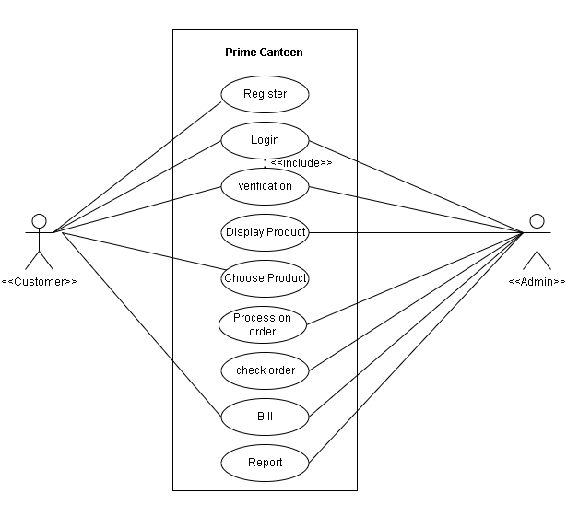
Functional Requirement​

Slide 7
Feasibility Study​
Technical Feasibility​
Operational Feasibility​
Economic Feasibility​
Schedule Feasibility ​

Slide 8
Technical feasibility Study​
It is the evaluation of the hardware and software and how it meets the need of proposed system.​
There are two types of requirements in technical feasibility study:​
Software Requirement: This website is compatible with any browser and OS.​
Hardware Requirement: It was developed and ran on Intel Core i7: 9th generation ​

Slide 9
Operational feasibility Study​
This system is a simple web-based application, therefore, the users would’t require any additional training in order to use this system.​
It cannot be used without internet connection since it is a web-based application.​

Slide 10
Economic feasibility Study​
It’s main goal is to weight the cost and benefit of the system.​
The only cost encountered are printing cost, paper costs and internet and electricity expensed.

Slide 11
Schedule Feasibility study​
It is the key aspect to determine whether the proposed project timeline is realistic or not.​
It includes the project schedule and time allocated for their completion.​
Gantt table and Gantt chart are below:​

Slide 12
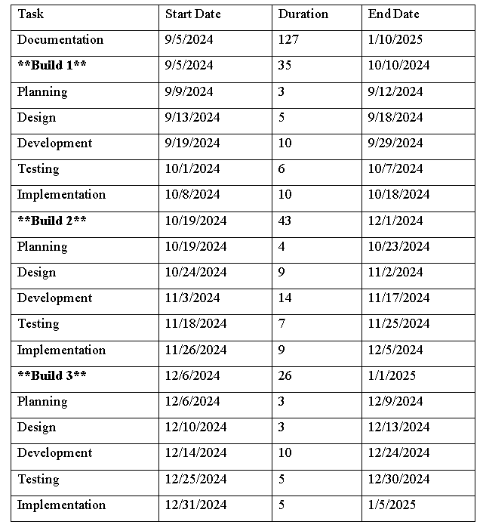
Gantt table​

Slide 13
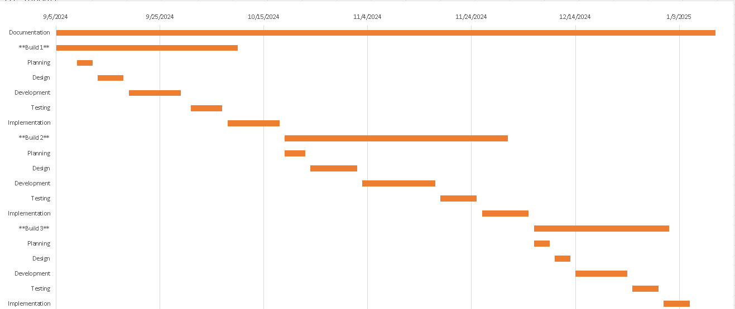
Gantt Chart​

Slide 14
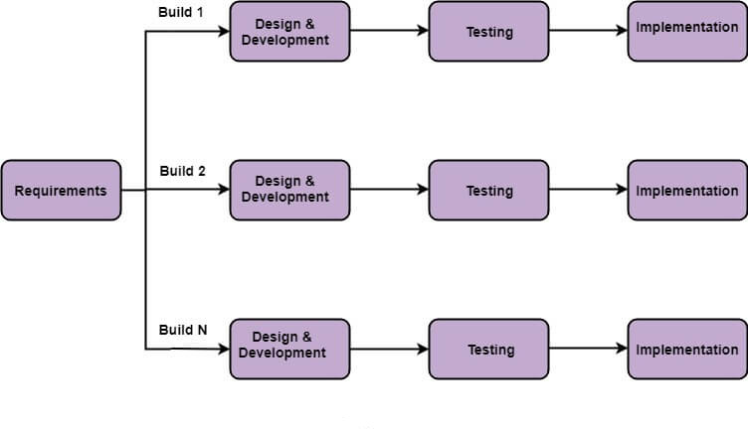
Methodology
Development methodology
Incremental Model

Slide 15
System Design​
ER Diagram​
Level 0 DFD​
Level 1 DFD​
System Architecture​
Database Schema Design​
Interface Design​
Physical DFD Design​

Slide 16
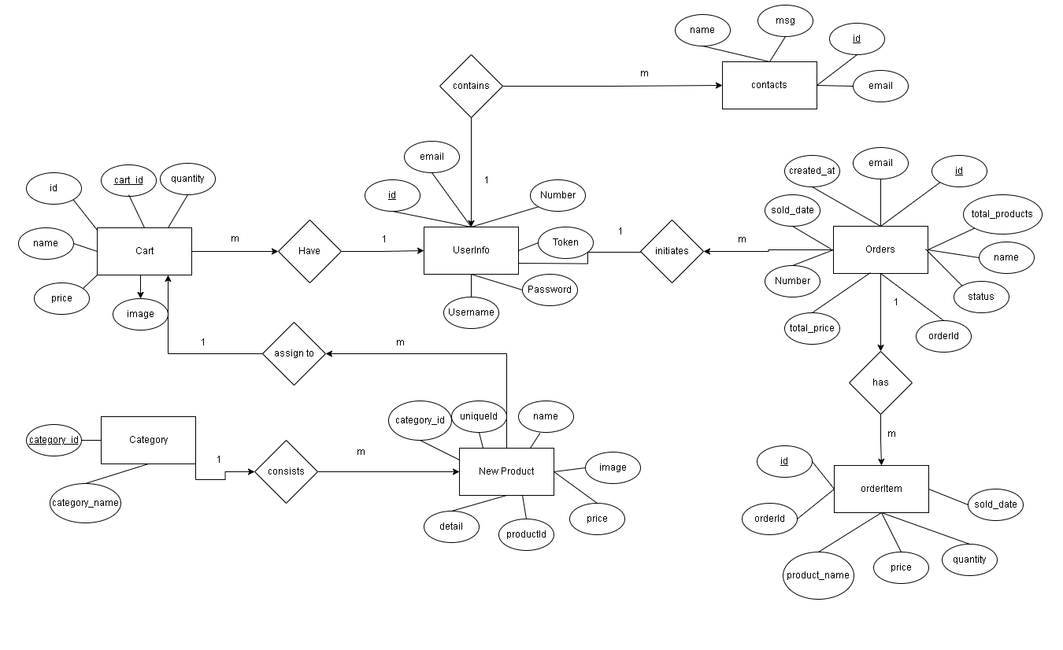
ER Diagram​

Slide 17
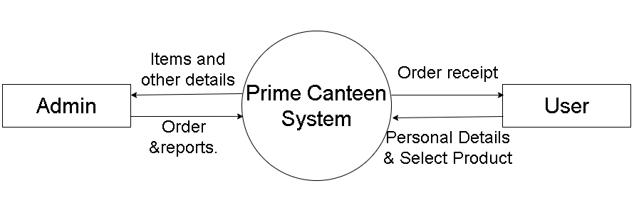
Level 0 DFD​

Slide 18
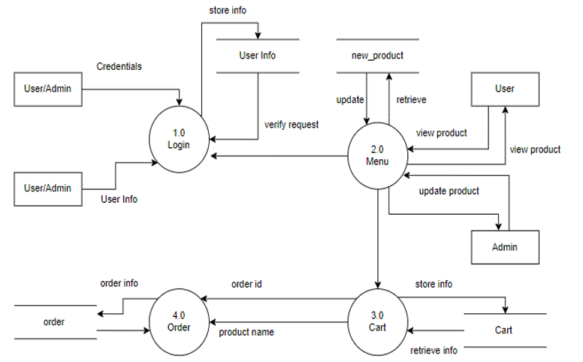
Level 1 DFD​

Slide 19
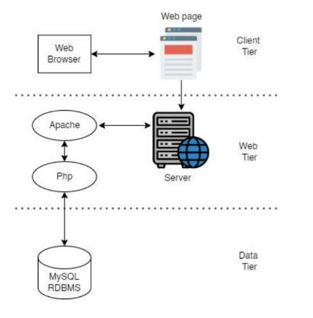
System Architecture​

Slide 20
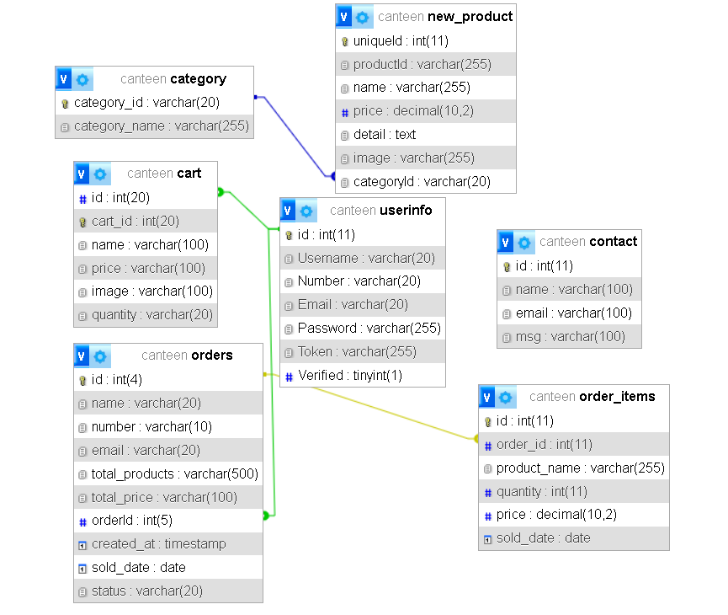
Database Schema Design​

Slide 21
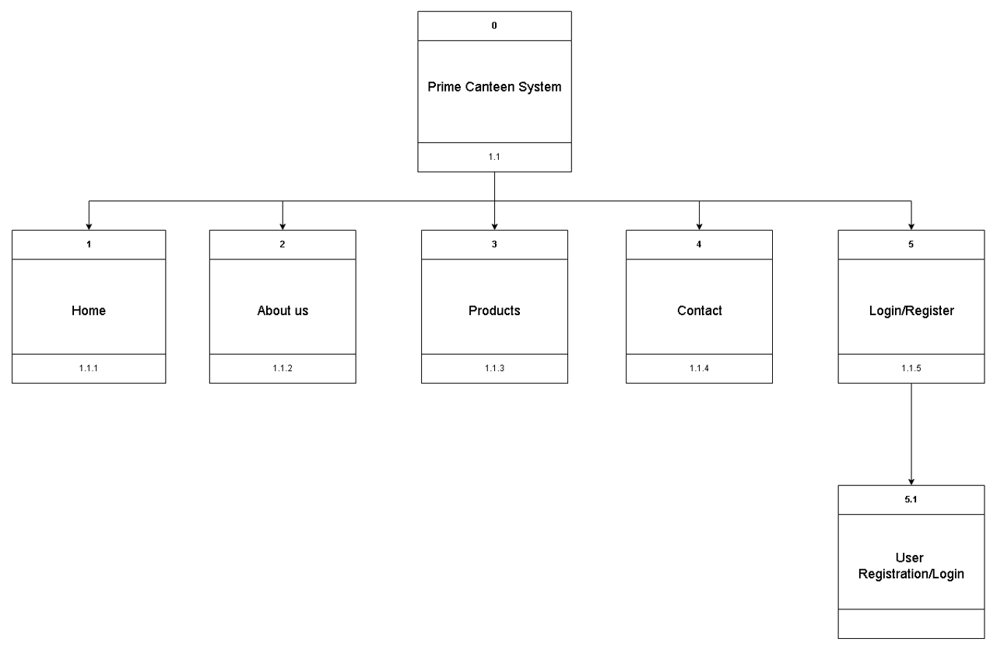
Interface Design​

Slide 22
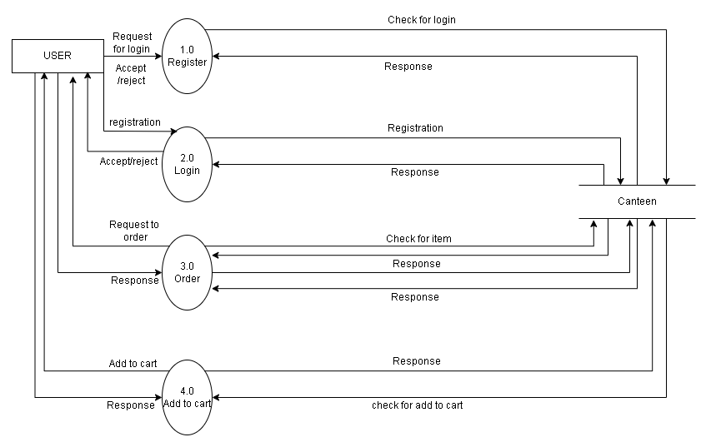
Physical DFD Diagram​

Slide 23
Tools Used​
Software tools​
Html​
CSS​
JavaScript​
PHP​
MySQL​

Slide 24
Modules​
Cart Management Module
User Management Module
Admin Management Module
Featured Items Module
Payment Management Module

Slide 25
User Registration​
Sno.​ | Action​ | Input​ | Expected Outcome​ | Actual Outcome​ | Test Result​
1​ | Login​ | Enter valid username and password​ | User is successfully logged in​ | User is successfully logged in​ | Pass​
2​ | Login​ | Enter invalid username/password​ | Error message displayed, login unsuccessful​ | Error message displayed, login unsuccessful​ | Pass​
3​ | Registration​ | Enter valid registration details​ | User account is successfully created​ | User account is successfully created​ | Pass​
4​ | Password Confirmation​ | Enter matching passwords​ | Passwords match and validation passes​ | Passwords match and validation passes​ | Pass​
5​ | Email Validation​ | Enter valid email format​ | Email format is valid and passes validation​ | Email format is valid and passes validation​ | Pass​
6​ | Password Verification​ | Enter password with special characters​ | Password meets validation criteria​ | Password meets validation criteria​ | Pass​

Slide 26
Add To Cart​
Sno. | Action | Input | Expected Outcome | Actual Outcome | Test Result
1 | Add Item to Cart | Click "Add to Cart" button | Item is added to the Food cart | Item is successfully added to the Foodcart | Pass
2 | Remove Item from Cart | Click "Remove" button | Item is removed from the Food cart | Item is successfully removed from the Food cart | Pass
3 | Adding same item | Add same items to the cart | Item already in cart. | Item already in cart. | Pass
4 | Add to cart without login | Click "Place Order" button | Please login first. Redirect to login form | Redirect to login form | Pass

Slide 27
Checkout Form​
Sno. | Action | Input | Expected Outcome | Actual Outcome | Test Result
1 | Fill Name | Enter valid name | Name is entered and validated | Name is entered and validated | Pass
2 | Fill Email Address | Enter valid email address | Email address is entered and validated | Email address is entered and validated | Pass

Slide 28
User Interface​
Sno. | Action | Input | Expected Outcome | Actual Outcome | Test Result
1 | Access Login Page | Navigate to the login page | Login page is displayed with username and password fields | Login page is displayed with username and password fields | Pass
2 | Enter Valid Credentials | Input valid username and password | User is logged into the system | User is successfully logged into the system | Pass
3 | Enter Invalid Credentials | Input invalid username or password | Error message is displayed indicating login failure | Error message is displayed indicating login failure | Pass
4 | Access Dashboard | Direct on dashboard link after successful login | Dashboard page is displayed with relevant information | Dashboard page is not displayed with relevant information | Fail
5 | View Product Catalog | Navigate to product catalog | Product catalog is displayed with available food items | Product catalog is displayed with available food items | Pass

Slide 29
Sno. | Action | Input | Expected Outcome | Actual Outcome | Test Result
6 | Add Item to Cart | Click "Add to Cart" button for a product | Product is added to the Food cart | Product is successfully added to the Food cart | Pass
7 | View Shopping Cart | Navigate to the food cart | Food cart page is displayed with added items and total price | Food cart page is displayed with added items and total price | Pass
8 | Proceed to Checkout | Click "Checkout" button | Checkout page is displayed with order summary and payment options | Checkout page is displayed with order summary and payment options | Pass
9 | Place Order | Click "Place Order" button | Order is successfully placed | Order is successfully placed | Pass

Slide 30
Admin Interface​
Sno. | Action | Input | Expected Outcome | Actual Outcome | Test Result
1 | Log in as Admin | Enter valid admin credentials | Admin successfully logs in | Admin successfully logs in | Pass
2 | Navigate to Product Page | Click on "Add Product" option | Redirects to the product addition page | Redirects to the product addition page | Pass
3 | Fill Product Details | Enter valid product information | Product details are entered correctly | Product details are entered correctly | Pass
4 | Upload Product Image | Select image file for the product | Image is uploaded successfully | Image is uploaded successfully | Pass
5 | Set Product Price | Enter valid price for the product | Price is set and validated | Price is set and validated | Pass
6 | Add Product to Inventory | Click "Add Product" button | Product is added to the inventory | Product is added to the inventory | Pass
7 | View Added Product | Navigate to product listing page | Newly added product is displayed in the inventory | Newly added product is displayed in the inventory | Pass
8 | View Order Status | Click on the date | Lists of product sold in a day | Null | Fail

Slide 31
Conclusion​
In conclusion, the "Prime Canteen System" successfully integrated features like email and the Khalti payment gateway, enhancing user engagement and ensuring secure transactions.​
The development process underscored the importance of effective time management, balancing coding, testing, and documentation to meet deadlines.​

Slide 32
DEMO ​

