Slide 1

26 JUNE 2024
An lost and found System
By: House of Flairs

Slide 2
AGENDA
Let’s face it — when we lose something valuable in Nepal, like a document or wallet with personal items, we panic.
We post in random Facebook groups, ask around, or stick to media surveys on walls.
There’s no dedicated platform to report lost items.
There’s no way to track or verify ownership.
There’s no assurance that what’s lost will ever be found.
Notes:
People use Facebook groups not because they work — but because there's no better option. They’re cluttered, unorganized, and lack trust. Vetayo is purpose-built to bring structure, security, and success to the lost & found process.

Slide 3
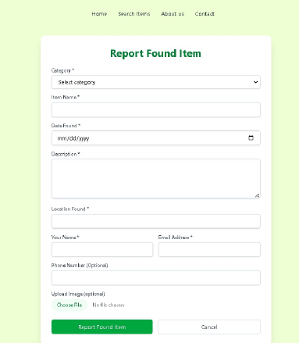
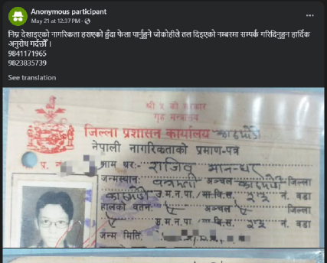
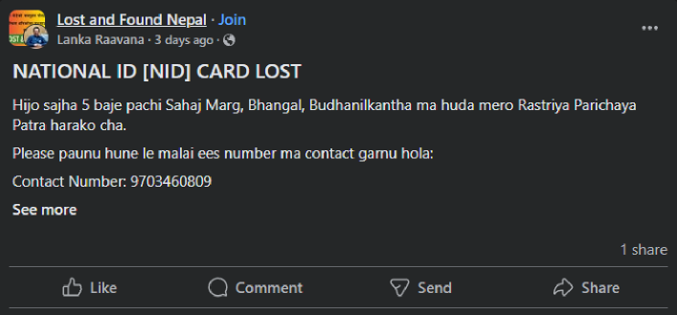
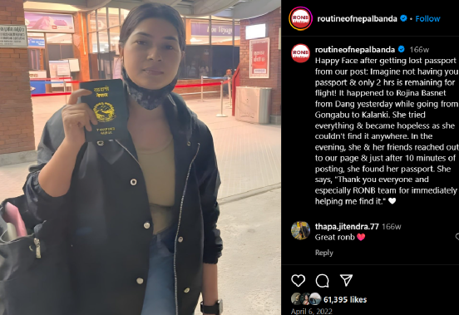
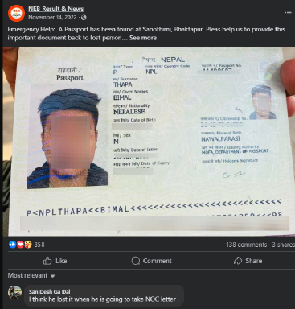
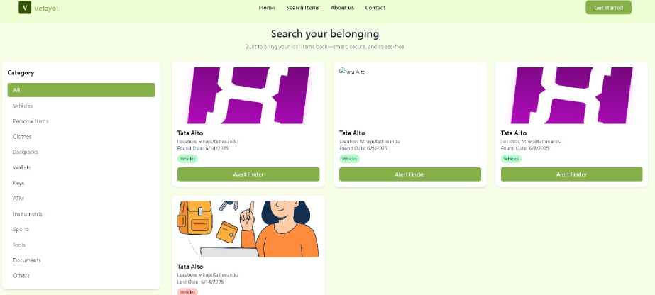
BEFORE
AFTER

Slide 4


26 JUNE 2024
INTRODUCING VETAYO
Welcome to Vetayo, your trusted platform for reuniting people with their lost valuables. We are revolutionizing the lost-and-found experience.

Slide 5
SOLUTION
Centralized Platform – One trusted place to report, search, and claim.
Smart Filters & Matching – Find items based on location, time, category.
Verified Claims – Built-in validation to ensure accurate returns.
4. Rewards – Motivate finders with transparent, fair tipping.

Slide 6
HOW IT WORKS
A Simple, Secure Path to Reuniting You With What Matters
Report Your Lost or Found Item
Browse or Search With Filters
Claim and Respond
Verify Ownership
Return & Reward
It’s all about clarity, fairness, and making the lost & found process finally work. No more chaos—just structured steps to find what matters.
Notes:
Offers structured item reporting with detailed descriptions, images, and location for clear communication. Enables users to search lost or found items using smart filters of category Verifies item claims through matching of images, descriptions, and timestamps to avoid false ownership. Applies a fair success fee only after verified return, split between finder and platform.

Slide 7





















































FUTURE REVENUE MODEL
Only pay on success — fair, optional, and rewarding for all.
Success-Based Revenue – We only charge after a verified return.
Ad Reveue – Users can boost visibility through web-based banners.
Smart Notifications – Premium users get early alerts through a subscription model.

Slide 8
High-Frequency Problem – Every day, people lose phones, wallets, and documents in public spaces with no proper recovery system.
Scalable Solution – Vetayo is built to grow, because it’s niche and ignored topic and there’s no deticated platform.
Market Opportunity
Thousands of items lost daily—Vetayo brings trust, structure, recovery.
Notes:
Untapped Segments – From colleges to airports, malls to offices — there’s no dedicated platform serving these needs

Slide 9
Conclusion
Lost & found shouldn’t rely on luck. With Vetayo, we bring structure, trust, and action to what’s been missing. We’re not just building a platform—we’re solving a daily problem. Let’s find what matters — together.

Slide 10
26 JUNE 2024
Thank you and let’s run into demo

