Slide 1
Employee Data Analysis using Excel
STUDENT NAME : ROSHINI S
REGISTER NO : 312215866
DEPARTMENT : III B.COM (A/F) - A
COLLEGE NAME : SHRI SHANKARLAL SUNDARBAI SHASUN JAIN COLLEGE FOR WOMEN

Slide 2
PROJECT TITLE
Employee Performance Analysis using Excel

Slide 3


AGENDA
Problem Statement
Project Overview
End Users
Our Solution and Proposition
Dataset Description
Modelling Approach
Results and Discussion
Conclusion
3/21/2024 Annual Review

Slide 4

PROBLEM STATEMENT FOR EMPLOYEES DATA ANALYSIS
Demographic analysis (age, gender, department, location)
- Performance evaluation (ratings, promotions, training)
- Turnover analysis (reasons, trends, impact)
- Employee engagement and satisfaction
- Career development and growth opportunities
- Diversity, equity, and inclusion metrics

Slide 5

PROJECT OVERVIEW FOR EMPLOYEES DATA ANALYSIS
.
1. *Workforce Demographics*: Age, gender, department, location, tenure, etc.
2. *Performance and Growth*: Evaluation ratings, promotions, training, career pathing
3. *Turnover and Retention*: Reasons, trends, impact, and cost analysis
4. *Employee Engagement and Satisfaction*: Survey results, sentiment analysis
5. *Diversity, Equity, and Inclusion*: Metrics and initiatives

Slide 6
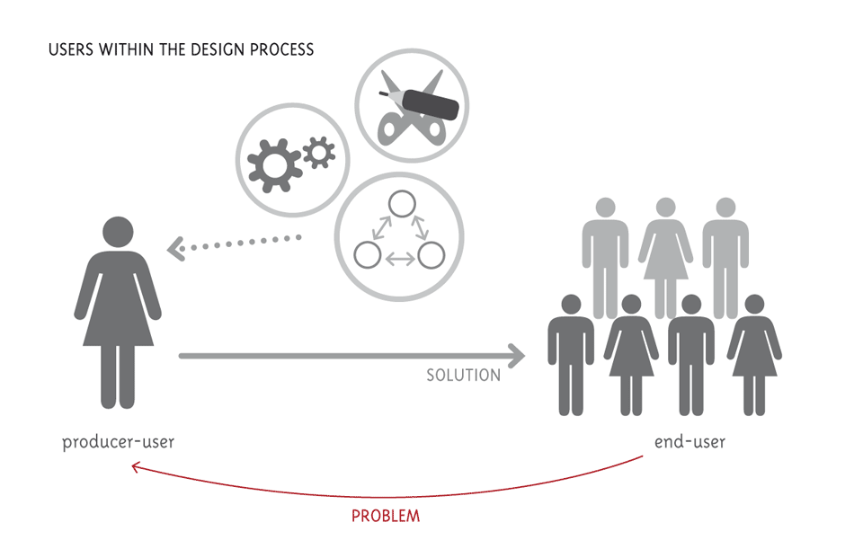

WHO ARE THE END USERS?

Slide 7

OUR SOLUTION AND ITS VALUE PROPOSITION
1. Improved employee satisfaction and retention 2. Enhanced HR strategic decision making 3. Increased operational efficiency 4. Better workforce planning and talent development 5. Competitive advantage in attracting and retaining top talent

Slide 8
Dataset Description
• Employee data set taken from the KAGGLE
• In dataset, out of 26 data I took only 9 features out of it.
• The selected 10 features are listed below:
1. Employee ID
2. First name
3. Last name
4. Business unit
5. Employee type
6. Employee status
7. Employee classification type
8. Gender code
9. Performance score
10. Current employee rating.

Slide 9

THE "WOW" IN OUR SOLUTION
1. *Forecast turnover risk* for individual employees, enabling targeted retention strategies. 2. *Identifies skill gaps* and recommends tailored development plans for growth. 3. *Detects sentiment trends* and suggests actions to boost engagement and satisfaction. 4. *Uncovers hidden talent* and predicts future leaders, enabling proactive succession planning
3/21/2024 Annual Review
9

Slide 10
MODELLING
1. *Turnover Prediction Model*: Identifies employees at risk of leaving. 2. *Performance Prediction Model*: Forecasts employee performance ratings. 3. *Succession Planning Model*: Identifies future leaders and talent gaps. 4. *Diversity and Inclusion Model*: Analyzes representation and equity across the organization. 5. *Employee Engagement Model*: Predicts satisfaction and engagement levels.
10

Slide 11
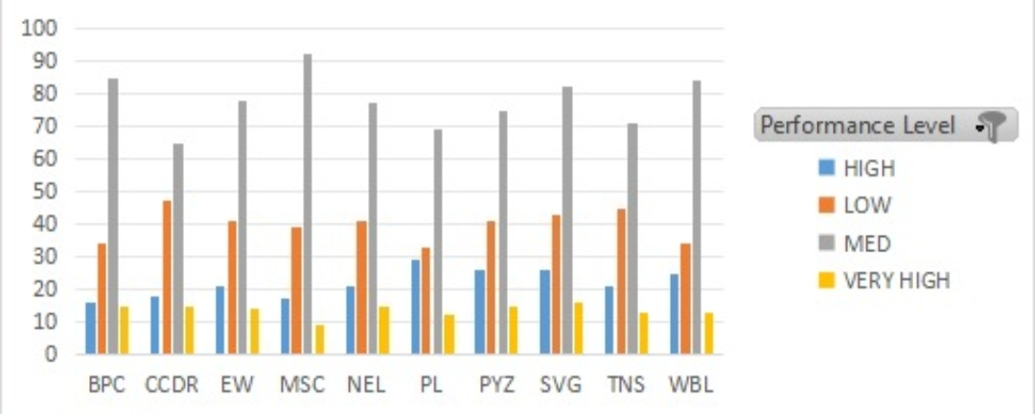
RESULTS
11

Slide 12
conclusion
1. Employee data analysis is critical for understanding workforce dynamics and driving business success.
2. Advanced analytics and machine learning can uncover hidden insights and predict future trends.
3. Data-driven decision making enables HR and business leaders to make informed, strategic choices.
4. Continuous monitoring and analysis of employee data ensures ongoing improvement and adaptation.

