Slide 1
Optimizing Text Summarization with Deep Learning Models and NLP Techniques
CSE 676 Deep Learning Final Project
Divija Ankam (divijaan - 50542158)
Roshini Konjeti(rkonjeti - 50560111)
Vavila S S V S Siri Sudheeksha(svavila2-50560556)

Slide 2
PROJECT DESCRIPTION
The goal of the project is to Achieve automatic text summarizing for large volumes of text/documents and Reduce large texts into brief summaries without losing important information.
Our application helps in summarizing and saving time for users to understand the context. This will help in support for Decision Making in many field ex: Employee performance summarization, food reviews etc.
The main objectives are to improve the text summarizing model performance on particular datasets, increase the correctness and coherence of the generated summary for a textual document, and enable the models to be customized for other kinds of text data.

Slide 3
BACKGROUND
Manual summarization of heavy documentation, articles, scripts, etc., is impractical.
Previous methods in text summarization include traditional NLP techniques and early machine learning models.Recent advancements leverage transformer models like Bart, GPT, and their variations.
Various domains where this is highly necessity include:
News Industry: Daily news articles are summarized to provide users with quick insights.
Healthcare: Patient records for quick review by medical staff and professionals.
Research: Lengthy research papers need a summary for developers to work effectively.

Slide 4
DATASET
The dataset contains the data on daily news. It’s a .tgz file which contains story files.
Each story file is having news data and having its summary at the end of the file.The summary is identified by a delimiter as “@highlight”.
The dataset can be used to train a model to understand news content and generate summary text.

Slide 5
DATA PREPROCESSING
Extraction: Decompressed the .tgz archive to access story files.
Compatibility Check: Ensured GPU compatibility (CUDA) for efficient training.
Reading & Storing: Parsed and stored story content and their respective summaries.
Filtering & Cleaning: Applied data cleaning techniques to improve model performance.
Stopwords Handling: Removed stopwords from articles but retained in highlights.
Vocabulary Creation: Compiled a list of frequently used words to enhance model accuracy.

Slide 6
METHODS
Initial Approach:
Attempted a single GRU-based Seq2Seq model.
Improved Approach:
Switched to pre-trained transformer models due to complexity and performance issues with the single model.
Implemented Models:
1. Model 1: Bert2Bert
2. Model 2: Facebook/bart-base
3. Model 3: Google-t5

Slide 7
MODELS
facebook/bart-base: BART is a transformer model designed by Facebook AI for text production. It combines bidirectional and autoregressive approaches to achieve efficient sequence-to-sequence learning.
Google-t5 : T5 is a flexible model developed by Google Research that treats all NLP tasks as text-to-text challenges. T5 is pre-trained on a wide range of tasks and can be fine-tuned for specific applications such as translation, summarization.
Bert2Bert: Bert2Bert is a transformer model that uses BERT as both an encoder and a decoder. It is designed for text creation jobs and takes advantage of BERT's bidirectional context understanding capabilities. It improves text summarizing by producing logical and context-appropriate summaries.

Slide 8
METHODS
Fine tuning of these models is done by adjusting the parameters in the training arguments method.
We Utilized Trainer and TrainingArguments from Huggingface Transformers.
Defined parameters like Learning rate(5e-5), Batch size per device(2) and Epochs (5). Etc.
Also used Configurations for logging, gradient checkpointing, FP16 optimization, and reporting metrics to Weights and Biases.

Slide 9

RESULTS

Slide 10
Evaluation Metrics Used
ROUGE Score:
Compares n-grams of generated text with reference text
ROUGE-1, ROUGE-2, ROUGE-L (Longest subsequence)
BERT Score:
Uses Contextual embeddings and cosine similarity for precision and recall
Measures semantic similarity between generated and reference text

Slide 11
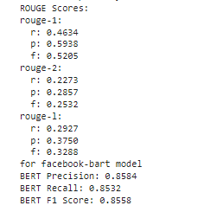
MODEL PERFORMANCES
Facebook/bart-base:
ROUGE Scores: The ROUGE-1 precision (0.5938) is higher than the recall (0.4634). ROUGE-2 scores are moderate, indicating some overlap for bigrams.
BERT Scores: High BERT precision (0.8584) and recall (0.8532), indicating the generated summaries are close in meaning to the reference texts.

Slide 12
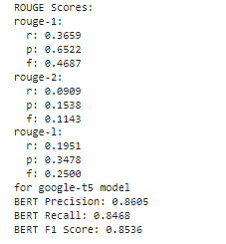
MODEL PERFORMANCES
For Google-T5 Model:
ROUGE Scores: The ROUGE-1 precision is high (0.6522), but the recall is a bit moderate (0.3659). ROUGE-2 scores are low, indicating less overlap for bigrams.
BERT Scores: High BERT precision (0.8605) and good recall (0.8468), Indicating that the summaries are very close in meaning to reference texts

Slide 13
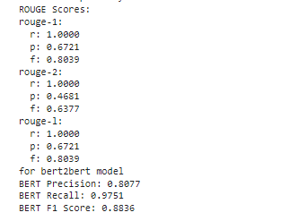
MODEL PERFORMANCES
Bert2Bert:
ROUGE Scores: Perfect recall and high precision for ROUGE-1 and ROUGE-L, but lower precision for ROUGE-2.
BERT Scores: High precision (0.8077) and very high recall (0.9751), indicating excellent content overlap with reference summaries.

Slide 14
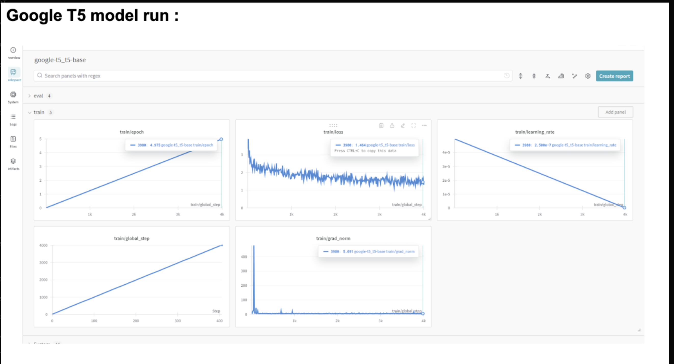
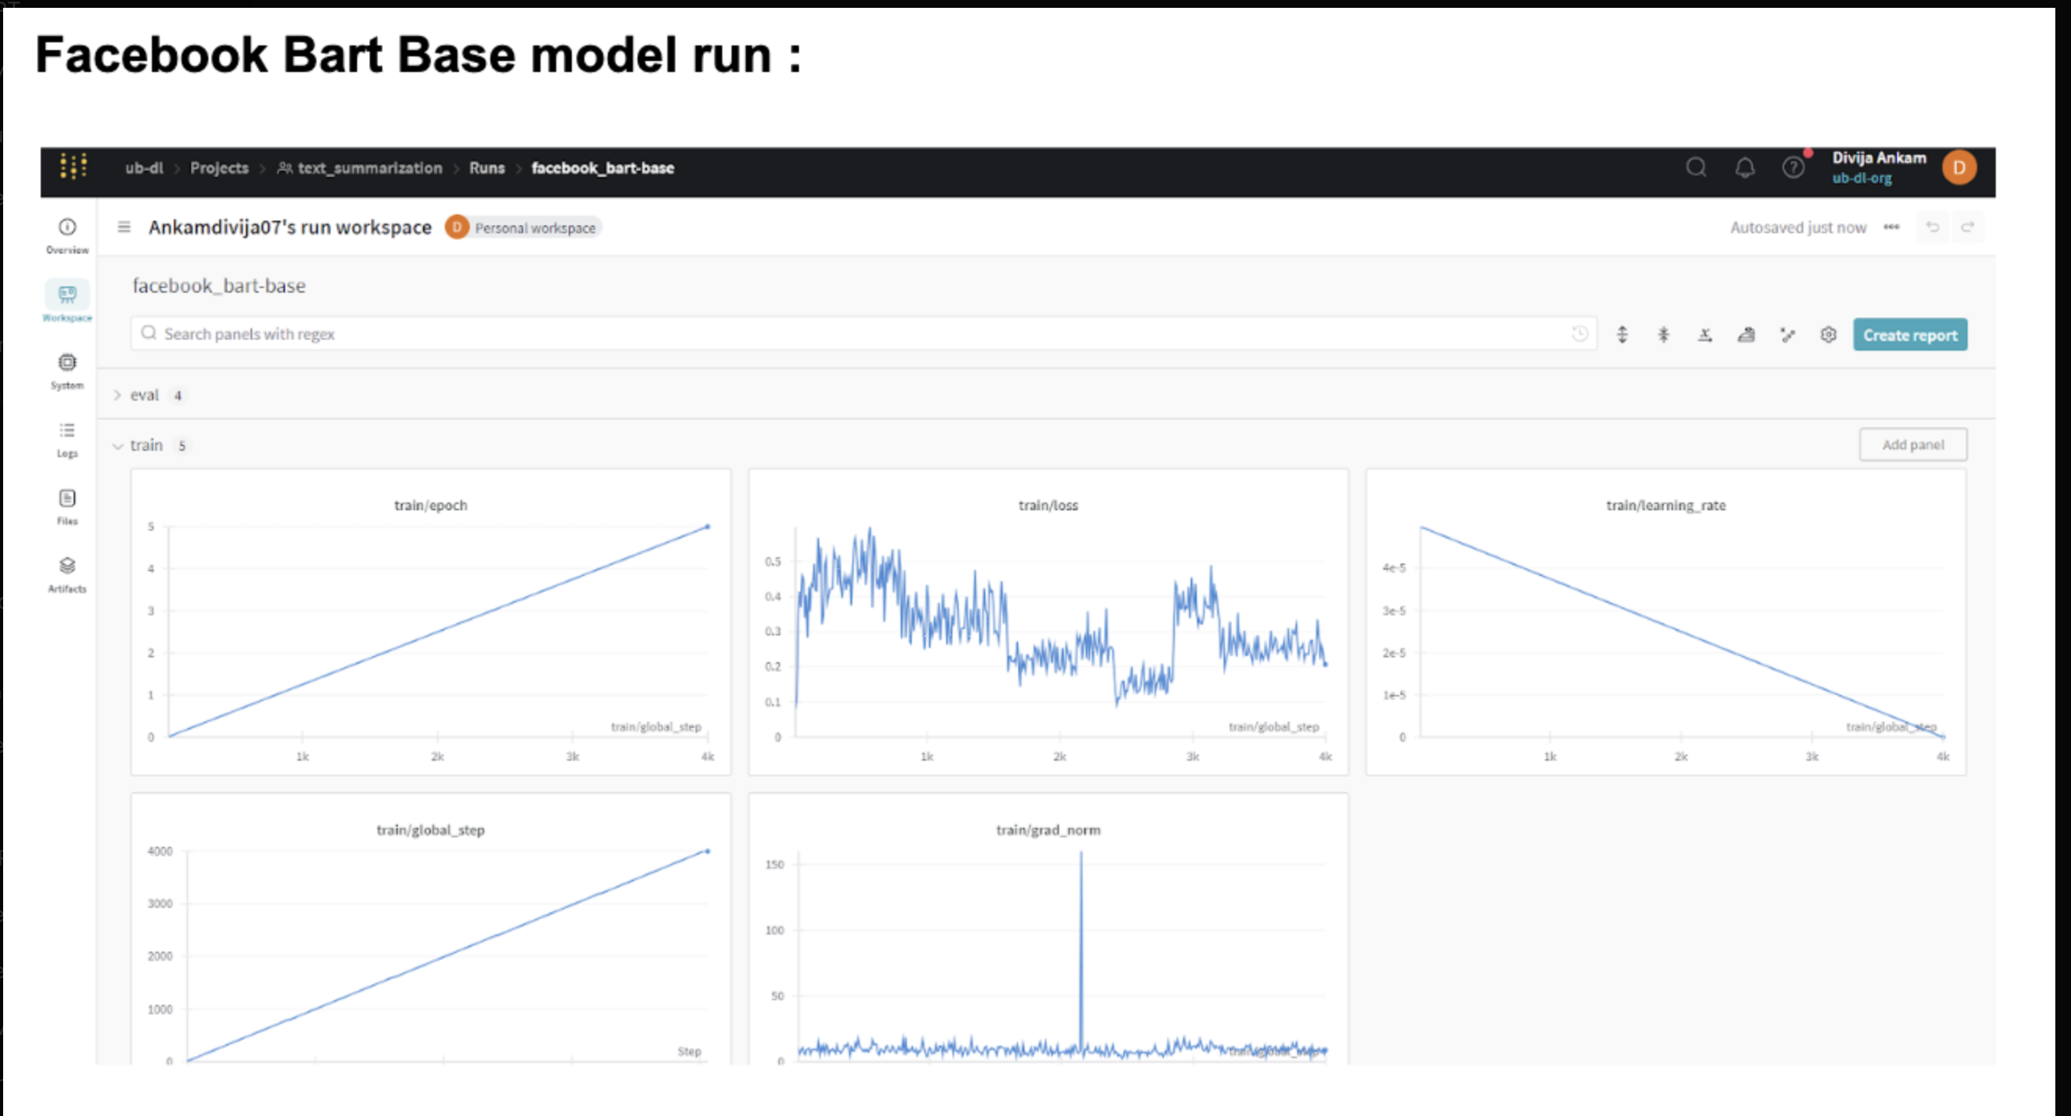
AI TOOL INTEGRATION
We have utilized AI tool for our project : link

Slide 15
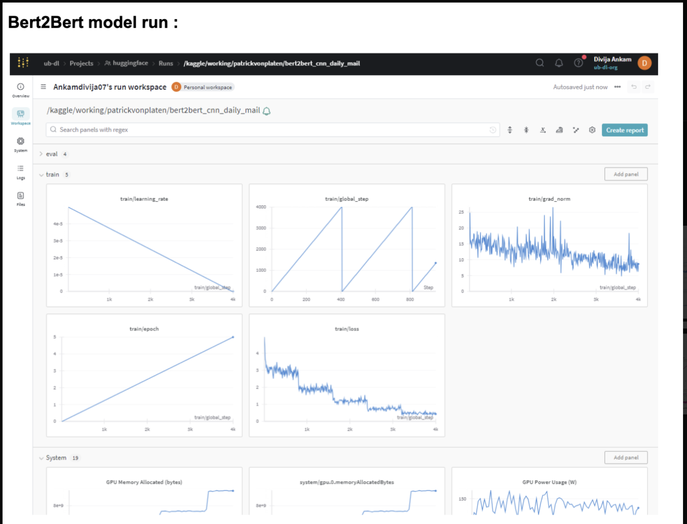
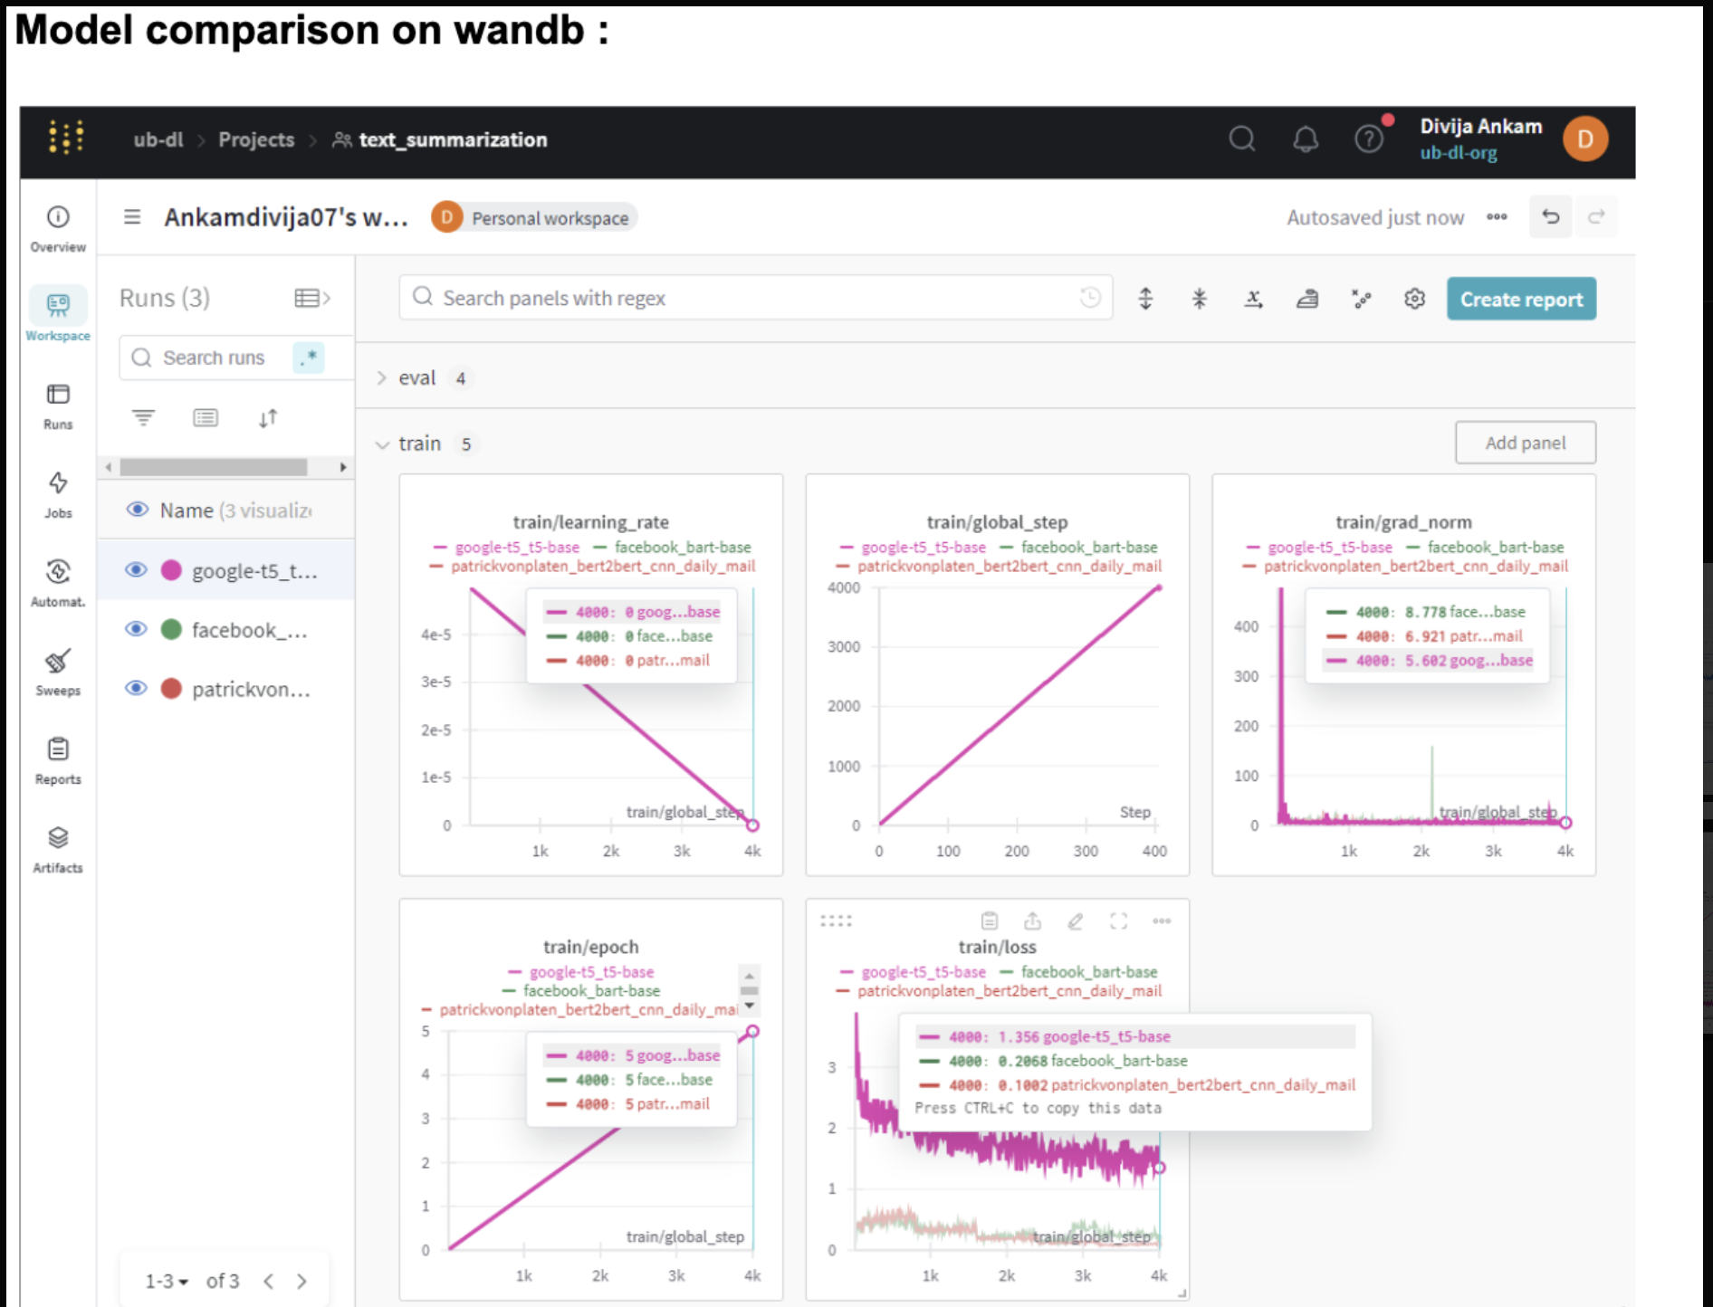
AI TOOL INTEGRATION

Slide 16
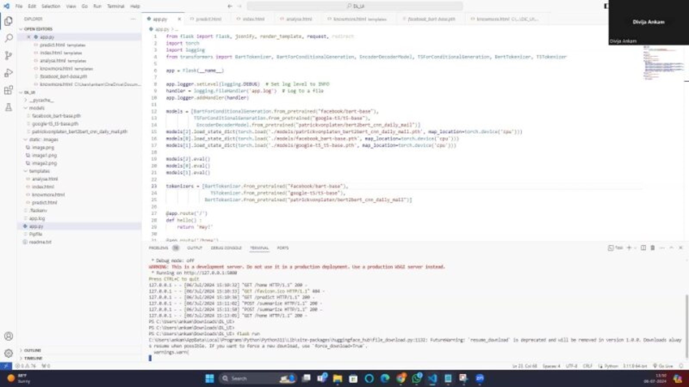
DEMO

Slide 17
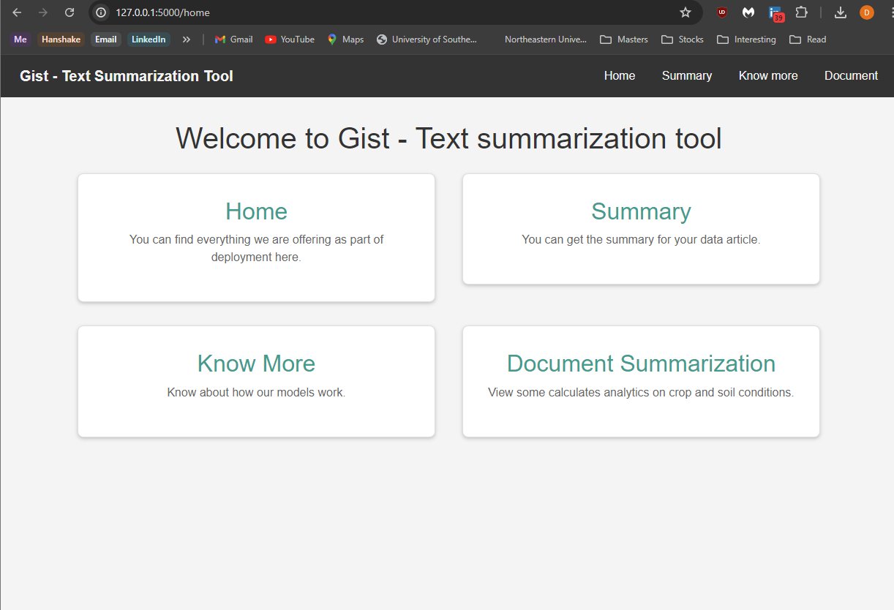
DEPLOYMENT
We deployed our model with a user interface as below

Slide 18
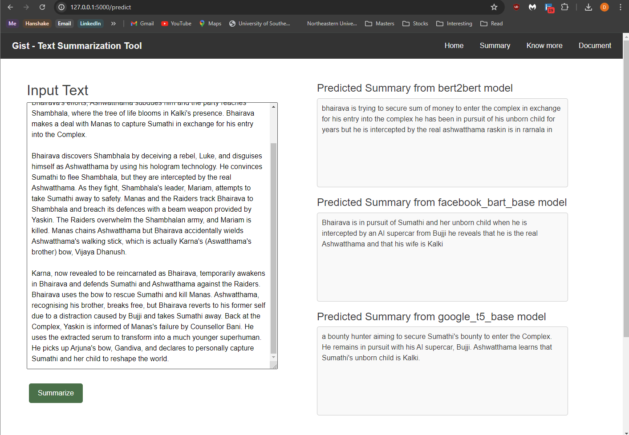
Summarization Screen

Slide 19
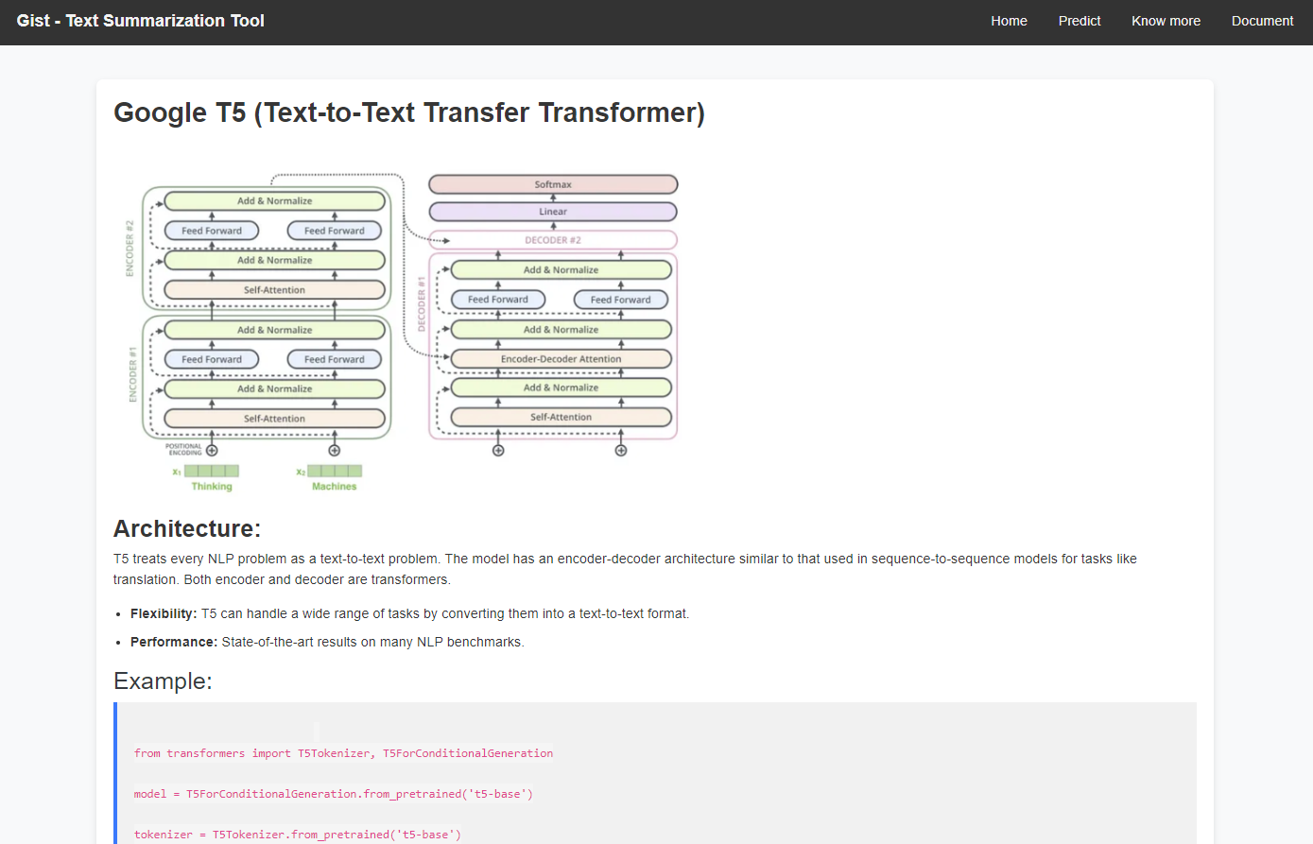
Model Description Screen

Slide 20
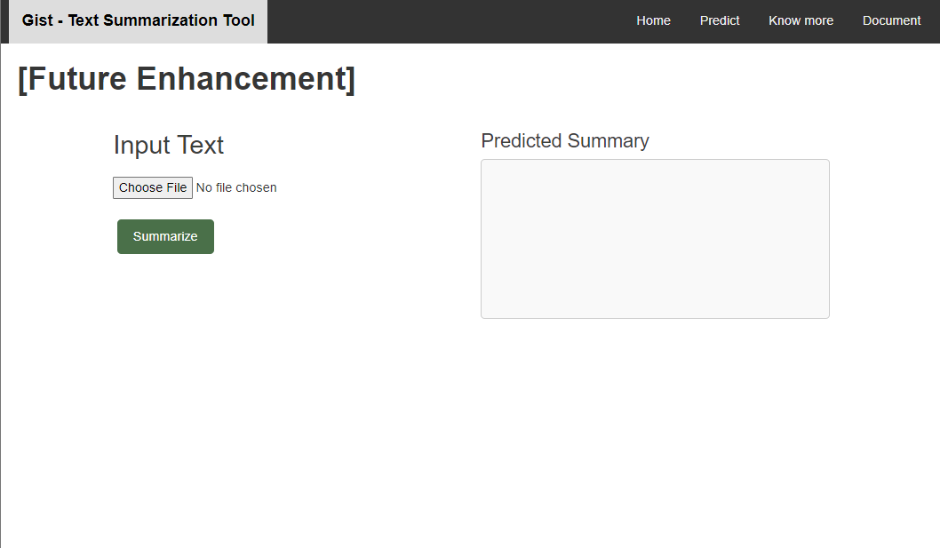
Future Enhancements Screen

Slide 21
OBSERVATIONS
Bert2Bert model and facebook bart model are trained well and quicker than compared to Google t5 model
Training loss are decreased over the epochs
Google t5 model is slowly trained but shows significant improvement over the epochs

Slide 22
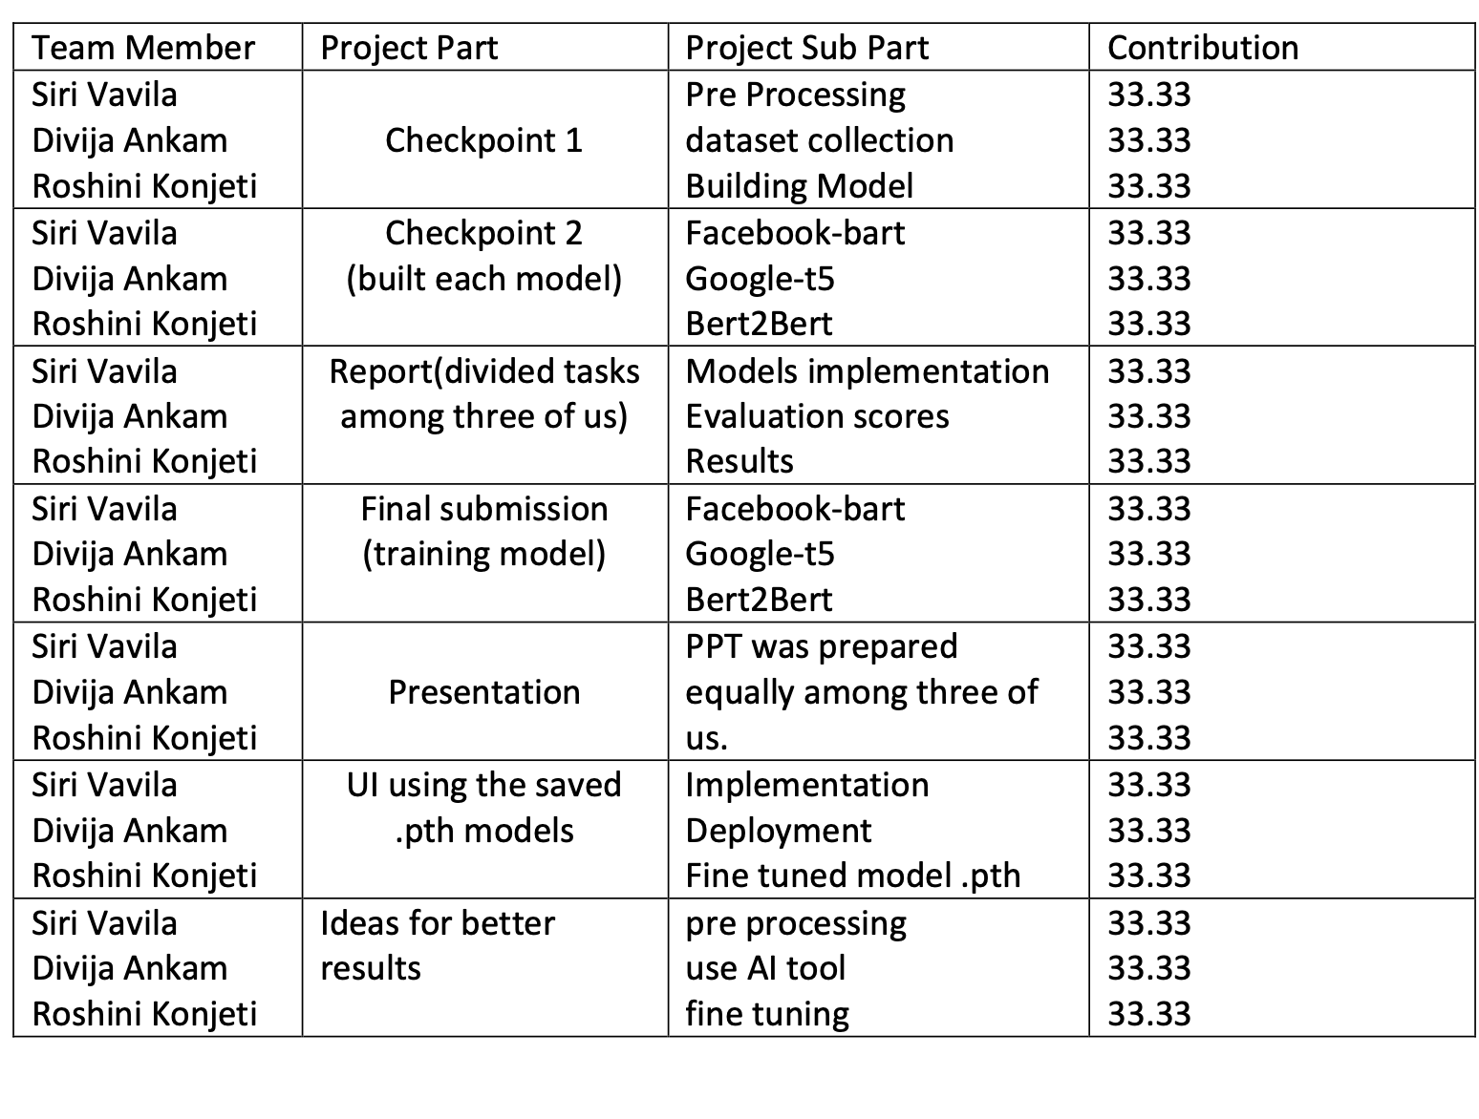
TEAM CONTRIBUTION

Slide 23

Thank You

