Slide 1
Hack the Future:
A Gen AI Sprint Powered by Data

Slide 2



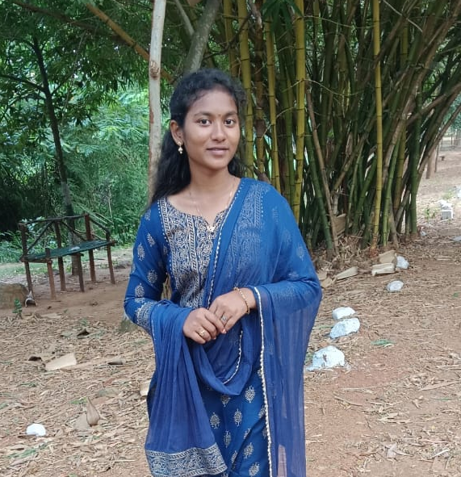
Hack the Future: A Gen AI Sprint Powered by Data
Data and AI Week
Team details
TEAM NAME: Neural Ninjas
Roshini(Team Leader)
Roshini
Photo

Slide 3
Entry Submission Summary
Idea Title (Provide a concise and impactful title for your idea.) | TalentMatch AI: Smart Resume Suitability Prediction
Team Name | Neural Ninjas
Problem Statement | "Develop an AI model that predicts candidate-job fit by analyzing resumes based on skills, experience, and education.".
Proposed Solution | We will build an AI-based Resume Screening System that: Extracts key features (skills, experience, education) from CVs. Uses BERT embeddings to capture the meaning of resumes. Trains a Machine Learning model to predict candidate suitability (Suitable / Not Suitable).Deploys a Streamlit app where recruiters can upload CVs and get instant predictions.Optimizes for high accuracy and fast, explainable results. This will accelerate hiring decisions and improve matching accuracy using AI.

Slide 4
Problem statement you are trying to address
"Manual resume screening is slow and subjective. We aim to automate and optimize candidate shortlisting using AI for faster and fairer hiring."
Recruiters and hiring managers often spend a significant amount of time manually screening resumes to identify candidates suitable for a given job role.
This process is time-consuming, subjective, and prone to human biases.
The problem we aim to address is:
How can we leverage AI to automatically analyze candidate CVs and accurately predict their suitability for a job based on skills, experience, education, and other relevant factors?
We aim to build an intelligent, efficient, and unbiased solution that enhances the recruitment process by making resume shortlisting faster, smarter, and fair

Slide 5
Proposed Solution Overview
Brief approach description or methodology used to tackle the problem
We propose developing an AI-driven resume screening system that predicts candidate suitability for a specific job role.
Our approach includes:
Data Preprocessing: Extracting important features such as skills, education, and experience from CVs.
Feature Representation: Using BERT embeddings to capture the semantic meaning of candidate profiles.
Model Training: Building a Machine Learning classifier (e.g., XGBoost, Random Forest) to predict suitability based on extracted features.
Model Evaluation: Measuring performance using metrics like Accuracy, Precision, Recall, and F1-Score.
Deployment: Creating an interactive Streamlit web app where recruiters can upload resumes and receive instant suitability predictions.
This system will accelerate hiring decisions, reduce manual effort, and improve matching accuracy using the power of AI.

Slide 6
Technologies Used
List the key technologies, frameworks, and tools you utilized in your solution
Python – Core programming language for data processing and model building
Pandas, NumPy – For data cleaning, manipulation, and feature engineering
Transformers (Hugging Face) – For using BERT-based embeddings to understand CV content
Scikit-learn – For building and evaluating Machine Learning models (classification)
XGBoost / Random Forest – For advanced model training and optimization
Streamlit – To build and deploy an interactive web application for recruiters
NLTK / SpaCy – For natural language processing and text extraction tasks
Matplotlib, Seaborn – For data visualization and insights during EDA (Exploratory Data Analysis)
Pickle / Joblib – For saving and loading trained models efficiently

Slide 7
Agents' interaction design
User Uploads CV ➔ Preprocessing Agent ➔ BERT Embedding Agent ➔ Prediction Agent ➔ Output Agent ➔ User Sees Results
"Users upload CVs ➔ Agents preprocess, extract features with BERT, predict suitability, and display insights on a web app."
In our solution, different agents (components/modules) interact in a streamlined workflow:
User Agent (Recruiter)
Uploads the candidate's CV through the Streamlit Web App interface.
2. Preprocessing Agent
Cleans and processes the uploaded CV (e.g., removing noise, extracting key features like skills, education, and experience).
3. Feature Extraction Agent
Uses BERT embeddings to capture the semantic meaning of the CV text.
Generates structured data for the machine learning model.
4. Prediction Agent
Passes the extracted features to the trained ML Classification Model (e.g., XGBoost / Random Forest).
Predicts the candidate’s suitability score or label (Suitable / Not Suitable).
5. Explanation Agent (Optional but powerful)
Provides reasoning or highlights key factors influencing the decision (e.g., skill match percentage, experience level).
6. Output Agent
Displays the prediction and additional insights (e.g., top matched skills, gaps) back to the user via the web app.

Slide 8
resume_screening_ai/
│
├── app.py # Main Streamlit app
│
├── models/
│ ├── model.pkl # Trained ML model (saved after training)
│ ├── bert_embeddings/ # BERT models or extracted features (optional cache)
│
├── src/
│ ├── preprocessing.py # Functions for CV text cleaning and feature extraction
│ ├── embedding.py # Code for generating BERT embeddings
│ ├── model_training.py # Script to train and evaluate ML models
│ ├── utils.py # Helper functions (e.g., file handling, visualization)
│
├── data/
│ ├── raw/ # Raw CV dataset (original)
│ ├── processed/ # Cleaned and processed data
│
├── requirements.txt # List of all Python packages
│
├── README.md # Project overview, how to run, instructions
│
└── slides/ # Presentation deck, images, charts
Code structure

Slide 9
Demo video

Slide 10
Conclusion
Summarize the impact and effectiveness of your solution. Reiterate how it solves the problem statement.

Slide 11
References/Other details

Slide 12

Thank You

