Slide 1




Anudip
Home
About
Contact
FITNESS TRACKER
DASHBOARD
Track Your Fitness
ROSHINI.S
9342666413
roshinir989@gmail.com
START SLIDE
01

Slide 2
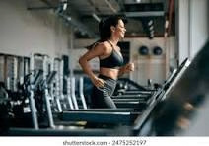
INTRODUCTION
A Fitness Tracker Dashboard is a data visualization tool used to monitor and analyze daily fitness activities. It provides useful information about steps, calories burned, workout duration, sleep, heart rate, water intake, and stress levels. The dashboard helps users understand their fitness patterns and track their progress toward their fitness goals.

Slide 3
DATASET OVERVIEW
. User Details: User_ID, Date, Age, Gender
. Activity: Daily_Steps, Active_Minutes, Distance_KM
. Health: Calories_Burned, Heart_Rate_Avg, Sleep_Hours
. Workout: Workout_Type, Workout_Duration_Min
. Lifestyle: Water_Intake_L, Stress_Level
. Goal: Fitness_Goal

Slide 4
KPI OVERVIEW
AVG CALORIES BURNED
2153.508
USERS TRACKED
2500
TOTAL DISTANCE
15,658.2 KM
AVG HEART RATE
74.46
AVG WORKOUT
56.49 min

Slide 5
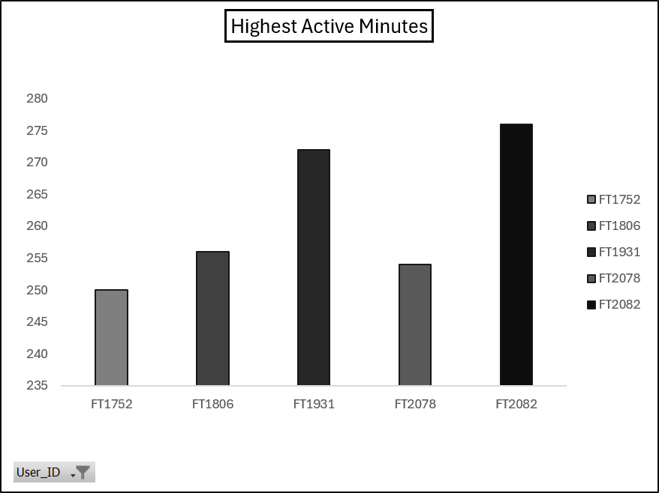
1.ACTIVE MINUTES BY USER
Which users have the highest total active minutes?
  FT1752 – 250 minutes
  FT1806 – 256 minutes
  FT1931 – 272 minutes
  FT2078 – 254 minutes
  FT2082 – 276 minutes
  Key Finding:
FT2082 has the highest active minutes with 276 minutes

Slide 6
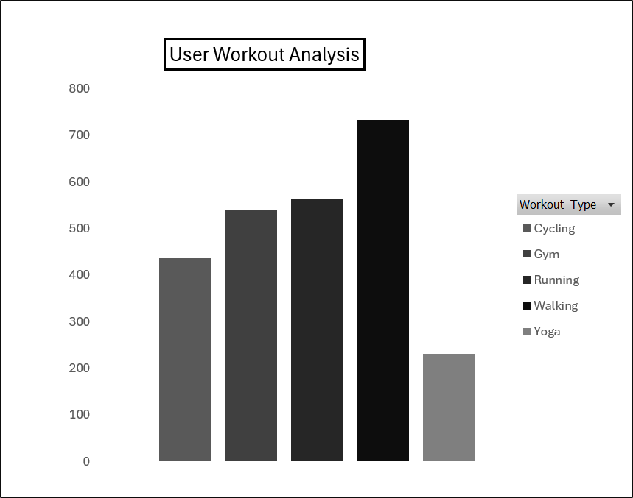
2.WHICH WORKOUT IS MOST PREFERRED BY USER
Workout TypeCount :
  Cycling - [436]
  Gym - [538]
  Running - [562]
  Walking - [733]
  Yoga - [231]
  Key Finding:
Walking is the most preferred workout type with 733 records.

Slide 7
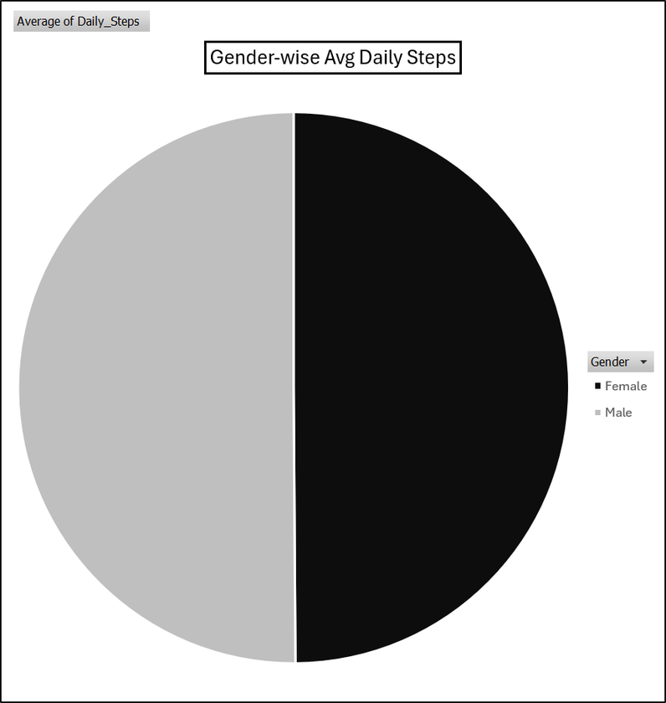
3.WHAT IS THE AVERAGE NUMBER OF DAILY STEPS BY GENDER
GenderAverage Daily Steps
  Female - [8,120.4]
  Male - [8,154.2]
  Overall - [8,136.0612]
  Key Finding :
Male users have a slightly higher average daily step count than female users.

Slide 8
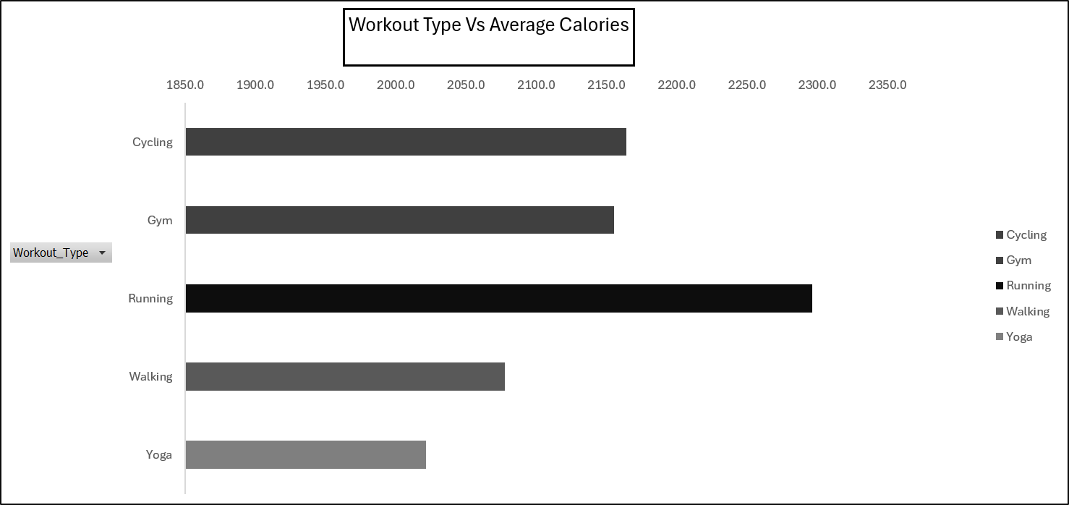
4.WHICH WORKOUT TYPE HAS HIGHEST AVERAGE CALORIES BURNED
Workout TypeAverage Calories :
  Cycling - [2,164.1]
  Gym - [2,155.4]
  Running - [2,296.5]
  Walking - [2,077.7]
  Yoga - [2,021.5]
  Key Finding :
Running has the highest average calories burned at 2,296.5 calories.

Slide 9
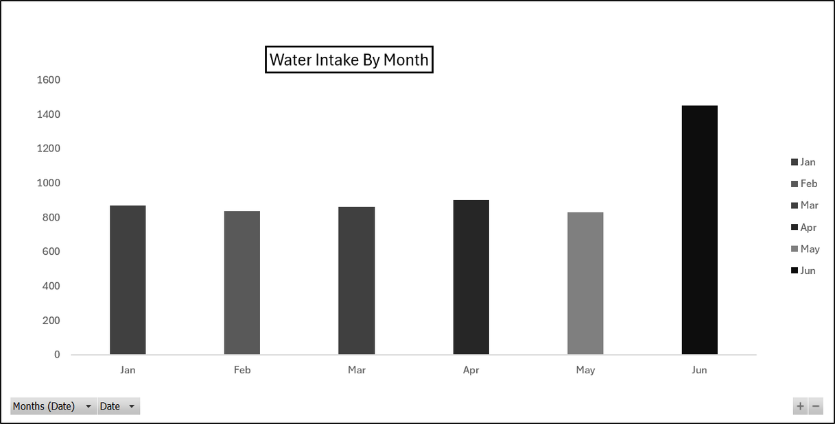
5.WHICH MONTH HAS THE HIGHEST TOTAL WATER INTAKE
MonthWater Intake :
  January - [867.7 L]
  February - [834.7 L]
  March - [860.5 L]
  April - [901.3 L]
  May - [827.6 L]
  June - [1,451 L]
  Key Finding
June has the highest total water intake with 1,451 L.

Slide 10
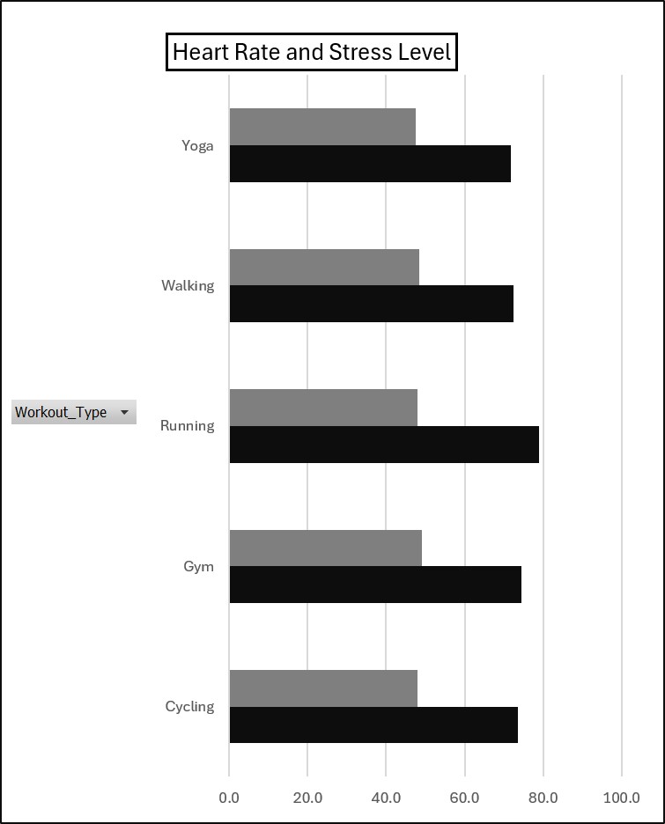
6.HOW DO AVERAGE HEART RATE AND STRESS LEVEL VARY ACROSS WORKOUT TYPES
WorkoutAvg. Heart RateAvg. Stress :
  Cycling [73.5] [47.9]
  Gym [74.5] [49.1]
  Running [78.9] [48.1]
  Walking [72.5] [48.4]
  Yoga [71.8] [47.6]
Key Finding:
  Running has the highest average heart rate: 78.9
  Gym has the highest average stress level: 49.1
  Yoga has the lowest average stress level: 47.6

Slide 11
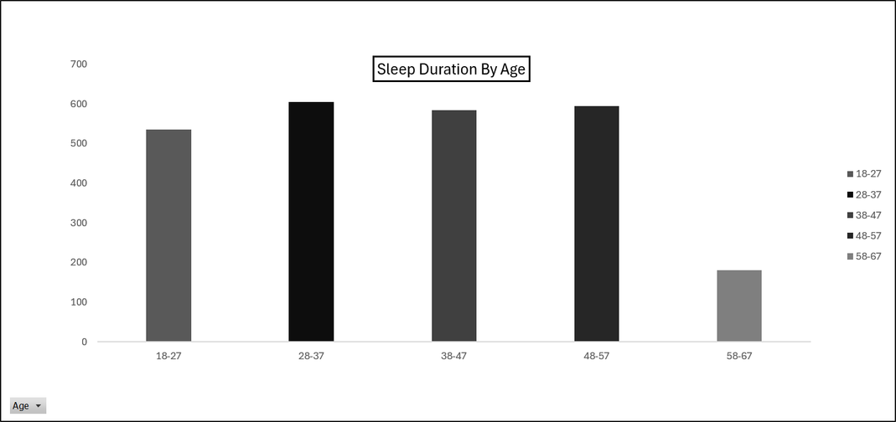
7.HOW IS THE NUMBER OF USERS DISTRIBUTED ACROSS DIFFERENT AGE GROUPS BASED ON SLEEP DATA
Age GroupCount:
  18–27 - [536]
  28–37 - [605]
  38–47 - [584]
  48–57 - [595]
  58–67 - [180]
Key Finding:
The 28–37 age group has the highest count with 605 records.

Slide 12
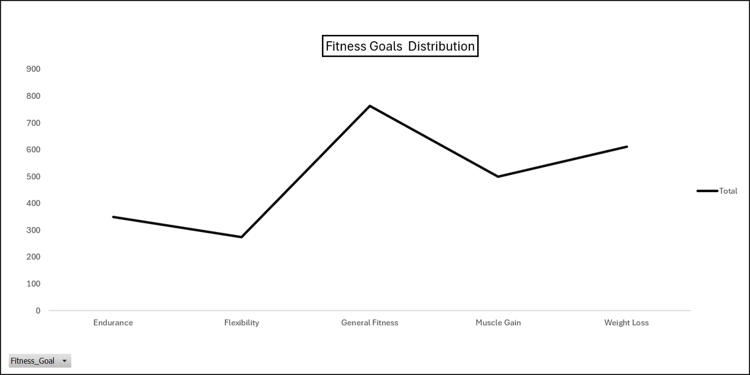
8.WHAT ARE THE MOST COMMON FITNESS GOALS AMONG USERS
Fitness GoalCount :
  Endurance - [350]
  Flexibility - [274]
  General Fitness - [764]
  Muscle Gain - [500]
  Weight Loss - [612]
Key Finding :
General Fitness is the most common fitness goal with 764 records.

Slide 13

OVERALL KEY INSIGHTS
Key Insights :
  Walking is the most preferred workout type.
  Running has the highest average calorie burn.
  FT2082 has the highest active minutes among the selected users.
  June has the highest total water intake.
  General Fitness is the most common fitness goal.
  Running has the highest average heart rate.
  The 28–37 age group has the highest number of records.

Slide 14

CONCLUSIONS
  The Fitness Tracker dashboard provides a clear view of fitness and wellness patterns.
  KPIs give a quick summary of overall performance.
  Pivot tables and charts help compare workouts, users, gender, age groups, months and fitness goals.
  The analysis helps identify important patterns in activity, health and lifestyle

