Slide 1
EMPLOYEE DATA ANALYSIS USING EXCEL
STUDENT NAME: ROSHINI. R.P
REGISTER NO:312204615, C50A333A0AC4E4B939A42CD1A849FD9E
DEPARTMENT: COMMERCE
COLLEGE: K.C.S.KASI NADAR COLLEGE OF ARTS & SCIENCE

Slide 2
PROJECT TITLE
Employee management

Slide 3


AGENDA
Problem Statement
Project Overview
End Users
Our Solution and Proposition
Dataset Description
Modelling Approach
Results and Discussion
Conclusion
3/21/2024 Annual Review

Slide 4
PROBLEM STATEMENT
The goal is to develop an improved employee management solution that addresses these challenges by automating routine tasks, enhancing data accuracy, and providing actionable insights to support strategic HR decisions

Slide 5
PROJECT OVERVIEW
The below given tools are used to analyse and help the organisation to manage employee data , HR processes and improve overall efficiency.
Tables
Slicers
Pivot chart ( line chart , bar chart , pie chart )

Slide 6

WHO ARE THE END USERS?
HR Managers
HR Assistant
Department Manager
Finance Staff
Employees
Executives

Slide 7
OUR SOLUTION AND ITS VALUE PROPOSITION
Accessibility
Ease of use
Data Integration
Scenario Analysis
Formulas and Functions
Pivot Table

Slide 8
DATASET DESCRIPTION
DATA OVERVIEW
An overview of a dataset for employee management typically includes various features that capture essential details about the employees, their roles, and their interactions within an organization.
DATA FIELDS
Employee ID
Full name
Department
Designation
Hire date
Annual salary

Slide 9
MODELLING
Data cleaning.
Creating table.
Creating pivot chart.
Creating dashboard.
Inserting pivot chart in dashboard.
Inserting formulas in dash board to make interaction.
Creating interactive dashboard by putting all together elements
9

Slide 10
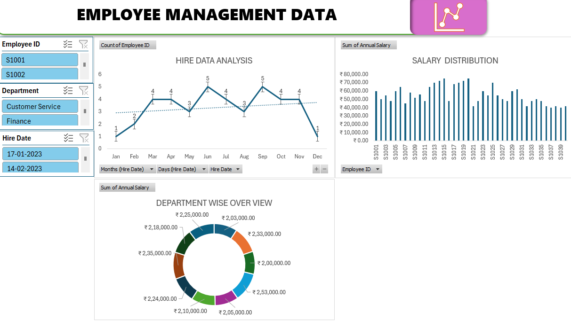
RESULTS
(Click to open file)
10

Slide 11
CONCLUSION
In conclusion, effective employee management is essential for the success and growth of any organization. It involves creating a positive work environment, fostering clear communication, providing opportunities for development, and recognizing and rewarding performance. By focusing on these aspects, managers can enhance employee engagement, productivity, and retention. Ultimately, well-managed employees are more likely to be motivated, satisfied, and aligned with the organization's goals, leading to a thriving workplace and sustainable business success.

