Slide 1
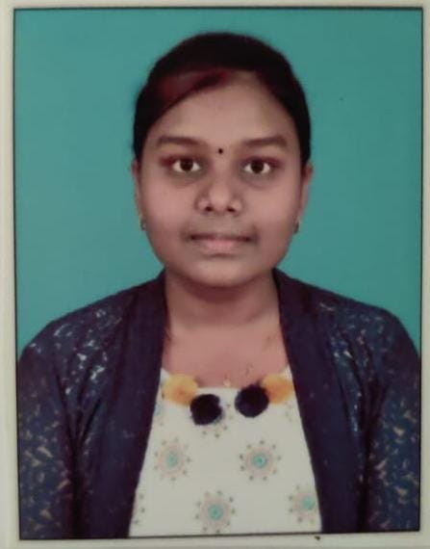
Student Details
Name: BUNGA ROSHINI
SkillsBuild Email ID: 20b01a0420@svecw.edu.in
College Name: Shri Vishnu Engineering College for Women, Bhimavaram, Andhra Pradesh
Internship Domain, Internship Start and End Date: Data Analytics (12 Jun 2023 - 16 Jul 2023)
AICTE Student ID: STU61d14f25d5f5a1641107237

Slide 2
PROJECT TITLE/Problem Statement
CASE STUDY: ANALYSIS OF SUPERSTORE

Slide 3
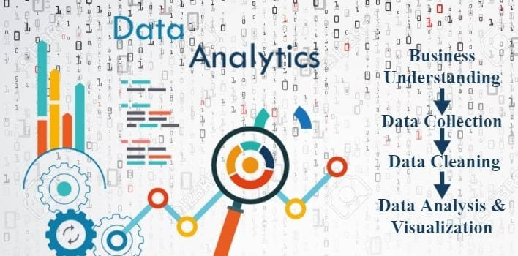
AGENDA
To find out various supermarket statistics such as:
Sales analysis based on region such as
Region, Profit etc.
To check which state has more profit.
To compare between the sales and state.
Statistical description of data.
Product type that was ordered many times.
Percentage sales by category.

Slide 4
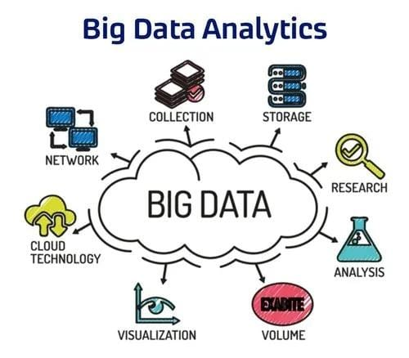
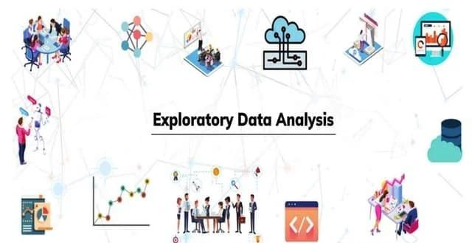
PROJECT OVERVIEW
The goal of this project is to analyze the Superstore dataset and identify insights that can help the company improve its business performance. Specifically, we aim to answer questions such as: which product categories are the most profitable? Which regions have the highest sales and profit? What are the most profitable products?
To begin our analysis, we need to gather the data from a reliable source and downloaded the Superstore dataset from Kaggle, which is a free and open-source platform for data analysis. After downloading the dataset, inspected it to identify any missing or inconsistent data and also cleaned the data by removing any duplicates, filling in missing values, and correcting any errors.
After cleaning the data, performed EDA by using Google Collab and started visualizing the data to identify trends and patterns, used various statistical techniques to understand the data and formulated hypotheses to test. Also used charts and graphs to help us visualize the data and identify any outliers or anomalies.
Based on our EDA, formulated hypotheses to test and formulated five hypotheses that thought could help to understand the data and identify insights that can help the company improve its business performance.

Slide 5
WHO ARE THE END USERS
1. Operations Team: The operations team can utilize the project's recommendations to streamline processes, improve inventory management, and optimize supply chain operations. They can identify areas of improvement based on the analysis of product categories, profitability, and customer satisfaction.
2. Finance Team: The finance team can benefit from the project's analysis of profitability and cost factors. The insights can help them identify cost-saving opportunities, evaluate the impact of discounts and shipping costs, and optimize pricing strategies.
3. Data Analysts/Scientists: Data analysts or data scientists within the organization can use the project as a reference for similar analyses and as a benchmark for future data-driven projects. They can also contribute their expertise in analyzing the dataset and extracting insights.

Slide 6
4. Management Team: The project's analysis and insights are primarily aimed at the management team of Sample Superstore. They are the key decision-makers who will utilize the findings to make strategic decisions and implement changes to improve the company's operations, sales, and profitability.
5. Business Analysts: Business analysts within Sample Superstore may use the project results to gain a deeper understanding of customer behavior, product performance, and sales trends. They can further analyze the insights and incorporate them into their reports and recommendations.
6. Marketing Team: The marketing team can benefit from the project's findings to develop targeted marketing strategies based on customer segmentation and preferences. The analysis can help them identify potential customer segments to focus on and tailor marketing campaigns accordingly.
7. Sales Team: The sales team can leverage the project's insights to optimize their sales approach. By understanding sales trends, product performance, and customer behavior, they can adapt their sales strategies to better meet customer demands and increase sales revenue.

Slide 7
YOUR SOLUTION AND ITS VALUE PROPOSITION
  The solution for the Analysis of Sample Superstore Dataset project involves applying advanced data analytics techniques to gain valuable insights from the provided dataset. By conducting comprehensive data exploration, cleaning, and analysis, we aim to uncover patterns, trends, and relationships within the data. The project includes customer segmentation, sales analysis, profitability analysis, and customer behavior analysis, among other key components and also made some recommendations that can help the company improve its business performance. Also suggested that the company should prioritize the development and promotion of technology products, while reducing the production and marketing of products with lower profit margins.
Value Proposition:
Competitive Advantage: By leveraging data analytics techniques, Sample Superstore gains a competitive edge in the retail industry. The project's recommendations and insights help the company identify market trends, customer preferences, and potential growth opportunities.
Actionable Insights: Our analysis provides actionable insights to the management team of Sample Superstore, enabling them to make data-driven decisions. The findings help identify areas of improvement, optimize operations, and enhance profitability.

Slide 8
Enhanced Decision-Making: Our project equips business analysts and stakeholders with a comprehensive understanding of the dataset, enabling them to make informed decisions. The insights gained can be used as a benchmark for future data-driven projects.
Cost Optimization: Our profitability analysis highlights the most and least profitable products and identifies factors impacting profitability. This empowers the management team to optimize pricing, manage discounts, and streamline operations for cost savings.
Streamlined Operations: The analysis provides valuable insights for the operations team, facilitating optimized inventory management, supply chain operations, and overall operational efficiency.
Scalability and Adaptability: Our solution can be scaled and adapted to accommodate additional datasets, variables, and analysis requirements, allowing Sample Superstore to leverage data analytics for ongoing improvement and growth.

Slide 9
How did you customize the project and make it your own
1. Personalized Project Objectives: Firstly, I would start working on the initial project objectives and consider any other goals or specific areas of focus that align with my expertise or interests.
2. Tailored Analysis Techniques: While the project might include suggested analysis techniques, I would bring in my knowledge of advanced analytics methods or specialized statistical models that could provide deeper insights. This could involve incorporating predictive modeling, time series analysis, or sentiment analysis to enhance the project's value and generate more accurate predictions or actionable recommendations.
3. Creative Data Visualization: To present the analysis findings in a visually appealing and easily understandable manner, Visualizing data using creative charts and graphs can help you spot new insights, carry out high-level analyses and communicate new findings clearly. This could involve using interactive dashboards, storytelling techniques, or infographics to engage stakeholders and convey the insights effectively.

Slide 10
4. Domain-specific Insights: This technology that harvests and harmonizes millions of Web pages to extract key elements of knowledge (e.g., entities and relations). It integrates corporate databases with the extracted data across sources and modalities encoding implicit and purposefully obfuscated relationships. It offers a faceted content search interface and visualizations to support analysis. Drawing from my domain knowledge or prior experience, I would provide context-specific insights that go beyond the basic analysis
5. Real-world Implementation Strategies: While recommendations are a crucial part of the project, I would ensure they are practical and actionable. This could involve providing specific implementation strategies, such as launching loyalty programs, optimizing pricing structures, or improving inventory management, to support the management team in implementing the recommended changes.
6. Reflecting Personal Style: I would infuse my personal style into the project by using clear and concise language, incorporating effective storytelling techniques, and presenting the analysis results in a visually appealing and engaging format. This makes the project more attractive and effective manner.

Slide 11
MODELLING
1. Customer Segmentation Modeling: Use clustering algorithms such as K-means, hierarchical clustering, or DBSCAN to segment customers based on their attributes, behavior, or purchasing patterns. This modeling technique helps identify distinct customer groups and understand their unique characteristics.
2. Predictive Modeling: Build predictive models to forecast sales, demand, or customer behavior. Techniques such as regression analysis, time series analysis, or machine learning algorithms like linear regression, random forests, or gradient boosting can be applied to predict future outcomes based on historical data.
3. Market Basket Analysis: Utilize association rule mining techniques like Apriori or FP-Growth to identify frequent item-sets and uncover relationships between products frequently purchased together. This modeling approach can help in cross-selling or product recommendation strategies.
4. Churn Prediction Modeling: Develop models to predict customer churn or attrition. Employ classification algorithms like logistic regression, decision trees, or support vector machines to identify factors that contribute to customer churn and create targeted retention strategies.
5. Optimization Modeling: Use mathematical optimization techniques like linear programming, integer programming, or network optimization to optimize inventory levels, pricing strategies, or supply chain operations. This modeling approach can help in maximizing profits or minimizing costs.

Slide 12
Results
Recommendations and Insights:
Proposed strategies for targeted marketing campaigns, product promotions, or customer retention initiatives. Highlighted potential areas for process optimization, inventory management, or supply chain efficiency improvements and also found that technology-based products have the highest profit margin compared to other products.
Sales Analysis Results:
Identified sales trends over time (monthly, quarterly, yearly).Explored correlations between sales and factors like region, customer segment, or product attributes. Predicted the performance of the product categories and identified the top selling products.
Profitability Analysis Results:
Calculated profit margins for different products and product categories to identify the most profitable and least profitable items. Analyzed the impact of discounts, shipping costs, or other factors on profitability and also found that the company’s profit is observed to be higher on weekdays than on weekends. Additionally, sales tend to increase in specific months of the year.
Customer Segmentation Results:
Identified distinct customer segments based on demographics, purchasing behavior, or geographic location. Analyzed the characteristics and preferences of each segment, such as high-value customers, frequent purchasers, or price-sensitive customers.
Customer Behavior Analysis Results:
Analyzed customer purchasing patterns, such as frequency, recency, and monetary value, to understand customer loyalty and lifetime value and noticed some of the factors influencing customer churn and developed strategies for customer retention. Explored cross-selling and upselling opportunities based on market basket analysis and product association.

Slide 13
links
Github Link: https://github.com/Roshini999/IBM_Internship.git
Drive Link: https://drive.google.com/drive/folders/1tHRG2pOISI-UY7yFA9jQ3FNrKlCt8VGi?usp=sharing
Google Colab Link: https://colab.research.google.com/drive/1TRIfa8dJDF2YKEaKqJdvzRNK6YcCvAs1?usp=sharing

Slide 14
THANK YOU

