Slide 1



EXPLORING INDIAN ROAD ACCIDENT DATA TO IMPROVE SAFETY
KONGU ENGINEERING COLLEGE
PERUNDURAI ERODE-638060
DEPARTMENT OF AI
PROJECT GUIDE
Dr.C.S.Kanimozhi selvi
PROJECT MEMBER
Pradeepa S-22ALR065
Roshini G-22ALR082
Yoganath M-22ALR116

Slide 2
PROBLEM STATEMENT
India faces a significant number of road accidents annually.
A considerable number of these accidents occur near schools, hospitals, and heavily trafficked areas.
The underlying causes of these accidents are not fully understood.
Young drivers and pedestrians are particularly vulnerable to these incidents.
Weather conditions also play a role in influencing accident rates.
Policymakers find it challenging to develop effective safety measures.
There is a pressing need for enhanced data analysis to improve road safety and reduce the incidence of accidents.

Slide 3
OBJECTIVE
To conduct a comprehensive analysis of trends and patterns in road accidents across India.
To identify and evaluate high-risk zones for accidents, particularly in proximity to schools, hospitals, and heavily trafficked areas.
To assess the influence of driver demographics, with a specific focus on young drivers and pedestrians, on accident rates.
To examine the relationship between weather conditions and road accident occurrences.
To provide data-driven insights and strategic recommendations for policymakers to enhance road safety measures.
To employ advanced data analysis techniques to deepen the understanding of road safety challenges.
To contribute to the formulation of effective strategies aimed at mitigating road accidents in India.

Slide 4
DATASET DESCRIPTION
It Contains 6 CSV File:
Accidents by Location (2014 & 2016): Data on road accidents near schools, hospitals, and busy areas, including casualties.
Driver Education Accidents (2009-2016): Accidents involving drivers with over 10 years of education across various states.
Driver Education (9-10 Standard, 2009-2016): Accidents involving drivers with up to 10 years of education.
Weather Impact on Accidents (2006-2015): Data on accidents influenced by weather conditions, including annual statistics and casualties.
Driver Age Accidents (2014-2016): Details on accidents categorized by the ages of drivers.
City Accident Profiles (2011-2015): Road accident statistics in select cities, highlighting fatalities and total incidents.

Slide 5
DATA PREPROCESSING
Data Preprocessing for Power BI:
Clean Data: Handle missing values and correct data types.
Merge Datasets: Combine related datasets for comprehensive analysis.
Transform Data: Create calculated columns and normalize data.
Format Dates: Ensure date columns are in the proper format.

Slide 6
KEY ANALYSIS QUESTIONS
Unit I: Foundations of Power BI
Using the road accident data from 2014 and 2016, analyze the trends in accident frequency across different states and Union Territories (UTs)?
Analyze the road accident trends from 2009 to 2016?
Compare the number of road accidents near schools and colleges in 2014 and 2016?
Using the data on road accident fatalities from 2016, identify the state with the highest number of fatalities?

Slide 7
Unit II: Data Model and DAX
Calculate the average number of injuries per accident for each state in 2016?
Examine the correlation between the education qualification of drivers and the number of accidents?
Evaluate the percentage change in the number of road accidents from 2015 to 2016 across different states?
Design a DAX measure to analyze the average severity of accidents by city?
Write a DAX measure to calculate the total number of fatalities per state, considering only accidents involving drivers under the age of 25?
Design a DAX measure to calculate the average number of fatalities per accident?

Slide 8
Unit III: Time Intelligence and Reports
Analyze the yearly distribution of accidents caused by weather conditions from 2006 to 2015?
Unit IV: Power Pivot, Pivot Tables, and Charts
Create a Pivot Table showing the total number of accidents by state and year?
Calculate the total number of fatalities per accident by year?
Unit V: Advanced Topics
Design a process to filter data by specific states for customized reports?
Identify the age group that has experienced the highest number of accidents?

Slide 9
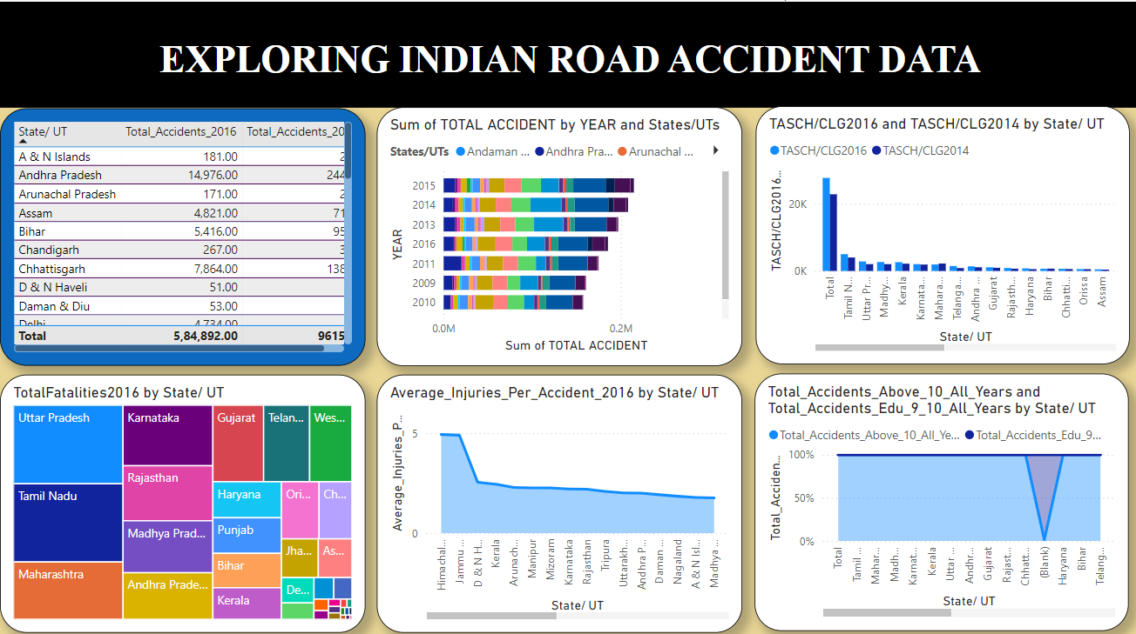
DASHBOARD
Page:1

Slide 10
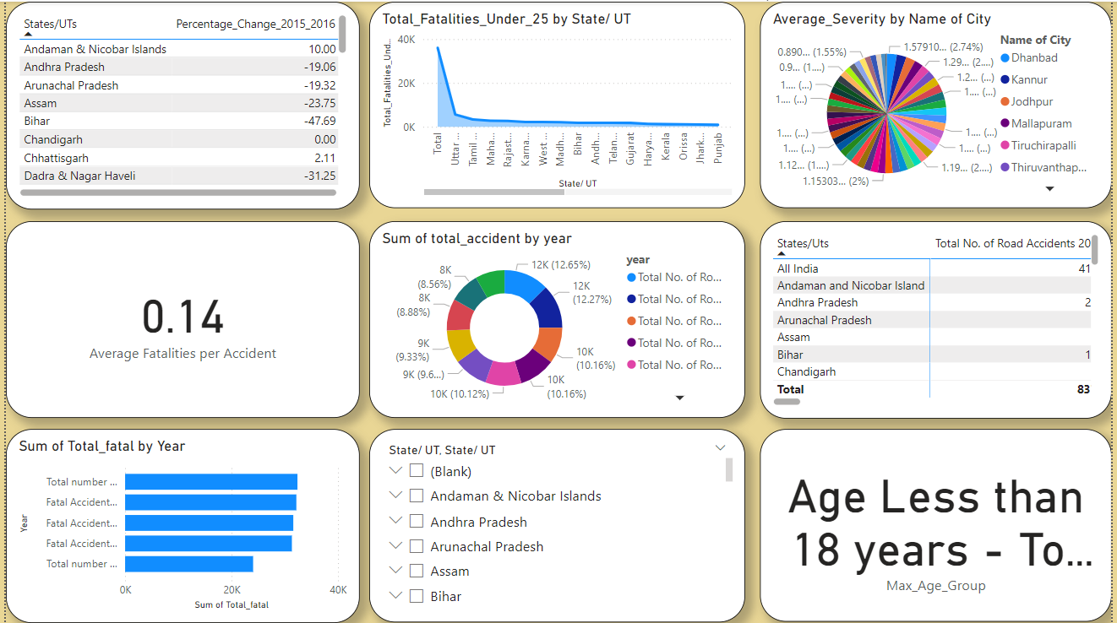
Page:2

Slide 11
GIT HUB LINK:
https://github.com/RoshiniGunasekaran/DA_MINI_PROJECT.git

Slide 12
REFERENCE
1. Sonal, Shristi, and Saumya Suman. "A framework for analysis of road accidents." 2018 International Conference on Emerging Trends and Innovations In Engineering And Technological Research (ICETIETR). IEEE, 2018.
2. Ruikar, Manisha. "National statistics of road traffic accidents in India." Journal of Orthopaedics, Traumatology and Rehabilitation 6.1 (2013): 1-6.
3. Krishnan, Vijay. "Research data analysis with power bi." (2017).
4. Becker, Louis T., and Elyssa M. Gould. "Microsoft power BI: extending excel to manipulate, analyze, and visualize diverse data." Serials Review 45.3 (2019): 184-188.
5. Ferrari, Alberto, and Marco Russo. Analyzing data with power BI and power pivot for excel. microsoft press, 2017.

Slide 13
CONCLUSION
The analysis of Indian road accident data from 2009 to 2016 using Power BI reveals key trends, including state-wise accident variations, the impact of driver education, and weather-related accidents. The data highlights vulnerable areas like schools and hospitals, along with significant fatalities in specific states. Yearly trends and state-specific reports offer valuable insights for developing targeted interventions, helping policymakers create more effective strategies to reduce accidents and enhance road safety across India.

Slide 14
THANK YOU

