Slide 1

DSCI-6003-01 Machine Learning
By:
ROSHINI BANDI

Slide 2

TOPIC: Medical image analysis of brain tumor using CNN Algorithm

Slide 3
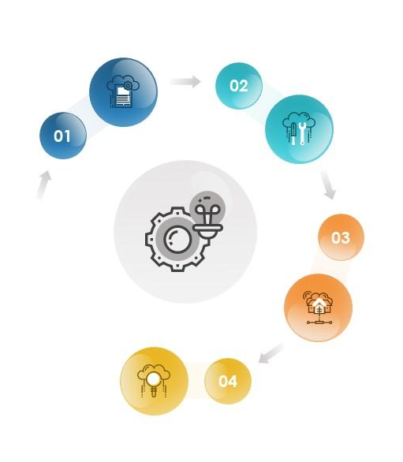
Context and Objective
The main objective is to,
Indicate how CNN algorithm has been applied to the entire MRI processing chain, from acquisition to image retrieval, from segmentation to disease prediction.
Provide a starting point for people interested in experimenting and perhaps contributing to the field of machine learning for medical imaging.

Slide 4
DATA
Data from Kaggle :- https://www.kaggle.com/datasets/sartajbhuvaji/brain-tumor-classification-mri
The data set was gathered from the Kaggle source. Images can be in the form of .csv (comma separated values),.dat (data) files in grayscale, RGB, or HSV, or simply in the form of a.zip file or JPEG, as in the case of our online Kaggle dataset.

Slide 5

Approach
Here in our project Keras model is built using the sequential class, which represents a linear stack of layers.
Sequential is the easiest way to build a model in Keras. It allows you to build a model layer by layer. We use the 'add()' function to add layers to our model.
The Sequential constructor takes an array of Keras Layers. We’ll use 3 types of layers for our CNN: Convolutional, Max Pooling, and ReLU.

Slide 6
Working Theory of our Project
MACHINE LEARNING:
Machine Learning is the science of training computers to learn and act in the same way that humans do, and to enhance their learning over time in an autonomous manner, by feeding them data and knowledge in real-world interactions.
DEEP LEARNING:
Deep learning is a branch of machine learning where networks of simple interconnected units are used to extract patterns from data in order to solve complex problems.

Slide 7
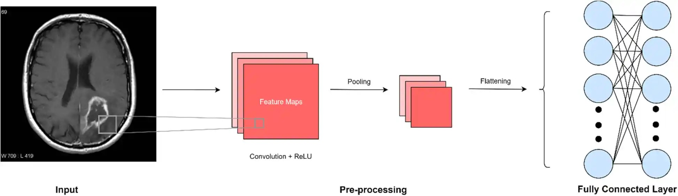
CNN Algorithm
Convolutional Neural Network(CNN) is a type of feed -forward artificial neural network in which the connectivity pattern between its neurons is inspired by the organization of the animal visual cortex(small region in brain).

Slide 8
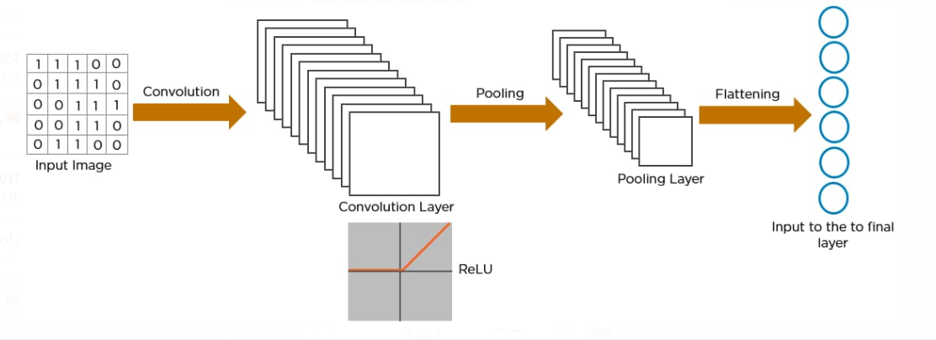
Cntd…

Slide 9
Model Construction
Here in this project Keras model is built using the sequential class, which represents a linear stack of layers.
Sequential is the easiest way to build a model in Keras. It allows you to build a model layer by layer. We use the 'add()' function to add layers to our model.
The Sequential constructor takes an array of Keras Layers. We’ll use 3 types of layers for our CNN: Convolutional, Max Pooling, and ReLU.

Slide 10
Training and testing of datasets
The CNN based brain tumor classification is divided into two phases such as training and testing phases.
In the training phase, preprocessing, feature exaction and classification with Loss function is performed to make a prediction model.
After training the model, we need to validate and fine-tune the parameters and finally test the model on unknown samples.

Slide 11
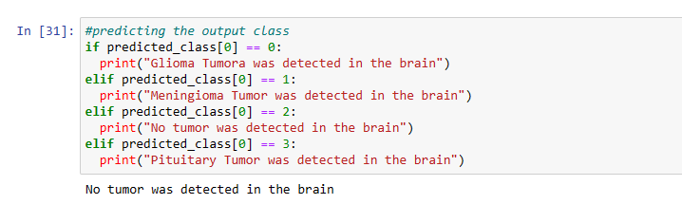
Brain tumor detection
Finally, the classification results are predicted and 84% accuracy is achieved.

Slide 12
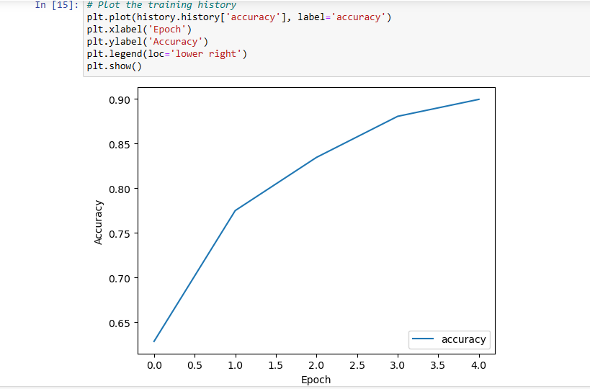
Cntd…

Slide 13
Future Scope
To build an app-based computer program in hospitals which allows doctors to simply determine the impact of tumor and suggest treatment accordingly.
Since performance and complexity of CNN rely on the computer file representation we will try and predict the placement furthermore as stage of the tumor from Volume based 3D images.
By creating three dimensional (3D) anatomical models from individual patients, training, planning and computer guidance during surgery is improved.

Slide 14


