Slide 1
Report on Impact of COVID-19 in USA
Roshith Elangovan

Slide 2
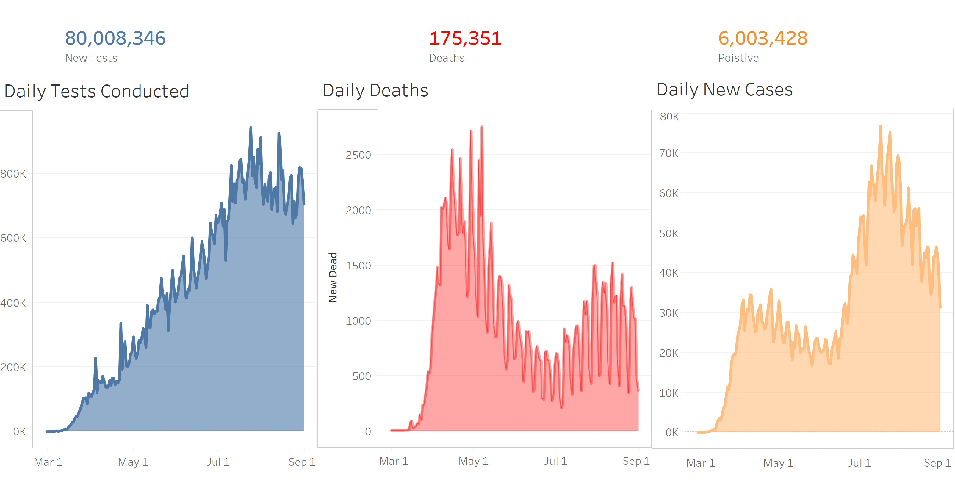

Slide 3
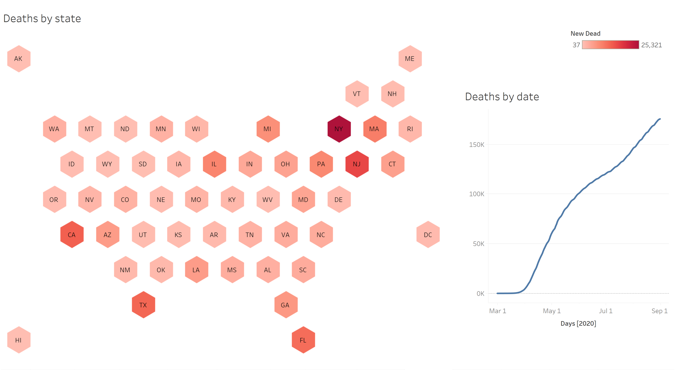

Slide 4
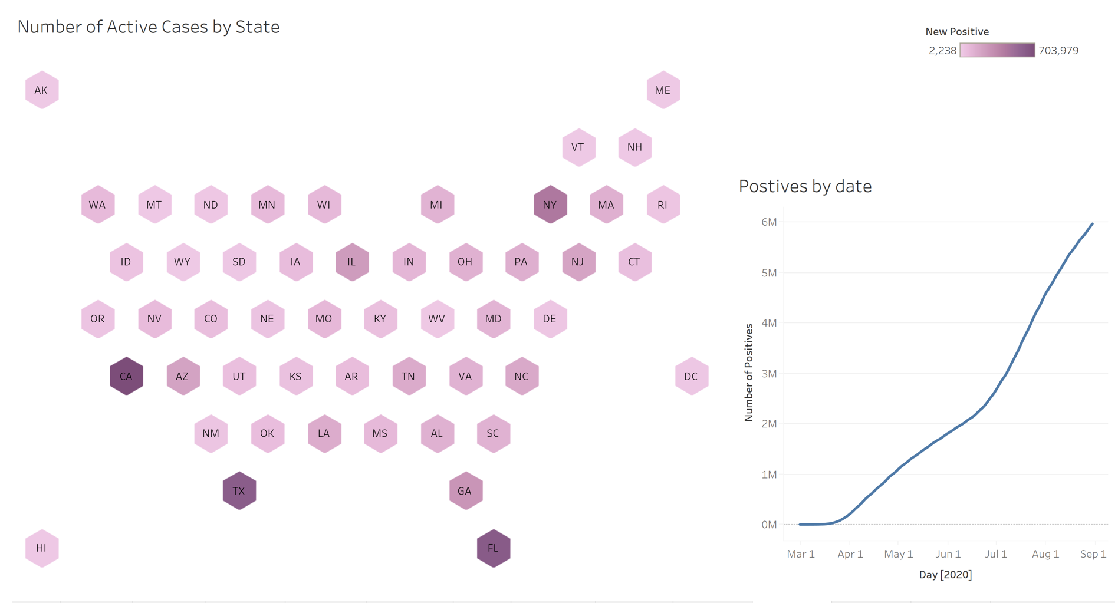

Slide 5
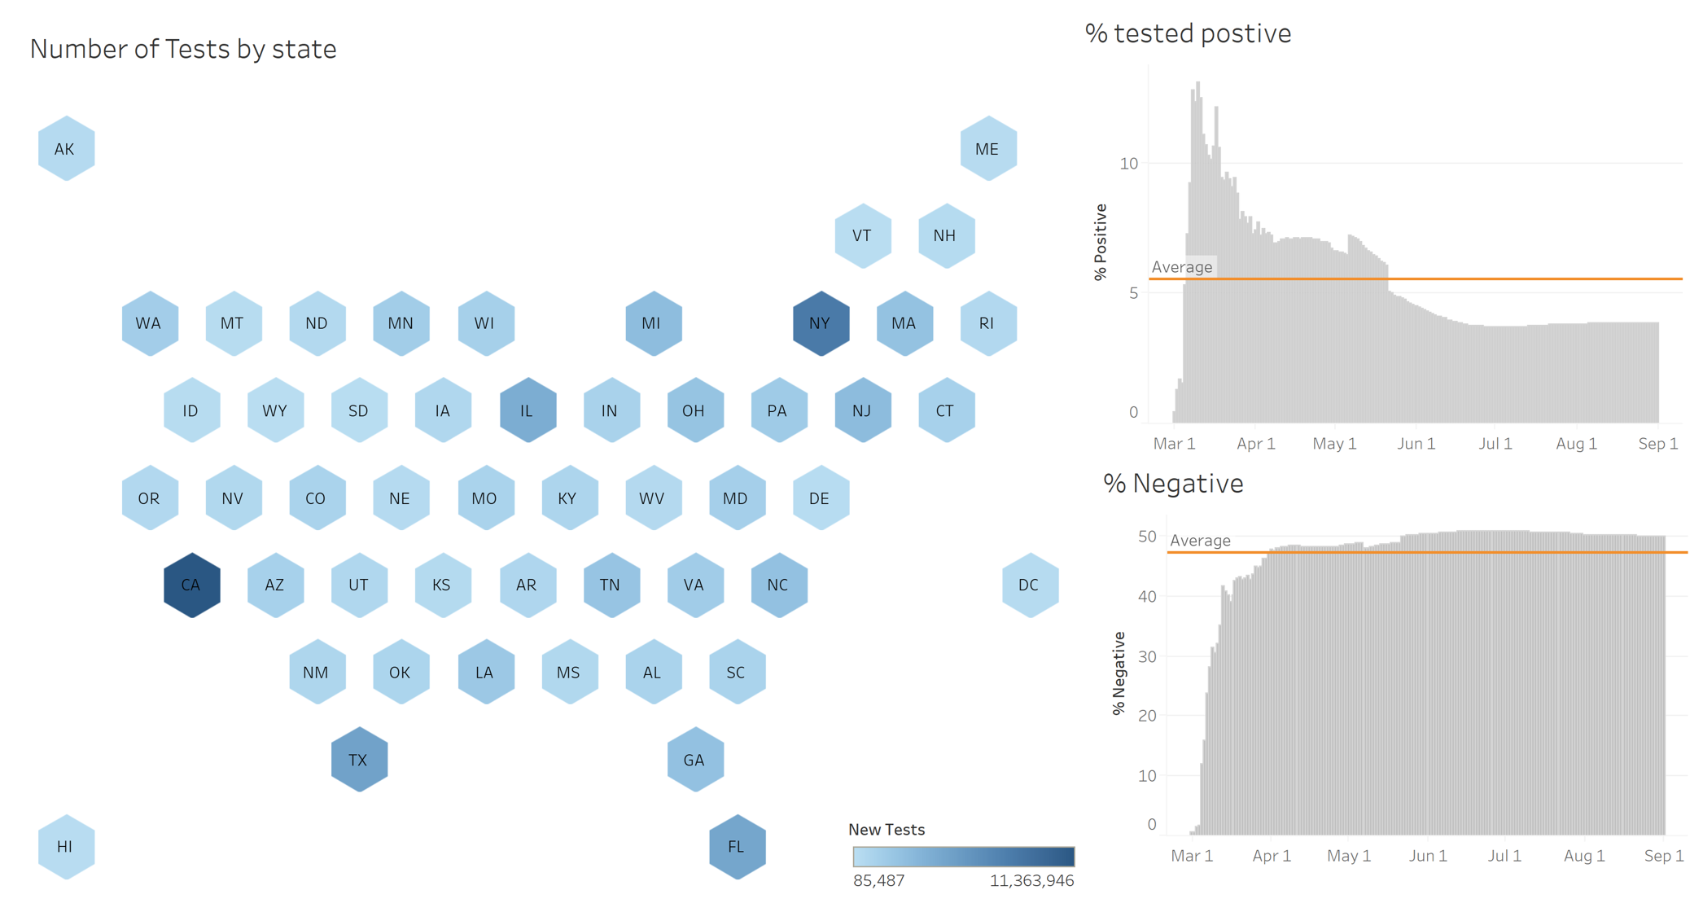

Slide 6
