Slide 1

ONLINE VOTING SYSTEM
DEPARTMENT OF COMPUTER ENGINEERING
S.S.V.P.S.’s B.S. DEORE COLLEGE OF ENGINEERING, DHULE
2023-2024
Presented By:
VAISHNAVI PATIL ROSHNI PATIL
PIYUSHA SONAWANE
BHAGYASHRI PATIL
Guided By:
Prof. B. R. MANDRE

Slide 2
INDEX
Introduction
Aim and Objectives
Literature Survey
Types of Voting System
System Modeling
Block Diagram
Stepwise Output / Test Cases
Future Scope
Conclusion
References

Slide 3

INTRODUCTION:
India has democratic government. As now all Indian citizen become a part of the growing digital India.
They have a digital ID that is Aadhar card. Voting schemes have evolved from counting hands in early days to systems that include paper, punch card, electronic voting machine.
An electronic voting system which is used nowadays provide some characteristic different from the traditional voting technique. But Electronic voting systems suffers from various drawbacks such as time consuming, damage of machines due to lack of attention. These drawbacks can overcome by Online Voting System.
This is a voting system by which any voter can use his/her voting rights from anywhere in the country without visiting to voting booths, in highly secured way. That makes voting a fearless of violence and that increases the percentage of voting.

Slide 4
Aim and Objectives::
The scope and objectives of the proposed system would be as follows –
To create a secured online voting platform where authenticity of votes and voters are ensured using username and password.
To improve the voter’s identification process through biometric (facial) recognition since biometric and facial features cannot be shared.
To ease the problem of queuing and crowding during voting period on elections.
The main objective of this project is to provide a secure online system for conducting fair elections online irrespective of the location without facing any difficulties.

Slide 5
Literature Survey:
In the year 2020, Vivek S K, et.al., developed a secure, transparent and decentralized e-voting system is proposed using the Hyperledger Sawtooth blockchain framework [1]. Restricted access of the system through election polling stations allows voters to cast their votes, which are recorded in the immutable blockchain state. Fairness and reliability of the election procedure due to nil possibility of vote manipulation. The issue of fairness and reliability of the election procedure due to nil possibility of vote manipulation was addressed. The technology/platform used were Angular 8, Node.js, Amazon RDS, and Sawtooth blockchain, Python with the APIs, Docker technology, Amazon Web Services.
In the year 2021, Shubham Gupta, Divanshu Jain, Milind Thomas Themalil developed a system where the voter is registered into the system database well before the time of election [2]. Now at the voting time, In the first step voter must verify his/her government identity such as Aadhar card or voting card with his/her proper picture, once it is verified, he/she moves to the second step. In second step voter has to go under the face reorganization process.

Slide 6
Types of Voting System:
Paper Ballot Voting:
The paper-based voting system is the traditional method of voting that has been used throughout history. It is also the standard method of holding elections in Nigeria and other countries around the world.
It works by distributing paper ballots to eligible voters who show up at the polling unit on Election Day. The voter's identity is verified by searching for and ticking his or her name on the voters register for that polling unit.
Electronic Voting:
It is a fundamental requirement for countries to improve their electoral systems. Because of the rapid advancement of technology in the computer and telecommunications worlds, e-Voting-based systems are about to be introduced, which will alleviate all of the problems associated with traditional manual election systems.
With the introduction of e-Voting systems, our election processes and social lives will become simpler, more efficient, and less expensive

Slide 7
System Modeling:
Requirements:
Python Libraries Required:
Pandas
Tkinter
Socket
Subprocess
Tools Used:
Programming: Python
Connection: Socket Programming
Protocol: TCP
User Interface: python-tkinter
Data Storage: Using CSV files
Data Updates: python-pandas
7. OS Calls: python-subprocess

Slide 8
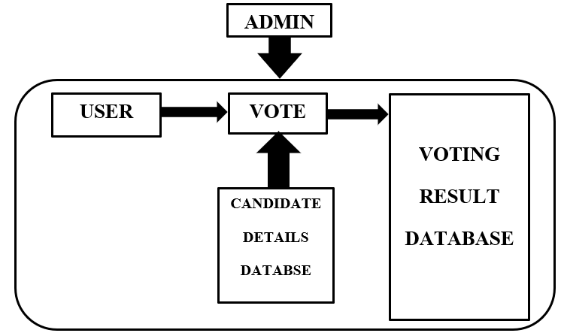
Block Diagram:

Slide 9
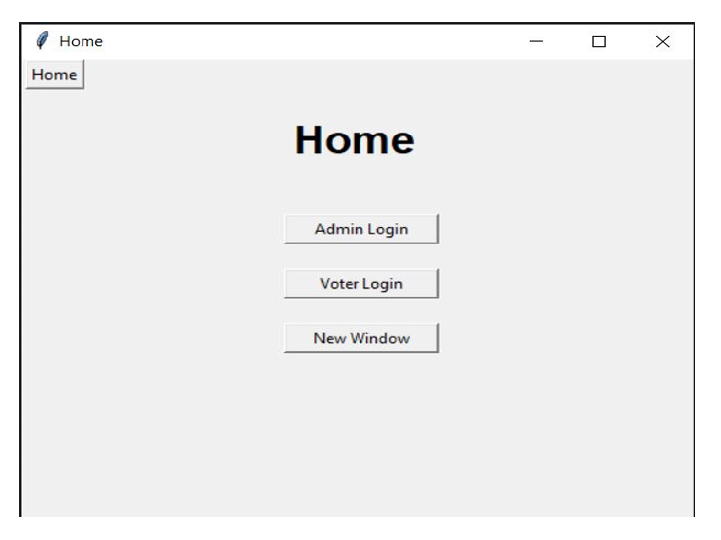
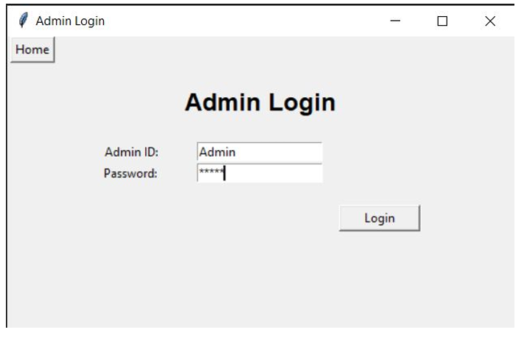
Stepwise Output / Test Cases:
Fig1: Homepage
Fig2: Admin Login

Slide 10
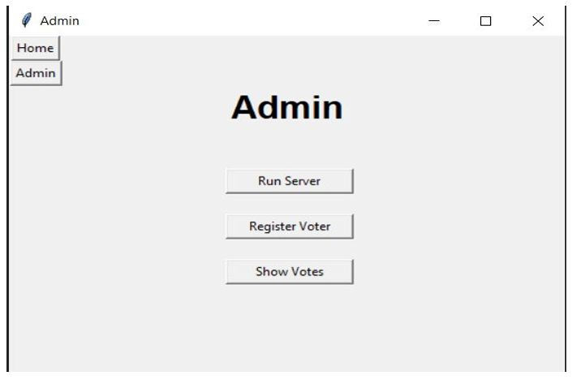
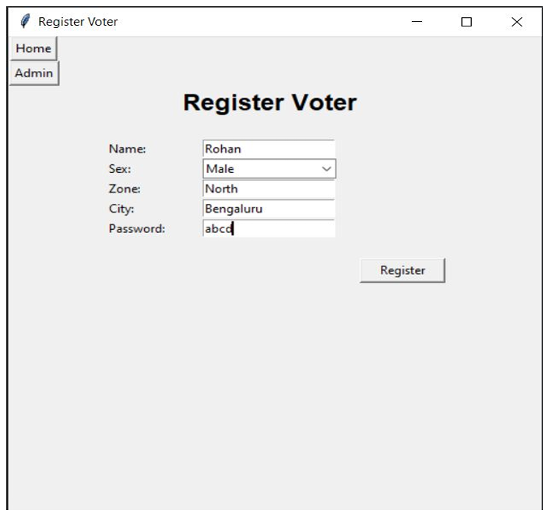
Fig3: Admin Home
Fig4: Register Voter

Slide 11
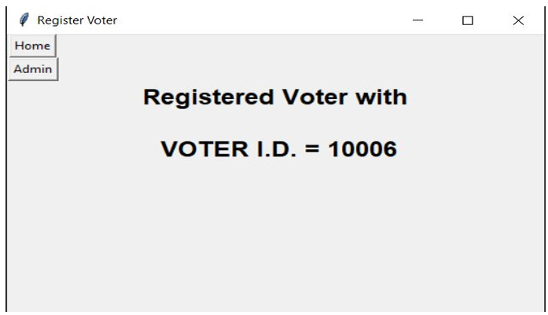
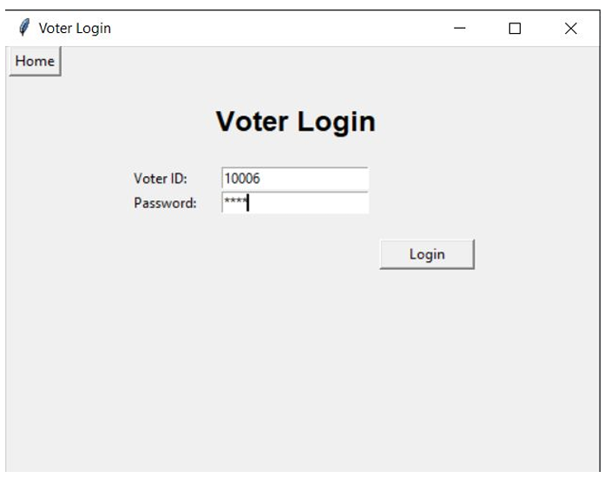
Fig5: Register Success Message
Fig6: Voter Login

Slide 12
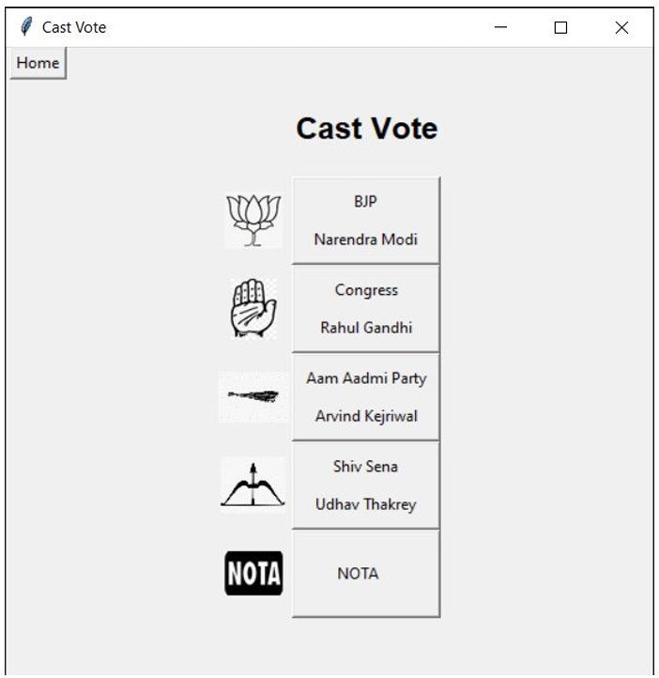
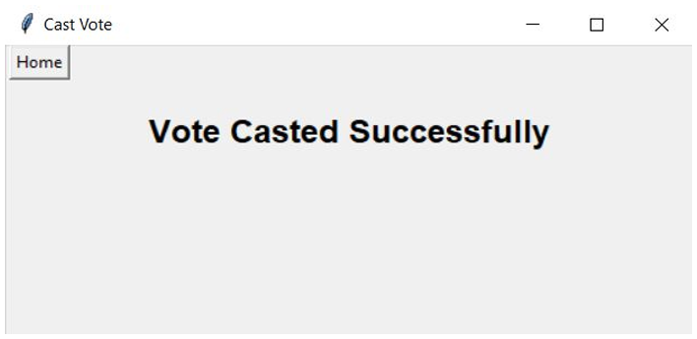
Fig7: Voting Page
Fig8: Vote Casted Successfully Message

Slide 13
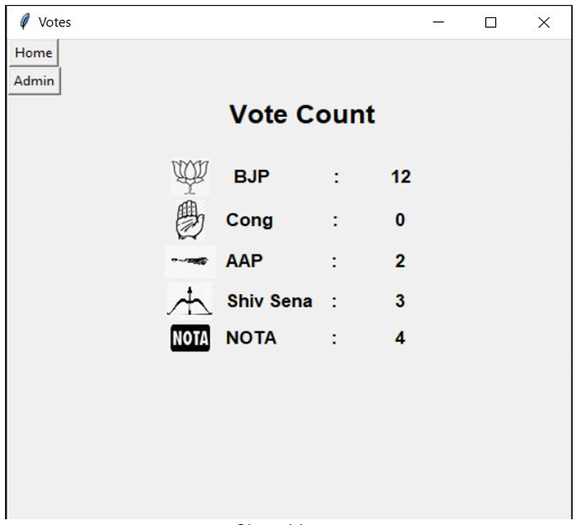
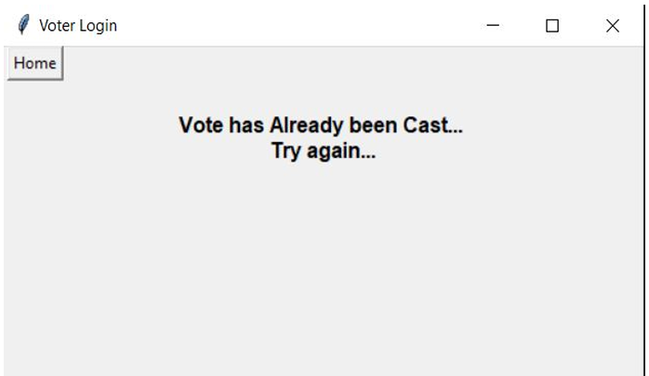
Fig9: Show Votes
Fig10: If the Vote already been casted

Slide 14
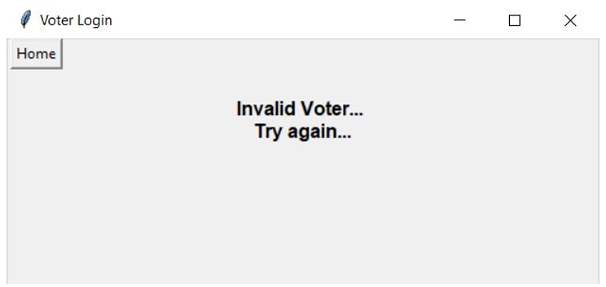
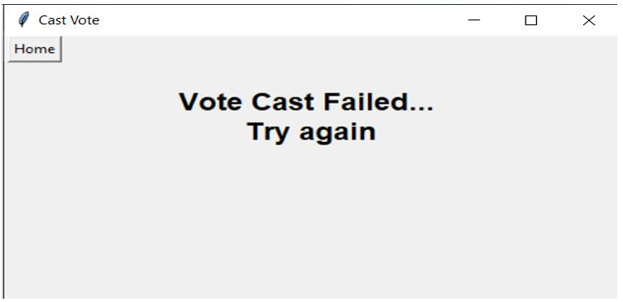
Fig11: If the voter is not registered/invalid voter
Fig12: Error while Casting Vote

Slide 15
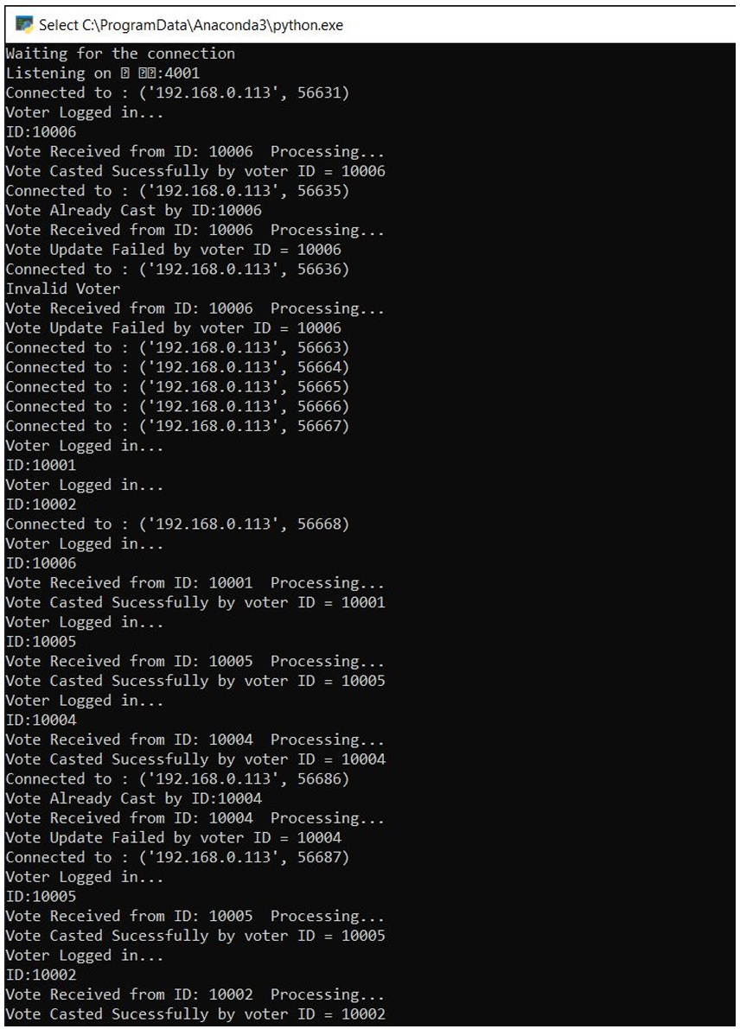
Fig13: Server Output

Slide 16
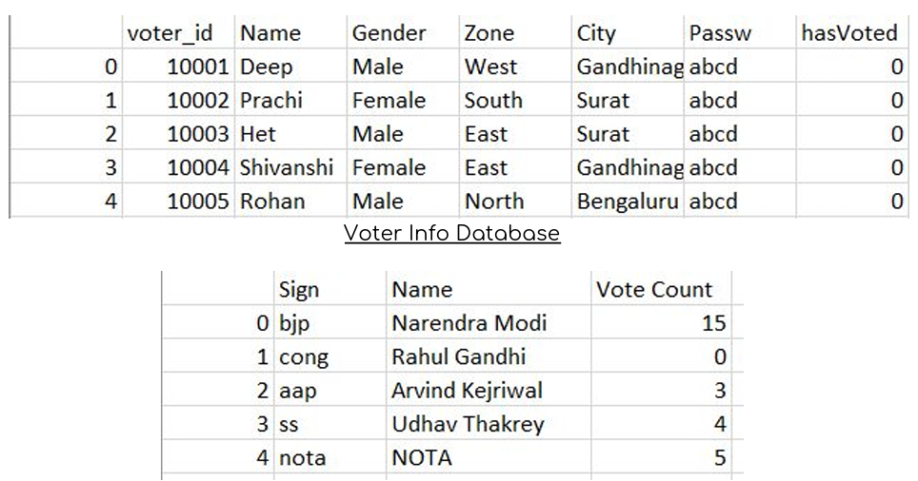
Fig14: Database

Slide 17
Future Scope :
Although this project tries to cover all limitations related to authentication and security, these are some of the few points where the scope of the project can be expanded -
1.In the future, we can make entire election system with a ‘Live Result Update’ feature.
2.This system that can also guarantee high level secrecy, security, and verifiability of a marked ballot transmitted over the Internet.
3.For advanced security, Block chain can also be integrated with the system for decentralization of database where the data is stored in multiple blocks so that even if one block is tampered, the data wouldn’t be manipulated
4.This Online Voting System can be advanced to be used by any organization in the world for conducting smooth and fair elections.

Slide 18
Conclusion:
Online Voting Systems have many advantages over the traditional voting system. Some of these advantages are less cost, faster generation results, easy accessibility, accuracy, and low risk of human and mechanical errors
Future development focused to design a system which can be easy to use and will provide security and privacy of votes on acceptable level by proper authentication and processing section. It is easy to use and it is less time consuming. It is very easy to debug.
The voting system proposed by us is far more secure and efficient than the traditional voting system. Delays in results and vote manipulation are easily avoided in this system.
The proposed online system is expected to increase the transparency and reliability of the current electoral system.

Slide 19
References:
[1] Vivek S K, et.al., “E-Voting System using Hyperledger Sawtooth”, International Conference on Advances in Computing, Communication & Materials (ICACCM), pp. 29-35, 2020
Accessed on: 10/11/2023.
[2] Shubham Gupta, Divanshu Jain, Milind Thomas Themalil, “Electronic Voting Mechanism using Microcontroller ATmega328P with Face Recognition”, Proceedings of the Fifth International Conference on Computing Methodologies and Communication (ICCMC 2021), pp. 1471-147, 2021
Accessed on: 10/11/2023.
[3] https://www.ijraset.com/research-paper/online-voting-system
“Online Voting System” Accessed on: 10/11/2023.

Slide 20

Thank You

