Slide 1
Country Data Exploration with Pandas
Analyzing Data for Insights and Patterns
Roshni Rathod
Data analytics 5:30 pm Batch
By Mr.Prakash Senapati

Slide 2
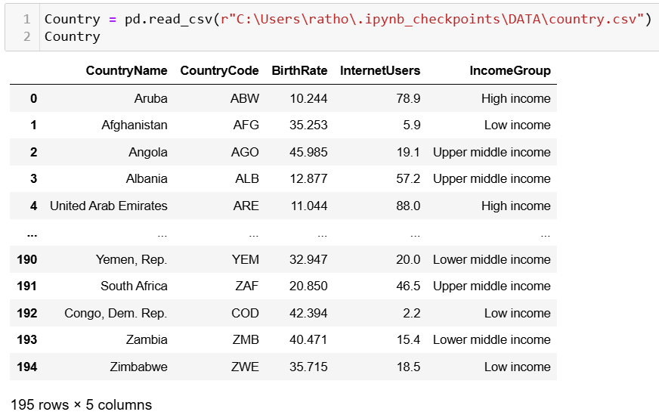
Dataset Overview
Dataset contains information about 195 countries.
Columns:
- CountryName:
Name of the country
- CountryCode:
Code for the country
- BirthRate:
Births per 1,000population
- InternetUsers:
Percentage of internet users
- IncomeGroup:
Economic classification (e.g., Low, High income)

Slide 3
Exploratory Data Analysis
Explored datasets: head()tail()info()describe()
Renaming columns
Checking null values
Basic operations with dataframe
Adding removing columns
seaborn introduction
• Filtered countries based on specific criteria:
- InternetUsers < 2: Identified 9 countries.
- BirthRate > 40: Found 12 countries.

Slide 4
Problem statements
Retrieve those countries having internet users less than 2
Retrieve the countries having birth rate more than 40

Slide 5
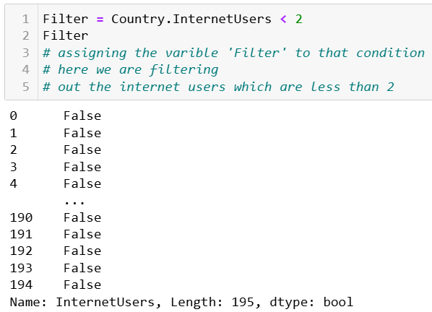
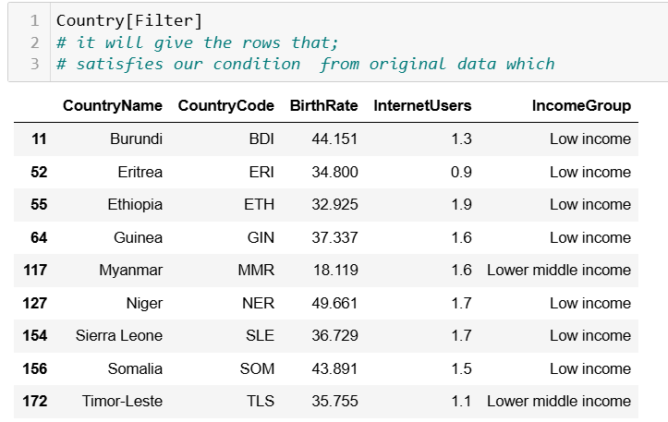
Problem statement 1 Retrieve those countries having internet users less than 2
Key insights:
1. Low Internet Usage: All listed countries have less than 2% internet users.
2. Geographical Focus: Predominantly African nations.
3. Development Barriers: Likely due to infrastructure, affordability, and educational challenges.
4. Growth Potential: Opportunities for internet service expansion.
5. Development Impact: Increased internet access can enhance education, health, and economic opportunities.

Slide 6
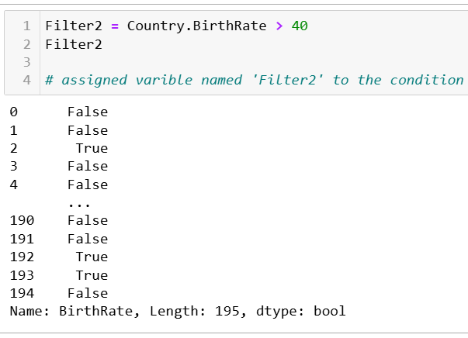
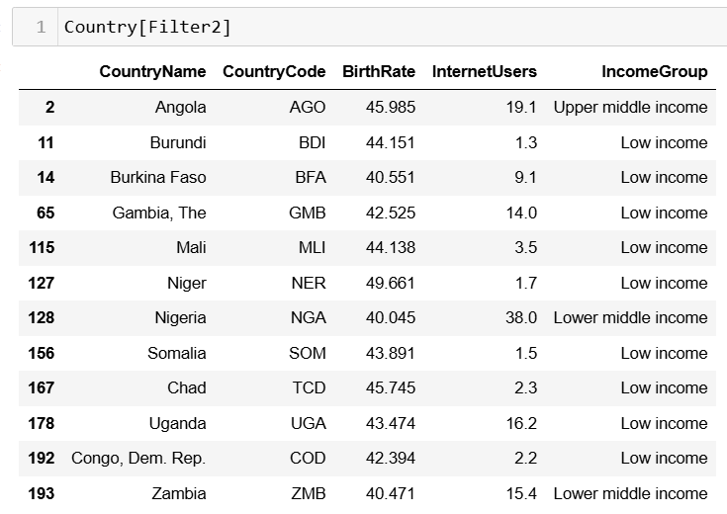
Problem statement 2 Retrieve the countries having birth rate more than 40
Key Insights:
1. High Birth Rates: Countries with birth rates over 40 per 1,000 people.
2. Income Levels: Mostly low or lower-middle income countries.
3. Internet Usage: Varies widely; some countries have higher internet penetration.
4. Geographical Focus: Primarily African nations.
5. Population Growth: High population growth impacting development.

Slide 7
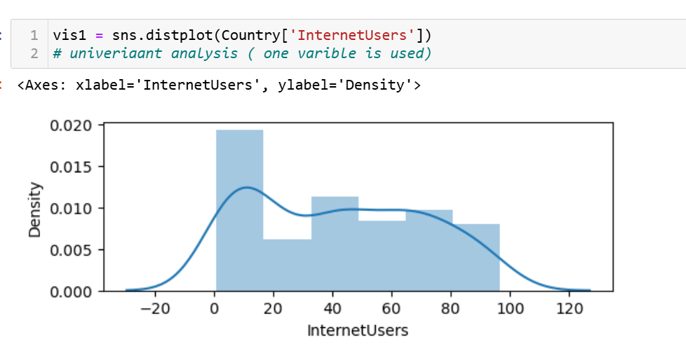
Visualizations
1• Distribution of Internet Users using distplot.
Univarient distribution of Internet users
The bars represent the frequency distribution of Internet user counts within specified intervals (bins).
Negative values might indicate an issue with the dataset or specific preprocessing assumptions.

Slide 8
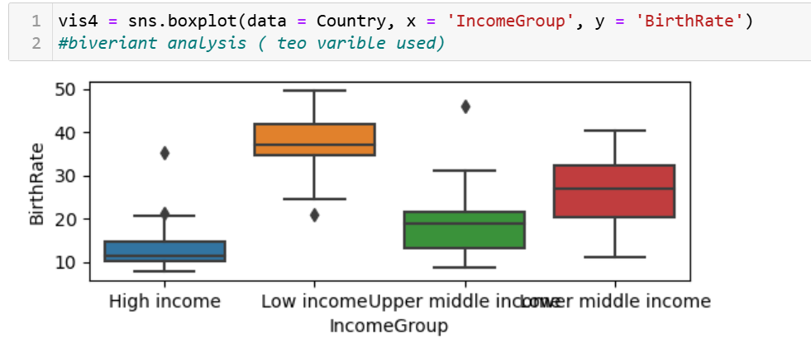
2• Boxplot analysis of BirthRate by IncomeGroup.
Bivariate analysis
1. High-income countries: lowest birth rates** (median ~10) with minimal variation.
2. Low-income countries: highest birth rates** (median ~40) and large variation.
3. Middle-income groups: birth rates between (medians ~25–30).
4. Outliers: are present in all groups, indicating some exceptions.
5. Trend: Birth rates decrease as income levels increase.
This suggests a negative correlation between income level and birth rate.

Slide 9
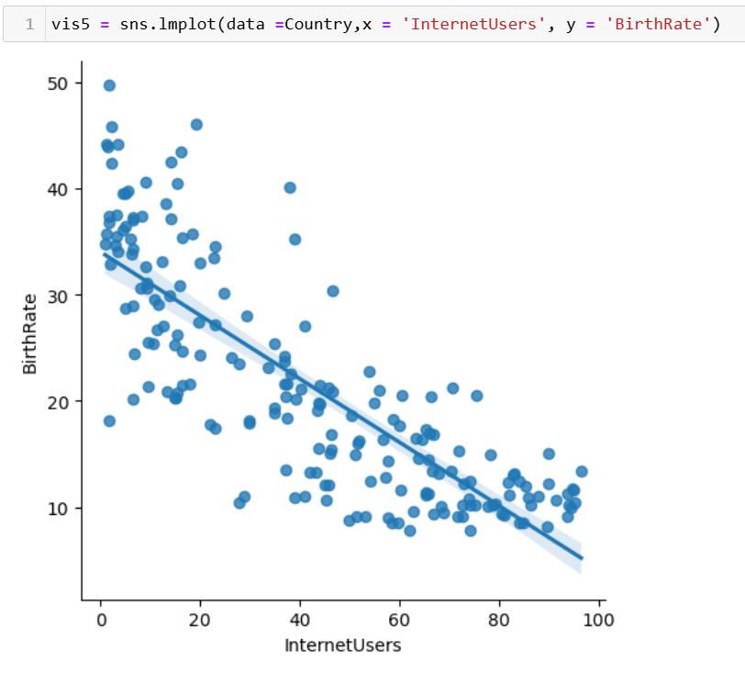
3• BirthRate vs. InternetUsers visualized through scatter plots.
Bivariate Analysis
There is a negative correlation—as Internet usage increases, birth rates tend to decrease.
Countries with higher internet penetration tend to have lower birth rates, likely reflecting socioeconomic development

Slide 10
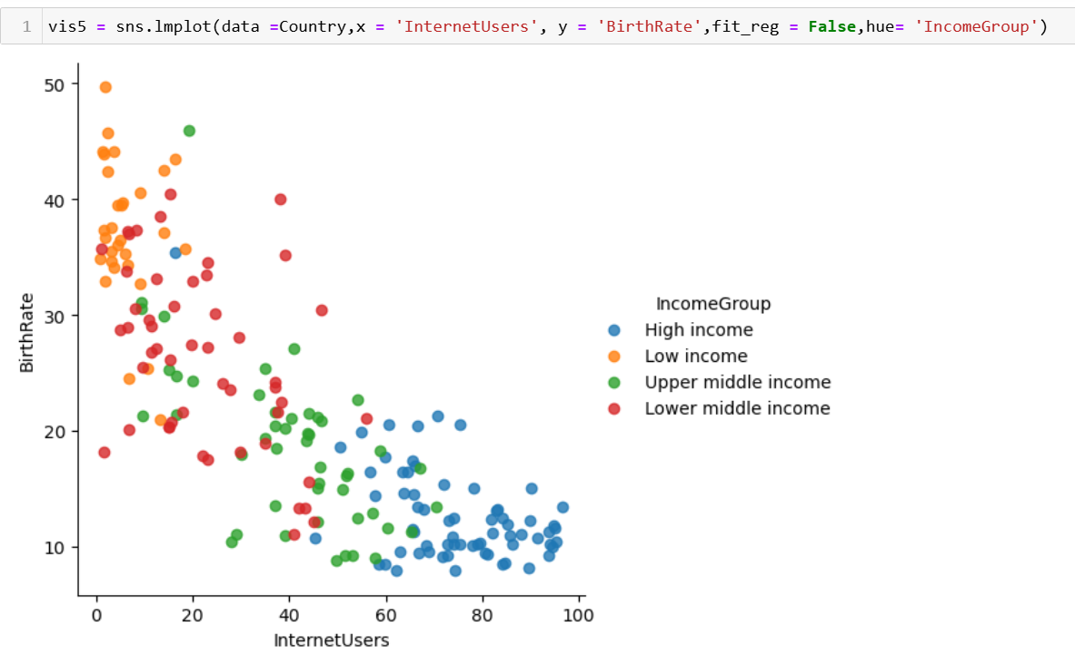
4. Relationship between internet users and birth rates across different income groups.
Key Insights:
1. Inverse Relationship: Higher internet usage correlates with lower birth rates.
2. Income Groups:
- Low Income: High birth rates, low internet usage.
- Lower Middle Income: Moderate ranges for both variables.
- Upper Middle Income: Lower birth rates, higher internet usage.
- High Income: Low birth rates, high internet usage.
3. Clustering: Distinct clusters by income group, showing socio-economic disparities.

Slide 11
Key Insights
• High-income countries have higher internet penetration.
Low-income countries often have higher birth rates.
Specific relationships between InternetUsers and BirthRate observed using scatter plots.

Slide 12
Conclusion
• The analysis highlights socio-economic differences among all income group.
• Provides a foundation for further studies on global connectivity and growth.
• Demonstrates the power of Python and Pandas for data exploration.
Also provides the importance of visualizing data over tabular format .8

Slide 13
Thank You

