Slide 1
Red Team vs Blue Team: AI Simulation for Cybersecurity Defense
By Modi Nitya & Malde Roshni
Internship: Digisuraksha Parhari Foundation
Powered by Infinisec Technologies Pvt. Ltd.
Github Links:
https://github.com/Roshni1603/Red-vs-Blue-AI-Simulation.git
https://github.com/nityamodi0810/Red_Blue_AI_Simulate.git

Slide 2
Introduction
Red vs Blue Teaming:
Red Team: Simulates attackers to test vulnerabilities.
Blue Team: Defends systems by detecting and responding to threats.
AI Simulation:
Using AI to create virtual environments that mimic real-world scenarios for training, testing, and improving models.
AI can help automate attack and defense strategies.

Slide 3
Problem Statement
Increasing frequency of cyber attacks
Manual Red vs Blue exercises lack scalability and consistency.
Need for automated, ethical, and safe testing environments.
Difficulty in modeling AI-driven cyberattacks and defenses.

Slide 4
Solution
Red Team agent simulates offensive actions across common services (HTTP, FTP, SSH).
Blue Team agent monitors, detects, and responds to threats using predefined logic.
Logs and system alerts are generated for analysis and evaluation.
Supports cybersecurity education, enterprise training, and strategic planning.

Slide 5
Objective
Build an AI-based simulation of Red (attacker) vs Blue (defender)
Provide a scalable, ethical training ground for cybersecurity.
Track and evaluate performance metrics (detection, compromise rate).

Slide 6
Architecture Overview
Red Agent ↔ Environment ↔ Blue Agent
Interaction loop between agents and environment
Virtual hosts simulate SSH, HTTP, FTP services.
Each step logs system status and alerts.

Slide 7
Code & Tool Breakdown
Programming Language: Python
Key Files:
red_team_agent.py – Implements offensive logic for simulating attacks
blue_team_agent.py – Handles defensive strategies and monitors system activity
environment.py – Controls the simulation environment and coordinates agent actions
Libraries Used:
random – For generating unpredictable behavior in simulations
os: Provides functions to interact with the operating system
sys: Provides access to system-specific parameters and functions
Output:
Logs – Record each action taken by agents
Alerts – Notify about detected attacks or anomalies
System Status – Provides snapshot of the network during simulation

Slide 8
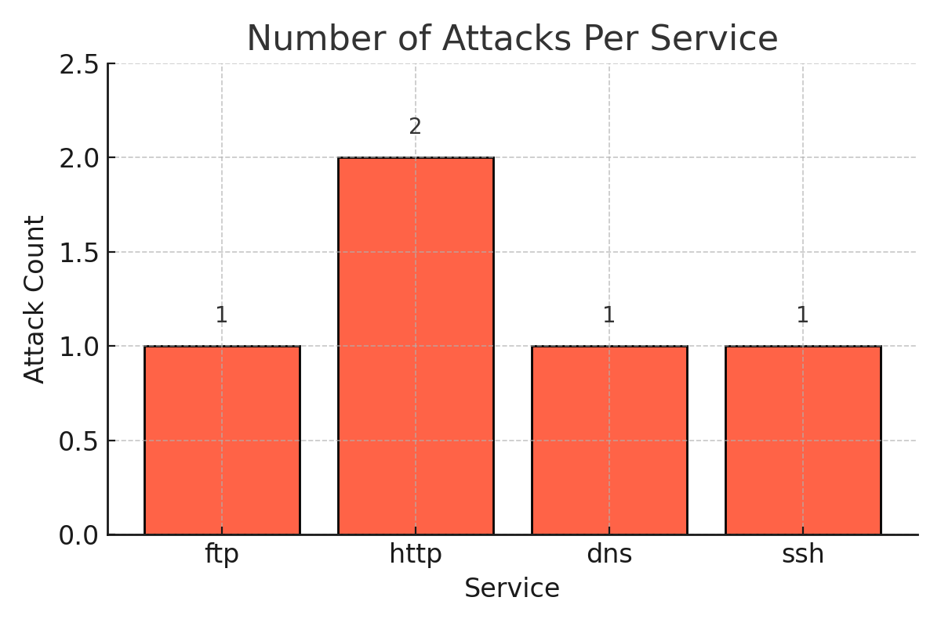
Results & Observations
Chart: Number of Attacks Per Service
- HTTP had the highest number of attacks (2)
- FTP, DNS, and SSH each had 1
- Suggests HTTP is more vulnerable or targeted

Slide 9
Real-World Use Cases
Cybersecurity Training Environments
Used by enterprises, military, and academia for safe cyber defense training.
Red & Blue Team Operations
Your AI system can automate this model for consistent and scalable testing.
Educational Platforms
Your project fits perfectly in learning environments and cyber bootcamps.

Slide 10
Future Enhancements
Smarter AI: Add reinforcement learning for adaptive attack/defense.
Real Tools: Integrate Metasploit, Snort, Wireshark,Kali.
Larger Networks: Use Docker/GNS3 for scalable setups.
Live Dashboards: Visualize attacks/defense with Grafana & Streamlit.
Educational Mode: Add Purple Team & learning competitions.

Slide 11
Conclusion
Showcased realistic cyber scenarios
Scalable and ethical AI-based simulation.
Effective for training and strategy testing.
Contributes to adaptive cybersecurity systems.

Slide 12
THANK YOU!!!

