Slide 1
Apache JMeter

Slide 2
Introduction
JMeter was primarily written to test the performance of Apache JServ(currently known as Apache Tomcat project).Apache redesigned JMeter to enhance the GUI, to add more features and functional testing capabilities.
JMeter is mainly used for testing Web application or FTP application but currently, it is applicable in functional testing, JDBC database connections, Web services, generic TCP connections and OS native processes.
Why JMeter?
Open-source application: JMeter is a free open-source application which facilitates users or developers to use the source code for development of other applications
Support various testing approach: JMeter supports various testing approach like Load Testing, Distributed Testing, and Functional Testing
Platform independent: JMeter is written and developed using java, so it can run on any environment / workstation that accepts a Java virtual machine
Simulation: JMeter can simulate multiple users by using virtual users or unique users in order to generate heavy load against web application under test
Support various server types: JMeter is highly extensible and capable to load the performance test in different server types:Web: HTTP, HTTPS, SOAP, Database: JDBC, LDAP, JMS and Mail: POP3
Test result visualization: Test results can be viewed in different formats like graph, table, tree, and report
Remote distributed testing: JMeter has Master-Slave concept for distributed testing where master will distribute tests among all slaves and slaves will execute scripts against your server

Slide 3
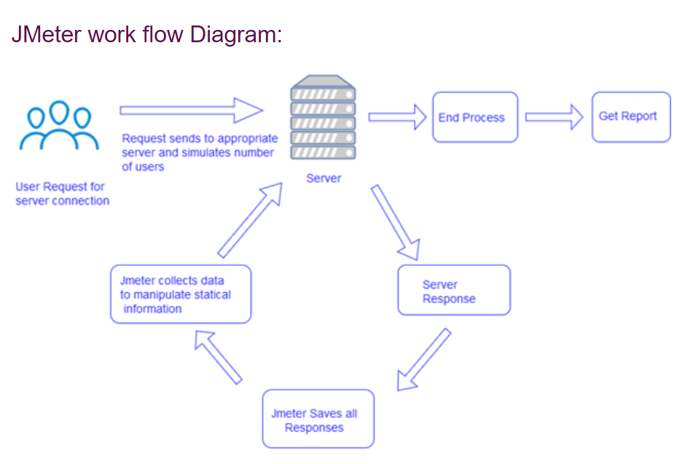
How does it Work?

Slide 4
Installation and Launching
JMeter is used as standalone application
JMeter is available for Windows, Linux and Mac as a standalone application
Steps to install JMeter standalone application:
Before installing JMeter, make sure Java is installed and setup in your system-> Type in CMD java –version to confirm java installation
Download the required OS version and extract to the desired directory
Go to bin folder and run the .exe file (ApacheJMeter.jar/.bat file)
VSCode Extension/Plugin is available in the Extension Marketplace as per the documentation.

Slide 5
JMeter Test Plan Creation and Options
Create your Test Plan or open an existing test plan once the application is launched
You can create multiple thread groups under the test plan with options of number of users and other looping criteria based on your requirement
Under the thread group -> Create Sampler -> there are multiple options like Http request,JDBC request,JMS P2P JMS Subscriber, JMS Publisher etc.
For example -> Select HTTP Request
You can key in the web server details if you are trying to hit one particular server
In HTTP request -> Key in endpoint and resource path along with the Http method
If there is a body involved –add in the request
Click on run
To view the results -> Add listener Views Results Tree, Summary Report etc

Slide 6
Builder Section
Request Type: Method for the API
End point address bar: To enter endpoint
Params: To insert query params, if any
Authorization: To add credentials to access information and get response from the server
Headers: Additional information that needs to be passed with the request
Body: Additional information needed commonly as part of POST/PUT requests
Tests: Scripts executed during the request processing
Clicking on Run → API server receives the request and returns the response → Displays on the Jmeter GUI

Slide 7
Response
Status code: Information on status of the request
Time: Duration which the response took after we sent the request and received the response
Size: Response size along with cookies and headers
Body: The main response content that has been sent from the server (Format type)
Cookie: Has the cookies that have been sent from the server as a response. Can be used for the subsequent requests to the same endpoint.
Headers: Additional information that is transferred to the user
Tests: Results of tests framed for asserting the response

Slide 8
References
Download: Apache JMeter - Download Apache Jmeter
Documentation: Apache JMeter - User's Manual: Getting Started

