Slide 1
Karate : Web Service Testing Tool
Web-Services Testing Made Simple

Slide 2
Introduction
Karate is the only open-source tool to combine API test-automation, mocks, performance-testing and UI -testing into a single, unified framework. The BDD syntax popularized by Cucumber is language-neutral, and easy for even non-programmers. Besides powerful JSON & XML assertions, you can run tests in parallel for speed - which is critical for HTTP API testing.
Why Karate?
Java knowledge is not required and even non-programmers can write tests.
Based on the popular Cucumber / Gherkin standard - with IDE support and syntax-coloring options.
Elegant DSL syntax 'natively' supports JSON and XML - including JsonPath and XPath expressions
Express expected results as readable, well-formed JSON or XML, and assert in a single step that the entire response payload (no matter how complex or deeply nested) - is as expected.
You can find the detailed feature of karate in below link.
https://github.com/intuit/karate/

Slide 3
Karate and BDD
Karate is built on top of Cucumber, another BDD testing framework, and shares some of the same concepts. One of these is the use of a Gherkin file, which describes the tested feature. However, unlike Cucumber, tests aren’t written in Java and are fully described in the Gherkin file.
A Gherkin file is saved with the “.feature” extension. It begins with the Feature keyword, followed by the feature name on the same line. It also contains different test scenarios, each beginning with the keyword Scenario and consisting of multiple steps with the keywords Given, When, Then, And, and But.
More about Cucumber and the Gherkin structure can be found in below link.
https://www.baeldung.com/cucumber-rest-api-testing

Slide 4
Installation and Launching
Karate can be implemented in two ways,
As a Standalone Application
Using IDE(Eclipse ,IntelliJ…)
Steps to install karate standalone application:
Go to https://dl.bintray.com/ptrthomas/karate/
Download the latest karate version and save in to folder.(and it will have the name karate-<version>. jar)

Slide 5
Sample API feature file and GET Method
Feature: integration test
Scenario: create user
Given url 'https://reqres.in/api/users/2'
When method get
Then status 200
And match response $.data.id == 2 // Assertion
Given: This step is to put the system into a well-defined state before users start interacting with the application. A Given clause can by considered a precondition for the use case.
When: A When step is used to describe an event that happens to the application. This can be an action taken by users, or an event triggered by another system.
Then: This step is to specify an expected outcome of the test. The outcome should be related to business values of the feature under test.
And and But: These keywords can be used to replace the above step keywords when there are multiple steps of the same type.

Slide 6
Given - Url – http(s)://{Endpoint}/{Resource URL of API}
When – Http method of API(Get, put, post…)
Then - Expected Status code
AND- Assertions(Json/XML validation)

Slide 7
POST request
Scenario: create a user
* def name = ‘ user1 ’
* def user =
"""{
"name": "#(name)", // Parameterization
"username": "testuser",
"email": "test@user.com"
} """
Given url 'https://jsonplaceholder.typicode.com/users'
And request user
When method post
Then status 201
* def id = response.id
* print 'created id is: ' + id

Slide 8
Execute feature file using karate standalone jar
Download Karate standalone jar file as mentioned in slide 3 and place in the folder.
Create a feature file which have extension as .feature and place in same folder.
Open Command prompt.
Navigate to the folder which have Karate jar and feature file.
Run the command, java –jar {karate-{version}.jar} {feature filename}
Feature file will be executed and html report will be stored in target folder (/target/ cucumber-html-reports) in the same path.

Slide 9
Execeute APIs Using IDE
Pre requisite – Eclipse IDE and Latest java version in your system.
1. Start up your favorite IDE. (I’ll be using Eclipse for this example.) 2. Go to File>New>Maven Project and take the defaults on first screen. 3. Under New Maven Project, create a click on Add Archetype 4. Enter the following info:
Archetype Group Id= com.intuit.karate ArchetypeArtifactId= karate-archetype ArchetypeVersion=0.9.0(you can use latest version) 5. Click OK. 6. It should find the Karate-archetype. Click on Next. 7. On the next screen, enter:
GroupId=com.karatedemo ArtifactId=karatedemo (Your project name).
Click Finish.

Slide 10
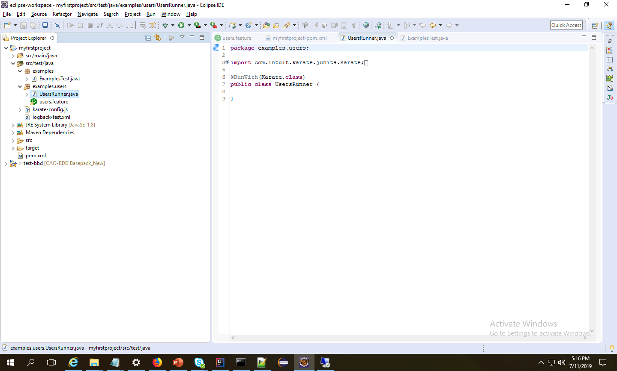
Karate/Maven Folder structure
Maven automatically downloads all your dependency jars and creates a karate project with sample feature file.
Default runner class will be created in the /src/test/java folder in your project.
You can create or add a feature file in the /src/test/java folder in your project.

Slide 11
Run your feature file
There are many ways to run your feature file.
1. Right click on the Feature file and select Run as Cucumber Feature.
2. Right click on the Runner java class and Run as Junit Test
3. Right click on the Project and Run as Maven Test.
Karate Html report will be saved in your target folder. (/target/surefire-reports)

Slide 12
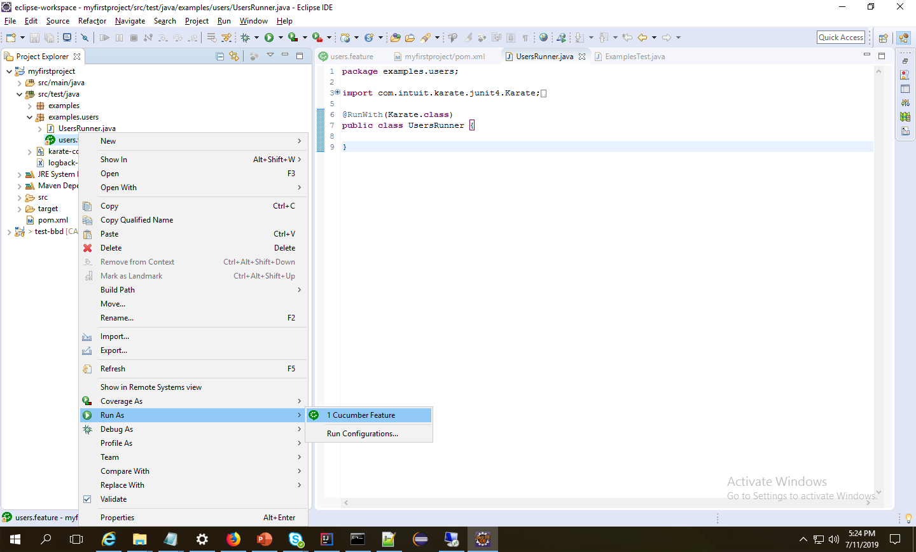
Run by Feature file

Slide 13
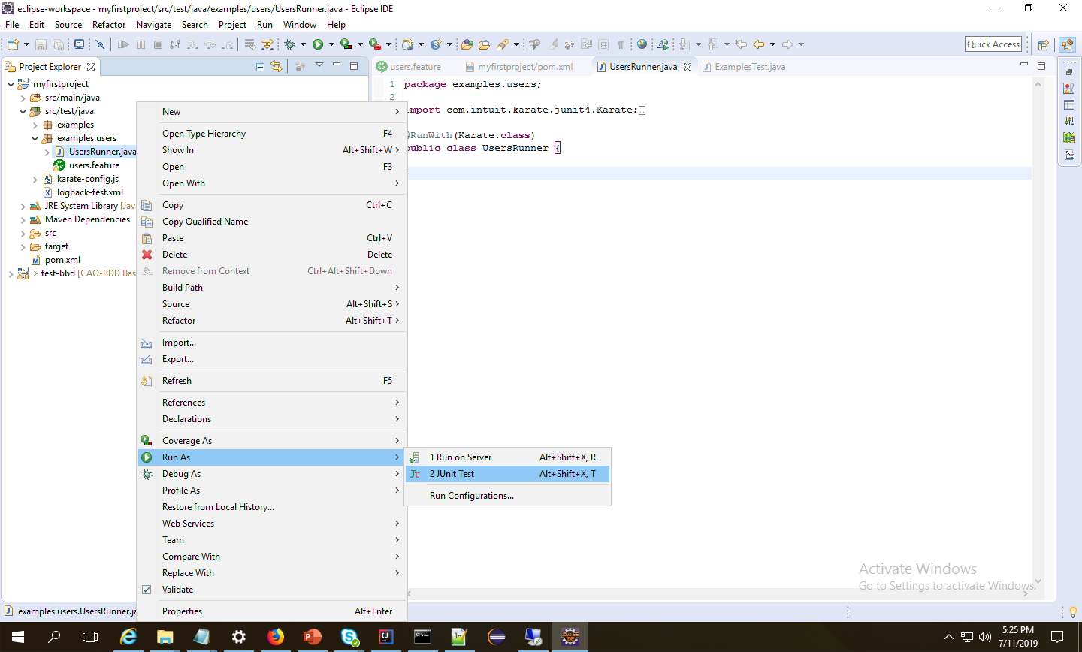
Run by Runner Class

Slide 14
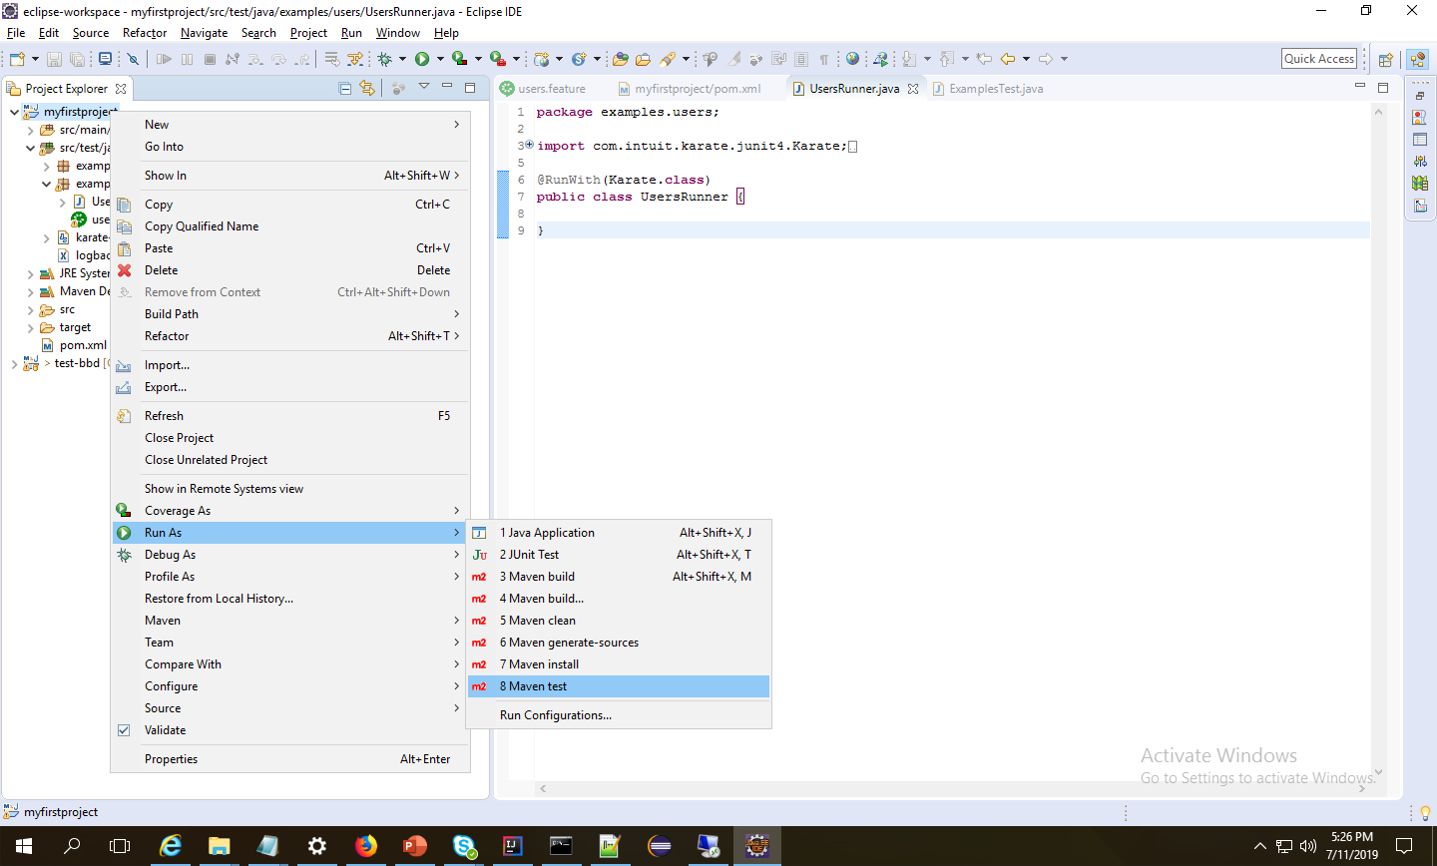
Run Using Maven

Slide 15
References
https://github.com/intuit/karate/
Demo:
API Execution using karate stand alone Jar.
API Execution using Eclipse IDE

