Slide 1
SOAPUI

Slide 2
Introduction and Installation

Slide 3
SOAPUI Introduction
SOAP UI is the leading open source cross-platform API Testing tool
SOAPUI allows testers to execute automated functional, regression, and load tests on different Web API.
SOAPUI supports all the standard protocols and technologies to test all kinds of API's.
SOAPUI interface is simple that enables both technical and non-technical users to use seamlessly.
Why SOAPUI (over other tools)
SOAPUI is not only used to do API functional testing but also used for Performance and Security testing.
It can also do Service virtualization(mock services), JDBC connection etc.
SOAPUI gives us proper Project framework style with Test Suites, Cases and Steps (unlike POSTMAN).

Slide 4
Installation
Smartbear gives you SOAPUI
Navigate to http://www.soapui.org/
Download SOAPUI for,
Windows
MAC
Linux

Slide 5
SOAP and REST

Slide 6
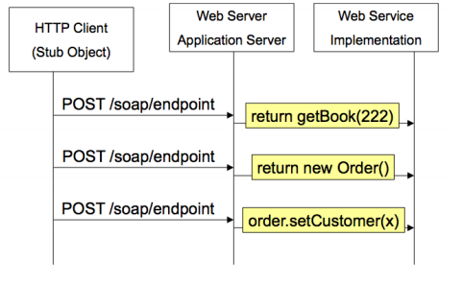
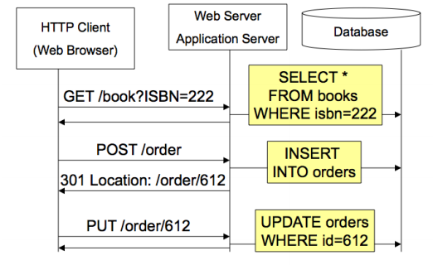
Web Services with SOAP Web Services with REST

Slide 7
Web Services Components
JSON
XML
{
"company": Volkswagen,
"name": "Vento",
"price": 800000
}
<car>
<company>Volkswagen</company>
<name>Vento</name>
<price>800000</price>
</car>

Slide 8
SOAP Project

Slide 9
Create SOAP Project
Click on SOAP Project in SOAPUI
Enter the path of the WSDL request. In this case http://www.webservicex.net/CurrencyConvertor.asmx?WSDL
Give different values for your request and check the response.
Create Test Suite
Create Test Case
Create Test Step
During Test Step creation, select the request for which you need to derive your test step.

Slide 10
REST Project

Slide 11
Create REST Project
Click on REST Project in SOAUI
Give your endpoint
Make modifications in your request according to its HTTP method (GET, POST).
Give different values for your request and check the response/connectivity.
Create Test Suite
Create Test Case
Create Test Step
During Test Step creation, select the request for which you need to derive your test step.

Slide 12
Properties

Slide 13
Properties
Properties can be used as variables to store values that can be referred in testing
We can set property values manually at Project, Suite, Case, Step level.
How to use Properties:
Properties can be accessed at following levels using below syntax:
Project - ${#Project#PropertyName}
TestSuite - ${#TestSuite#PropertyName}
TestCase - ${#TestCase#PropertyName}
TestStep - ${TestStepName#PropertyName}

Slide 14
Groovy script

Slide 15
Set and Get Property
Project testRunner.testCase.testSuite.project.getPropertyValue("Name") testRunner.testCase.testSuite.project.setPropertyValue("Name","I am in Project")
TestSuite testRunner.testCase.testSuite.getPropertyValue("Name") testRunner.testCase.testSuite.setPropertyValue("Name","I am in TestSuite")
TestCase testRunner.testCase.getPropertyValue("Name") testRunner.testCase.setPropertyValue("Name","I am in TestCase")
TestStep testRunner.testCase.getTestStepByName("CountryCodes").getPropertyValue("Name") testRunner.testCase.getTestStepByName("CountryCodes").setPropertyValue("Name","I am in Test Step")

Slide 16
Property Transfer

Slide 17
Property Transfer
Property Transfer is majorly used to send a value from a response to another request.
How to do it?
Add Property Transfer to your Test Case.
Select Source Test Step, Property, Path language.
Select Target Test Step, Property, Path language.
Test Step: This is your Test Step Name
Property: This can be Response, Request, Custom Properties.
Path language: Xpath (XML), JSONpath (JSON).
Now, write your Xpath or JSONpath of your Source and Taget value.

Slide 18
Assertions

Slide 19
Assertions
Contains:
Searches for the existence of the specified string. It also supports regular expression.
Not Contains:
Searches for the non-existence of the specified string. It also supports regular expression.
Xpath:
Uses XPath expression to select the target node and its values. XPath, is an XML query language for selecting nodes from an XML document.
SLA:
Validates if the response time of the last received response was within the defined limit. (ms)
Script Assertion:
It uses Groovy/JS to assert the response.

Slide 20
Run Script

Slide 21
Run Script
UI:
We can run the script by right clicking on Project, Suite, Case, Test level.
Command Line:
Right click on Project, Suite, Test Case.
Select Launch TestRunner
Copy the command
Use it in Command Prompt to run your script.
This command can be used in Jenkins.

Slide 22
Any Queries?

Slide 23
Thank You! for your Interest

