Slide 1
Roshni N 2021503548 MIT, Anna University
Flower Classification using CNN
3/21/2024 Annual Review

Slide 2
Flower Classification using CNN
3/21/2024 Annual Review

Slide 3


AGENDA
Data Preparation:
Download and extract flower images from a Kaggle dataset.
Resize images and assign labels to preprocess the data.
Data Visualization:
Visualize a subset of images from the dataset to gain insights into the data distribution and characteristics.
Data Encoding:
Perform label encoding on the target variable (types of flowers) to convert categorical labels into numerical values.
Use one-hot encoding to transform the numerical labels into a binary matrix representation.
Data Splitting:
Split the dataset into training and validation sets to train and evaluate the model's performance respectively.
Model Building:
Construct a CNN model architecture using Keras, consisting of convolutional layers followed by max-pooling layers, flattening, and dense layers.
Implement ReLU activation function for hidden layers and softmax activation function for the output layer.
Display model summary to visualize the architecture and parameters.
3/21/2024 Annual Review

Slide 4

PROBLEM STATEMENT
Develop a machine learning model capable of accurately classifying images of flowers into different categories. The model should be trained on a dataset containing images of various types of flowers and should be able to classify new images into predefined flower categories. The goal is to build a robust image classification system that can effectively distinguish between different types of flowers based on their visual characteristics.
3/21/2024 Annual Review

Slide 5

PROJECT OVERVIEW
This project focuses on developing an efficient image classification system for categorizing various types of flowers. It begins with acquiring flower images from a Kaggle dataset and standardizing their size while assigning appropriate labels. Through exploratory data analysis, the dataset's composition and characteristics are visualized, aiding in understanding its distribution. The core of the project lies in constructing a Convolutional Neural Network (CNN) architecture using Keras, featuring convolutional layers for feature extraction, max-pooling layers for dimensionality reduction, and fully connected layers for classification, with ReLU and softmax activation functions enabling multi-class classification.
3/21/2024 Annual Review

Slide 6

WHO ARE THE END USERS?
The end users of this image classification system could vary across different domains. Primarily, botanists, horticulturists, and researchers in the field of botany and plant sciences could benefit from such a system. It could assist them in quickly identifying and cataloging different types of flowers, aiding in research, conservation efforts, and botanical studies.
Florists and gardeners may find value in this system for inventory management, floral arrangement suggestions, and plant identification purposes.
Educational institutions, including schools and universities, could integrate this system into their curriculum to teach students about plant diversity and classification.
3/21/2024 Annual Review

Slide 7

YOUR SOLUTION AND ITS VALUE PROPOSITION
The solution presented here is a robust image classification system specifically designed for identifying various types of flowers. Its value proposition lies in its accuracy, efficiency, and versatility. By employing state-of-the-art deep learning techniques, such as Convolutional Neural Networks (CNNs), the system can accurately classify flower images with high precision. This ensures reliable results, crucial for users in botanical research, horticulture, floristry, education, and hobbyist gardening.
Moreover, the system's efficiency is highlighted through its ability to handle large datasets and process images rapidly, thanks to optimization techniques like data augmentation and learning rate annealing. This efficiency translates into time savings for users, enabling quick and reliable flower identification and classification tasks.
3/21/2024 Annual Review

Slide 8

THE WOW IN YOUR SOLUTION
The "wow" factor in this solution lies in its ability to seamlessly combine cutting-edge technology with practical utility. By leveraging state-of-the-art deep learning techniques, particularly Convolutional Neural Networks (CNNs), the system achieves remarkable accuracy in flower image classification. This accuracy instills confidence in users, ensuring reliable results for tasks ranging from botanical research to educational purposes and commercial applications.
3/21/2024 Annual Review
8

Slide 9
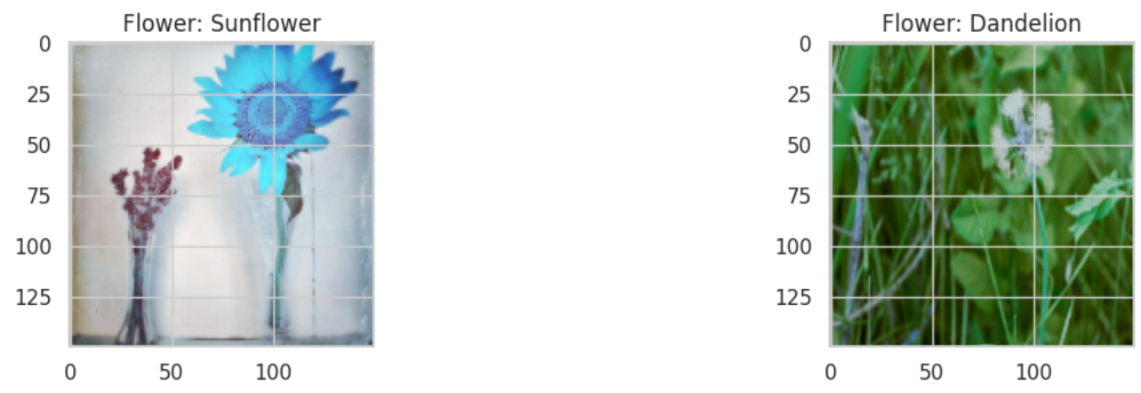
MODELLING
The modelling approach adopts a Convolutional Neural Network (CNN) architecture, utilizing successive convolutional and pooling layers for feature extraction and dimensionality reduction, culminating in dense layers for classification, ensuring robust flower image classification. Through careful parameter tuning and optimization techniques like learning rate annealing, the model achieves high accuracy and generalization, making it proficient in accurately categorizing various types of flowers.
3/21/2024 Annual Review
9

Slide 10
RESULTS
The model achieved impressive results, demonstrating high accuracy in classifying flower images. Through rigorous evaluation on a validation set, it consistently maintained accuracy above a predefined threshold, indicating its reliability in accurately identifying different types of flowers.
The results highlight the model's proficiency and effectiveness in flower image classification, making it a valuable tool for botanical research, education, and practical applications in floristry and gardening.
https://colab.research.google.com/drive/1nqBgYA2WD7p76N6SzuiVBfyMDXmYnTuJ?usp=sharing
3/21/2024 Annual Review
10

