Slide 1
Mini Project
YOUR DAY, AT A GLANCE
CareMate
Medicine plan
OK
Morning dose
Medication tracking
and care coordination
Recorded for today
OK
Evening dose
Reminder scheduled
A calmer way to keep track of prescriptions,
reminders, and shared care.
Clear plans.
More confident check-ins.
Roshani Chavan 245109051
Diksha Chougule 245109050
Akanksha Bhanage 245109055
PLAN
REMIND
CONNECT

Slide 2
01 | THE PROBLEM
Managing medicines can become a daily juggling act.
Instructions, reminders, and follow-ups are easy to scatter across paper, phones, and memory.
1
Details in many places
2
Missed doses are hard to see
3
Prescription entry takes time
4
Care involves other people
Names, timing, and follow-up notes are hard to keep together.
Patients and caregivers may not share one clear record of what happened.
Copying medicine details from a photo is repetitive.
Families need updates while patients stay in control of access.
WHAT WE WANT TO SOLVE
Make the daily routine easier to follow, while keeping people in charge of care decisions.
CAREMATE | PROJECT PRESENTATION
02

Slide 3
02 | OBJECTIVES & DESIGN
Reduce repeated work. Keep people in control.
CareMate links prescription entry, daily tracking, and caregiver access in one patient-centered flow.
- Capture details - OCR reads the prescription image and drafts medicine information for review.
- Confirm the plan - Users can edit every field; OCR never saves a plan by itself.
- Follow the routine - Confirmed plans drive a schedule, dose logs, reminders, and reports.
- Share by approval - Caregivers request access; the patient decides whether to approve.
- Explain saved records - The built-in rule-based assistant helps with app use, not diagnosis or dose advice.
THE DIFFERENCE
OCR helps with entry.
A person confirms the plan.
Patients approve caregiver access.
CareMate supports the routine; people make care decisions.
CAREMATE | PROJECT PRESENTATION
03

Slide 4
03 | TECHNICAL IMPLEMENTATION
A compact web app, with clear responsibilities.
The browser talks to a FastAPI service, which checks access and stores care records in SQLite.
FRONTEND
API + SECURITY
DATA STORE
EXTERNAL SERVICES
Browser app
Python +FastAPI
SQLite
OCR.space + RxNorm
HTML + CSS
Vanilla JavaScript; responsive single-page UI
Pydantic validation; bearer-token sessions; patient access checks
Profiles, medicine plans,
dose logs, and alerts
OCR.space reads images.
RxNorm medicine lookup is optional.
BACKGROUND REMINDER WORKER
Checks due times and stores alerts; the browser polls while open.
CAREMATE | PROJECT PRESENTATION
04

Slide 5
04 | PRESCRIPTION WORKFLOW
From a prescription photo to a plan someone has checked.
OCR speeds up data entry; the user still checks the details before they become part of a care plan.
01
02
03
04
05
Upload
Read
Extract
Review
Confirm
Choose a clear JPG, PNG, WEBP, or TIFF image.
OCR.space returns the recognized text.
The parser looks for names, strengths, frequency, duration, and timing.
Edit or remove entries; uncertain medicine names are flagged.
Only checked, reviewed entries become saved plans.
A PERSON CHECKS THE RESULT
Compare every extracted detail with the original prescription before saving.
CAREMATE | PROJECT PRESENTATION
05

Slide 6
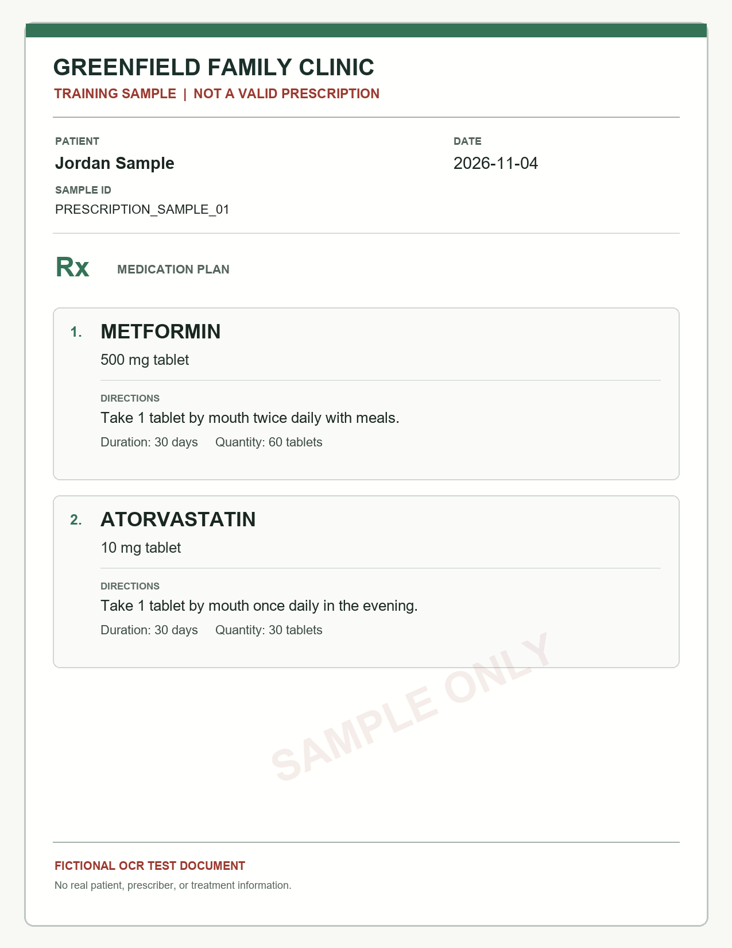
05 | DEMO WALKTHROUGH
Follow one medicine through the app.
Start with an approved account, then show how an image becomes a daily routine.
DEMO INPUT
Sign in - as a Caretaker or approved Caregiver.
Connect - request access, then approve it from the patient account.
Upload - a fictional prescription sample.
Review - the extracted fields and choose what to save.
Save and track - open today's schedule, record a dose, and view its status.
Fictional prescription sample
Sample data only | OCR reading needs an OCR.space key
CAREMATE | PROJECT PRESENTATION
06

Slide 7
06 | APPLICATIONS & OUTCOMES
Built for everyday medication routines.
Patients and approved caregivers can keep the practical details in one shared workspace.
01
For patients
02
For caregivers
03
For follow-up visits
Keep instructions, reminder times, dose records, and follow-ups together.
Request access to a patient's plan and receive missed-dose alerts after approval.
Use dose history and adherence summaries to prepare questions for a clinician or pharmacist.
WHAT THE CURRENT BUILD DOES
Prescription image -> review -> saved plan -> schedule -> dose records and alerts
CAREMATE | PROJECT PRESENTATION
07

Slide 8
07 | FUTURE SCOPE
What we would improve next.
The next phase should measure quality, improve reliability, and learn from people who would use the app.
01
Improve OCR quality
02
Multilingual Voice Assistant
03
More languages
We will try another method for improving ocr as it does not works well on blurred images and handwritten scripts
Support regional languages and voice commands to make the app easier for elderly and less tech-savvy patients.
Adding multiple languages across the world so that everyone can use it
04
Prepare data storage
05
Doctor and Hospital
Integration:
NORTH STAR
Fewer repeated steps.
Clearer records.
People stay in control.
Move beyond demo SQLite we can add managed storage, backups, and access reviews.
Allow doctors to access patient medication reports and update prescriptions digitally.
CAREMATE | PROJECT PRESENTATION
08

Slide 9
CAREMATE
Make the routine
easier to follow.
Small steps can make medication care easier to manage - and easier to share.
PLAN
REVIEW
CareMate helps with organization and follow-through.
Care decisions stay with the patient and their care professionals.
REMIND
THANK YOU

