Slide 1
PROJECT SHOWCASE
TODAY AT A GLANCE
CareMate
Medication plan
OK
Morning dose
Medication tracking
and care coordination
Recorded for today
OK
Evening dose
Reminder scheduled
A clearer routine for patients and the people
who support their care.
Connected care, with
clear human review.
PLAN
REMIND
CONNECT
PROJECT PRESENTATION | NOVEMBER 2026

Slide 2
01 | PROBLEM STATEMENT
Medication routines are easy to lose track of.
Care often depends on small details being remembered, recorded, and shared at the right time.
1
Instructions are scattered
2
Missed doses go unseen
3
Prescription entry takes time
4
Care is shared
Medicine names, timing, and follow-up notes can live in different places.
Without a simple record, patients and supporters may not know what was taken.
Manually entering details from a photo is repetitive and can introduce errors.
Patients need a way to involve caregivers while keeping access controlled.
PROJECT OPPORTUNITY
Bring medication plans, dose records, reminders, and approved caregivers into one clear workflow.
CAREMATE | PROJECT PRESENTATION
02

Slide 3
02 | OBJECTIVES
Make everyday medication care easier to follow.
The project focuses on practical organization, shared visibility, and careful handling of extracted information.
- Organize - Keep patient profiles, medication plans, schedules, and follow-ups together.
- Support - Provide reminders and a straightforward way to record doses as taken or missed.
- Reduce re-entry - Read prescription images into editable fields for a human to review.
- Coordinate - Let caregivers request access and let patients approve or decline.
- Inform - Show dose history and adherence summaries without giving treatment advice.
DESIGN PRINCIPLE
Assist with the routine.
Keep the person in control.
OCR suggests. A user reviews.
The app records only after confirmation.
CAREMATE | PROJECT PRESENTATION
03

Slide 4
03 | INNOVATION / UNIQUENESS
A human-reviewed workflow, not an automatic prescription.
CareMate combines useful automation with explicit patient and caregiver control.
01
OCR with a review step
02
Consent-based care sharing
03
One connected routine
Extracted medicine details stay editable; nothing becomes a plan until confirmed.
Caregivers request access. The patient approves before records are shared.
Plans, schedules, dose logs, reports, follow-ups, and reminders use the same patient record.
04
Conservative assistant
05
Accessible caregiver view
WHAT IS DISTINCTIVE
Built-in intents can explain saved records and app usage; they do not diagnose or recommend doses.
Approved caregivers can follow connected patient plans and receive relevant alerts.
Technology supports the workflow; people stay responsible for care decisions.
CAREMATE | PROJECT PRESENTATION
04

Slide 5
04 | IMPLEMENTATION
A small, integrated web architecture.
The browser, API, database, and reminder worker run as one local application.
USER EXPERIENCE
APPLICATION LAYER
PERSISTENCE
CONNECTED SERVICES
Browser app
FastAPI
SQLite
OCR.space | RxNorm
HTML | CSS
Vanilla JavaScript
Auth | API routes
Parsing | reports
Profiles | plans
Logs | alerts
OCR is required for image reading.
RxNorm lookup is optional.
BACKGROUND REMINDER WORKER
Checks schedules and writes due or missed-dose notifications.
CAREMATE | PROJECT PRESENTATION
05

Slide 6
04 | IMPLEMENTATION
From prescription image to a reviewed plan.
The key safety boundary is explicit: reading text is not the same as creating a medication plan.
01
02
03
04
05
Upload
Read
Extract
Review
Save
Patient selects a JPEG, PNG, WEBP, or TIFF image.
OCR.space returns text from the image.
Parser identifies possible names, strengths, frequency, duration, and timing.
User checks and edits every field; uncertain names are flagged.
Only selected, reviewed entries become medication plans.
HUMAN CONFIRMATION
OCR may misread names or instructions. CareMate never saves extracted results automatically.
CAREMATE | PROJECT PRESENTATION
06

Slide 7
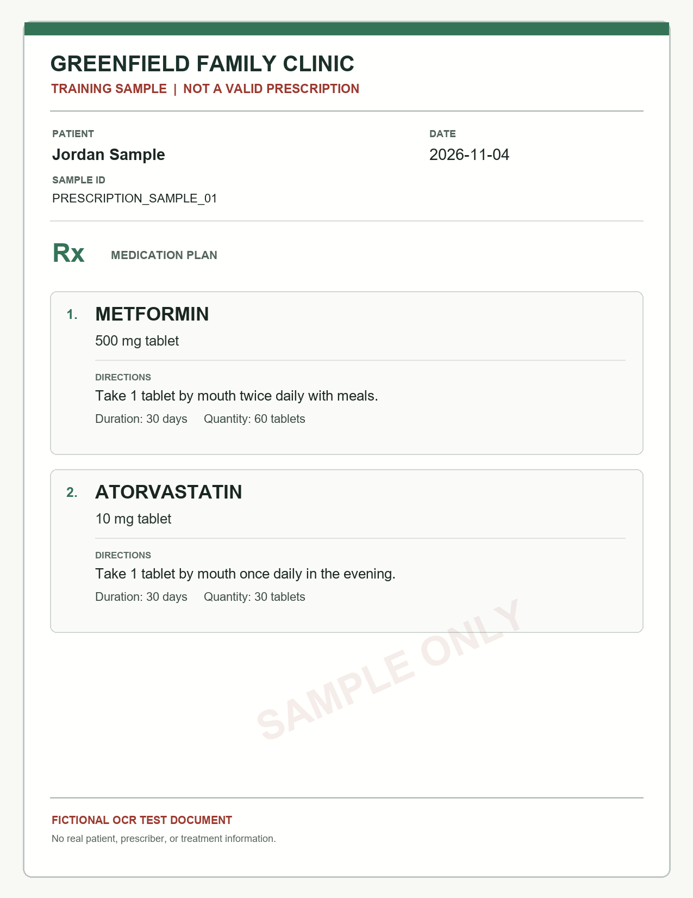
05 | IMPLEMENTATION / DEMO
A short, repeatable product walkthrough.
Use this sequence in a live demo; it follows the actual application flow.
- Sign in - as a Caretaker or Caregiver.
- Connect - a caregiver through a patient-approved access request.
- Upload - a sample prescription and review the extracted fields.
- Save - a medication plan, then open today's schedule.
- Record - a dose and show the updated log or notification.
DEMO INPUT
Synthetic prescription sample
Fictional data | OCR requires an OCR.space key
CAREMATE | PROJECT PRESENTATION
07

Slide 8
06 | APPLICATIONS
Designed for everyday home medication routines.
CareMate brings the repeated tasks of medicine tracking into a shared, patient-centered workspace.
01
For patients
02
For family caregivers
03
For routine check-ins
Maintain profiles, medicine plans, reminder schedules, dose records, and follow-ups.
Monitor a connected patient after access is approved; see plans and missed-dose alerts.
Use schedules and reports to prepare questions for a clinician or pharmacist.
IN THE CURRENT BUILD
OCR-assisted entry | editable plans | dose tracking | reports | appointments | custom reminders
CAREMATE | PROJECT PRESENTATION
08

Slide 9
07 | OUTCOMES
A working end-to-end care workflow.
Current outcomes are functional capabilities; no clinical impact or OCR accuracy benchmark is claimed.
OK
A prescription becomes structured data
OCR text is parsed into fields users can review and correct.
OK
A plan becomes a daily routine
Saved plans drive a dated schedule and status tracking.
OK
Care becomes shareable with permission
Patient approval controls caregiver access to records.
OK
Activity becomes visible
Reports summarize recorded doses; notifications surface due and missed events.
Measured next: extraction accuracy, field-level error rates, reminder delivery reliability, and usability.
CAREMATE | PROJECT PRESENTATION
09

Slide 10
08 | FUTURE SCOPE
A practical path from prototype to trusted service.
The next steps focus on reliability, accessibility, evaluation, and deployment readiness.
01
Evaluate OCR quality
02
Improve alert delivery
03
Expand accessibility
Build a consented, de-identified test set; measure field-level accuracy and correction effort.
Add dependable delivery options and operational monitoring beyond an open browser session.
Complete Hindi and Marathi coverage; test mobile layouts and assistive technology.
04
Strengthen deployment
05
Pilot with care teams
NORTH STAR
Use HTTPS, managed secrets, backups, rate limits, and access audits before real-world use.
Test workflows with patients, caregivers, pharmacists, and clinicians; refine from feedback.
Useful reminders.
Clear records.
Human-led decisions.
CAREMATE | PROJECT PRESENTATION
10

Slide 11
CAREMATE
Make the routine
easier to follow.
One place for medication plans, dose records, reminders,
and approved care connections.
PLAN
REVIEW
CareMate supports organization and follow-through.
It does not replace clinical advice.
REMIND
THANK YOU

