Slide 1
TEW-KB
TiddlyWiki - TypeDB

Slide 2
TiddlyWiki

Slide 3
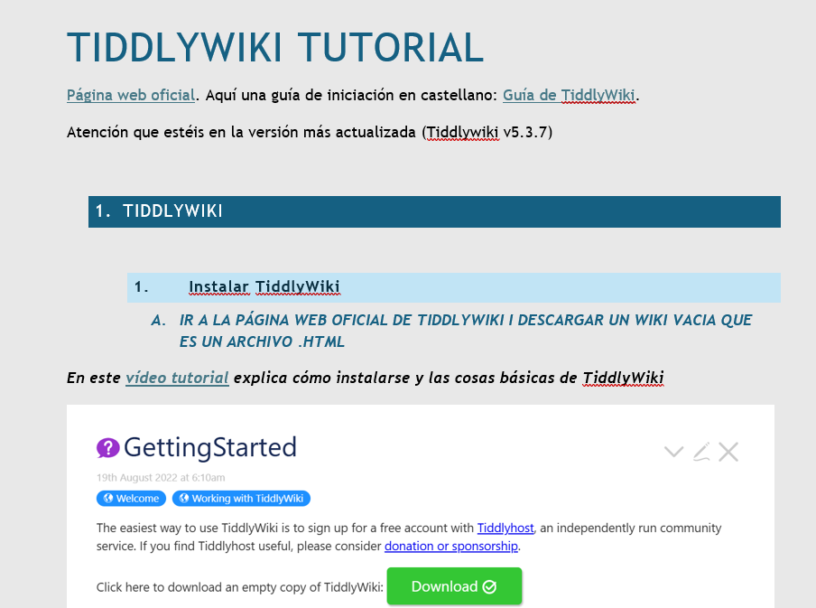
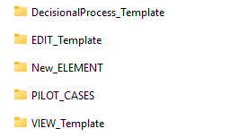
TiddlyWiki Documents
TiddlyWiki Tutorial
Folders

Slide 4
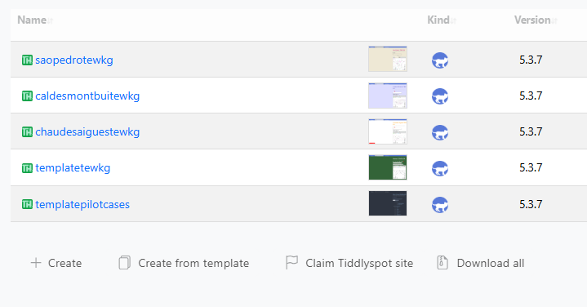
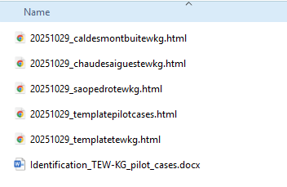
TEW-KG Projects
1. Pilot_Cases: projects in .html files
Before using TEW-KG on the Web Server, ensure the Pilot Case responsible has saved and closed the tool.

Slide 5
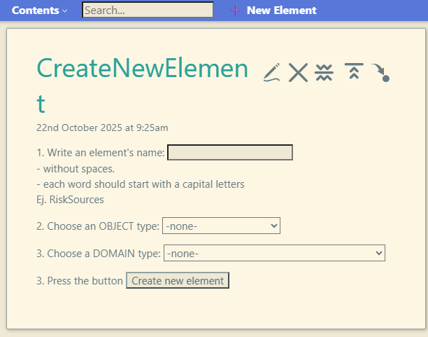
TiddlyWiki Scripts
2. Script: New Element in the Menu

Slide 6
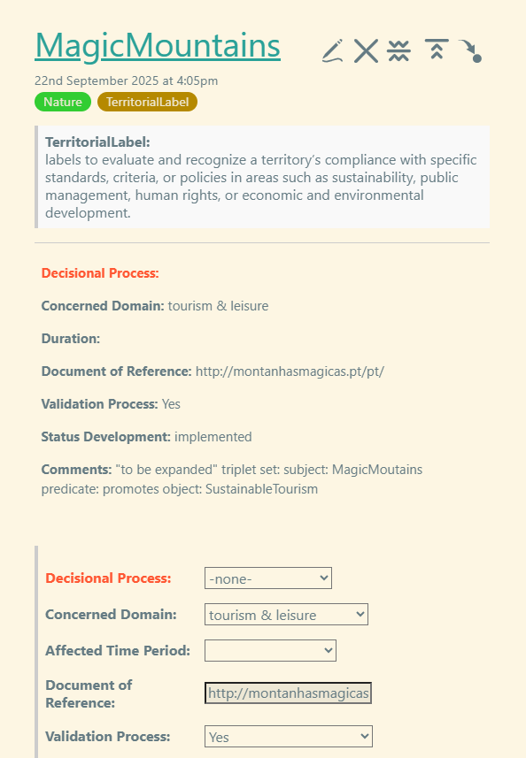
TiddlyWiki Scripts
3. Scripts: Create and View the attributes / decisional Process

Slide 7
TypeDB

Slide 8
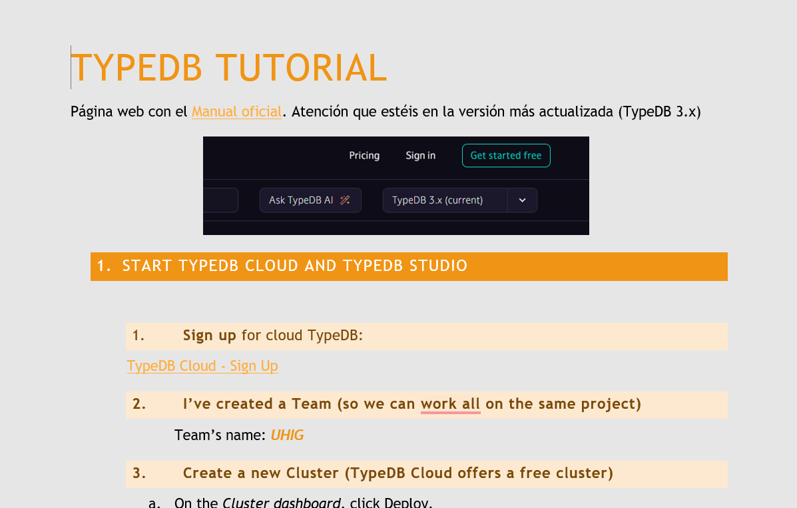
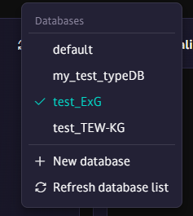
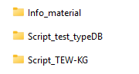

TypeDB Documents
TypeDB Tutorial
  Starting TypeDB Cloud & TypeDB Studio
  TypeDB Console Installation
  TypeDB Model Creation
    Defining TypeDB SCHEMA
    Querying the SCHEMA
    Inserting Instances
    Querying entities, relations and attributes.
Folders

Slide 9
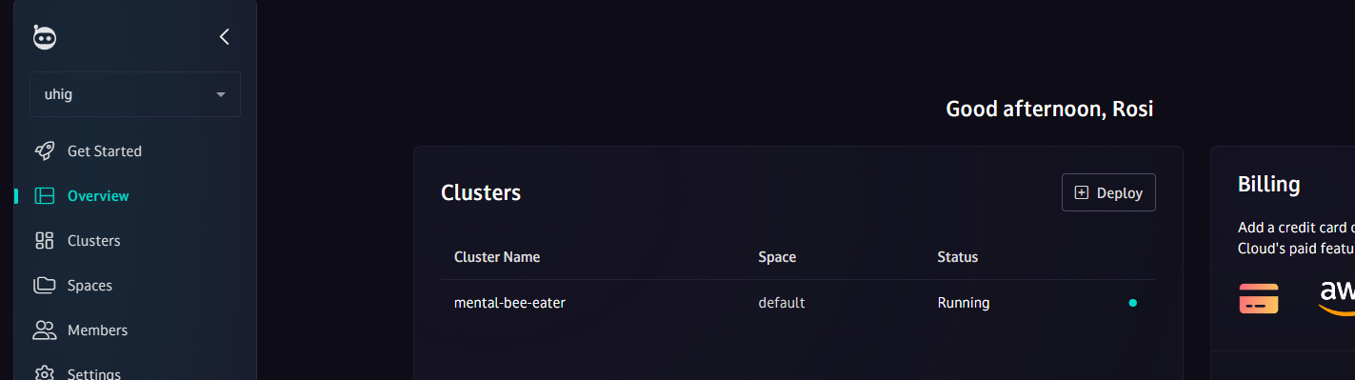
¿Cómo acceder a TypeDB?
To access the TypeDB Studio interface, you need to connect to TypeDB Cloud and create a server (“cluster”):
  Instructions for connecting are provided in the document: TypeDB_Tutorial.doc
You can use the “cluster” I have already set up for practice, logging in as another member.
TypeDB Studio & Cloud

Slide 10
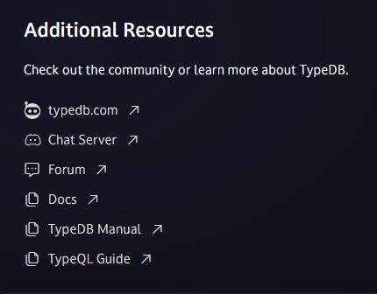
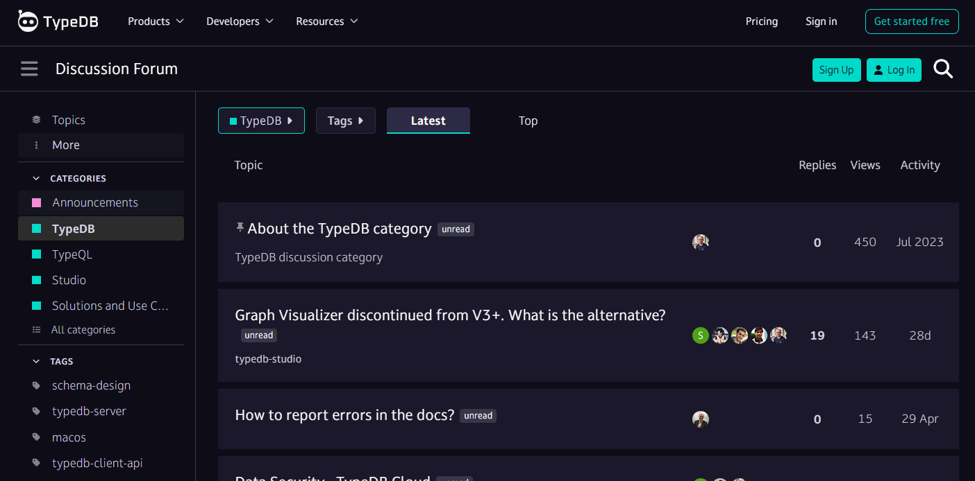
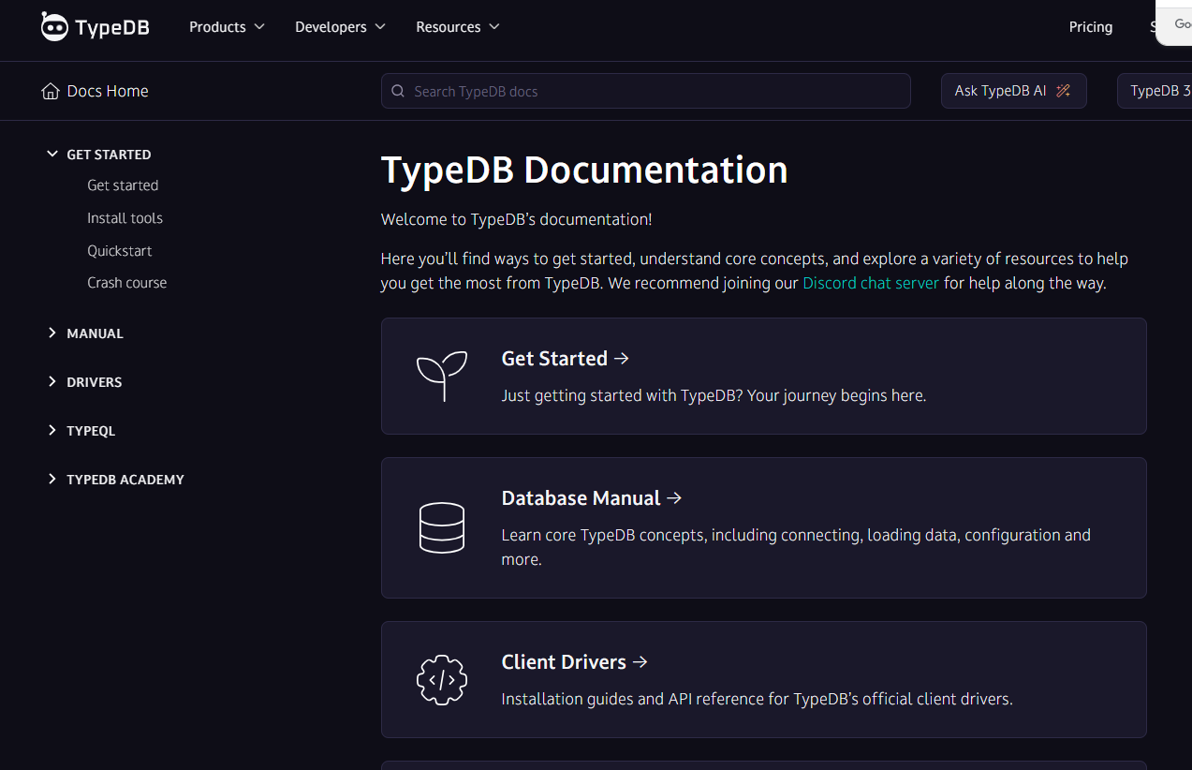
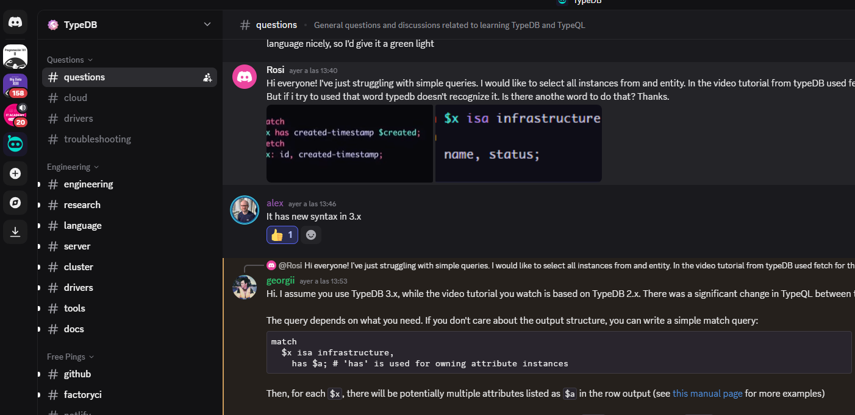
Information & Formation Sources
Video tutorials and some documentation are outdated.
Very active Discord channel with fast responses

Slide 11
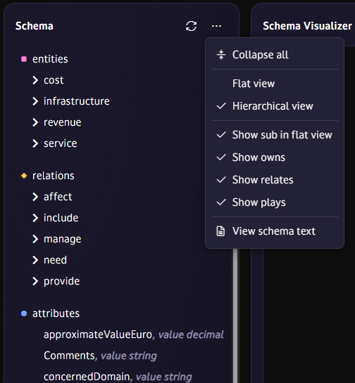
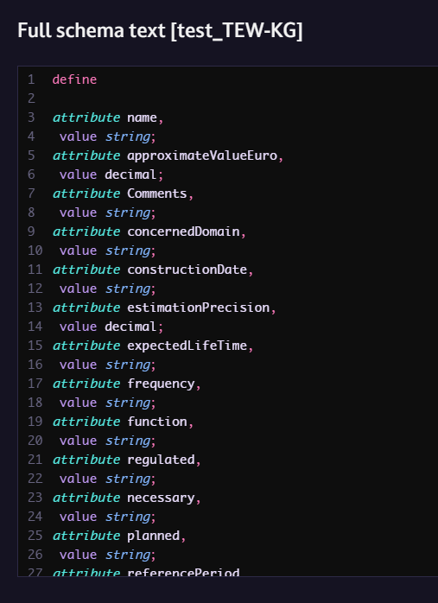
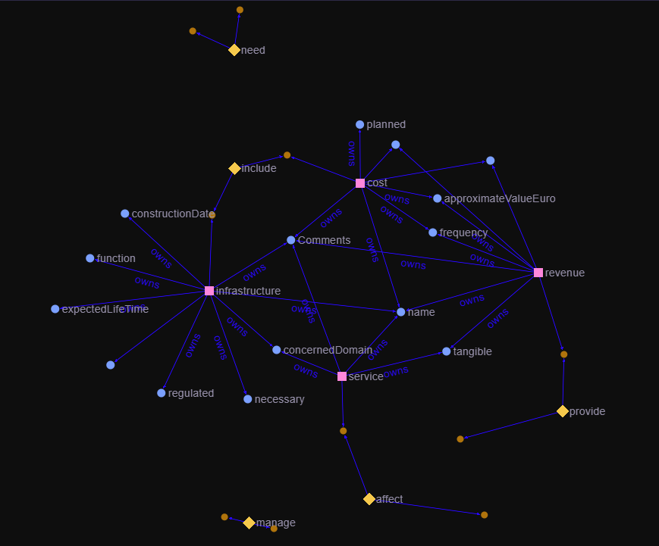
TypeDB Tutorial
  Schema dropdown
  Schema Script
  Schema Visualizer
Interface Updated: SCHEMA

Slide 12
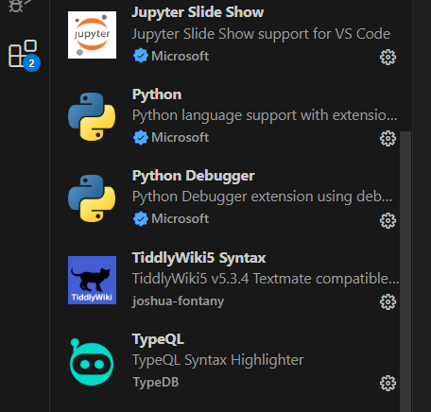
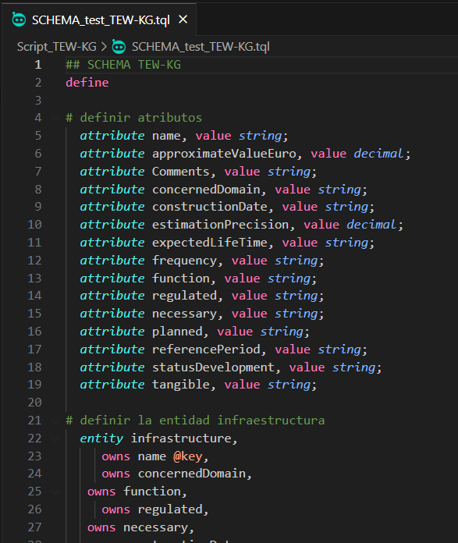
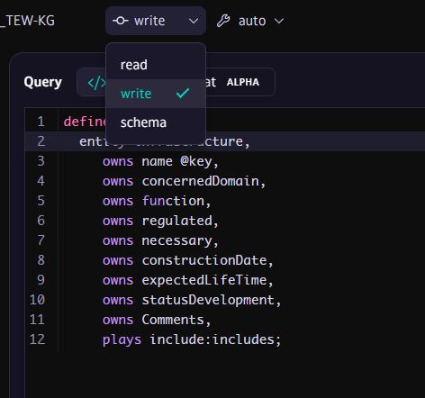
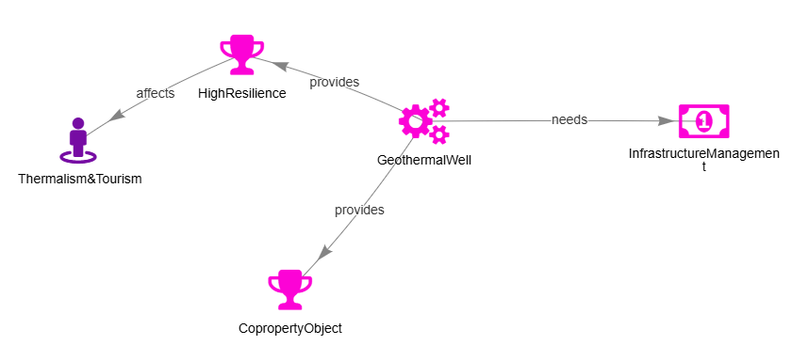
TEW-KG SCHEMA
TypeQL Extension for VSC
define
entity
Infrastructure, Cost, Revenue, Service
attribute
relation

Slide 13
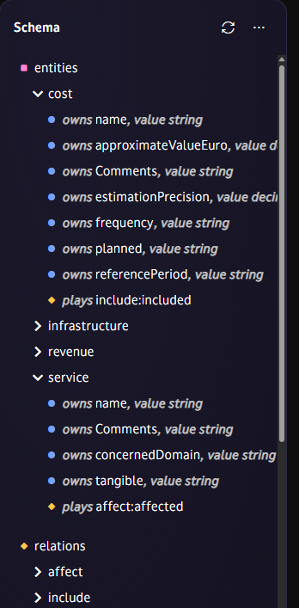
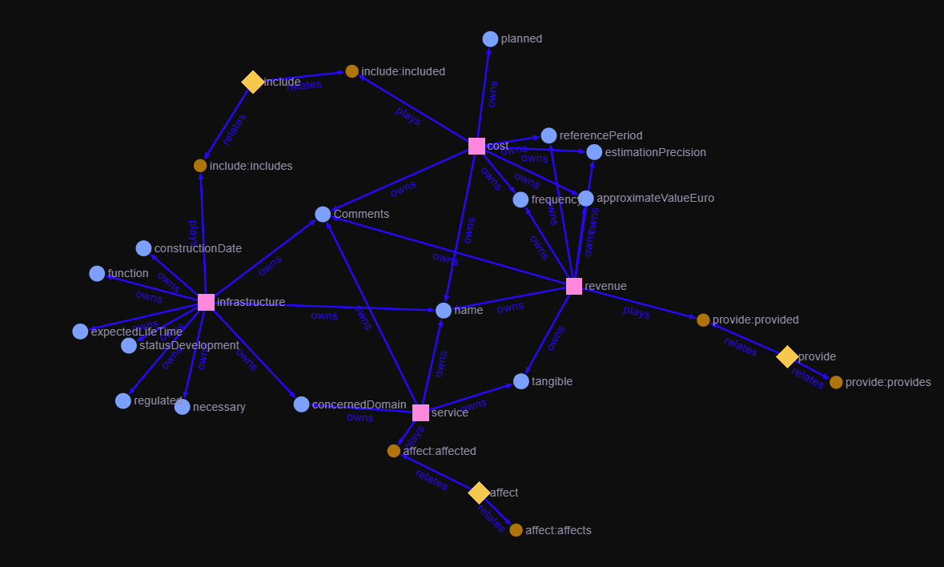
TEW-KG SCHEMA

Slide 14
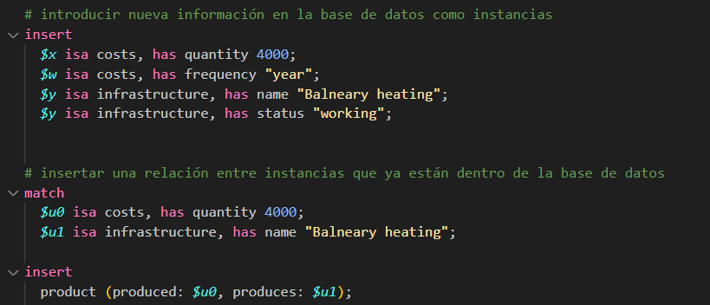
TEW-KG Instances
How to insert in TypeDB?

Slide 15
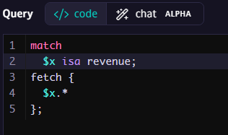
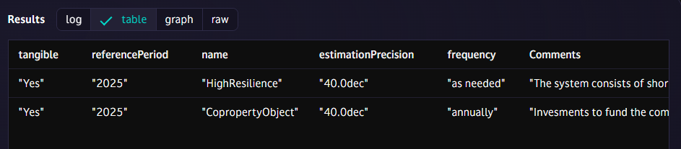
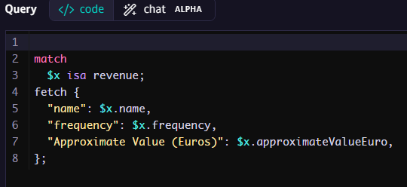
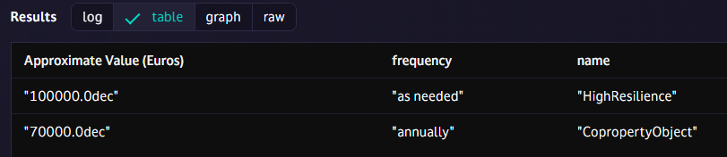
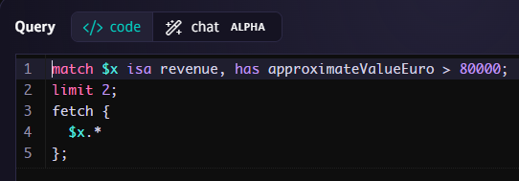
Querying Instances

Slide 16
TEW-KB
TiddlyWiki → TypeDB

Slide 17
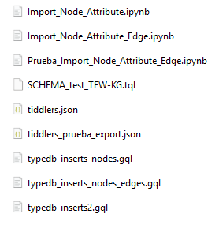
TiddlyWiki → TypeDB
Translation Python Script .ipynb
(TW→TDB)
INPUT: .json (TiddlyWiki)
OUTPUT: .gql (TypeDB)

Slide 18
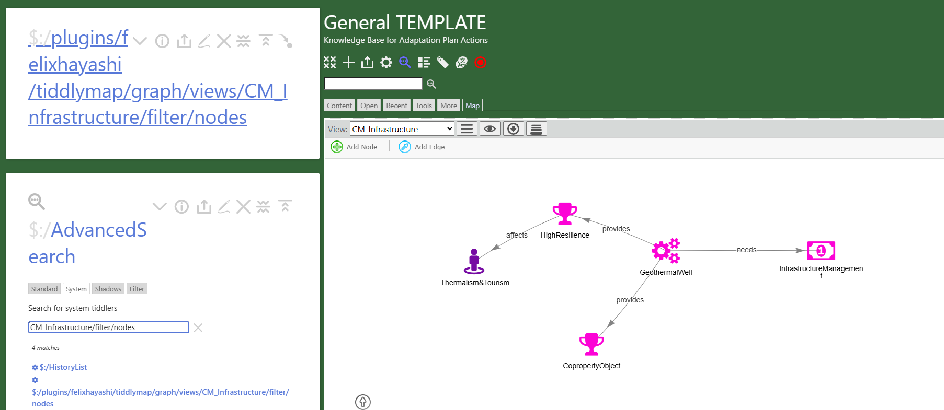
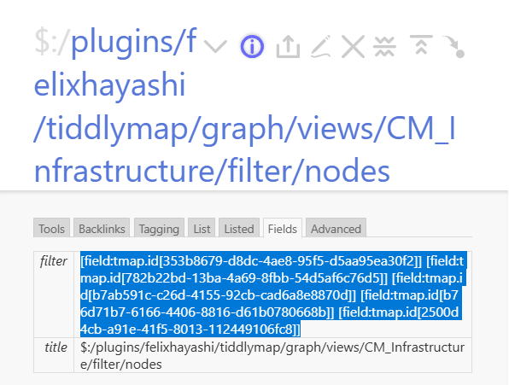
TiddlyWiki → TypeDB
1. Getting the INPUT FILE

Slide 19
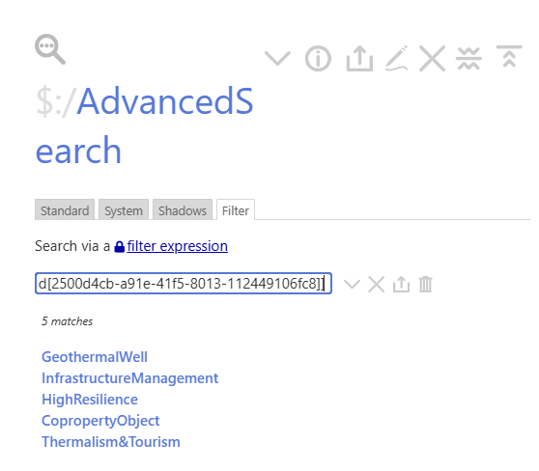
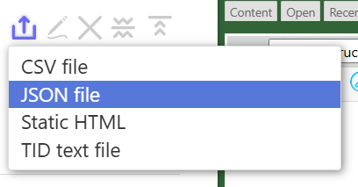
TiddlyWiki → TypeDB
1. Getting the INPUT FILE

Slide 20
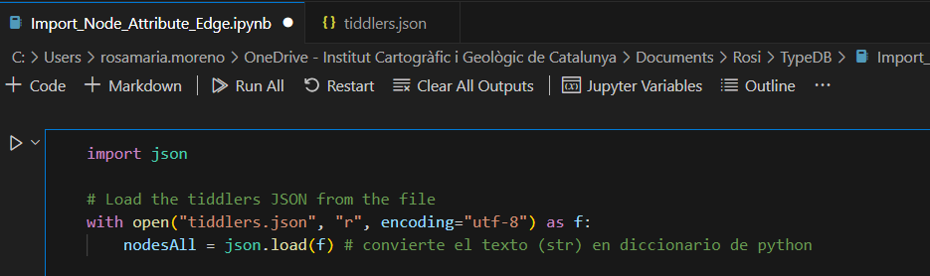
TiddlyWiki → TypeDB
Instances
INPUT: .json (TiddlyWiki)

Slide 21
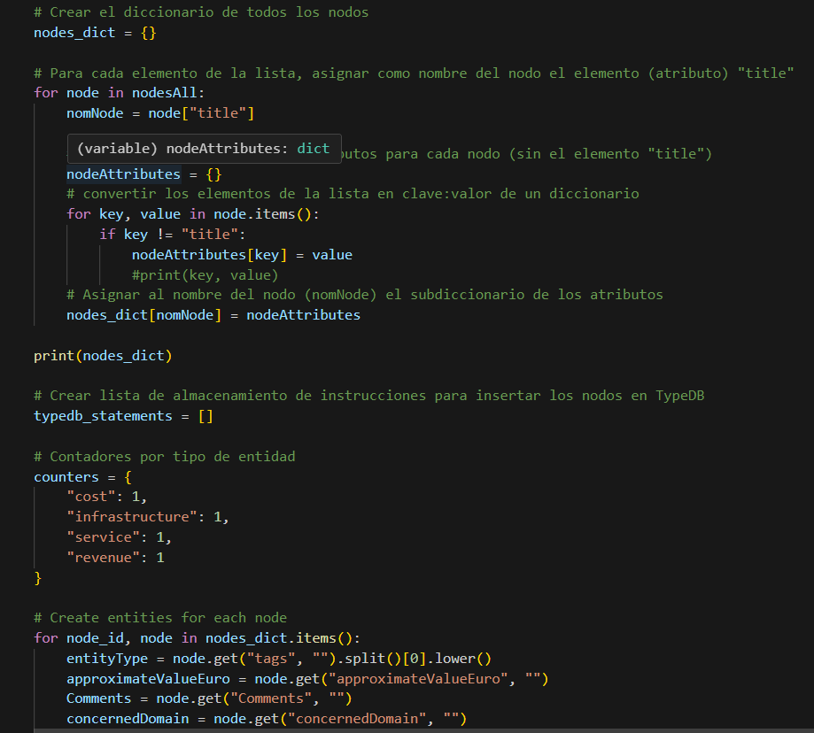
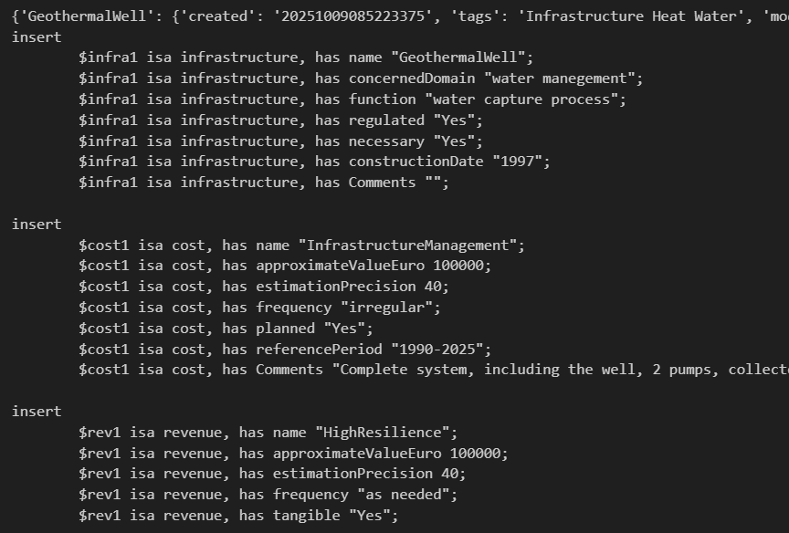
TiddlyWiki → TypeDB
Translation Python Script .ipynb
(TW→TDB)
Instances

Slide 22
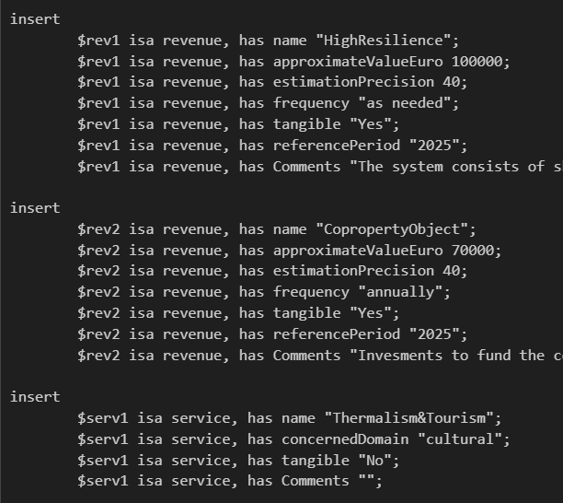
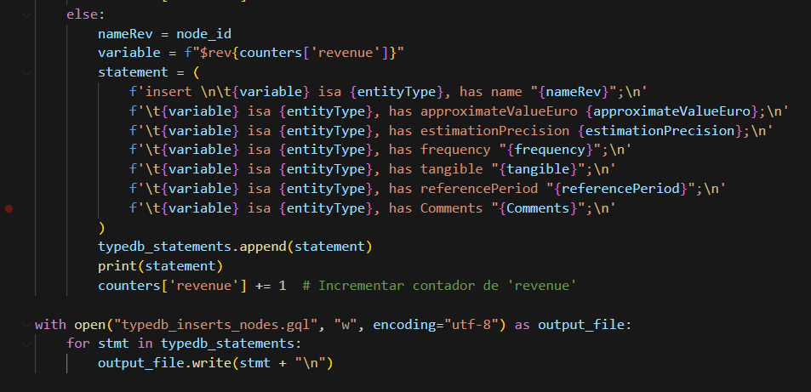
TiddlyWiki → TypeDB
Translation Python Script .ipynb
(TW→TDB)
Instances

Slide 23
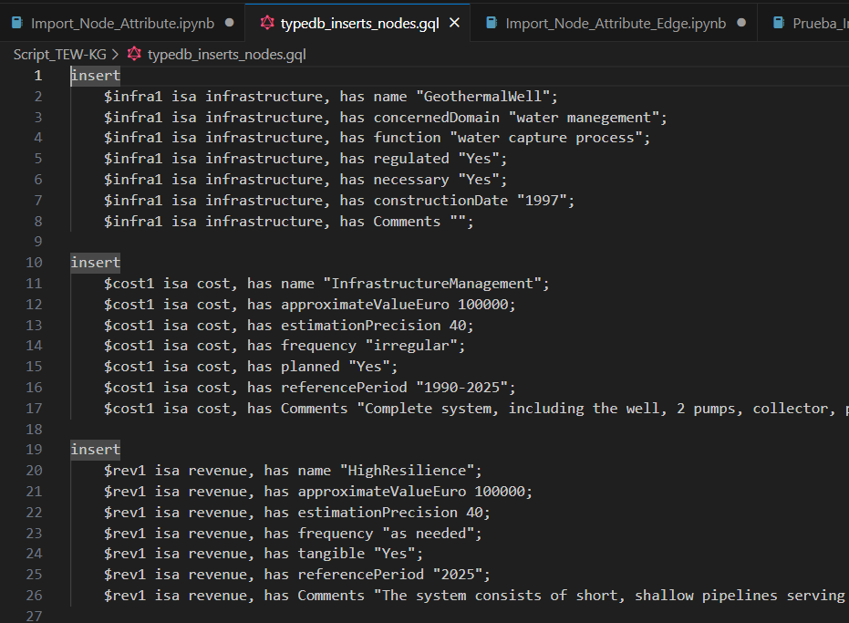
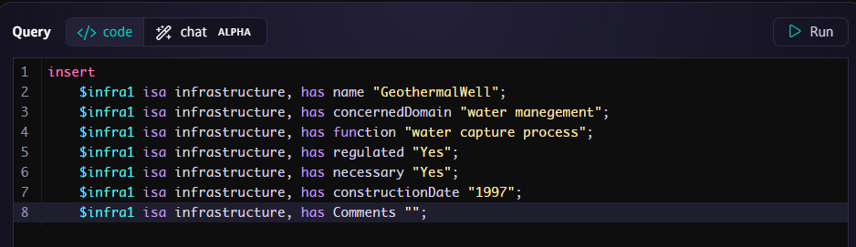
Script for TypeDB
OUTPUT: .gql (TypeDB)
Instances
IT WORKS!!!

Slide 24
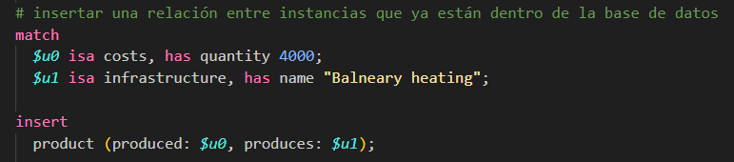
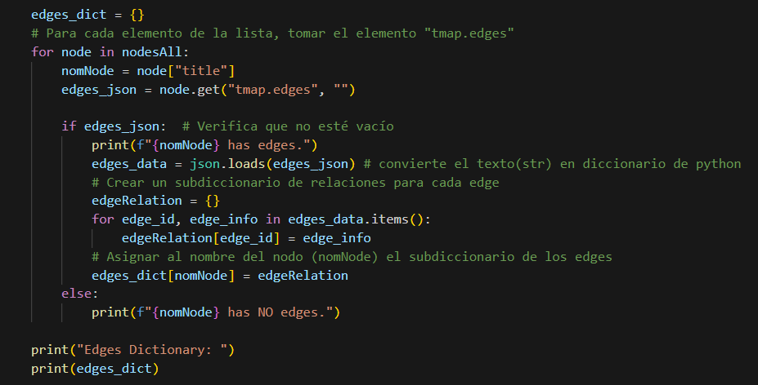
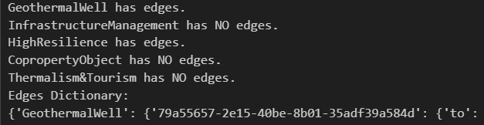
Script for TypeDB
INPUT: .json (TiddlyWiki)
Relations
Translation Python Script .ipynb
(TW→TDB)

Slide 25
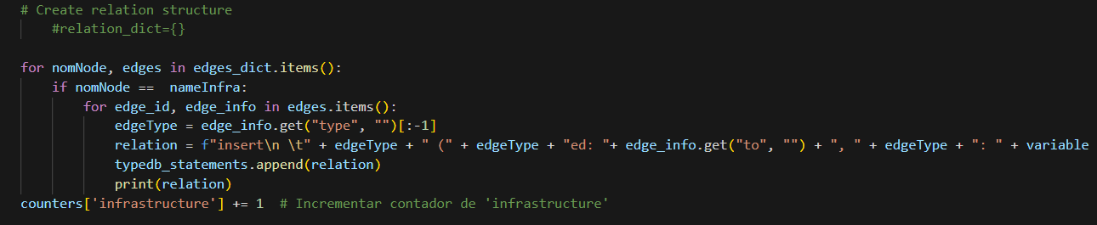
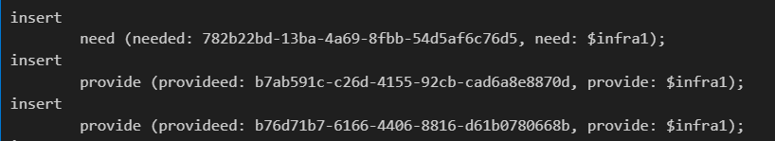
Script for TypeDB
INPUT: .json (TiddlyWiki)
Relations
OUTPUT: .gql (TypeDB)
IT DOESN’T WORKS YET!!!

Slide 26
TypeDB
Constraints & Weaknesses

Slide 27
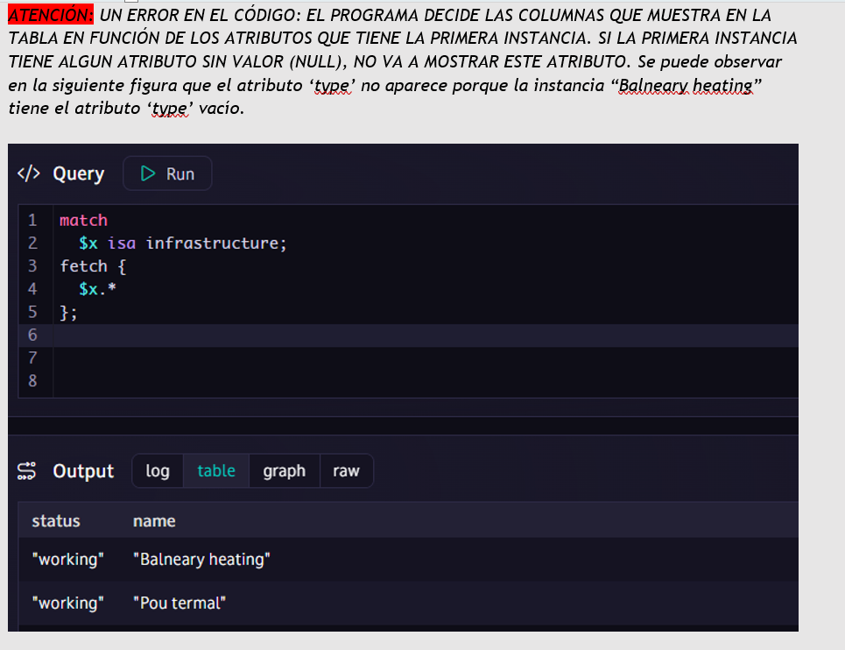
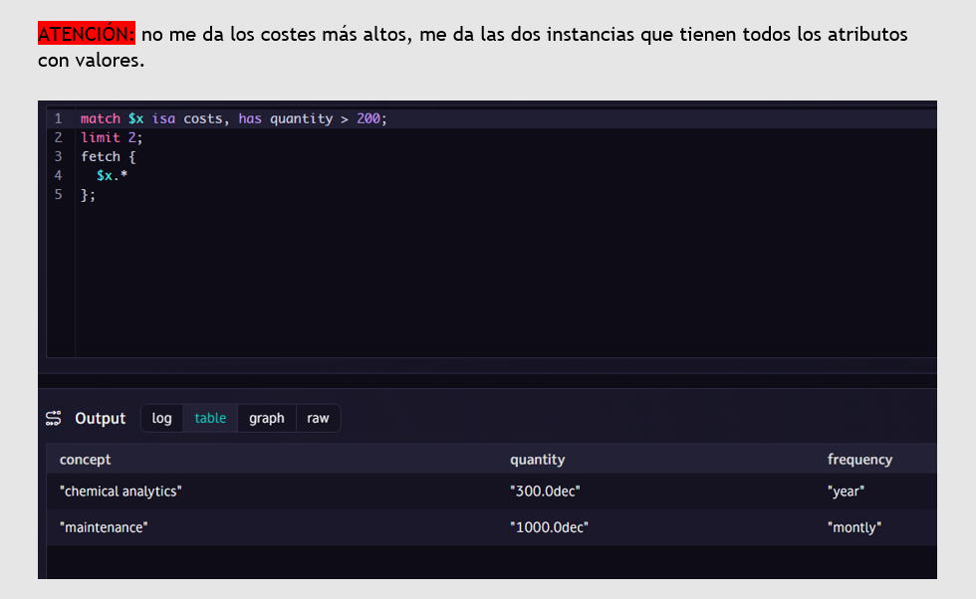
Outputs Errors

