Slide 1
Visualization of neural network prediction using LIME package

Slide 2
Agenda
1. Goal and Motivation
2. The need for Interpretability in models
3. Intro to LIME
4. Code Example

Slide 3
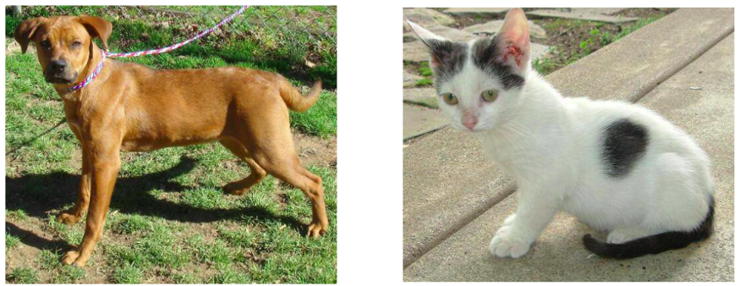
Goal - Classification
Which features identify each pets?

Slide 4
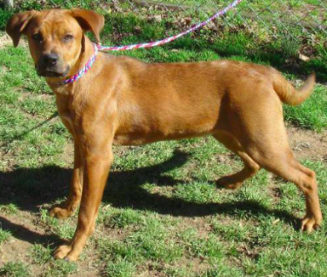
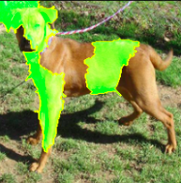
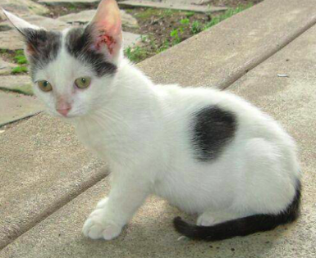
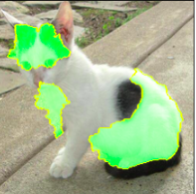
Motivation
Input
Output
Black Box

Slide 5
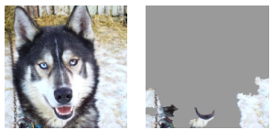
2. The need for Interpretability in models
Verification of the model
How do we trust the model?
Production ready models (Hospitals etc..)
Detect and improve untrustworthy models
Example - Classification of Husky vs Wolf
Learning from the model
Alpha Go
Compliance to legislation
EU's GDPR law for "Right to explanation" for AI systems

Slide 6
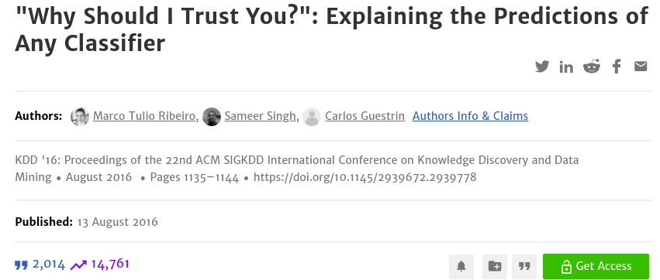
3. Into to LIME - Local Interpretable Model-agnostic Explanations

Slide 7
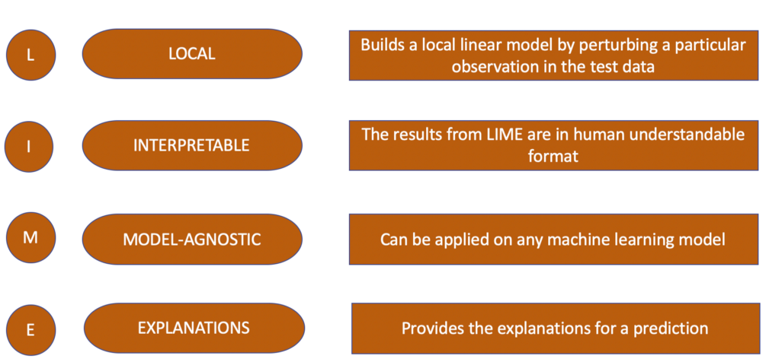
4. Into to LIME - Local Interpretable Model-agnostic Explanations

Slide 8
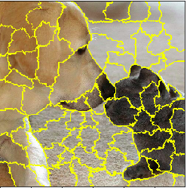
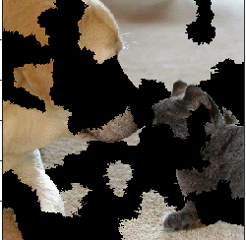
LIME - Algorithm
Extract super-pixels and create random perturbations
Use model to predict the new perturbed images
Calculate distance between perturbed images and
original image to get similarity scores
Fit a linear model with perturbed images, predictions
and similarity scores
This gives the importance of each super-pixel segment
for the prediction of a dog/cat.

Slide 9
Code Example - Classification

Slide 10
Resources
Husky vs Wolf
Lime Paper
CNN Visualisation
LeNet
Kaggle notebook
Talk on LIME framework by author

