Slide 1
Predicting Late Deliveries of Global Health Commodities
BUAN6356 · GROUP D
An early warning at purchase-order release, using USAID GHSC-PSM data
Jihye · Indra · Aarushi · Vishnu · Ethan · Jeremiah
Notes:
Hi everyone, we are Group D. Our project predicts which health-commodity order lines will miss the program’s on-time window, early enough for managers to act.

Slide 2

Why late deliveries matter
3 · PATIENT HARM
1 · LATE DELIVERY
2 · STOCKOUT
About 2.8×
11.4%
Empty shelves
HIV patients who had to stop treatment because of stock-outs left care or died at about 2.8 times the rate of other patients
of order lines miss the program’s on-time window
Procurement delays are cited as a cause of medicine stockouts in Africa
Our goal: flag risky order lines when the purchase order is released, typically about four months (median 121 days) before the promised date, so managers can act early.
Sources: our data (Not On Time rate, days left); Gallien et al. (2017), POMS; Pasquet et al. (2010), PLoS ONE, adjusted hazard ratio 2.83
Notes:
Why does this matter? These orders carry HIV, malaria, family planning, and maternal and child health products. In our data, 11.4% of order lines miss the program’s on-time window. Research links such delays to real harm. Gallien and colleagues note that procurement delays are cited as a cause of medicine stockouts in Africa. And Pasquet and colleagues followed HIV patients in Côte d’Ivoire, also called Ivory Coast: patients who had to stop treatment because of stock-outs left care or died at about 2.8 times the rate of other patients. That is an association from an observational study, not proof of cause. So our goal is an early warning when the purchase order, or PO, is released. At that point there is still a median of 121 days, about four months, before the promised date, so managers have time to act.

Slide 3
Our dataset: USAID GHSC-PSM deliveries
The USAID Global Health Supply Chain Program – Procurement and Supply Management (GHSC-PSM) buys and delivers health products for U.S. programs such as the President’s Emergency Plan for AIDS Relief (PEPFAR).
39,681
104
order lines
columns
Each row is one order line. It records:
18,198
4,592
What was ordered (product, quantity, price)
When each approval and purchase-order step happened
How it was shipped (air, land, sea)
When it arrived versus the promised date
orders
products
96
2016–23
recipient countries
orders entered
Source: data.usaid.gov dataset tikn-bfy4, via Internet Archive snapshot (June 11, 2024)
Notes:
Our data comes from GHSC-PSM, the Global Health Supply Chain Program – Procurement and Supply Management. It buys and delivers health products for U.S. programs such as PEPFAR, the President’s Emergency Plan for AIDS Relief. Each row is one order line: what was ordered, when each approval and PO step happened, how it was shipped, and when it arrived compared with the promised date. The original download is no longer online, so we used an Internet Archive copy from June 2024. It has 39,681 order lines and 104 columns, covering 96 countries and orders entered from 2016 to 2023.

Slide 4
Data Exploration
& Visualization
PART 1
Each variable’s statistics, outliers and pre-processing
Jihye · Indra
Notes:
Indra and I will walk you through part one: what we analyze and predict, each variable’s statistics, and then outlier detection with box plots and pre-processing.

Slide 5
The analysis data at a glance
Type | Count | What it holds
Outcome (0/1) | 2 | Not On Time (main), Late Only (robustness)
Numeric predictor | 11 | Quantity, price, lead times, approval and purchase-order (PO) times
Log version | 4 | log10 of quantity, price, line value, lines per order (Logistic Regression only)
Categorical predictor (factor) | 10 | 2–13 groups each, e.g., transport mode, country
ID (not a predictor) | 2 | Order number, order entry date (for splitting by time)
27,950
order lines (rows)
29
columns (variables)
Source: USAID GHSC-PSM Health Commodity Delivery Dataset, cleaned analysis sample
Notes:
Here is the data we end up modeling: 27,950 order lines and 29 columns. Two are outcomes, 21 are predictors, 11 numeric and 10 categorical, four are log versions used only in Logistic Regression, and two are IDs we keep only to split the data by time. How we got from 39,681 lines to 27,950 comes at the end of this part.

Slide 6
What we predict: Not On Time
The program’s official rule: a line is on time if it arrives between 14 days early and 7 days late versus the agreed delivery date.
11.4%
Too early
On time (0)
Late
More than 14 days early
14 days early to 7 days late
More than 7 days late
of order lines are Not On Time (3,173 of 27,950)
24,777
263
2,910
Robustness check: late only = 10.4%
Not On Time (1) = too early or late · On Time (0) = inside the window
Rule: GHSC-PSM FY2018 Annual Report. The dataset’s On Time (OTD) column follows this rule in 97.9% of rows.
Notes:
What do we predict? Our outcome follows the program’s own on-time rule, not one we made up: a line is on time if it arrives between 14 days early and 7 days late versus the agreed delivery date. Anything outside that window is Not On Time. That is 11.4% of lines: 2,910 arrived late and 263 arrived too early. As a robustness check, we also model late-only deliveries, which is 10.4%.

Slide 7

From 104 columns to 21 predictors
104 columns in the original data
Why 55 columns were not used
Known only after PO release
27
Middle dates, replaced by durations
6
76 base columns
ID numbers and names
5
28 duplicate date parts dropped (year, month, fiscal quarter)
Same information as another column
5
Too detailed or unclear
4
Used only to build the outcome
3
14
7
55
Too many blanks
3
used as they are
used to build new variables or filter rows
not used (see right)
Too many categories (4,592 products)
1
Same value in every row
1
29 columns in the model data
2 outcomes · 21 predictors (14 + 7 new) · 4 log versions · 2 IDs
Counts from our review of all 76 base columns. Leakage = information the model would not have at prediction time.
Notes:
Next, which columns do we use? The original file has 104 columns, but 28 just repeat parts of other dates, like the year or fiscal quarter. That leaves 76 real columns. We use 14 as they are and 7 more to build new variables or filter rows, and we set aside the other 55. Almost half of those, 27, are only known after the PO is released, like shipped quantity or actual delivery dates. Using them would leak the answer. The rest are IDs, duplicates, or columns with too many blanks or categories.

Slide 8

21 predictors, all known by PO release
AT ORDER ENTRY · 12
AT APPROVAL · 3
AT PO RELEASE · 6
Order type · TLP indicator† · Transport mode* · Task order · Product category · Country · Framework contract · Funding source* · Ordered quantity · Unit price · Line value · Lines per order*
Planned lead time · Promise vs. request · USAID approval time
PO processing time · Entry to PO · Days left at PO · Supplier slack · Vendor incoterm* · Destination incoterm*
Not used: anything recorded after PO release, such as shipped quantity, number of shipments and actual ship or delivery dates. Using them would leak the answer.
* Timing assumed; the dataset does not say when these fields are recorded. † Likely the procurement channel: central (GSC) or decentralized (DCP); what TLP stands for is not documented. PO = purchase order sent to the supplier.
Notes:
That leaves our 21 predictors, grouped here by when they are known. Twelve are known when the order is entered, three at approval, and six at PO release. So everything the model uses is available at the moment we make the prediction. For the starred fields, the dataset does not say exactly when they are recorded, so we state that as an assumption.

Slide 9
Table 1. Definitions and summary statistics
Role | Variable | Definition | Mean | Std. Dev. | Min | Max
DV | Not On Time | 1 = over 14 days early or 7 days late | 0.114 | 0.317 | 0 | 1
DV* | Late Only | 1 = arrived more than 7 days late | 0.104 | 0.305 | 0 | 1
IV | Ordered Quantity | Number of units ordered | 29,334.6 | 113,418.7 | 1 | 2,890,944
IV | Unit Price (USD) | Estimated price of one unit | 419.6 | 4,487.1 | 0.01 | 193,455
IV | Line Value (USD) | Quantity × unit price | 140,949.3 | 392,246.5 | 0.01 | 20,145,375
IV | Lines per Order | Product lines in the same order | 6.0 | 7.1 | 1 | 51
IV | Planned Lead Time | Days from order entry to promised date | 257.9 | 121.7 | 14 | 1,462
IV | Promise vs. Request | Promised date minus requested date | 74.3 | 93.1 | −557 | 1,144
IV | USAID Approval Time | Days from country to USAID approval | 4.9 | 16.3 | 0 | 233
IV | PO Processing Time | Days from USAID approval to PO release | 47.5 | 52.4 | 0 | 775
IV | Entry to PO | Days from order entry to PO release | 121.4 | 87.3 | 0 | 797
IV | Days Left at PO | Days from PO release to promised date | 136.5 | 87.2 | −618 | 1,274
IV | Supplier Slack | Spare days after the supplier is ready | 75.9 | 80.7 | −892 | 1,141
n = 27,950 lines after pre-processing · PO = purchase order · Time in days · DV* = robustness check
Notes:
This is Table 1, in the format from our course guideline: definition, mean, standard deviation, minimum and maximum. The shaded rows are the outcomes; a mean of 0.114 means 11.4% Not On Time. Two things stand out. First, the size variables are very skewed: the average order is about 29,000 units, but the largest is almost 2.9 million, so Logistic Regression uses their log, shown at the end of this table section. Second, some values are negative, and they are real: a negative days-left value means the PO was sent after the promised date had already passed.

Slide 10
Table 1 (cont.). Categorical predictors
Variable | Groups (share of 27,950 lines)
Order Type | Purchase order 89.4% · Distribution order, from a regional warehouse 10.6%
TLP Indicator† | GSC 65.0% · DCP 35.0% (likely central vs. decentralized procurement)
Transportation Mode | Air 49.2% · Land 25.9% · Sea 24.7% · Multiple 0.2%
Task Order (area) | HIV/AIDS 75.9% · Malaria 15.0% · Family planning 4.8% · Mother & child health 4.3%
Product Category (11) | Lab reagents 23.7% · Lab supplies 20.3% · Other 13.4% · HIV/AIDS drugs 11.0% · 7 more
Country (13) | Other 22.2% · Mozambique 14.6% · DR Congo 14.2% · Nigeria 9.2% · Zambia 8.8% · 8 more
Framework Contract | Under a long-term supplier contract 60.8% · Not 30.1% · Unknown 9.0%
Funding Source§ | Mission 88.6% · CORE 9.8% · Other donors 1.3% · Unknown 0.4%
Vendor Incoterm‡ | FCA 54.1% · DDP 22.2% · Unknown 10.6% · DAP 9.8% · CIP 2.2% · Other 1.1%
Destination Incoterm‡ | DDP 54.4% · DAP 41.2% · Other 4.4%
Each group is a 0/1 dummy (mean = share). Groups under 500 lines are merged into Other. Full table: next two slides.
† Likely, not documented in the dataset: GSC = Global Supply Chain (central); DCP = decentralized procurement, mostly lab supplies bought by teams near the country. What TLP stands for is unknown.
‡ Shipping terms: FCA = Free Carrier · DDP = Delivered Duty Paid · DAP = Delivered at Place · CIP = Carriage and Insurance Paid
§ Likely: Mission = USAID country-office funds (e.g., PEPFAR country plans); CORE = central funds (e.g., COVID-19); Other donors = CDC, DOD (U.S.) and DFID (UK)
Notes:
For categorical predictors, each group becomes a 0/1 dummy, so the mean is simply the share of lines. About three quarters of lines are HIV/AIDS orders, and about half go by air. Blank values, for example in framework contract, are kept as an Unknown group instead of being dropped, and small countries and product types are combined into Other. Some codes are not documented in the data, so the footnotes give our best reading. If asked: GHSC-PSM reports use DCP for decentralized procurement, and 80% of DCP lines in our data are lab supplies, which matches. Judging by their detailed labels, Mission and CORE most likely mean country-office and central funds. What TLP stands for is unknown.

Slide 11
Table 1 (cont.). All dummy variables (1 of 2)
Group | Mean | Std. Dev.
Order Type
Purchase order | 0.894 | 0.307
Distribution order | 0.106 | 0.307
TLP Indicator
GSC | 0.650 | 0.477
DCP | 0.350 | 0.477
Transportation Mode
Air | 0.492 | 0.500
Land | 0.259 | 0.438
Sea | 0.247 | 0.431
Multiple | 0.002 | 0.039
Group | Mean | Std. Dev.
Task Order
TO1 HIV/AIDS | 0.759 | 0.428
TO2 Malaria | 0.150 | 0.357
TO3 Family planning | 0.048 | 0.214
TO4 Mother & child | 0.043 | 0.202
Product Category
Lab reagents | 0.237 | 0.425
Lab supplies | 0.203 | 0.403
Other | 0.134 | 0.341
HIV/AIDS drugs | 0.110 | 0.313
Malaria drugs | 0.086 | 0.280
Group | Mean | Std. Dev.
Product (continued)
Essential medicines | 0.082 | 0.275
Medical supplies | 0.038 | 0.191
Respiratory support | 0.037 | 0.189
Lab equipment | 0.027 | 0.161
Bed nets (LLINs) | 0.024 | 0.153
Male condoms | 0.021 | 0.143
Framework Contract
Framework | 0.608 | 0.488
Non-framework | 0.301 | 0.459
Unknown | 0.090 | 0.287
10 categorical variables split into 52 groups (Product continues in the next column). Each group is a 0/1 dummy: Min = 0, Max = 1, Mean = share of 27,950 lines. LLINs = long-lasting insecticide-treated nets.
Notes:
The next two slides list every group with its mean and standard deviation. I will not read them all; they are here so that every variable in our model data is documented. This one covers order type, TLP indicator, transport mode, task order, product category and framework contract.

Slide 12
Table 1 (cont.). All dummy variables (2 of 2)
Group | Mean | Std. Dev.
Country
Other | 0.222 | 0.416
Mozambique | 0.146 | 0.353
DR Congo | 0.142 | 0.349
Nigeria | 0.092 | 0.289
Zambia | 0.088 | 0.283
Haiti | 0.062 | 0.241
Uganda | 0.055 | 0.228
Tanzania | 0.047 | 0.211
Ethiopia | 0.039 | 0.194
Zimbabwe | 0.031 | 0.174
Group | Mean | Std. Dev.
Country (continued)
Rwanda | 0.029 | 0.167
Cameroon | 0.026 | 0.159
Côte d’Ivoire | 0.020 | 0.141
Funding Source
Mission | 0.886 | 0.318
CORE | 0.098 | 0.297
Other donors | 0.013 | 0.112
Unknown | 0.004 | 0.062
Group | Mean | Std. Dev.
Vendor Incoterm
FCA | 0.541 | 0.498
DDP | 0.222 | 0.416
Unknown | 0.106 | 0.308
DAP | 0.098 | 0.297
CIP | 0.022 | 0.147
Other | 0.011 | 0.102
Destination Incoterm
DDP | 0.544 | 0.498
DAP | 0.412 | 0.492
Other | 0.044 | 0.204
Country continues in the next column. Each group is a 0/1 dummy: Min = 0, Max = 1, Mean = share of 27,950 lines. Code meanings: see the Categorical predictors table.
Notes:
And this is the second half: countries, funding source and the two incoterms.

Slide 13
Table 1 (cont.). Log versions and ID columns
Log versions (used in Logistic Regression only)
Variable | Definition | Mean | Std. Dev. | Min | Max
log Ordered Quantity | log10(ordered quantity + 1) | 2.653 | 1.438 | 0.301 | 6.461
log Unit Price | log10(unit price + 1) | 1.584 | 0.856 | 0.004 | 5.287
log Line Value | log10(line value + 1) | 4.147 | 1.106 | 0.004 | 7.304
log Lines per Order | log10(lines per order + 1) | 0.690 | 0.351 | 0.301 | 1.716
ID columns (not predictors)
Variable | What it is | In the model data
Order Number | Order an order line belongs to | 12,748 orders
Order Entry Date | Date the order was entered; used to split by time | Oct 2, 2017 – Aug 8, 2023
On the log scale, 1 unit = 10 times larger (2 = about 100, 3 = about 1,000). n = 27,950 order lines.
Notes:
Finally, the six model columns not shown in the earlier tables. The four log versions are used only in Logistic Regression; on a log scale, one unit means ten times larger. The two ID columns are not predictors: order number tells which order a line belongs to, and the order entry date lets us train on earlier orders and test on later ones.

Slide 14
From 39,681 to 27,950 order lines
Step | Why | Removed | Remaining
Original dataset | All order lines, entered 2016–2023 | – | 39,681
No outcome or program-excluded | Cannot label on time or not | 35 | 39,646
Replenishment orders | Go to warehouses, not countries | 1,678 | 37,968
PO date after delivery | Date error; prediction point unknown | 2,962 | 35,006
Entered before Oct 2017 | Start-up period, 56.7% not on time | 6,450 | 28,556
Impossible values | E.g., promised date in 2099 | 98 | 28,458
Missing numeric predictor | Both models use the same rows | 508 | 27,950
The last two cleaning steps remove 2.1% of lines; the Not On Time rate stays at 11.4%.
Start-up period: the program restructured its supply chain team and processes at the start of FY2018 (GHSC-PSM, FY2018 Annual Report)
Notes:
We started with 39,681 order lines. After the first round of filtering, we had 28,556. The error rules removed 98 lines, leaving 28,458. Then we dropped 508 lines with missing numbers. That gave us 27,950 lines for modeling. The last two steps removed about 2.1 percent of the lines, and the Not On Time rate still rounded to 11.4 percent.

Slide 15
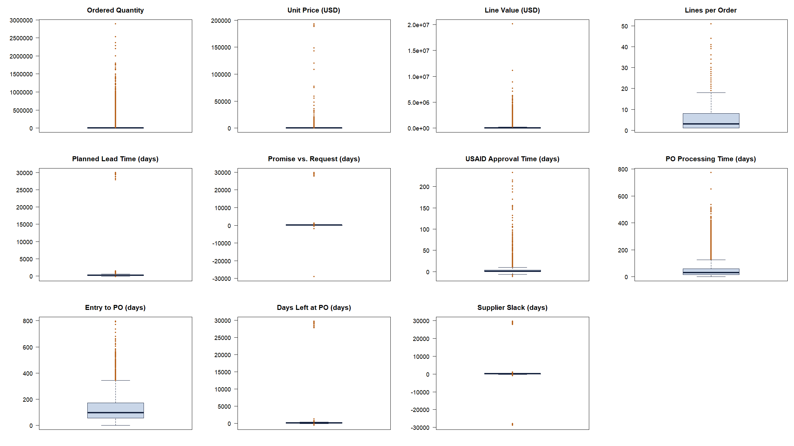
Likely placeholder dates stretch the scale
How to read
Box = Q1 to Q3. Line = median. Dots fall below Q1 − 1.5 × IQR or above Q3 + 1.5 × IQR.
Errors
Four date-based variables reach ±30,000 days (about 80 years) because of likely placeholders such as 2099.
Skew
A few very large orders flatten the boxes for quantity, price and value.
n = 28,556 order lines before pre-processing. Dots are possible outliers, not automatically errors.
Notes:
These box plots show the 28,556 lines before cleaning. The box shows the middle half of the data, and the line inside is the median. A dot appears when a value is more than one and a half times the height of the box past either end of the box. Some date differences were close to 30,000 days because of dates like 2099, which look like placeholders. Very large orders also stretched the scale. The dots showed us where to look more closely.

Slide 16
Seven rules flag likely errors
Rule | Lines | Reason for flagging
Promised delivery date after 2030 | 35 | Data ends in 2023; 2099 looks like a placeholder
Supplier ready date after 2030 | 10 | Same reason
Requested date after 2030 | 1 | Same reason
Requested date over 5 years after entry | 3 | Next largest gap is 932 days
Promised date before order entry | 9 | Cannot promise before the order exists
USAID approval before country approval | 39 | The steps happen in a fixed order
Ordered quantity = 0 | 2 | Nothing was ordered
Lines removed | 98 | 0.34% of lines; one line breaks two rules
Planned lead time, Std. Dev.
Days left at PO, Std. Dev.
Supplier slack, Std. Dev.
1,024 → 122 days
1,012 → 87 days
1,146 → 81 days
Before rules: 28,556. After rules: 28,458. After missing-value removal: 27,950.
Notes:
We used seven rules to flag likely errors, including dates like 2099. One line triggered two rules, so 99 flags came from 98 lines. Removing those lines left 28,458. The spread numbers on this slide compare the starting data with the final sample, after we also removed lines with missing numbers. For example, the standard deviation of planned lead time dropped from 1,024 days to 122 days.

Slide 17
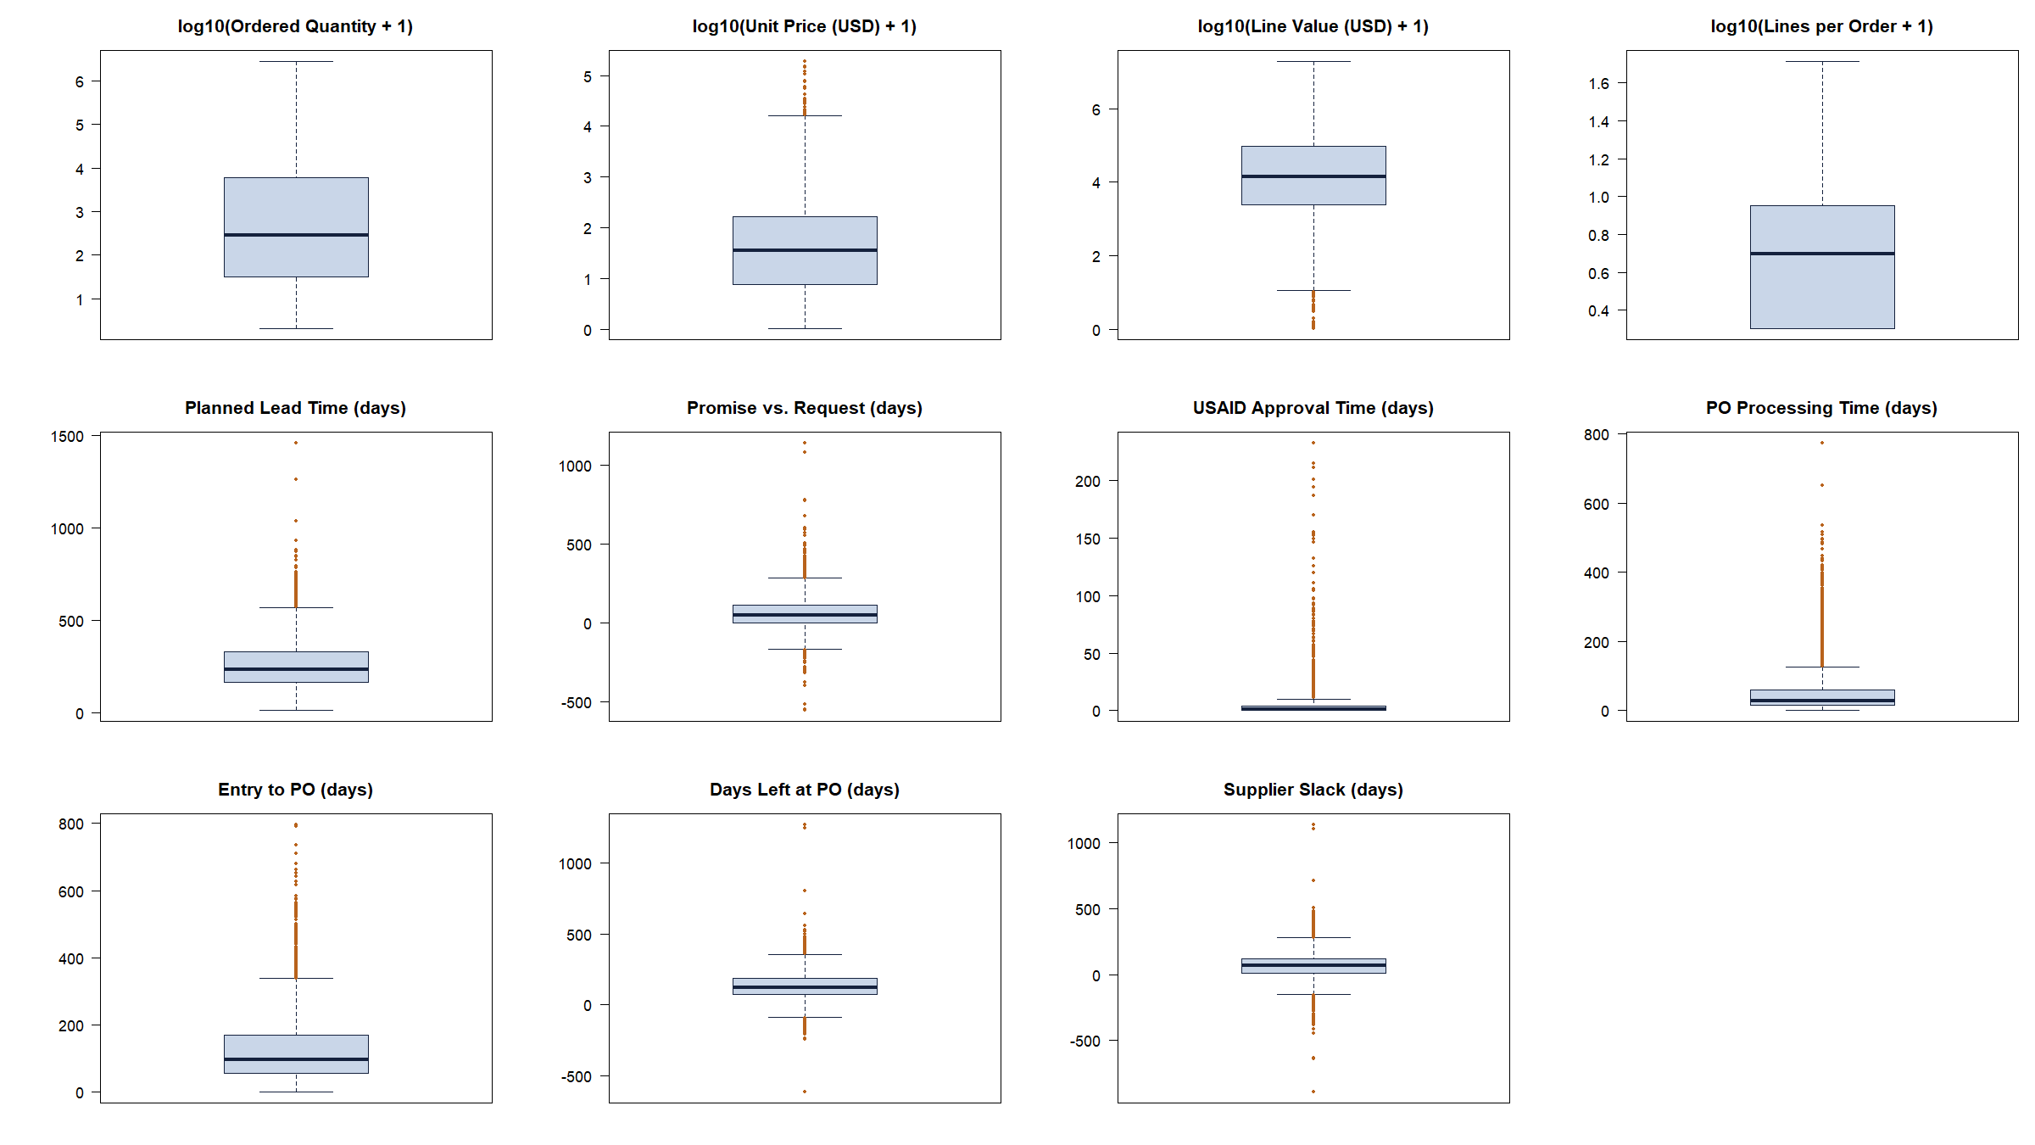
After cleaning, plausible extremes remain
Log scale
On the log scale, the box plots flag 0% of quantities and lines per order.
Observed association
Lines with PO processing over 127.5 days: 16.2% Not On Time, vs. 11.0% for the rest.
We keep these lines. The rates are descriptive.
n = 27,950 order lines after pre-processing. Size variables shown as log10(x + 1).
Notes:
Here are the box plots after cleaning. On the log scale, no dots are flagged for order quantity or lines per order. We kept unusual values that could be real, including long processing times. When purchase order processing took more than 127.5 days, 16.2 percent of lines were Not On Time. For the rest, it was 11 percent. That is the pattern we saw in this sample.

Slide 18
Pre-processing: four decisions
1 · REMOVE IMPOSSIBLE VALUES
2 · LOG THE SIZE VARIABLES
98 lines (0.34%)
log10(x + 1)
Placeholder dates and steps out of order. Spread of date-based variables drops about tenfold.
For Logistic Regression only. Decision Tree splits on order, so it keeps the original values.
3 · KEEP PLAUSIBLE EXTREMES
4 · DROP LINES WITH MISSING VALUES
No trimming
508 lines (1.8%)
Not On Time is more common for longer PO processing (16.2% vs. 11.0%).
Both models use the same rows. Removed lines are 11.0% Not On Time vs. 11.4% kept.
Blank categories (e.g., framework contract) are kept as an Unknown group, not removed. Final data: 27,950 lines.
Notes:
To wrap up, we removed 98 lines with likely errors. We used a log scale for four size variables in logistic regression. The decision tree uses the original numbers. We kept unusual values that could be real. And we dropped 508 lines with missing numbers, so both models start with the same 27,950 lines. The Not On Time rate was 11 percent for the lines we dropped for missing numbers and 11.4 percent for the lines we kept. That outcome includes deliveries that were too early or too late. Next, we use these 27,950 lines to build the decision tree and the logistic regression.

