Slide 1

Group 09
20-March-2024
The analysis of variables influencing movie ratings

Slide 2

CONTENTS
Introduction
01
02
Data Cleaning & Exploratory Analysis
03
04
05

Slide 3
Dataset Description
The IMDB database contains a variety of information on all films that have been released. The following analysis aims to explore the relationship between a set of descriptive variables about a film and its success measured by its respective IMDB rating.
Main Research Questions
Which properties of films influence whether they are rated by IMDB as greater than 7 or not?
Analysis Procedure
Data Cleaning
Data Cleaning
Data Cleaning
Data Cleaning

Slide 4
Data Cleaning
As a subset of the IMDB database, the film dataset contains the following variables:
film_id – The unique identifier for the film
year – Year of release of the film in cinemas
length – Duration (in minutes)
budget – Budget for the films production (in $1000000s)
votes – Number of positive votes received by viewers
genre – Genre of the film
rating – IMDB rating from 0-10
It is now established that film_id will not be used as an explanatory variable since it is only an identifier for the film, rather than an informative feature about it.
Genre is the only categorical variable contained in the data set.
Year, length, budget, and votes are the numerical explanatory variables to be tested in this analysis.

Slide 5
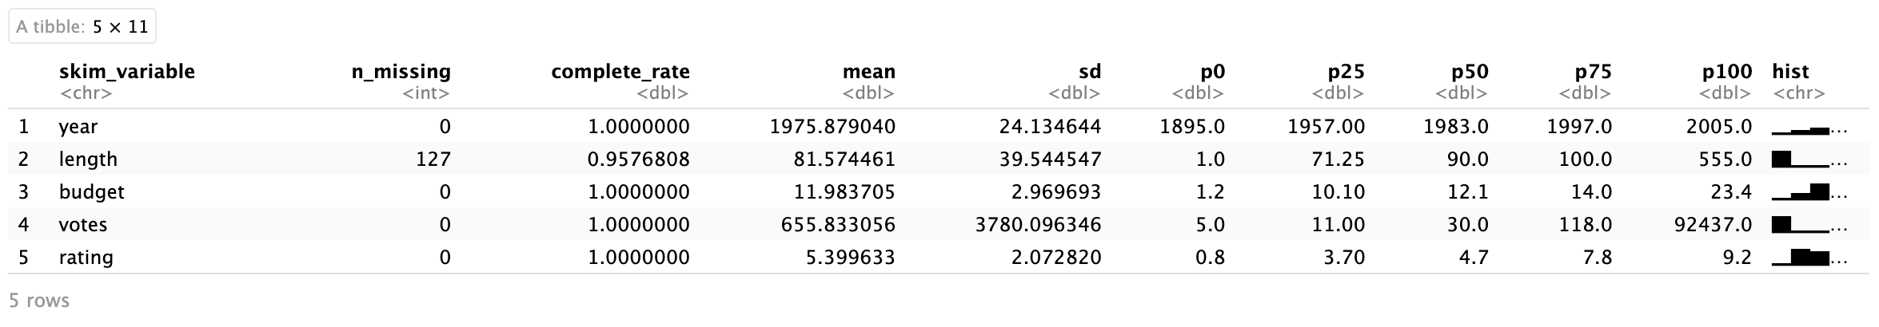
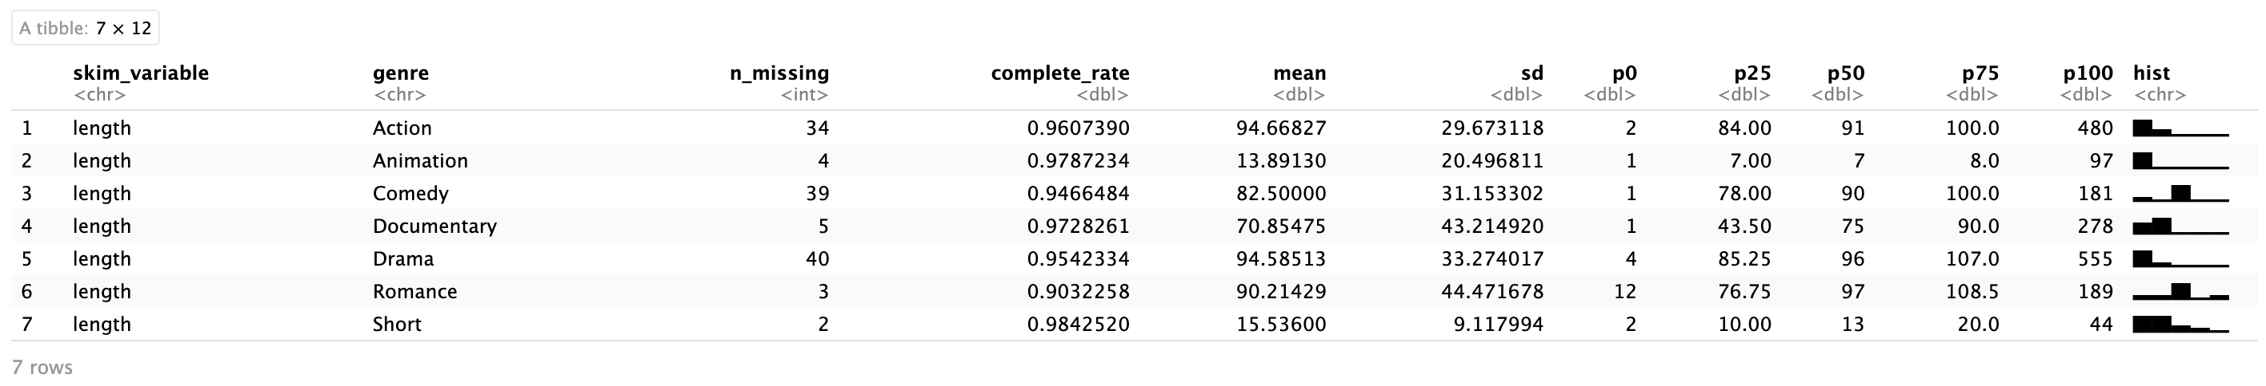
Data Cleaning
When it comes to the numerical variables, summary statistics above show that there are 127 missing values in length variable. For these missing values, the median film length by genre will be chosen to impute, considering the length distribution is not equal among different film genres.

Slide 6
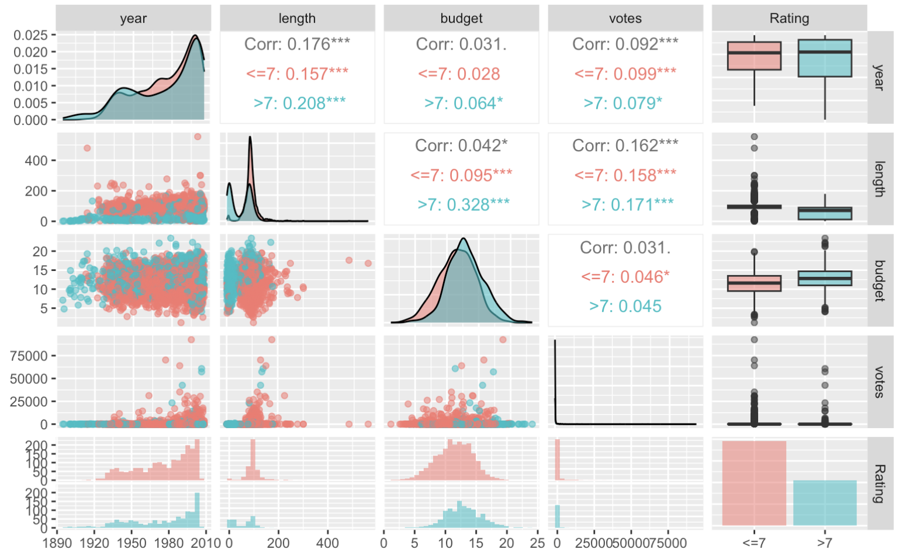
Exploratory Analysis
From this graph, we can see that the correlations between all numerical explanatory variables are very weak.
And according to the boxplots, the ratings tends to be influenced by length and budget, while the influence of votes and years appear to be less pronounced.

Slide 7
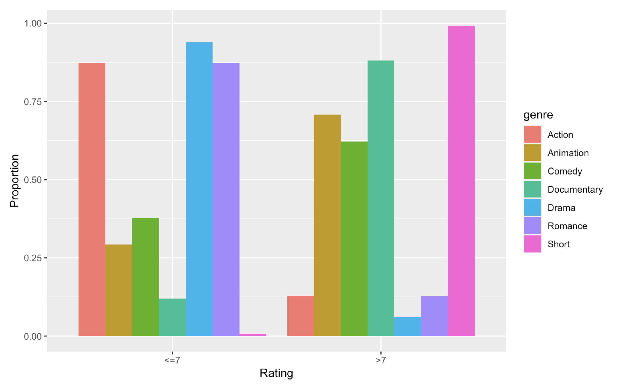
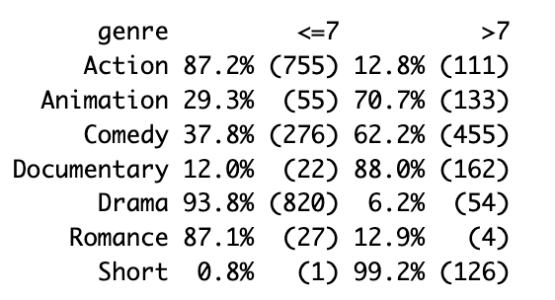
Exploratory Analysis
The barplot and table above show the proportion of ratings in different genres. As we can see, the distribution of the proportion varies greatly across genres.

