Slide 1

Group 09
20-March-2024
The analysis of variables influencing movie ratings

Slide 2

CONTENTS
Introduction
01
02
Data Cleaning & Exploratory Analysis
03
Model Fitting
04
Model Comparison
05
Conclusion

Slide 3
Dataset Description
The IMDB database contains a variety of information on all films that have been released. The following analysis aims to explore the relationship between a set of descriptive variables about a film and its success measured by its respective IMDB rating.
Main Research Questions
Which properties of films influence whether they are rated by IMDB as greater than 7 or not?
Analysis Procedure
Data Cleaning
Data Cleaning
Data Cleaning
Data Cleaning

Slide 4
Data Cleaning
As a subset of the IMDB database, the film dataset contains the following variables:
film_id – The unique identifier for the film
year – Year of release of the film in cinemas
length – Duration (in minutes)
budget – Budget for the films production (in $1000000s)
votes – Number of positive votes received by viewers
genre – Genre of the film
rating – IMDB rating from 0-10
It is now established that film_id will not be used as an explanatory variable since it is only an identifier for the film, rather than an informative feature about it.
Genre is the only categorical variable contained in the data set.
Year, length, budget, and votes are the numerical explanatory variables to be tested in this analysis.

Slide 5
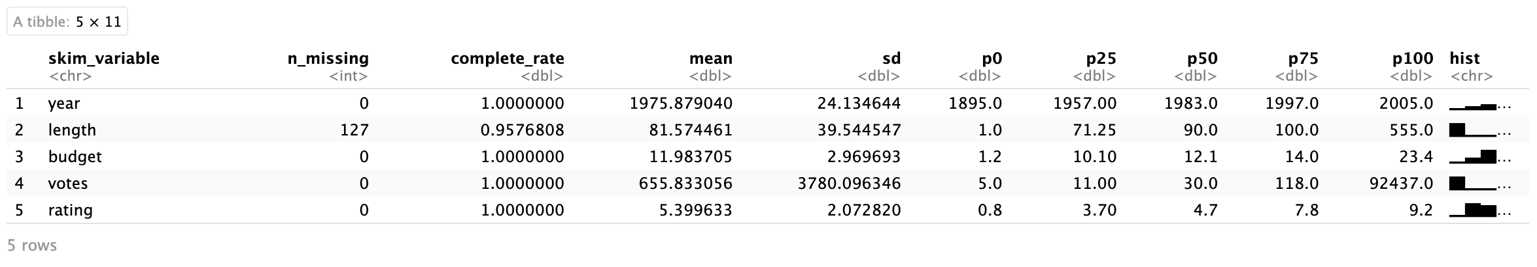
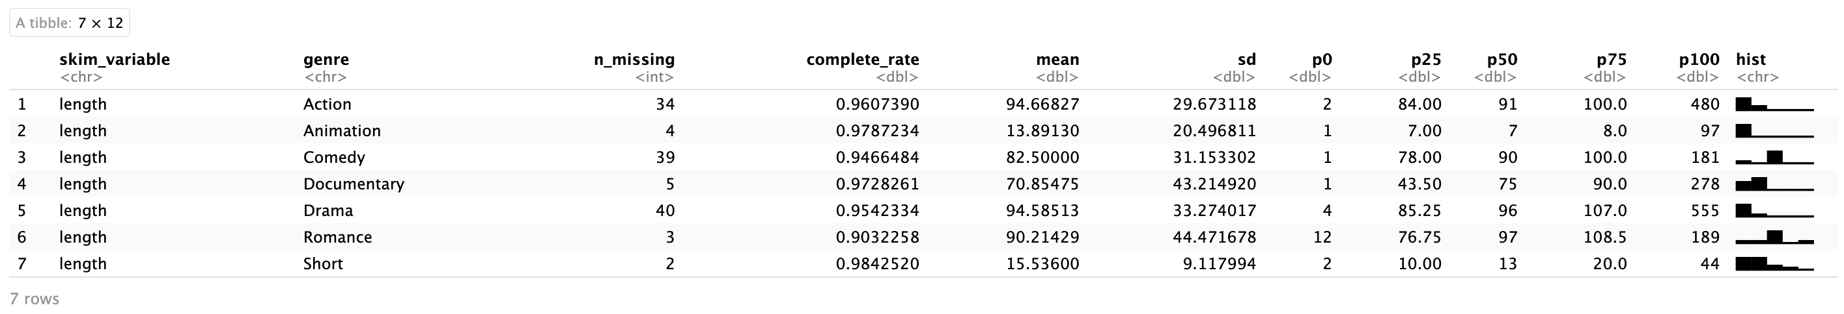
Data Cleaning
When it comes to the numerical variables, summary statistics above show that there are 127 missing values in length variable. For these missing values, the median film length by genre will be chosen to impute, considering the length distribution is not equal among different film genres.

Slide 6
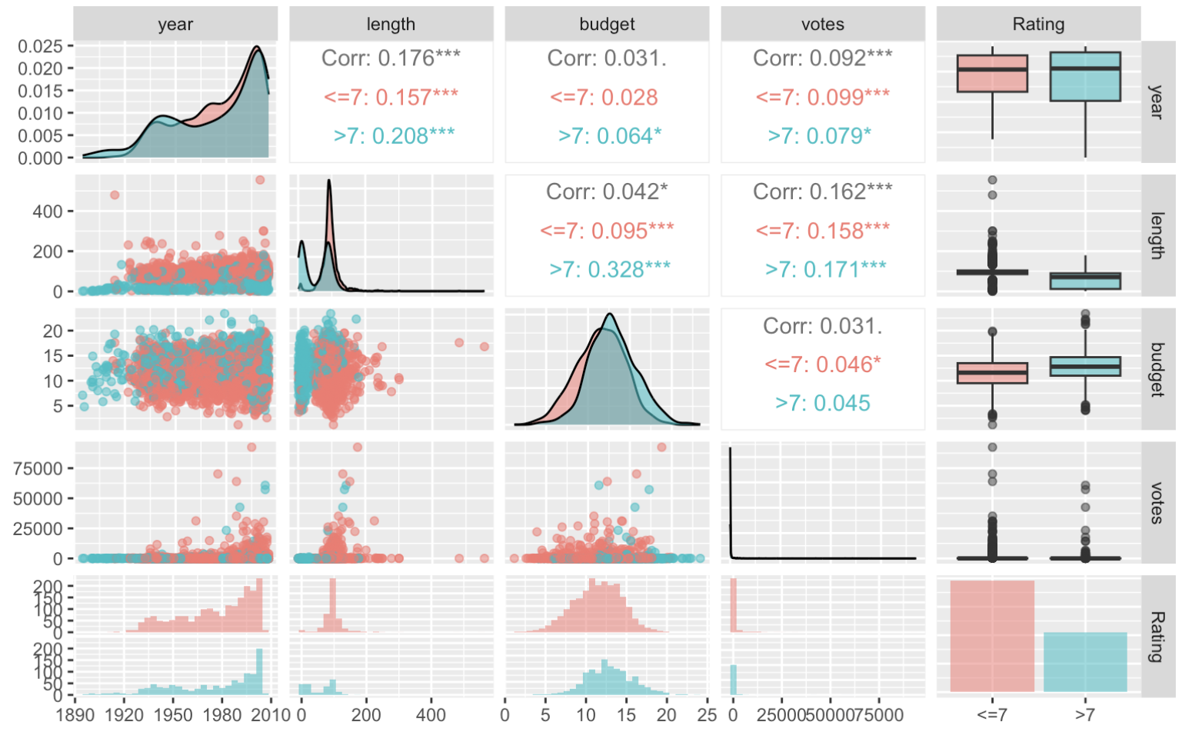
Exploratory Analysis
From this graph, we can see that the correlations between all numerical explanatory variables are very weak.
And according to the boxplots, the ratings tends to be influenced by length and budget, while the influence of votes and years appear to be less pronounced.

Slide 7
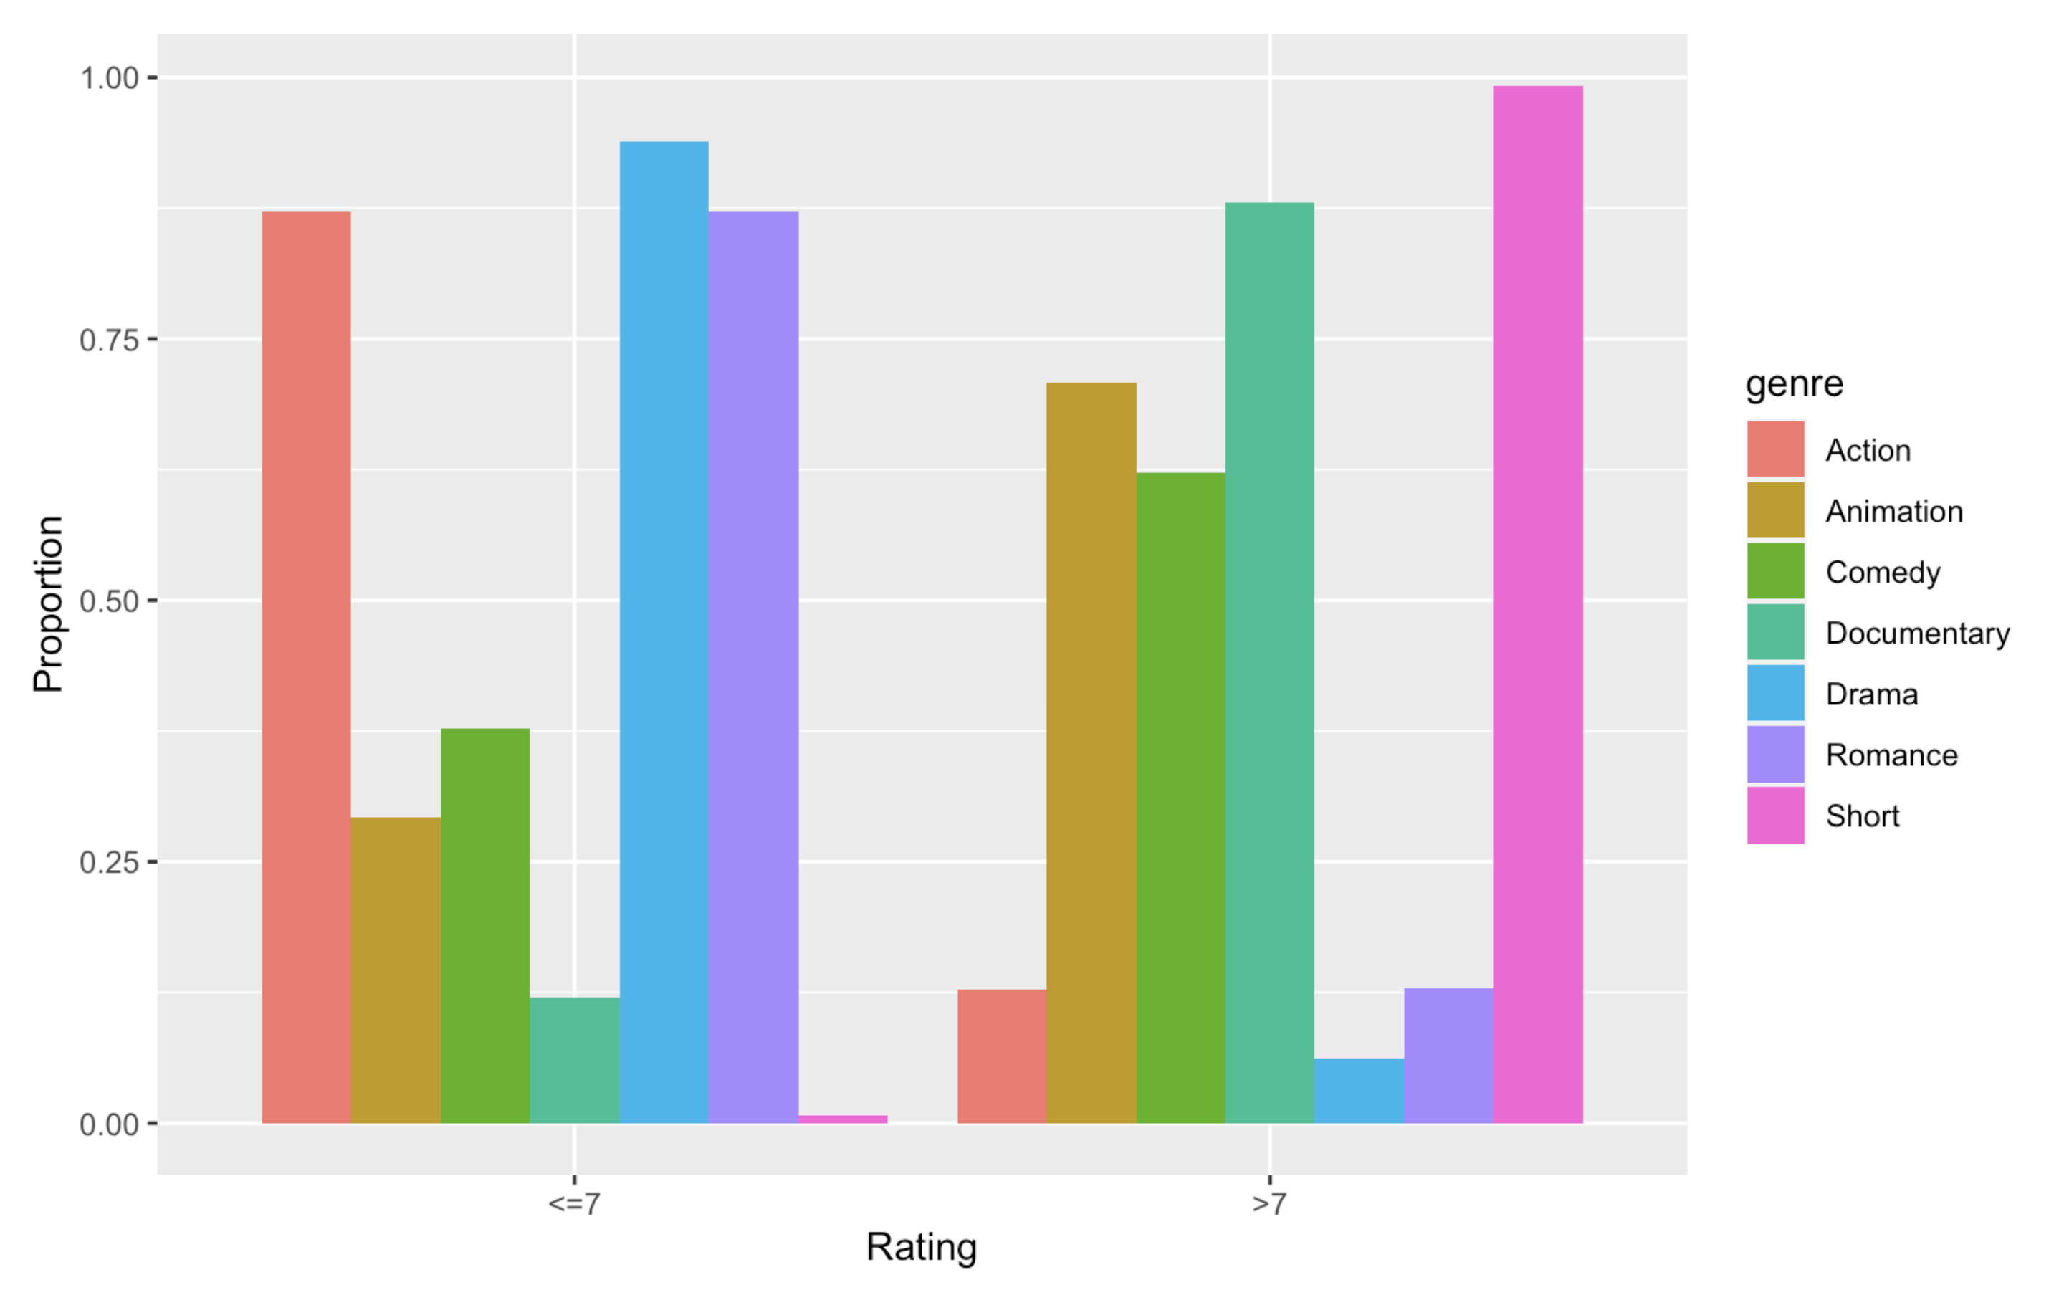
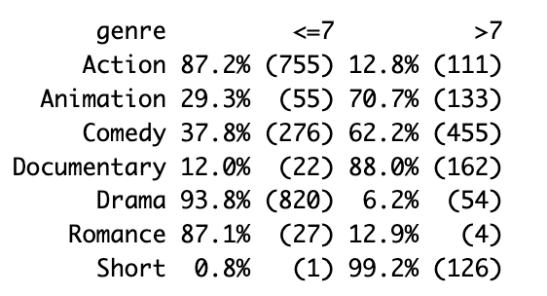
Exploratory Analysis
The barplot and table above show the proportion of ratings in different genres. As we can see, the distribution of the proportion varies greatly across genres.

Slide 8
Model with categorical variable(Genre):
Model 1.1 (Replace missing values with median values in Length)
Model 1.2 (Remove missing values in Length)
Model without categorical variable(Genre):
Model 2

Slide 9
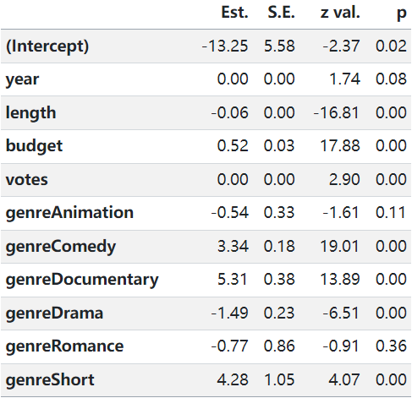
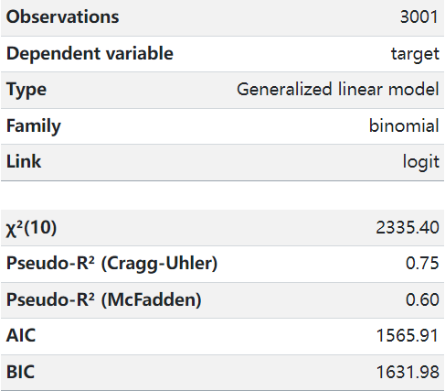
Summary of Model 1.1
Variable Year is not significant(0.08 > 0.05)

Slide 10
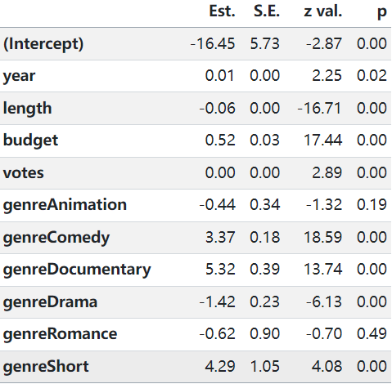
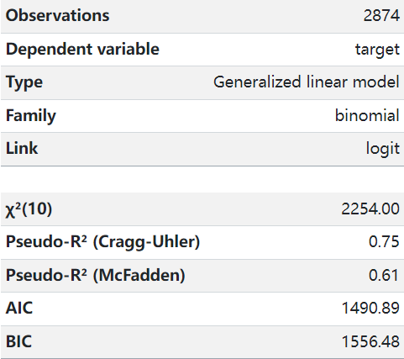
Summary of Model 1.2
Variable Year is significant now(0.02 < 0.05).
The two treatments of length have slightly different impacts on the film.

Slide 11
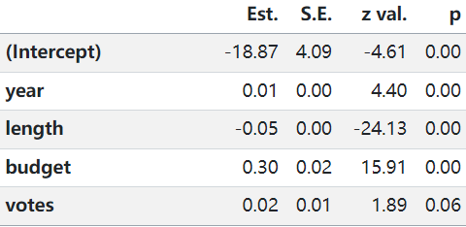
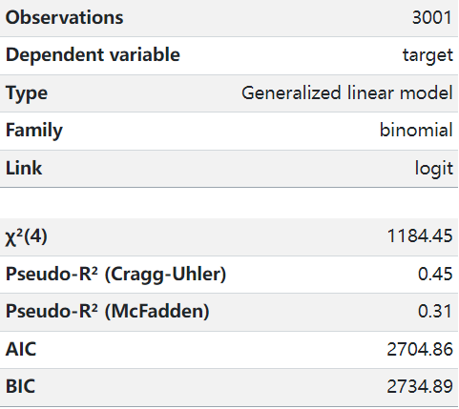
Summary of Model 2
Variable Votes is not significant now(0.06 > 0.05), and the AIC is larger than the other
two models

Slide 12
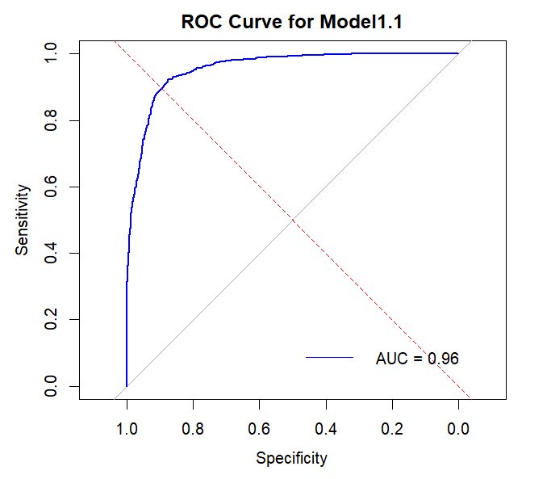

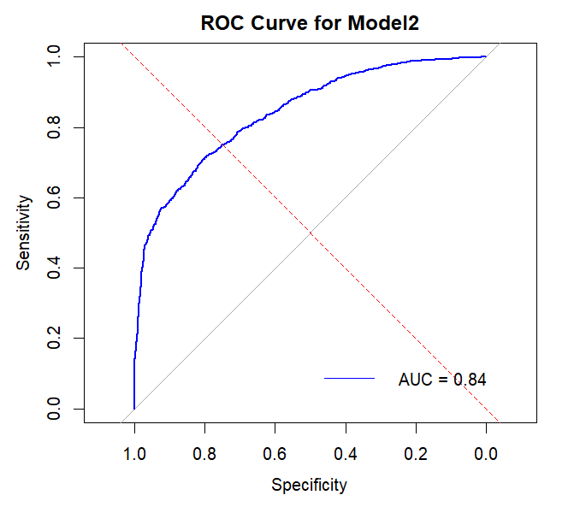
ROC Plots
The ROC curve for model 1.1 and model 1.2 show better predictions than model 2

Slide 13
Confusion Matrix
 |  | Reference
 |  | 0 | 1
Prediction | 0 | 1815 | 178
 | 1 | 141 | 867
 |  | Predicted condition
 |  | Predicted Positive (PP) | Predicted Negative (PN)
Actual condition | Positive (P) | True positive (TP) | False negative (FN)
 | Negative (N) | False positive (FP) | True negative (TN)
Model 1.1
 |  | Reference
 |  | 0 | 1
Prediction | 0 | 1733 | 168
 | 1 | 134 | 839
Model 1.2
 |  | Reference
 |  | 0 | 1
Prediction | 0 | 1798 | 448
 | 1 | 161 | 597
Model 2

Slide 14


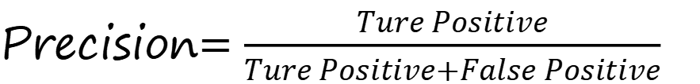
Precision, Recall and Accuracy
 |  | Predicted condition
 |  | Predicted Positive (PP) | Predicted Negative (PN)
Actual condition | Positive (P) | True positive (TP) | False negative (FN)
 | Negative (N) | False positive (FP) | True negative (TN)
Precision$=\frac{Ture Positive}{Ture Positive+False Positive}$
Recall$=\frac{Ture Positive}{Ture Positive+False Negative}$
Precision$=\frac{Ture Positive+Ture Negative}{Positive+Negative}$

Slide 15
Compare Models
Model | AIC | AUC | Precision | Recall | Accuracy
Model 1.1 | 1565.906 | 0.956 | 0.911 | 0.928 | 0.894
Model 1.2 | 1490.885 | 0.957 | 0.912 | 0.928 | 0.895
Model 2 | 2704.857 | 0.841 | 0.800 | 0.918 | 0.797

Slide 16
Model Selection
Higher Precision: indicates more reliability in the model's prediction of positive examples.
Higher recall: indicates that the model is able to identify most of the actual positive examples.
Higher accuracy: indicates that the model has better overall prediction performance.
Better ROC curve and higher AUC valve(not significant)
Lower AIC valve

Slide 17
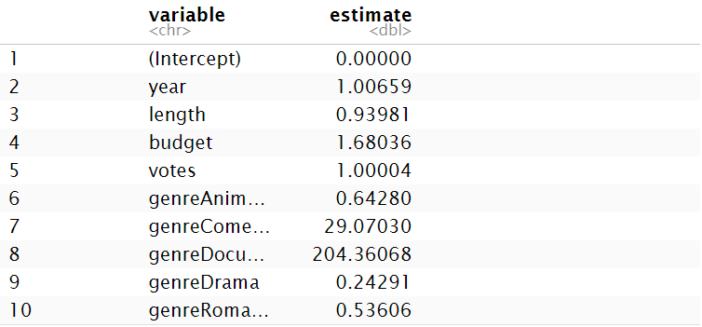
Conclusion
For continuous variables:
It is predicted that an increase in the length of the film may negatively affect the film's ability to receive a high score of 7 or higher.
The higher the budget of the film, the higher the probability of the film's rating becoming higher improves the most.
For categorical variables:
Animated films, dramas and romances are less likely to score above 7 than action films.
Comedies and documentaries are significantly more likely to receive high scores. Documentaries are significantly more likely to receive a high score than other genres.

Slide 18
Conclusion
Implication
Well-crafted, more costly films are the ones that are clearly more enjoyable to viewers.
Audiences as well as film raters seem to favour documentaries with more authenticity than other types of films. Also comedy films are well liked by the public.
Meanwhile drama is perhaps not as popular with audiences due to the form of artistic expression and the time period in which it was made.
These data and conclusions will give filmmakers and entertainment industry workers some insights into the market and deeper artistic thinking.

Slide 19
Conclusion
Validity
Num of observations:2874
Remove variables that do not have a significant effect.
Sample size
P-value
Models comparison
Standardisation of data
Neglect non-linear relationships
The influence of time on aesthetics
Outlier handling
Limitations
Model Selection
(GLM)
Response variable: binomial distribution
Explanatory variables are not highly correlated

Slide 20
Conclusion
Future Extension
The study examines the trend of change over the years between the audience's aesthetics of the film.
Comparison of film genre preferences across age groups.
How the cast of a film is put together can increase the film's box office.
01
02
03

