Slide 1
RoundTable Discussion
Rosie Wang

Slide 2

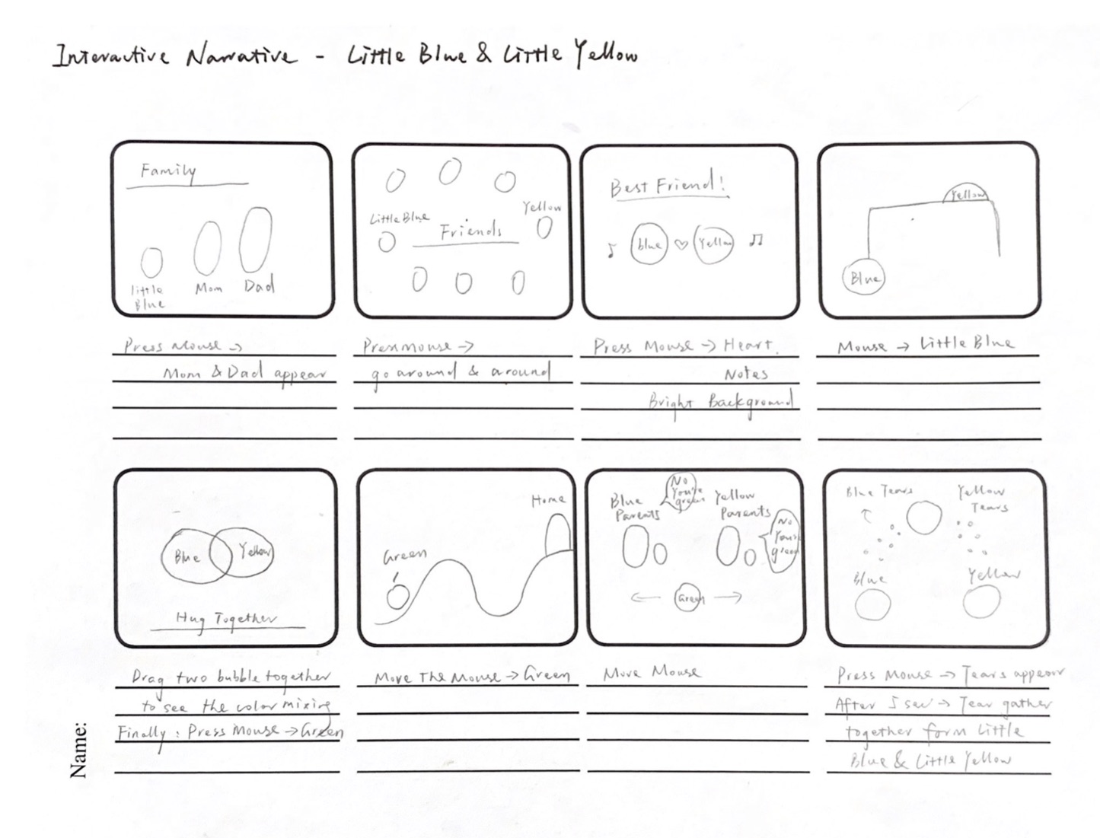

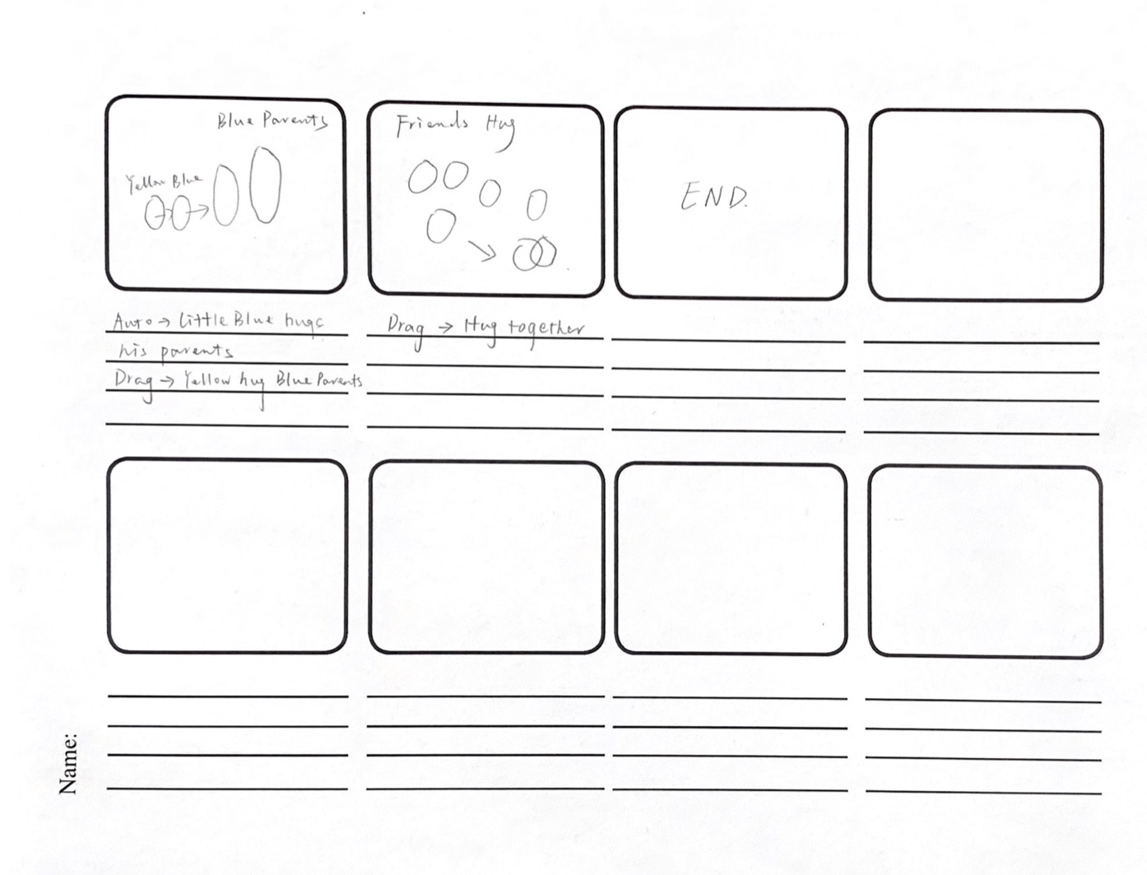
Little Blue & Little Yellow
Interactive Narrative
Mouse Press & Drag
String Manipulation
Pixel
Sound
http://www.sbs.com.au/theboat/

Slide 3
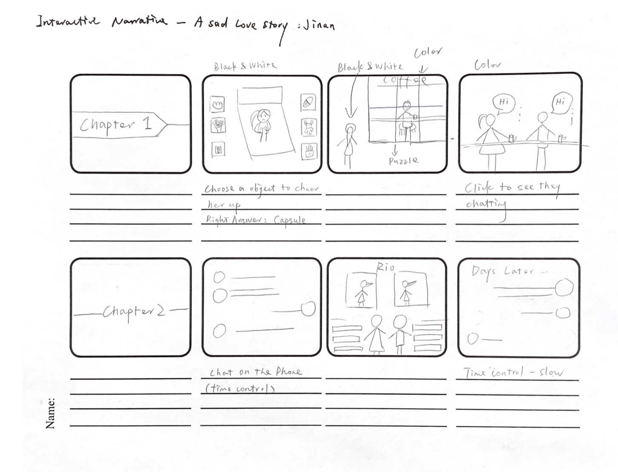
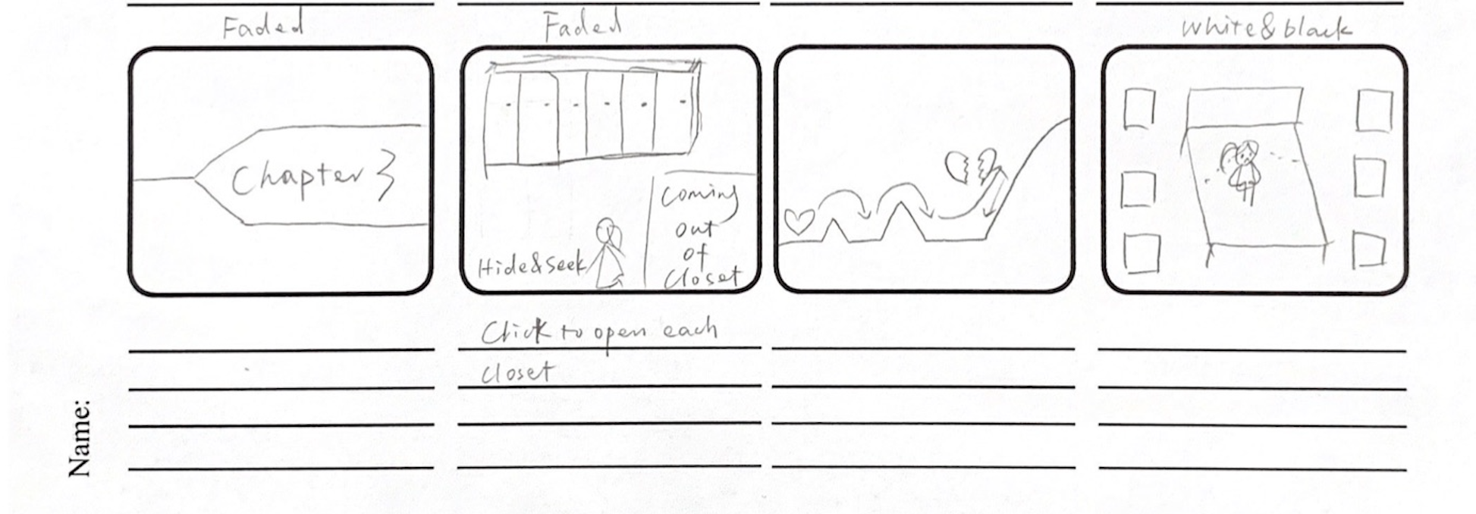
Love Story
Interactive Narrative
Mouse Press & Drag
Simple games
Time
Sound
String Manipulation
https://www.youtube.com/watch?v=4U9IVBdII54

Slide 4
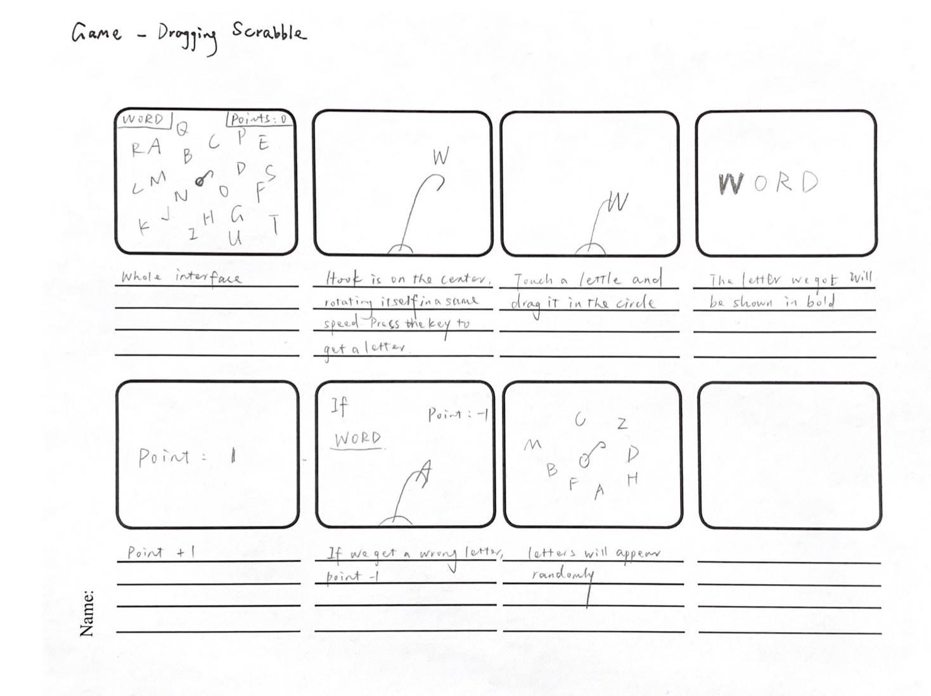
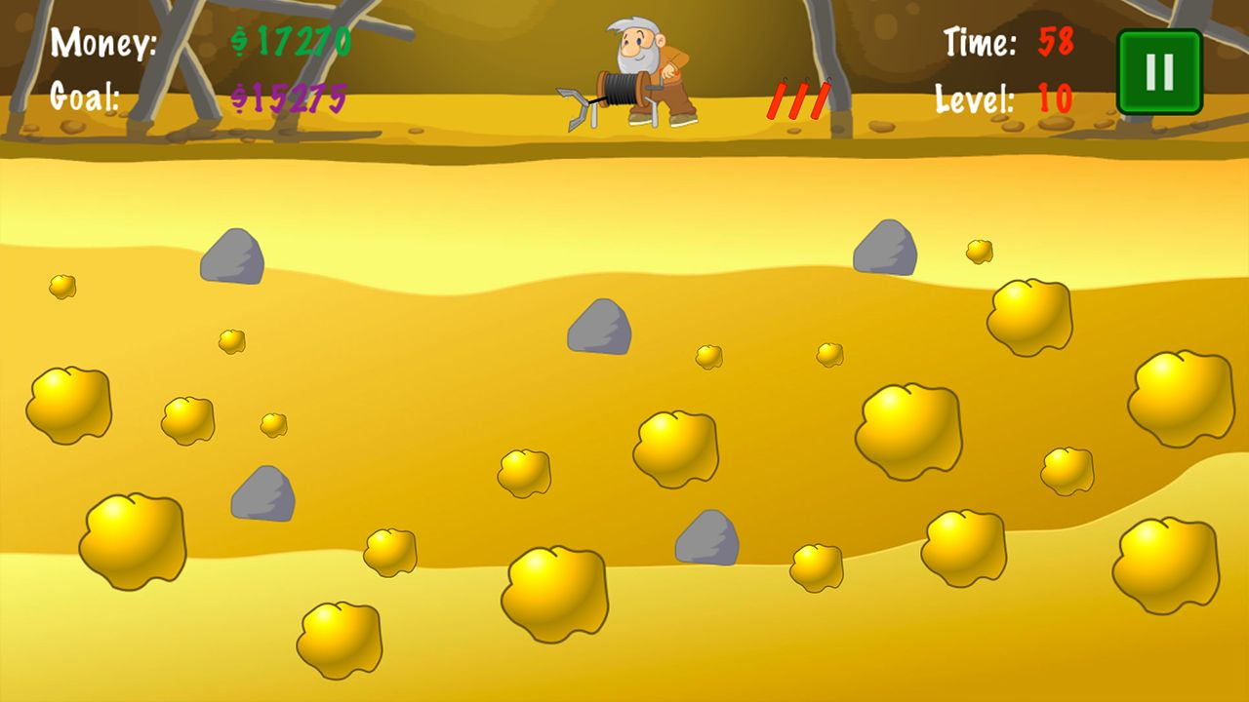
Dragging Scrabble
Game
Key Press
String Manipulation
Reference: Gold Miner

Slide 5
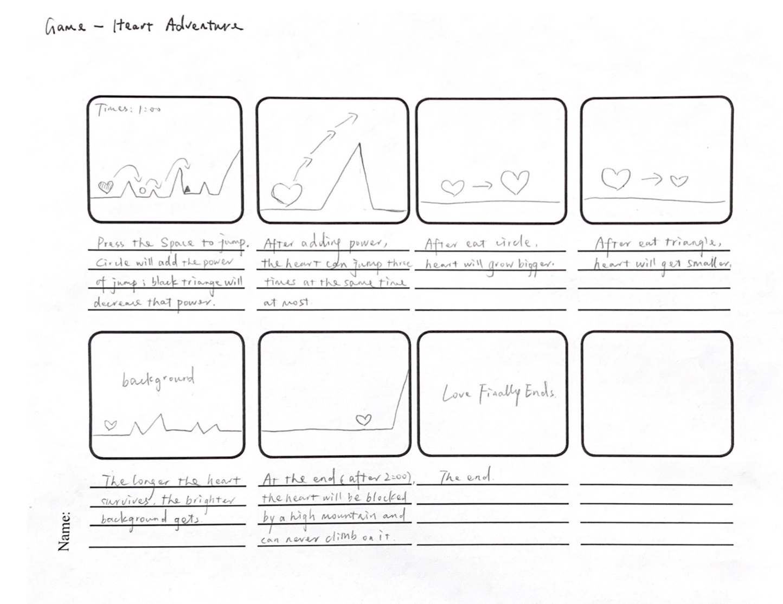
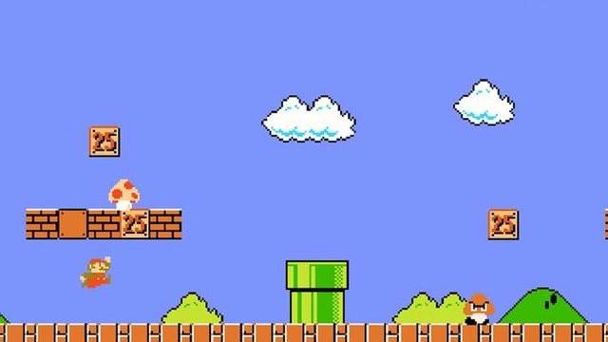
Heart Adventure
Game
Key Press
Vector + forces
Time
Reference: Super Mario Bros

