Slide 1
Hour ahead demand forecasting
Load profiles for several facilities at 1hr minute intervals.
Task: Improving hour-ahead forecasting accuracy

Slide 2
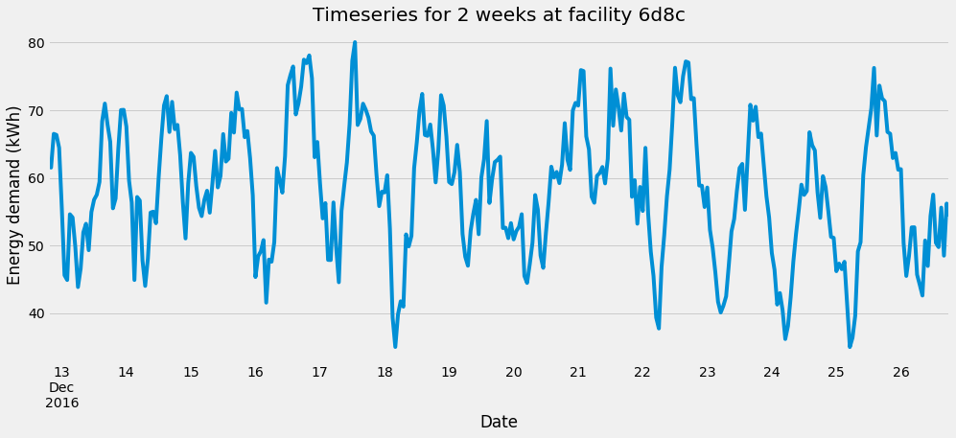
Overview
Example load profile:

Slide 3
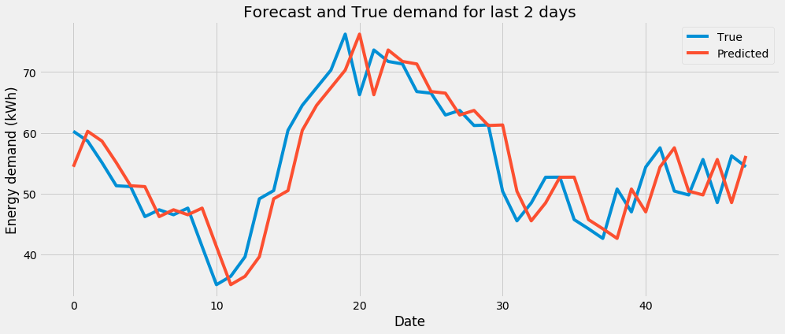
Baseline model - 1
Baseline_previous:
Predicting the forecast to be the same as the previous hour

Slide 4
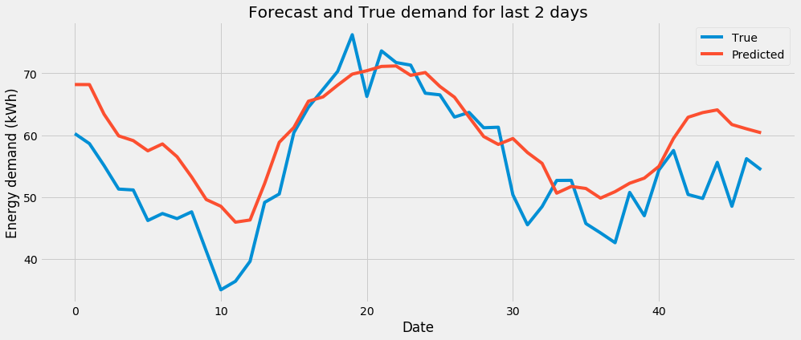
Baseline model - 2
Baseline_average:
Predicting the forecast to be the same as the previous hour

Slide 5
Cross validation
Sequentially trains the model on a growing dataset, forecasting 1 hour ahead over a window at each step.
RMSE between forecast and actual load calculated.
Average RMSE taken a training score.
Train
< Forecast
Train
< Forecast
Train
< Forecast
Train

Slide 6
Grid search
Initial analysis of facilities suggests that the timeseries are already stationary with daily and weekly seasonal trends.
**Compromise** Didn’t include weekly seasonal trend due to run time issues. Daily consideration already exhibited an improvement with respect to baseline models and therefore the additional computational requirement for grid searching was not deemed necessary.
For each SARIMA model, grid searched over the following space of parameters:
ARIMA Seasonal
p = [0,1,2,3] p = [0,1]
d = [0,1] d = [0]
q = [1,2,3] q = [0,1]

Slide 7
SARIMA results so far
Project | Training Baseline – previous RMSE | Training Baseline – average RMSE | Training SARIMA RSME
6d8c (3,0,2)-(1,0,1,24) | 34.0 kWh | 29.6kWh | 3.93 kWh
5526 (1,1,2)-(1,0,0,24) | 91.0 kWh | 102 kWh | 23.8 kWh
1074 (0,0,2)-(1,0,0,24) | 28.1 kWh | 26.8 kWh | 9.3 kWh
Others still to be tested….

Slide 8
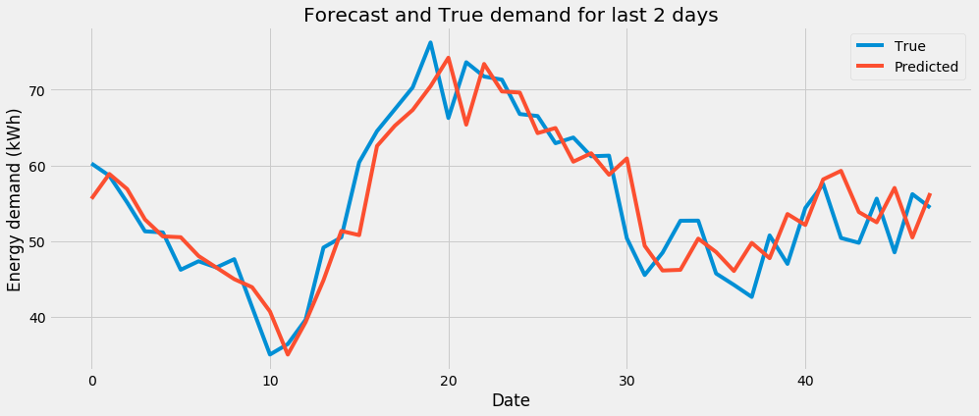
SARIMA
SARIMA:
Grid searched and cross validated for minimum RMSE on hour ahead forecast

Slide 9
Next steps
- DEVELOP SIMPLE LSTM RNN
I have a very basic LSTM RNN model working and want to develop a script which can grid search and cross-validate it according to the same methodology as the SARIMA model.
- INCLUDE EXOGENOUS VARIABLES IN SARIMAX
- INCLUDE FEATURES IN LSTM RNN
- COMPARE LSTM RNN and SARIMAX
Compare the two on run-time and accuracy. If this model is implemented in a live environment, which one would be best?

Slide 10
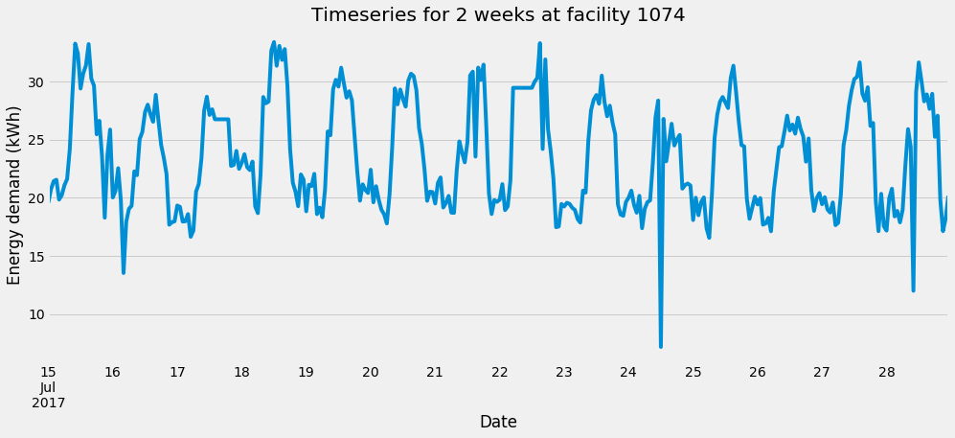
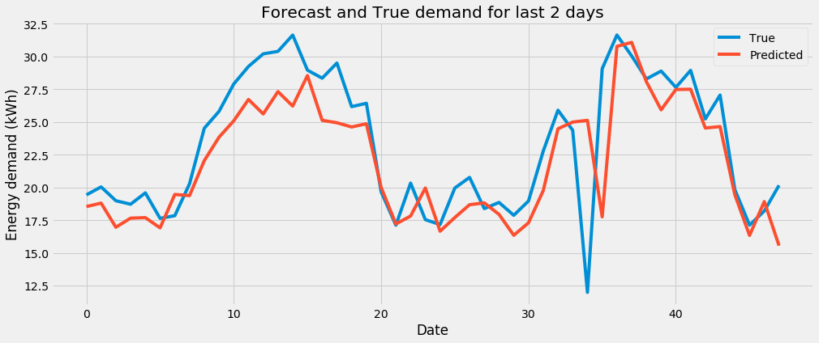
Appendix
Graphs for site 1074

Slide 11
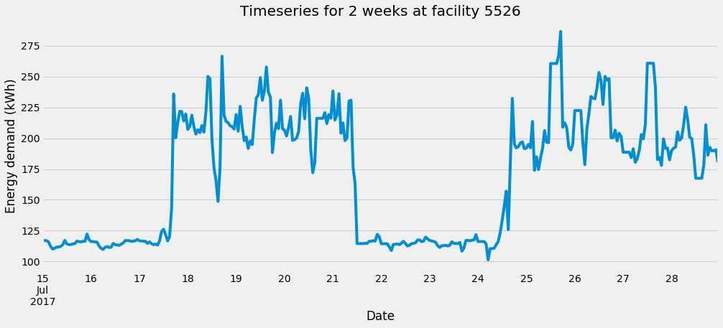
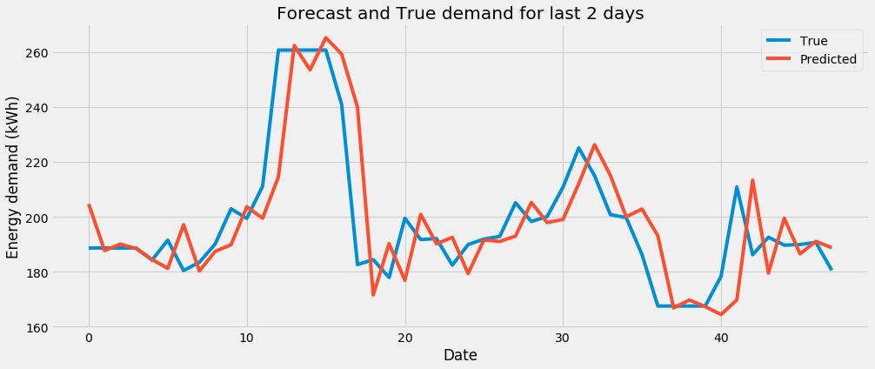
Appendix
Graphs for site 1074

