Slide 1

FilePilot: A Multi-Layer Windows File Manager Using C++ and C#
A Project Presentation
Submitted By: [Your Name(s)]
Roll No.: [Your Roll Number(s)]
BSc. CSIT Final Project Presentation
Tribhuvan University, Nepal
Under the Supervision of [Supervisor Name]

Slide 2
Table of Contents
Introduction
Problem Statement
Objectives
Development Methodology
Core Features
System Architecture
Search and Duplicate Detection
Compression and File Operations
Result Analysis
Testing, Conclusion, and Demo

Slide 3
Introduction
FilePilot is a Windows desktop file management application.
It combines a native C++ core with a C# WinForms graphical interface.
The project demonstrates a practical multi-language software architecture.
It supports real file operations instead of being only a UI mockup.
The main goal is to balance system-level capability with user-friendly interaction.

Slide 4
Problem Statement
Many academic desktop projects do not reflect real production-style architecture.
A file manager needs both low-level file-system access and a responsive user interface.
Using one language for everything can make structure less realistic for this use case.
The challenge is to keep the core efficient while keeping the interface easy to build and extend.

Slide 5
Objectives
Develop a functional Windows file manager with essential file and folder operations.
Implement performance-sensitive logic in C++20.
Build the desktop interface in C# WinForms.
Connect both layers through a native DLL using P/Invoke.
Add search, sorting, compression, duplicate detection, and analysis features.

Slide 6
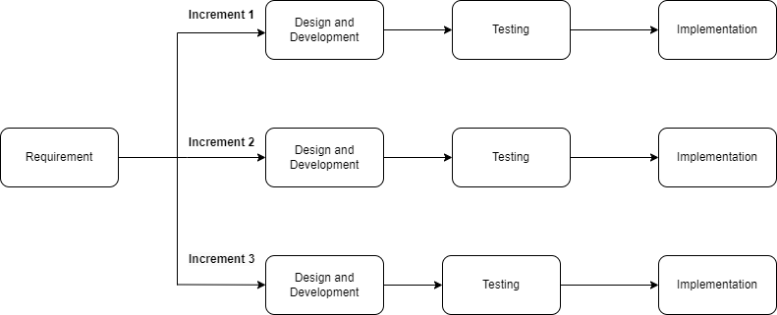
Development Methodology
The project follows an incremental development model.
Phase 1: basic navigation and directory listing.
Phase 2: DLL bridge and C# interoperability.
Phase 3: search, sorting, opening, and file operations.
Phase 4: compression, duplicate detection, analysis panel, and usability improvements.

Slide 7
Core Features
Navigate folders and open files with their default applications.
Create, rename, delete, copy, cut, and paste files and folders.
Search and sort directory contents by name, size, and modified time.
Compress and decompress using Zstandard and ZIP.
Detect duplicates by filename and by file content.
Run analysis and benchmark utilities from a separate panel.

Slide 8
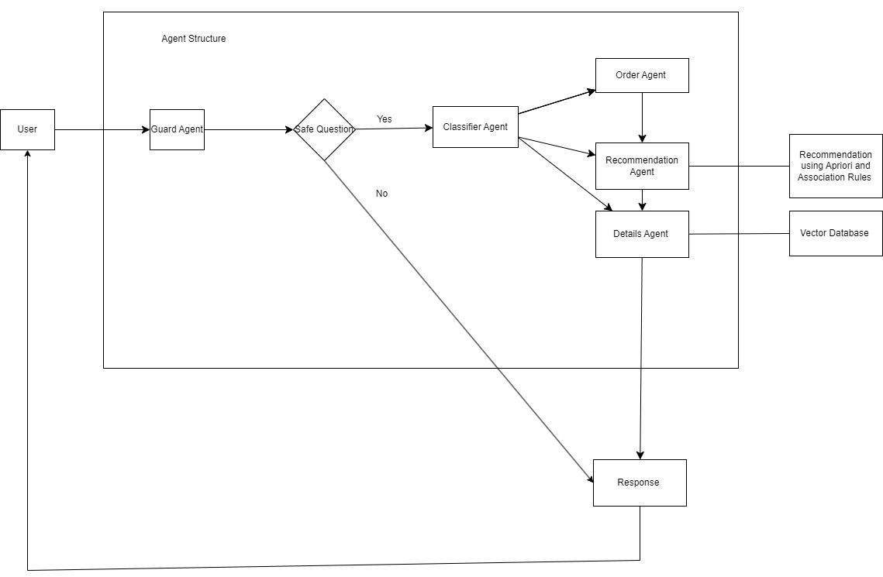
System Architecture
Layer 1: C++ core implements file services, search, sorting, compression, and duplicate detection.
Layer 2: a native DLL exposes a simple C-style API for interop.
Layer 3: C# WinForms handles layout, events, dialogs, and user interaction.
This separation improves maintainability, testing, and future extensibility.
The architecture is close to how real desktop tools are often structured.

Slide 9
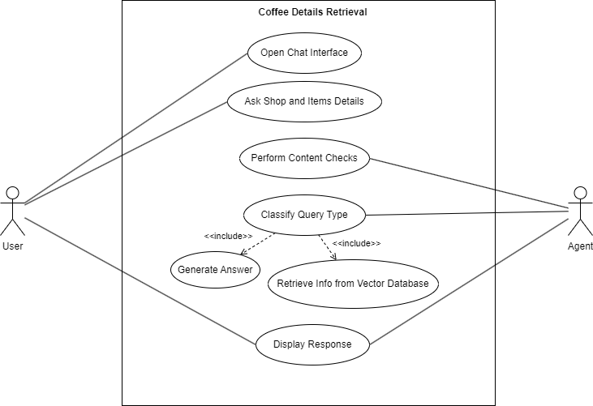
Functional Requirements
List contents of a selected directory.
Navigate into folders and move through location history.
Open, create, rename, delete, copy, cut, and paste files and folders.
Search and sort the current directory contents.
Compress, decompress, and analyze storage-related operations.
Detect duplicates and show results to the user.

Slide 10
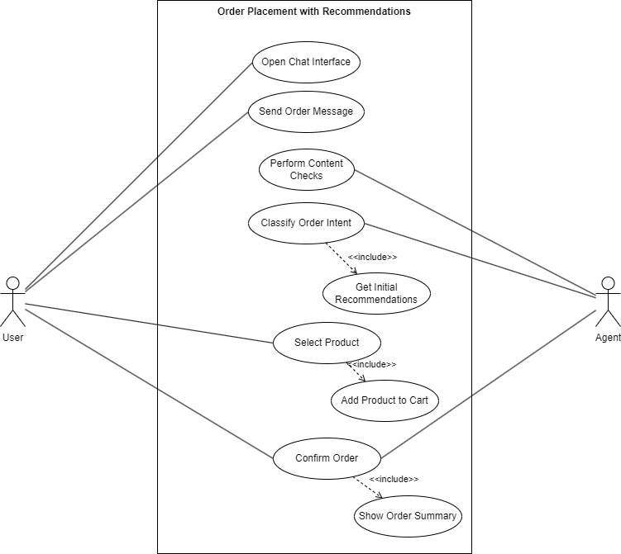
Data Structures and Algorithms
std::vector<FileInfo> stores file listings and result collections.
std::unordered_map is used for the inverted index and duplicate grouping.
std::sort is used for flexible ordering by different criteria.
std::filesystem provides traversal, metadata access, and path handling.
SHA-256 hashing supports content-based duplicate detection.

Slide 11
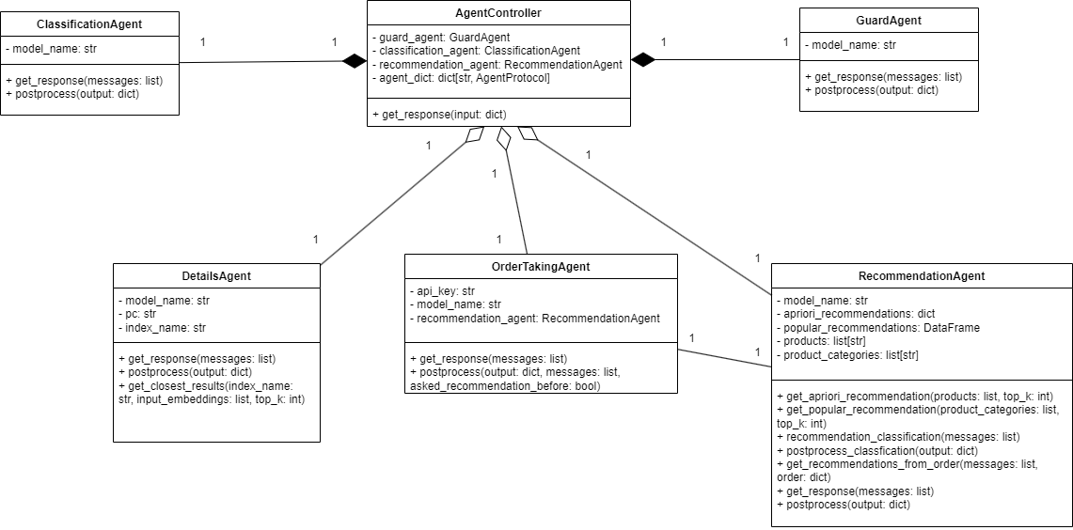
Search Implementation
File names are tokenized using separators such as underscore, hyphen, and dot.
Tokens are stored in an in-memory inverted index for fast lookup.
Exact token matches are preferred in the results.
Partial token matches are also supported for better usability.
This design keeps search responsive for the active directory.

Slide 12
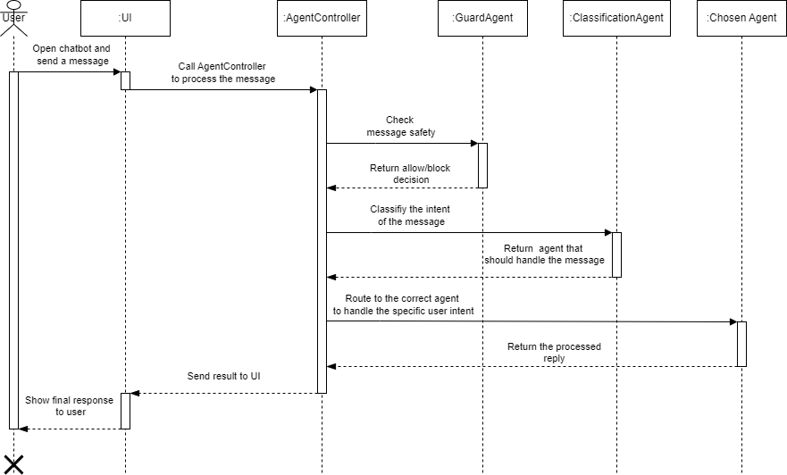
Duplicate Detection
Name-based detection groups files with identical file names.
Content-based detection first groups files by size to avoid unnecessary hashing.
Only same-size groups are hashed using SHA-256.
Files with identical hashes are reported as content duplicates.
The recursive scan uses safe error-code traversal to skip broken paths.

Slide 13
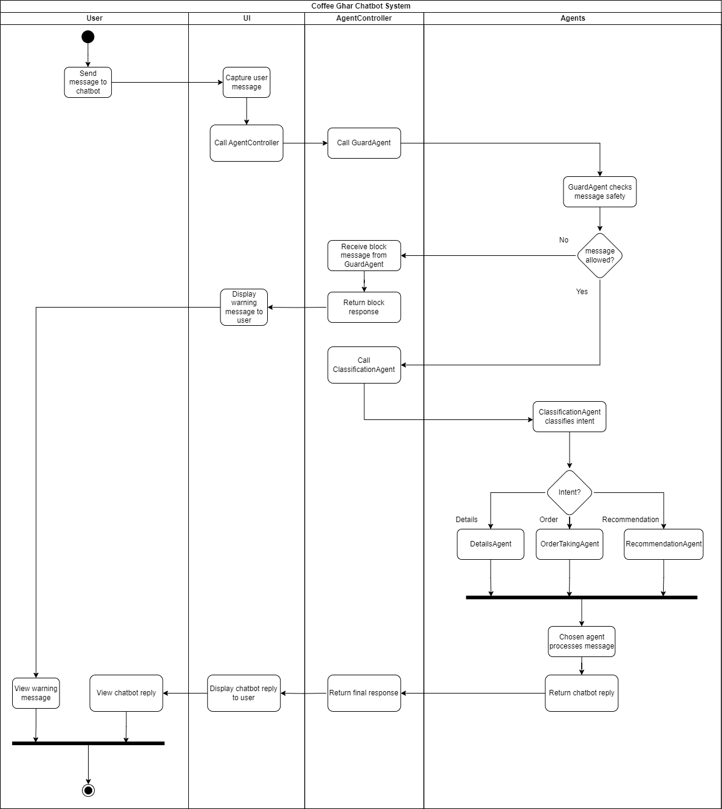
Compression and Decompression
Zstandard was selected because it offers a strong balance of speed and compression ratio.
ZIP support was added for common archive compatibility.
The user can choose the compression format from the interface.
ZIP extraction targets folders, while ZST decompression produces output files.
The GUI calls these features through the native backend.

Slide 14
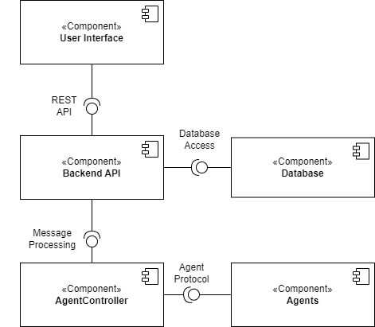
Clipboard-Style File Operations
Copy does not immediately duplicate the item; it stores copy intent.
Cut stores move intent in the application clipboard.
Paste executes the pending operation in the current destination folder.
This behavior matches Windows File Explorer more closely.
Both files and folders are supported.

Slide 15
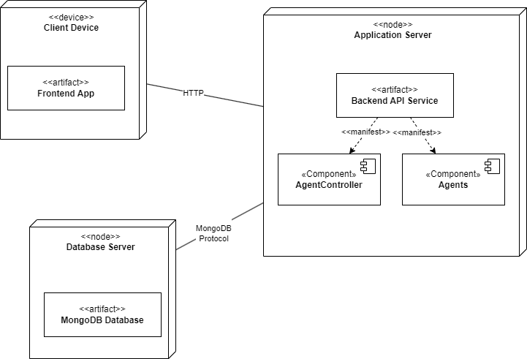
UI and Navigation
The interface includes an address bar, search box, file grid, and context menu.
Keyboard shortcuts support Ctrl+C, Ctrl+X, Ctrl+V, Delete, F2, and Ctrl+L.
Alt+Left and Alt+Right navigate backward and forward through history.
Alt+Up and Backspace navigate to the parent folder.
Escape returns focus from text inputs back to the file grid.

Slide 16
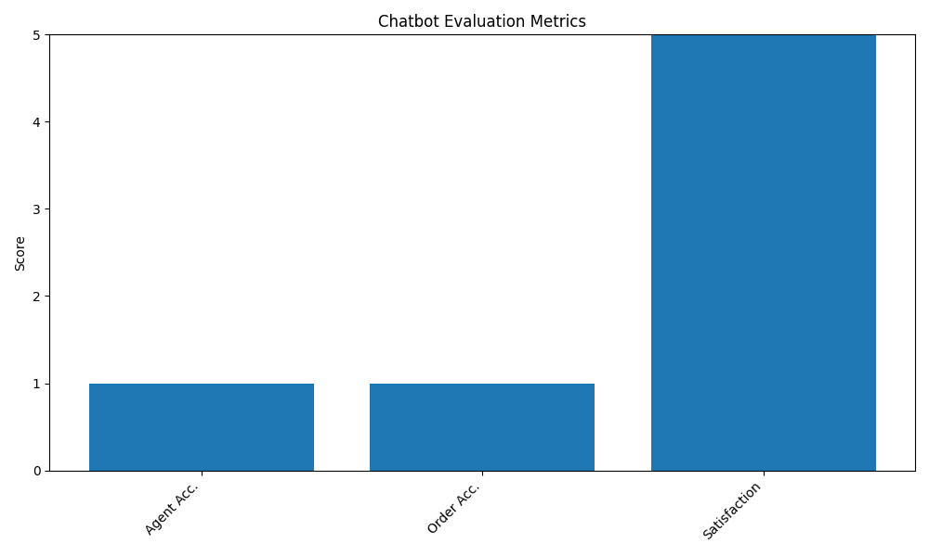
Result Analysis
The project is evaluated in terms of functionality, architecture, usability, and measurable analysis support.
Functional Result
Navigation, open, create, rename, delete, copy, cut, and paste are implemented.
Search and sort work on the active directory with live UI updates.
Architecture Result
C++ core, native DLL bridge, and C# UI integrate successfully.
The interop boundary keeps the UI separate from filesystem-heavy logic.
Advanced Feature Result
ZIP and Zstandard compression are available through the same UI workflow.
Duplicate detection works by name and by content using hashing.
Usability Result
Right-click menus, keyboard shortcuts, address bar focus, and history navigation are supported.
Clipboard-style copy and cut behave closer to Windows File Explorer.
What can be shown live in the demo:
storage summary, search benchmark, sort benchmark, compression ratio, and duplicate scan output from the analysis panel
Overall outcome: FilePilot is a working functional prototype with realistic desktop architecture and demonstrable algorithmic features.

Slide 17
Tools and Technologies
Languages: C++20 and C#.
Frameworks: WinForms and P/Invoke interoperability.
Libraries and APIs: STL, std::filesystem, Windows shell integration, Zstandard.
Development environment: Visual Studio 2022 targeting x64.
Design focus: modularity, interop safety, and practical desktop behavior.

Slide 18
Testing and Evaluation Summary
Validated Areas
Functional testing: navigation, open, create, rename, delete, and clipboard-style operations
Interop testing: C# UI calls C++ DLL successfully through P/Invoke
Algorithm testing: search, sorting, duplicate detection, and compression workflows verified
Usability testing: context menu, keyboard shortcuts, focus handling, and history navigation
Evaluation Snapshot
Functional coverage [#####]
Architecture clarity [#####]
Search responsiveness [####-]
Duplicate analysis [####-]
UI usability [#####]
These bars are qualitative summaries based on completed feature validation and the built-in analysis tools.
The detailed numeric values are intended to be shown live from the Analysis panel during demonstration, while this slide summarizes what was successfully achieved.

Slide 19
Conclusion and Future Work
FilePilot demonstrates a practical multi-layer desktop application architecture.
The project successfully combines native performance with rapid GUI development.
Core file manager operations, search, compression, and duplicate analysis were implemented.
Future work includes multi-select actions, drag-and-drop, preview panes, and conflict dialogs.
Background indexing and richer analysis charts could further improve the system.

Slide 20
References
[1] O. Bergman, R. Beyth-Marom, and R. Nachmias, "The user-subjective approach to personal information management systems," JASIST, 2003.
[2] J. Zobel and A. Moffat, "Inverted files for text search engines," ACM Computing Surveys, 2006.
[3] T. G. W. Epperly et al., "High-performance language interoperability for scientific computing through Babel," IJHPCA, 2012.
[4] A. P. Maulidina et al., "Comparative study of data compression algorithms: Zstandard, zlib & LZ4," Springer, 2024.
[5] P. Warren, "Personal information management: The case for an evolutionary approach," Interacting with Computers, 2014.
[6] O. Bergman, T. Israeli, and S. Whittaker, "Factors hindering shared files retrieval," Aslib Journal of Information Management, 2020.

Slide 21

Project Demonstration
Launch the application and navigate between folders.
Search and sort the current directory.
Create, rename, and delete files or folders.
Copy, cut, and paste items using the internal clipboard.
Compress, decompress, and run duplicate detection and analysis.

