Slide 1

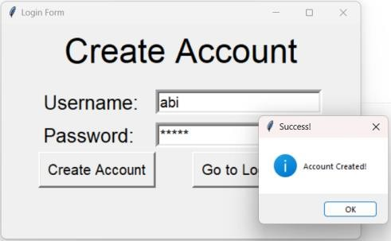
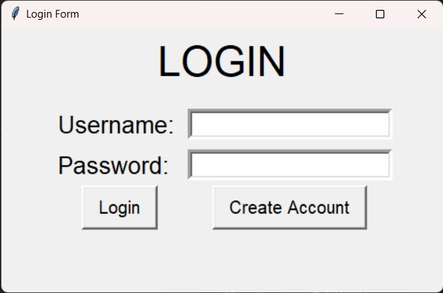
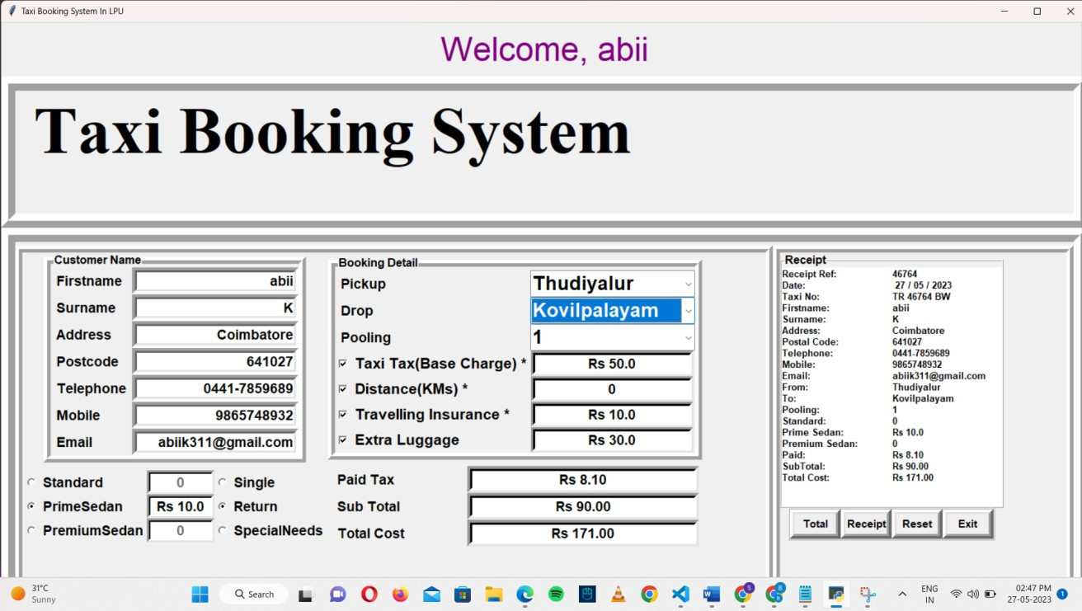
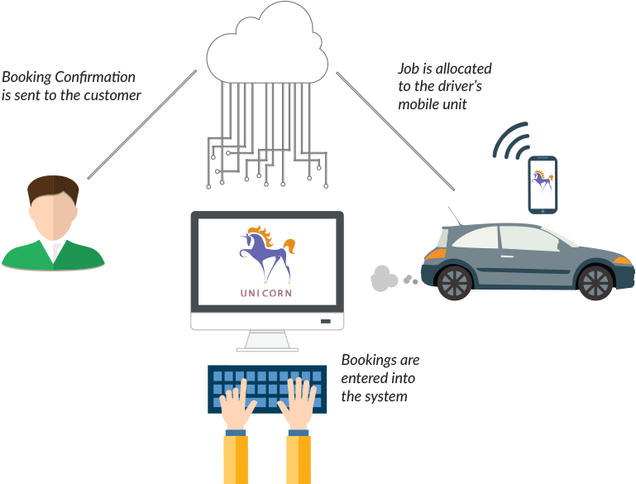
TAXI MANAGEMENT SYSYEM
PAVITHRA B, PRIYADHARSINI M, ROSITHA A, SOWMIYA P
III CSE B
Introduction
Results
The taxi management system developed using Tkinter is a powerful and use-friendly application designed to streamline and automate the operations of a taxi service. It aims to simplify the booking process and receive prompt confirmation through receipt. It’s user-friendly interface makes the system to enhance the overall experience for both passengers and taxi drivers. The database are stored in MySQLLITE to gather information from the user.
It improves the operational efficiency and enhance customer experience .
.
Fig 1.Sign in
Fig 2. Login
Fig 3.User Interface
Motivation
Taxi management system offers numerous benefits, including increased operational efficiency, improved customer satisfaction, enhanced safety, and access to valuable data insights.
These motivations make it an attractive solution for taxi fleet operators looking to optimize their operations and stay competitive in the evolving transportation industry.
SCOPE of the Project
The system allows customers to book rides through various channels, such as mobile apps, websites, or phone calls.
It includes features like trip scheduling, passenger information, and automated dispatching algorithms to assign the nearest available taxi to the customer's location.
It tracks driver assignments, working hours, and performance metrics. It may also include features like driver ratings, incentives, and communication tools for efficient driver management.
Technologies Used
The taxi management system uses the following technologies:
Python (3.11.3)
TKINTER (3.11.3)
MySQLLITE (16.0.1000.6)
Methodology
The methodology for developing a taxi management system involves several key steps. First, thorough requirement analysis is conducted to understand the needs of fleet operators, drivers, and customers.
This information guides the system design phase, where the architecture, modules, and data flow are defined. Next, appropriate technologies and frameworks are selected based on scalability, compatibility, and performance requirements. Development follows an agile approach, breaking tasks into smaller modules, implementing them, and conducting regular code reviews.
Integration and testing are carried out to ensure proper functionality, performance of the system. Deployment involves setting up the necessary infrastructure, considering scalability and reliability.
User training and documentation are provided to assist users in understanding and efficiently using the system. The system is then launched, and ongoing support and maintenance are provided, including bug fixes and user feedback incorporation.
Communication and collaboration with stakeholders are maintained throughout the process, ensuring their satisfaction and facilitating adaptations to changing requirements.
SYSTEM ARCHITECTURE
Conclusion
A taxi management system plays a crucial role in optimizing operations and improving the overall efficiency of taxi fleets. By automating processes such as ride booking and dispatching, driver management, vehicle tracking, and fare management, the system streamlines operations, reduces costs, and enhances customer satisfaction. It provides real-time data insights and analytics, enabling data-driven decision-making for fleet operators. The system's integration with external services and platforms expands its functionality and provides a seamless experience for both customers and drivers.
Reference
“Design and Implementation of Taxi Management System” by Yueming Peng,Shanshan Liu, Xinglong Dai , an intelligent taxi dispatch system that uses real-time data to predict demand and optimize taxi routes.
“Research on the optimization of allocating resources of urban taxi based on decision analysis model” by Weiyu Chen, Haochi Wu, Zhen Wang, Jialven Huang, ring Jiang, Jing Zhang, Lingxuan Zhu, depecting adecision analysis on taxi management.
“A Service Choice Model for optimimizing Taxi Service Delivery” by Shih-Fen Cheng and Xin Qu. It describes Proposeto leverage on infrastructure and build a service choice model that helps individual drivers.

