Slide 1


Comparison of brain networks from EEG and fNIRS: a multilayer network analysis
Rosmary Blanco, Cemal Koba, Alessandro Crimi
Sano center for computational medicine

Slide 2

Introduction
Multimodal monitoring is getting increased interest in the last few years. Mostly functional near-infrared spectroscopy (fNIRS) and electroencephalography (EEG) because of their non-invasiveness, low cost, and portability.
Their integration can reveal more comprehensive information associated with brain activity, taking advantage of their strengths (high spatial resolution of fNIRS and high temporal resolution of EEG) and compensating for their shortcomings (highly sensitive to extracerebral physiology for fNIRS and volume conduction for EEG).
The brain has been described as an interconnected neural network modeled as a graph.

Slide 3
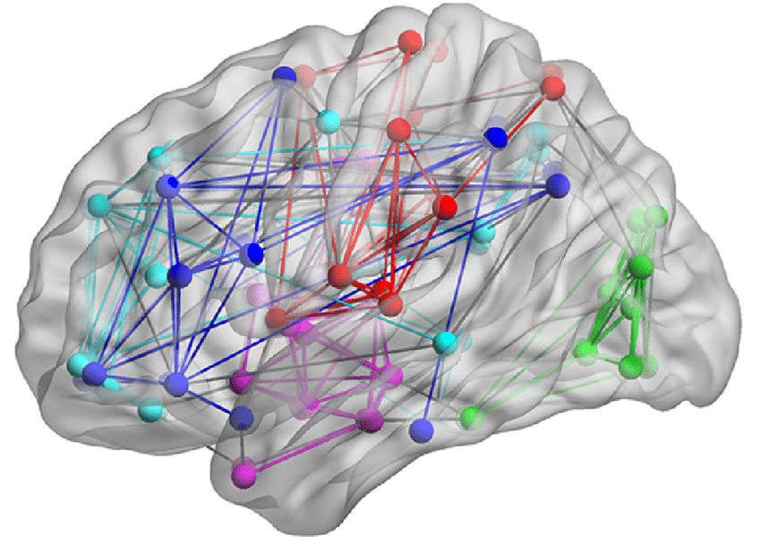
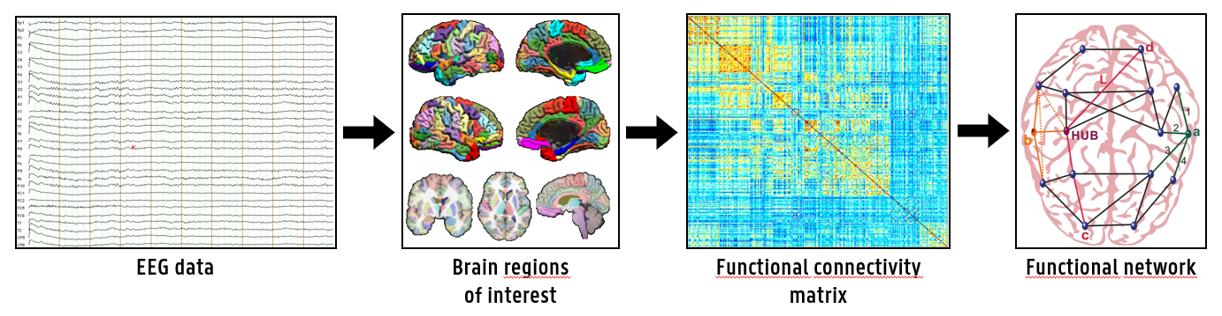
Introduction
A graph is a mathematical tool used to describe the brain as a set of nodes (brain regions) and edges (connections).
Functional connectivity measures the statistical dependence of different brain areas during information processing, by means of different metrics (i.e. correlation, coherence, phase synchrony), based on the neuroimaging techniques adopted.

Slide 4
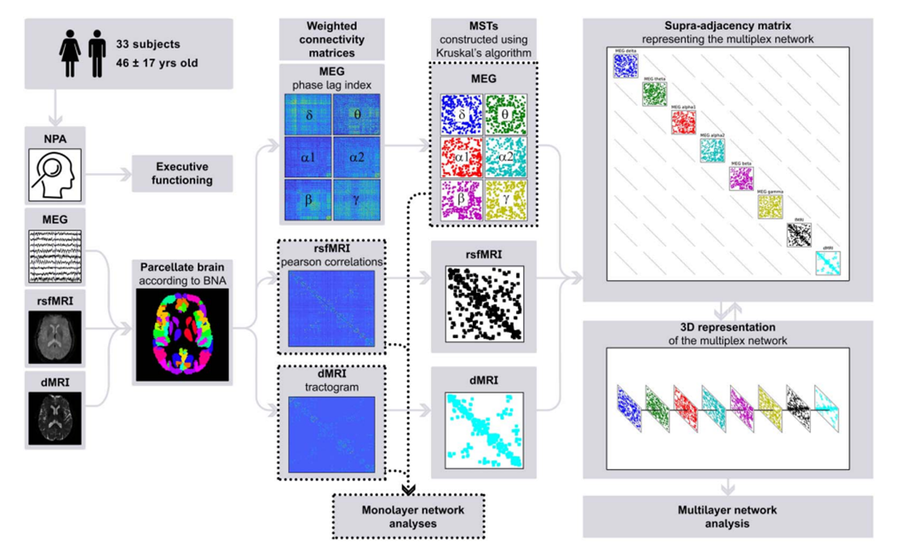
Introduction
In Graph theory, the classical approach is to model the brain as a single-layer network, where the edges represent the same type of connections between nodes.
However, the complex network representation of the human brain on multiple scales and in multiple dimensions can be modeled by taking into account the hierarchical organization of the brain in both spatial and temporal dimensions.
The recent advances in network science have led to the development of a powerful mathematical framework for multilayer modeling that consists of several distinct classical networks, each one encoding a specific type of information about the system.

Slide 5
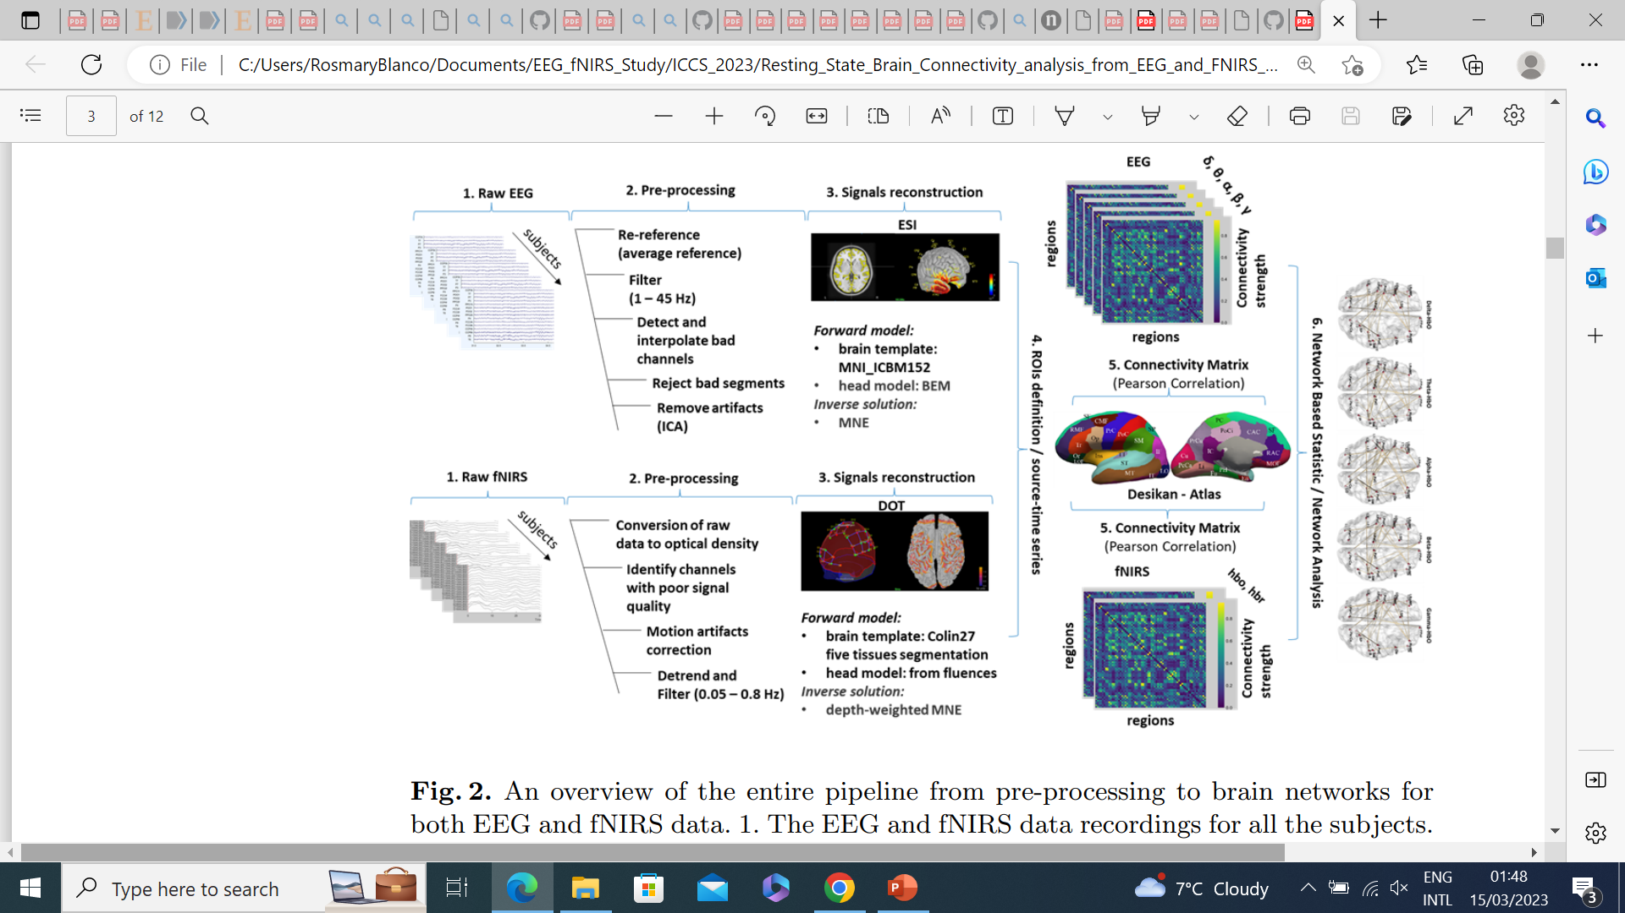
This project aims at combining the two modalities, together with graph theory to produce a more reliable approximation of the topology and dynamics associated with cognitive and motor brain functions.
Methods
Dataset: simultaneous EEG and fNIRS recordings of 22 subjects performing a motor imagery task.
To be comparable the signals for both techniques need to be modeled on the same source.

Slide 6
Objectives
How to explore the advantage of the integration of the two techniques?
Monolayer network for both the modalities and multilayer-multimodal network (fusion).
Comparison of model provided by single modality vs integrated multilayer model, by means of graph metrics for group comparison (such as modularity, nodal centrality, or other network descriptors), to quantify the network organisation.
Expected results
Map the topology of the brain networks related to the specific task:
co-activating brain regions emerging mainly in the left hemisphere (because of the dominant right hand)
and/or a co-activation in different regions (functional network: FPN)
Demonstrate the superiority of the multilayer model for tracking and quantifying brain networks related to motor imagery tasks.

Slide 7

Thanks for your attention

