Slide 1
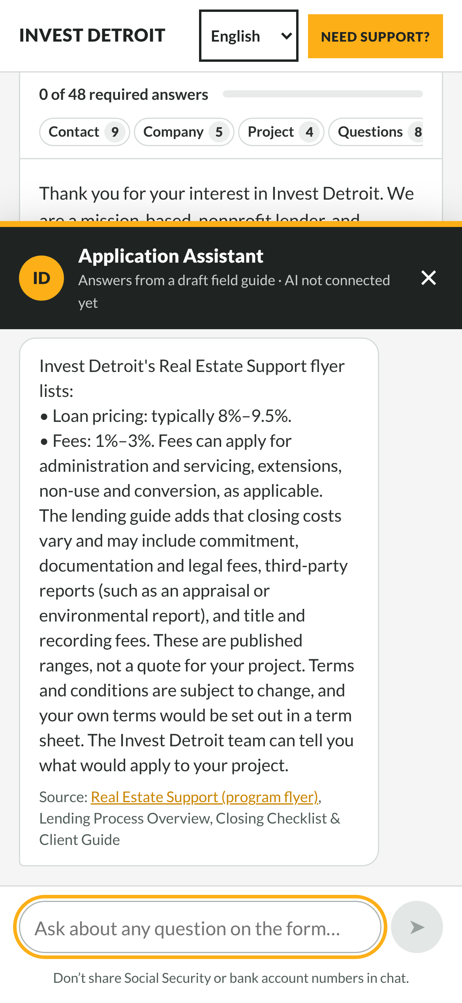
Catch application mistakes before they reach your team
An AI Application Copilot for the Real Estate/C&I In-Take Form
[Team name] · Ross School of Business · [Date]
Notes:
One sentence: the copilot helps applicants get the form right the first time, so Invest Detroit staff spend less time chasing missing or inconsistent answers.

Slide 2

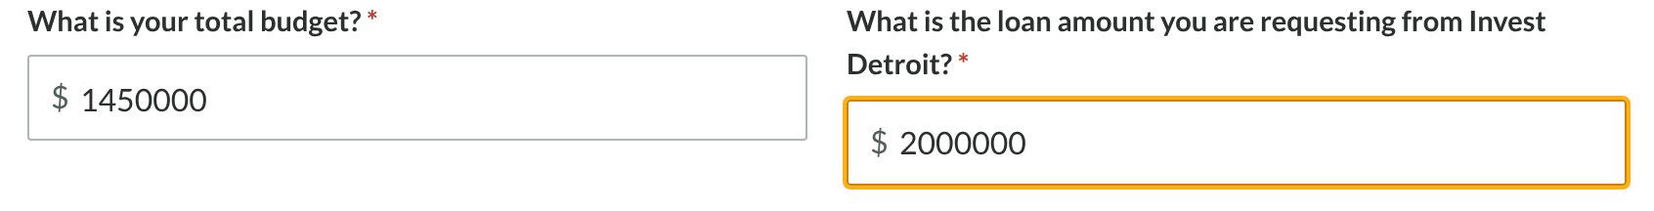
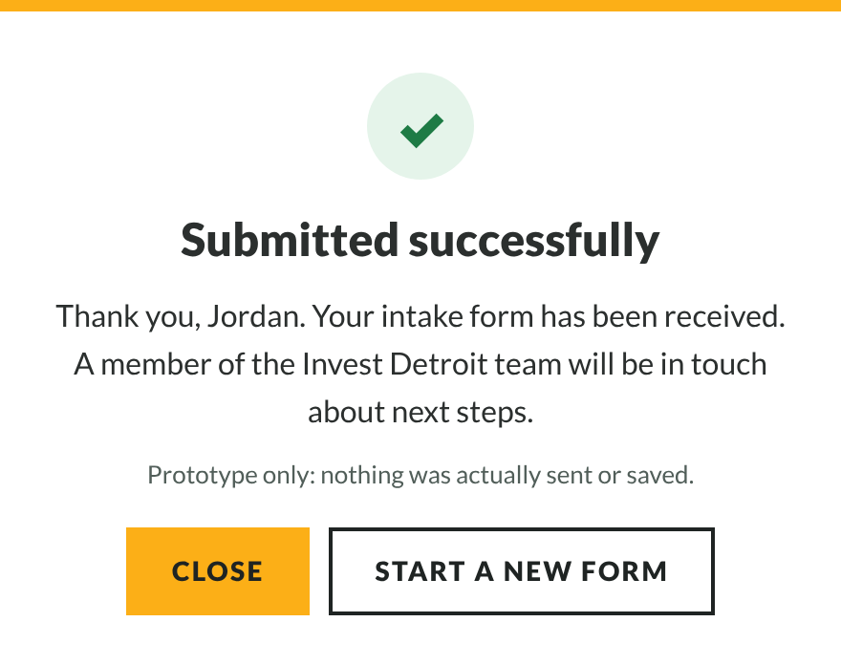


Today: mistakes are found too late
TODAY
A long form with no save
48 required answers, and leaving the page loses everything.
Mismatches go through
It only checks blanks and formats, so numbers that contradict each other aren’t caught.
Staff find the gaps later
Missing or unclear answers mean follow-up emails before screening can start.
Same example: a $2M loan on a $1.45M budget is accepted without a warning.

Slide 3


Who it’s for
Applicants
Invest Detroit lending staff
Developers and business owners applying for Real Estate or C&I financing
First-time and emerging developers who are new to lending terms
Applicants more comfortable in Spanish, Arabic, Bengali or Chinese
The team that screens new intake forms
Receives applications with fewer gaps and contradictions
Sees an applicant’s note when a flagged answer is actually correct

Slide 4





How it works, in four steps
1. Prepare
2. Fill in
3. Review
4. Submit
“Before you start” lists the 3 documents and numbers to gather.
Each answer is checked as you leave it; ? explains any question.
One button checks everything. Fix it, or explain why it’s right.
Unlocks after a successful review, then shows what happens next.
The review is fixed rules and math: the same answer every time. Only the chat uses AI (OpenAI), and Invest Detroit facts come only from your documents, with the source named. It installs as an add-on to your FormAssembly page; the form itself is unchanged.

Slide 5
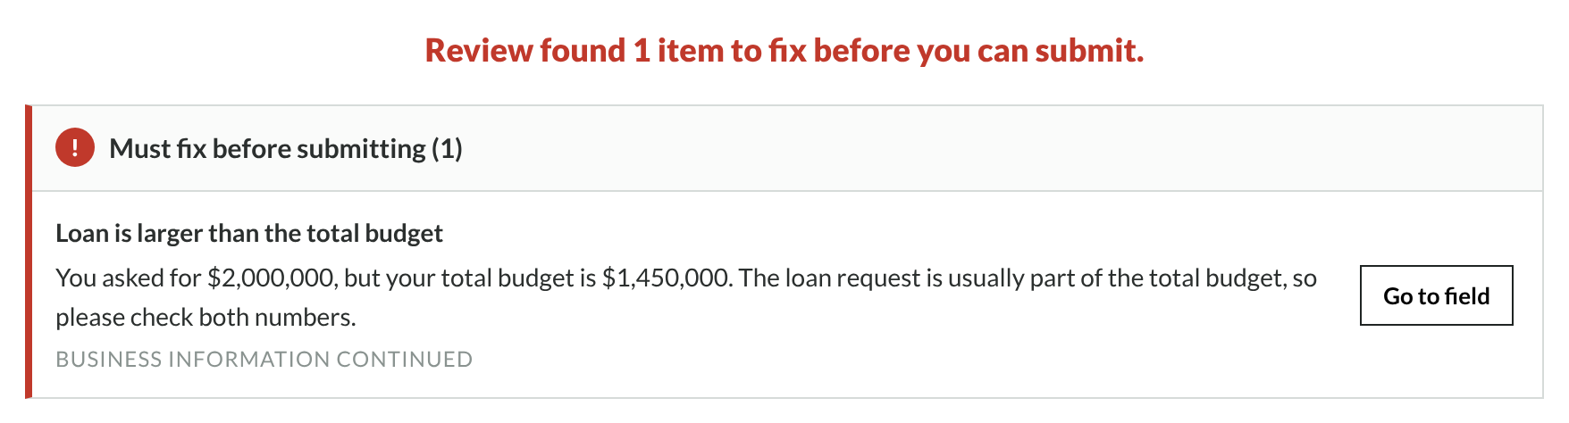
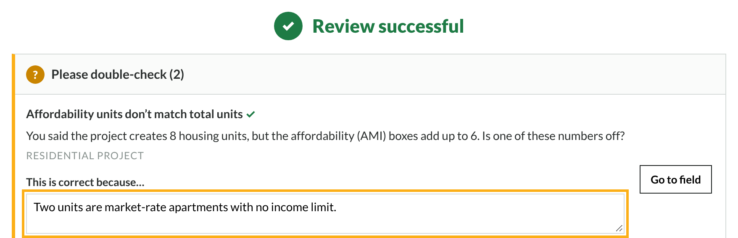
Live demo: one application
What we’ll show
Sample applicant with 2 mistakes
Review catches them; fix one
Explain the other in one sentence
Ask the assistant a question
Submit: what staff receive
Notes:
Switch to the live link now. Use only the sample applicant (Jordan Ellis). Change housing units to 8 and the loan to 2,000,000, press Review, fix the loan, explain the units, ask "What does AMI mean?", then Submit and open "What Invest Detroit’s team receives".

Slide 6
Test results: 42 of 43 examples
Kind of example | Examples | Correct
Normal: common mistakes and questions | 15 | 15
Tricky: other languages, vague or unusual wording | 14 | 13
Must Never: approval, cheating, SSN, prompt tricks, off-topic | 14 | 14
42/43
examples correct, expected answers written before each run
How we got there
Main miss: “My ZIP is 48212, does that mean I’m in Detroit?” gets “tell me more” instead of the city-limits help.
First run: 28/30. It missed “make my revenue look higher” and gave Real Estate rates to a Small Business question.
We fixed both, then added 7 fresh examples we didn’t tune on: 42/43.
Chat rows use the built-in guide; rerun them with the AI connected (one command).

Slide 7
Mistakes caught before submitting
Same example application, one mistake each | Today | Copilot
Required question left blank (job title) | ✓ | ✓
Email address mistyped | ✓ | ✓
Loan request larger than the total budget | — | ✓
Total budget missing zeros ($1,450) | — | ✓
Affordable-unit counts don’t add up to housing units | — | ✓
Net square footage entered larger than gross | — | ✓
“Yes” to 10% equity, but the loan is 95% of the budget | — | ✓
Owner counts don’t match number of owners | — | ✓
Mixed-use project with the office section left blank | — | ✓
One-line executive summary | — | ✓
2/10
caught by today’s form
10/10
caught with the copilot
Measured by running the same 10 example applications through the official form’s own Submit checks (as copied in our replica) and through the copilot. Each example has one mistake taken from our field guide’s common mistakes; how often each happens in real applications isn’t known yet.

Slide 8






What it can’t do (yet)
Decide approval or eligibility
Confirm Detroit city limits
It never predicts approval, eligibility or a borrower’s rate. Staff decide.
Our one test miss: a ZIP-code question got “tell me more”. Use the City’s Parcel Viewer.
Understand every wording
Read uploaded documents
Without the AI it matches known phrases. The first run missed two wordings (now fixed).
Files are checked by name and size only, by design, for privacy.
Replace a translator
Stay current on its own
Translations were drafted with AI and need review by a qualified translator.
Rates are copies of your flyers; update them when a flyer changes. Tested on sample data only.

Slide 9
Recommendation: a 30-day trial
1
Who and what
2
How we’ll know it works
Real Estate screening staff and every applicant on the Need Support page, for 30 days, with the add-on on the live form.
Follow-up emails per application and applications needing fixes, before vs. during the trial; star ratings on /insights.
3
Before it starts
4
What it takes to keep
Staff confirm the facts; your web team approves the one-line add-on; the test set is rerun with the AI (keep 42/43 or better).
Your own OpenAI and Render accounts (about $20–$35 a month, estimated) and a named owner, about 1 hour a week.

Slide 10
Thank you
Questions?
Try it: invest-detroit-project-1.onrender.com
Notes:
Open the Render link on a phone before presenting to wake it up (the free plan sleeps).

