Slide 1
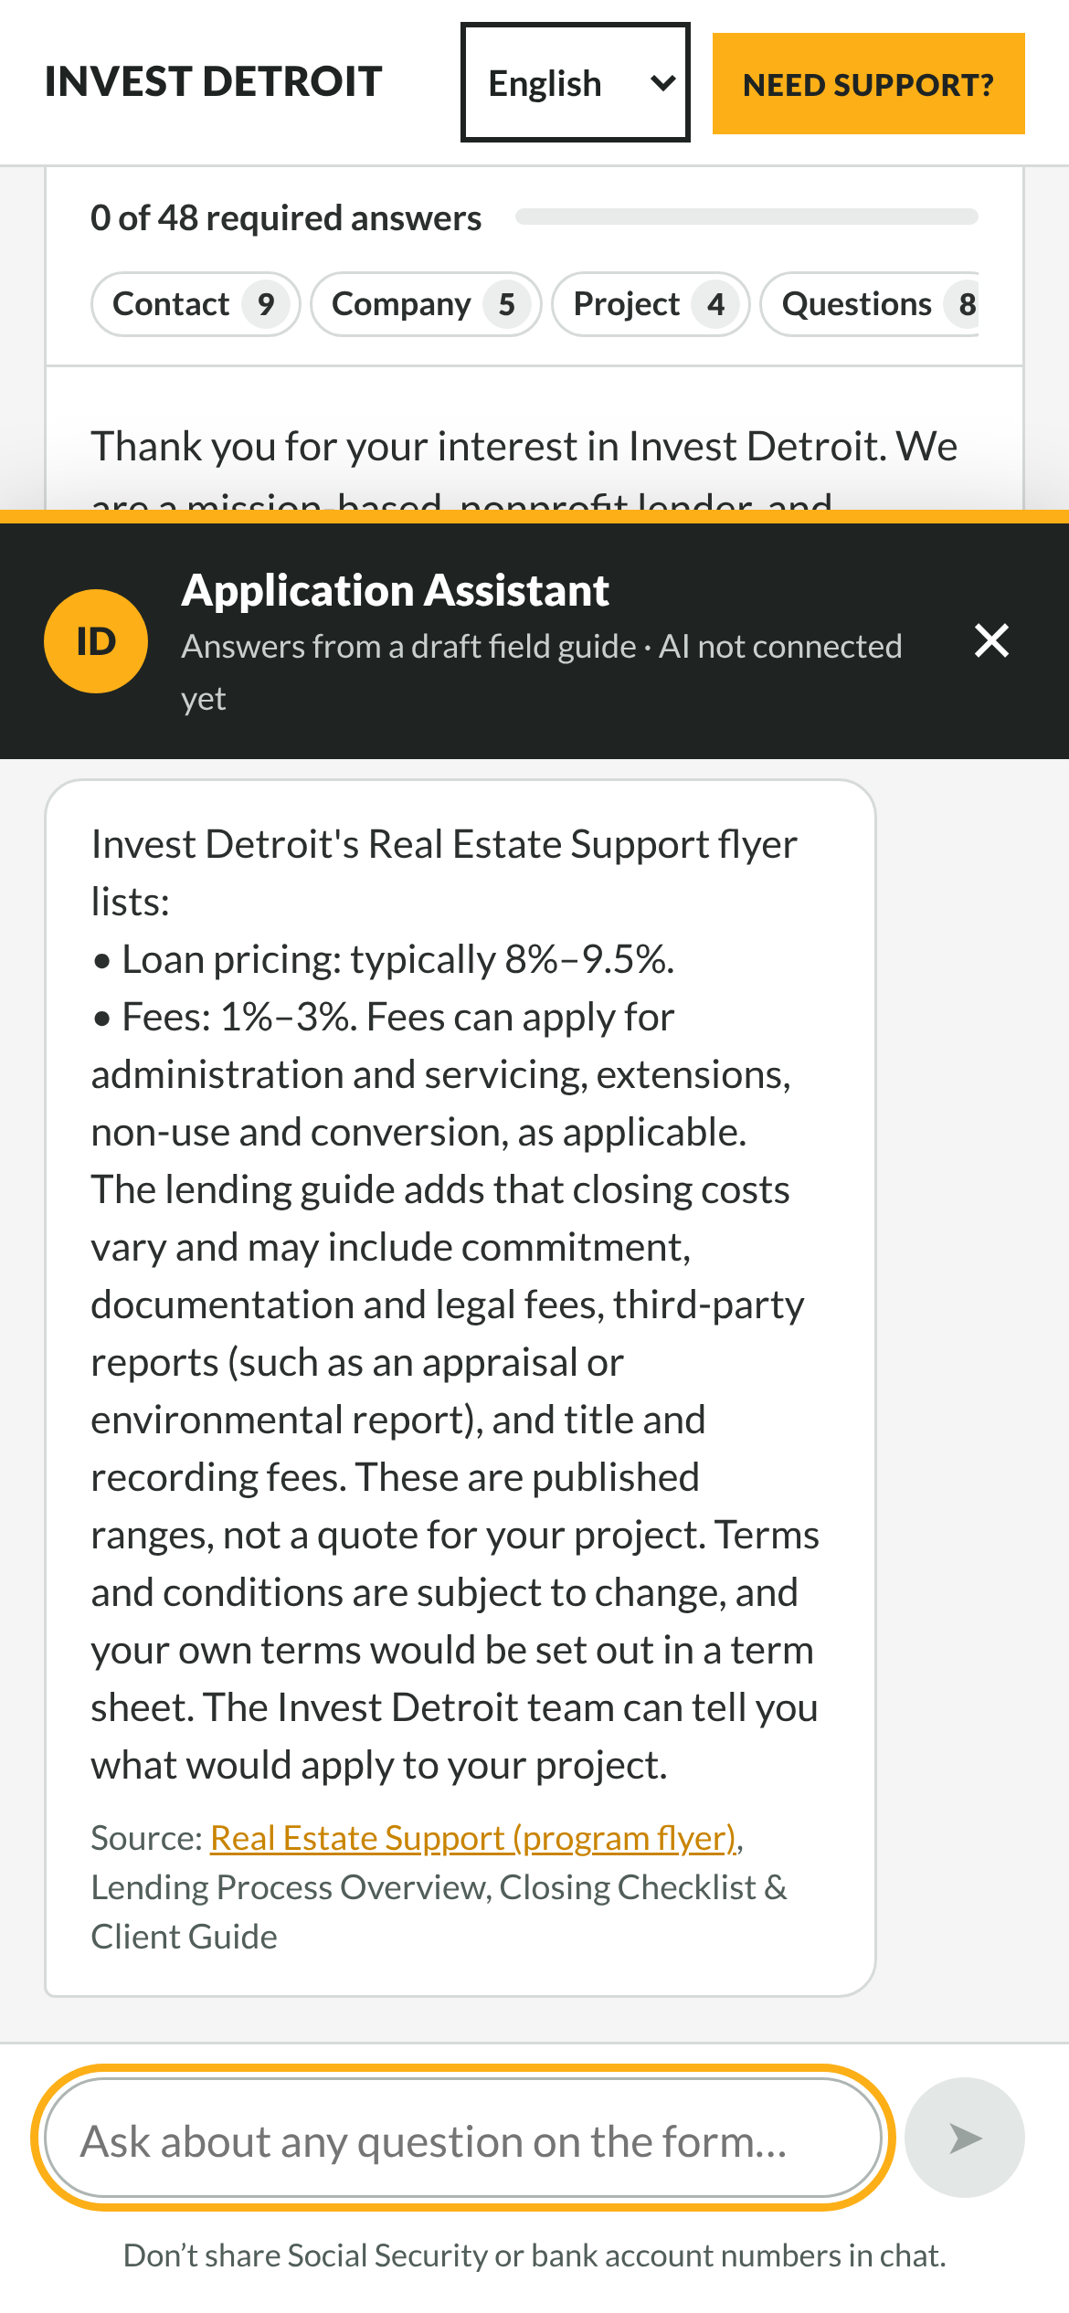
AI Application Copilot
Helping Detroit developers submit complete, accurate Invest Detroit loan applications
[Team name] · Ross School of Business · [Date]
Notes:
Open with the one-sentence goal: fewer incomplete applications, less back-and-forth for Invest Detroit staff.

Slide 2
Today
01
The problem
Why applications come back incomplete
02
What we built
Review, assistant, languages, easier filling
03
How it works
The applicant journey, start to finish
04
What’s next
Roadmap and what we need to go live

Slide 3



Good projects, incomplete forms
A long form with no save
Easy-to-miss mistakes
Back-and-forth with staff
48 required answers across many sections, and closing the page loses everything.
A loan bigger than the budget, AMI units that don’t add up, net and gross swapped.
Missing or unclear answers surface after submitting, so screening starts with emails.

Slide 4
What we built
01
A copilot that sits on the existing intake form

Slide 5




Four ways the copilot helps
Review My Application
Application assistant
Catches blanks, typos and numbers that don’t fit before Submit unlocks.
Plain-language answers from Invest Detroit’s own documents, with sources.
Five languages
Easier form filling
English, Spanish, Arabic, Bengali and Chinese, including right-to-left.
Live checks, progress by section, money formatting and upload tips.

Slide 6
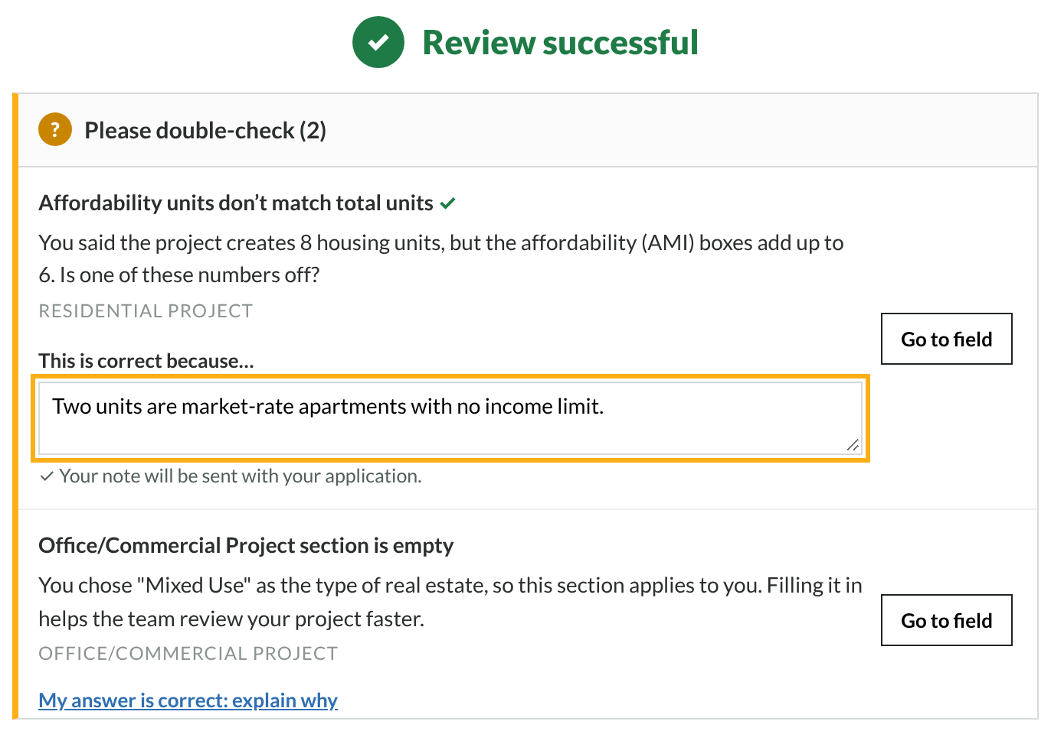
Review before submitting, not after
Grouped by urgency
“Must fix”, “Please double-check” and “Good to know”, each with Go to field.
Explain instead of change
If an answer is right, a short note goes in with the application.
Submit unlocks on success
Only clear errors block. Tips never do.

Slide 7

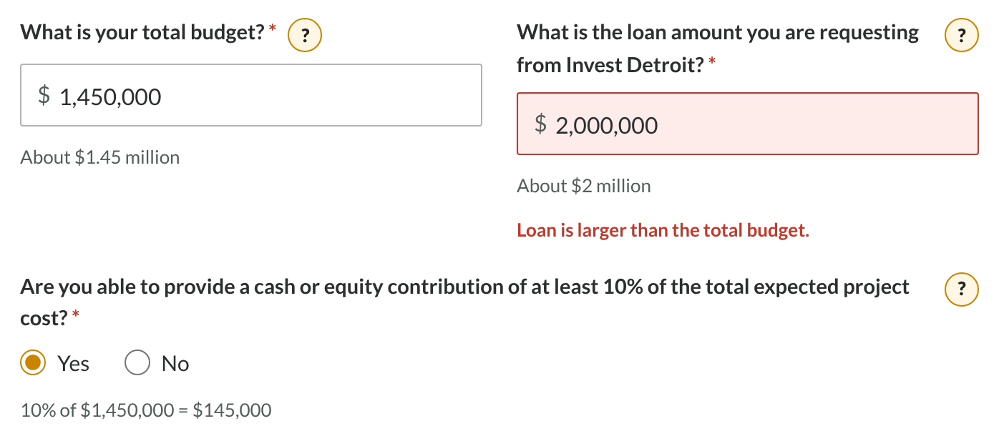


Mistakes caught as you type
Money that reads clearly
1450000 becomes 1,450,000, with “About $1.45 million” underneath.
The 10% equity math
“10% of $1,450,000 = $145,000” sits next to the yes/no question.
Checked as you go
A loan bigger than the budget is flagged right away.

Slide 8



An assistant that knows its limits
Answers from Invest Detroit’s documents
Flyers, lending guide and official sources, always named.
Never predicts approval
Published rates are quoted as “subject to change”. Decisions stay with staff.
Guardrails built in
Stays on topic, won’t help falsify answers, hides Social Security numbers.

Slide 9
Built to be trusted
160
~80
5
0
automated tests on every change
help entries from Invest Detroit sources
languages, every screen translated
applicant files opened or stored
Update these numbers before presenting.

Slide 10
How it works
02
The applicant journey, from first visit to first call

Slide 11





The applicant journey
1. Prepare
2. Fill in
3. Review
4. Submit
5. What’s next
“Before you start” list of documents and numbers
Live checks, progress bar, ? help on every question
One button checks everything; explain or fix
Unlocks after a successful review
Screening 1–2 weeks, then term sheet and closing
Timeline stages from Invest Detroit’s lending guide; every project is different.

Slide 12
Roadmap
Now
Next
Later
Prototype live on a test link
Knowledge base drafted from 4 documents
Add-on built for the real form
Invest Detroit reviews facts and translations
Install the add-on on the live page
Notes field added to FormAssembly
Connect an approved AI model
Staff-owned facts sheet
Measure fewer incomplete applications

Slide 13

The team
[Name]
[Name]
[Name]
[Name]
[Role]
[Role]
[Role]
[Role]
Notes:
Replace each grey circle with a photo (right-click, Replace image) and fill in names and roles.

Slide 14
Thank you
Questions?
Try it: [add your demo link]
Notes:
Test links expire after about a week; publish a fresh one before presenting.

