Slide 1
JSP Tutorial Part 2:
The Book List JSP
Providing a View for the List of Available Books.

Slide 2
JSP design
Since we need to give the user a list of Books from which to choose, and a way to select the book, we’ll use an html form with a select..
The book is coming from a database, so we can use the java Bean we created earlier to populate the list.

Slide 3
JSP Implementation
Open a file called BookLook.jsp
On the first line, add an html comment.
<!-- Displays a form that gets its content from a java Bean -->

Slide 4
JSP BookLook Implementation
In the file called BookLook.jsp
On the next line, add the JSP Comment
<%-- import java.util.* to get access to the Iterator class --%>
On the next line, add a page directive to utilize the java.util package.
<%@ page import = "java.util.*" %>

Slide 5
JSP BookLook Implementation
In the file called BookLook.jsp
On the next line, below the page import, begin the html content.
<!-- begin html document -->
<html>
<!-- specify html head element and title -->
<head>
<title> Book Look-Up </title>
</head>

Slide 6
JSP BookLook Implementation
In the file called BookLook.jsp
On the next line, below the closing head tag, begin the body of the html document.
<!-- specify html body element -->
<body>

Slide 7
JSP BookLook Implementation
In the file called BookLook.jsp
On the next line, below the opening body element, add an h1 tag to provide a description of the page.
<h1>Book Search Web Application</h1>
Note that we are providing static content here.

Slide 8
JSP BookLook Implementation
In the file called BookLook.jsp, we are going to provide a form to allow the user to select a book from a list.
On the line below the h1 tag , add a form tag.
<!-- create form -->
<form method = "post" action = "Books">
A post request will be sent to a page called “Books” when the submit is pressed on the form.

Slide 9
JSP BookLook Implementation
Below the form tag, add a paragraph to tell the user what to do:
<p>Select a name from the list and click
the Get Book button</p>

Slide 10
JSP BookLook Implementation
Below the paragraph tag, add a select tag to give the selected title a place holder, namely “titleName”. When the post is issued, a parameter called titleName will contain the selected title.
<!-- create list that contains titles -->
<select name = "titleName">

Slide 11
JSP BookLook Implementation
After the select tag, add a JSP action element to get an instance of the BookBean:
<%-- Use a jsp action to instantiate a Java Bean --%>
<jsp:useBean id="dbBean" class="javaII.dbBeans.BookBean" scope="session"/>
This will actually create a reference variable called dbBean that references a BookBean object (e.g. BookBean dbBean = new BookBean()).

Slide 12
JSP BookLook Implementation
After the action jsp:usebean tag, add a JSP scriplet element to allow the use of the iterator of the BookBean. In other words, you will use a while loop to get the data from the BookBean.An opening scriptlet tag is simply ‘<%’ :
<%-- begin JSP scriptlet to get the data from the bean --%>
<%

Slide 13
JSP BookLook Implementation
After the opening scriplet tag, instantiate an Iterator. Keep in mind that you are now in pure java-code land…
After <%:
java.util.Iterator it = dbBean.getTitleList();
while (it.hasNext()) {
String currentName = (String) it.next();

Slide 14
JSP BookLook Implementation
Next, you need to interrupt the scriplet (while loop) to allow the list elements to be displayed in an option tag.
After String currentName = (String) it.next();
%> <%-- end scriptlet to insert HTML option tag --%>
<%-- Use JSP expressions to output from this loop --%>
<option><%= currentName %></option>

Slide 15
JSP BookLook Implementation
Next, you need to continue the scriplet to finish the while loop, and close the select tag. Note the java in-line comment after the scriplet tag.
After <option><%= currentName %></option>:
<% // continue scriptlet to close out the while loop
}
%>
</select>

Slide 16
JSP BookLook Implementation
Next, you need to add a button to allow the user to submit the book title of choice.
After </select>:
<!-- create View Information button -->
<p><input type = "submit" value = "Get Book"></p>

Slide 17
JSP BookLook Implementation
Finally, close the form, body, and html tags, and save the file.
At the bottom of BookLook.jsp:
</form>
</body>
</html>

Slide 18
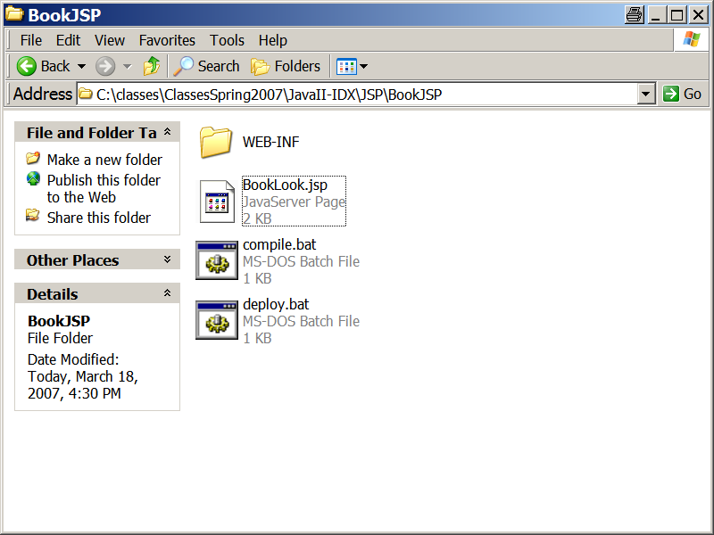
JSP BookLook Deployment
The BookLook.jsp should be in a WEBAPP style folder containing the BookBean you created earlier.

Slide 19
JSP BookLook Deployment
The Compile script should look something like this:
cd .\WEB-INF\classes\javaII\dbBeans
javac -classpath ..\..\..\lib\dals.jar;..\..\..\lib\mysql-connector-java-3.1.7-bin.jar;c:\tomcat\common\lib\servlet-api.jar;..\..\..\classes;. -d ..\..\..\classes *.java
pause

Slide 20
JSP BookLook Deployment
Run the compile script to compile your classes.
The deploy script should look something like:
jar -cvf BookJSP.war *
copy BookJSP.war "C:\tomcat\webapps\."
Pause
Run the deploy script.

Slide 21
Start Tomcat
Go to the bin directory of Tomcat, run startup.bat
Open a browser to http://localhost:8080/BookJSP/
You should see your BookLook.jsp there.
Click on it.

Slide 22
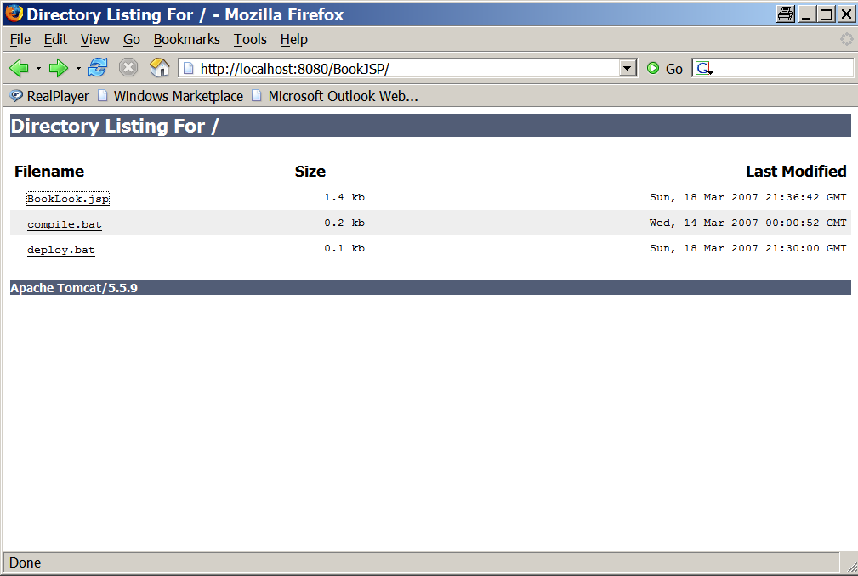
Start Tomcat
Open a browser to http://localhost:8080/BookJSP/

Slide 23
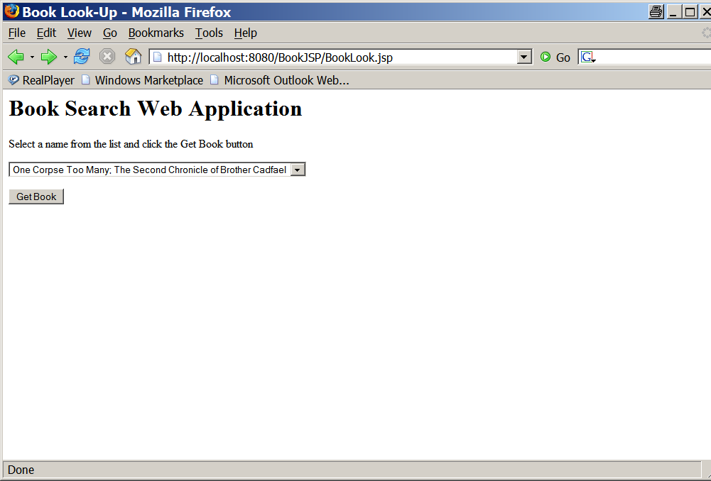
Start Tomcat
Click on BookLook.jsp

Slide 24
Click the submit Button.
Clicking on the submit button will result in an error:
Servlet Book is not available. Why does this error occur (hint: see web.xml)?

