Slide 1
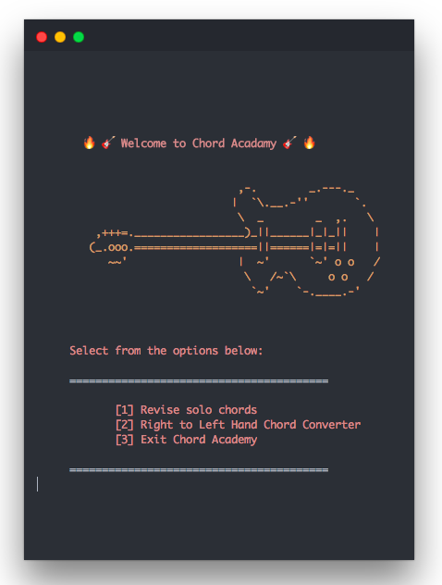
Chord Academy
A Terminal App by Ross and Callum

Slide 2
Discussion Points
What’s the problem?
What’s our solution?
Our Approach?
The ethics of it all?

Slide 3
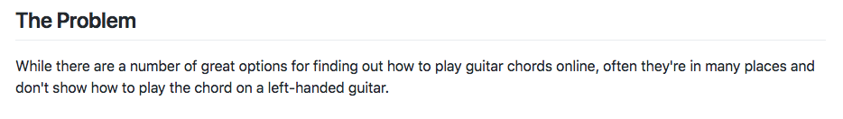

Slide 4
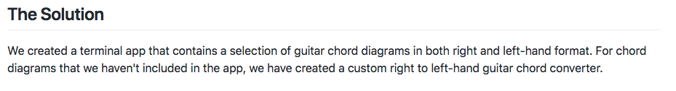

Slide 5
Live Demo

Slide 6
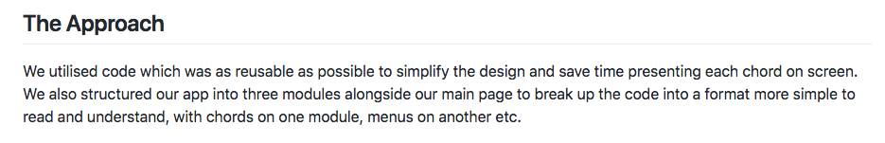

Slide 7
Ethical Concerns?

