Slide 1
Data Science Group Project
Group 17
Abhinav Singh (2001CE02)
Kartikay Gupta (2001ME32)
Padmaja Joshi (2001EE94)
Parth Gupta (2001CB38)
Pratham Chaudhary (2001EE45)
Rushikesh Langde (2001EE57)

Slide 2
Introduction
We had to analyse the data related to the reviews given by customers on an E-commerce site. In our case we choose to work on the data from Amazon customer reviews.
So the raw data was composed of the rating given to the products bought and the no. of customers who gave the rating.
We aim to understand the similarities between populations of two categories of products, to understand the similarities between distribution of a category (sample unit) and the population (sample frame of 10 categories) on the whole , to visually analyse the statistical measures for different sample units.

Slide 3
Data Collection
We collected Raw data from various websites from the internet namely,
https://jmcauley.ucsd.edu/data/amazon/
https://snap.stanford.edu/data/web-Amazon.html
https://nijianmo.github.io/amazon/
https://www.kaggle.com/datasets/datafiniti/consumer-reviews-of-amazon-products
On inspecting the data from various sites we found out that the data from site https://nijianmo.github.io/amazon/ satisfied our requirements since it had 233.1 million reviews and we needed more reviews per product to make more accurate hypothesis. Moreover, a larger data set has more chances of it being equivalent to Gaussian distribution.

Slide 4
Data Collection
The collected data had a metadata and a 5 core set of data since metadata had a very large size and parsing the data of that size required a modern machine with faster processing speed than the machine we had, so we chose to use the 5 core data that contained
reviewerID - ID of the reviewer, e.g. A2SUAM1J3GNN3B
asin - ID of the product, e.g. 0000013714
reviewerName - name of the reviewer
vote - helpful votes of the review
style - a dictionary of the product metadata, e.g., "Format" is "Hardcover"
reviewText - text of the review
overall - rating of the product
summary - summary of the review
unixReviewTime - time of the review (unix time)
reviewTime - time of the review (raw)
image - images that users post after they have received the product

Slide 5
Data Collection
For parsing and collecting the required data we needed a good amount of memory to hold the data, the data was in a json.gz file as we extracted the data to a json file the size increased further, so in order to avoid this hassle of storing and processing the data on our device, we decided to use Google Collab.
We had to upload the data to the the google servers from our device and download the json files to the device first .This created a bit confusion in identifying the data, instead we used get function to directly upload the required 5 core dataset to collab servers from source URL.

Slide 6
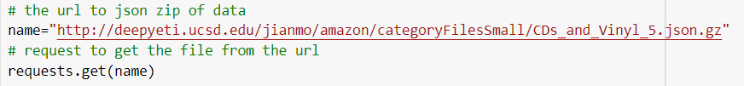
Data Collection
The following function was used to get the data :

Slide 7
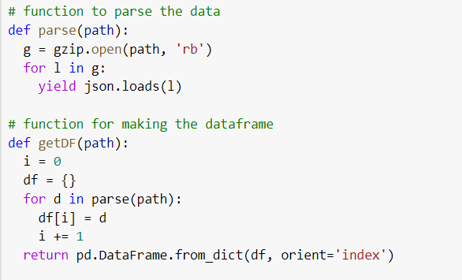
Data Collection
Function for parsing json.gz file and making a pandas dataframe, i.e getDF function.

Slide 8
Data Preprocessing and Cleaning
The given dataset had
reviewerID - ID of the reviewer, e.g. A2SUAM1J3GNN3B
asin - ID of the product, e.g. 0000013714
reviewerName - name of the reviewer
vote - helpful votes of the review
style - a dictionary of the product metadata, e.g., "Format" is "Hardcover"
reviewText - text of the review
overall - rating of the product
summary - summary of the review
unixReviewTime - time of the review (unix time)
reviewTime - time of the review (raw)
image - images that users post after they have received the product
I.e 11 categories but we required only a few namely, id of the product, rating of the product and rating per product for all unique products.

Slide 9
Data Preprocessing and Cleaning
First we try sampling the data,
Target Population for required data is the review ratings for all categories of products.
Sampling Units will be the categories of the data that we have for example
Amazon Fashion, All Beauty, Appliances, Arts, Crafts and Sewing, Automotive, Books, CDs and Vinyl, etc.
Sampling frame will be list of all categories i.e. image on the next slide.

Slide 10
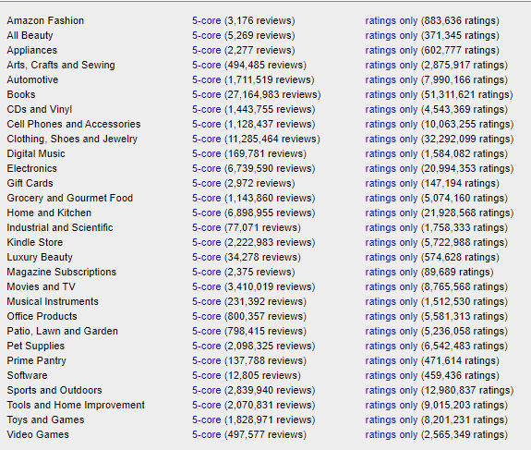

Slide 11
Data Preprocessing and Cleaning
Here, due to our choice of selection of raw data we faced no sampling frame problems i.e. Omission of sample , inclusion of non-element., repetition of sample, in some cases, this may lead to sampling bias
For the sampling scheme, since we had a good sampling frame we did Non probability sampling of type convenience sampling we chose the samples with 100k-400k reviews as it was convenient for us with a moderate runtime of 1-2 min for parsing the data and plotting the required graphs.
For larger samples we faced parsing issues and longer runtimes.
The categories we chose are
Art,craft,sewing Musical instruments Industrial and Scientific
Luxury beauty Office products All beauty
Video Games Amazon Fashion Prime pantry
Patio, Lawn and Garden

Slide 12
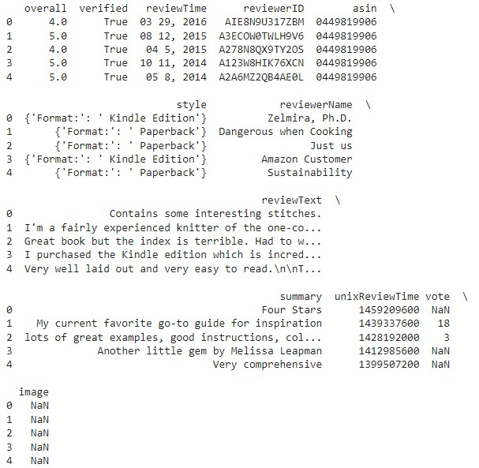
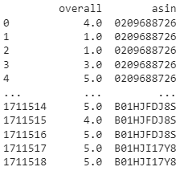
Data Preprocessing and Cleaning
For cleaning the data we dropped the useless columns from the dataset. The change can be seen in the images ->
Here the column heads represent :
asin =>product code
overall=>ratings

Slide 13
Data Preprocessing and Cleaning
In order to use these reviews we need the reviews per product for all the product i.e. we need the frequency of reviews for all products.
In these reviews for avoiding inconsistency in the reviews we neglect all the products (asins) that have no. of reviews less than 50 since the products with less than 50 reviews can be considered less significant.
Now since we have multiple reviews for any product, in order to work with the data according to the frequency of reviews for each product we took the average rating of the product i.e.
Avg overall = sum of all ratings of same asin/frequency of the reviews
After processing the data in the above manner we get following dataset.

Slide 14
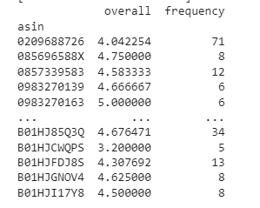
Data Preprocessing and Cleaning
Here asin is the product id, overall is the average rating for a product asin and frequency is the no. of reviews for the given asin.
Basically instead of taking different ratings for different frequency we considered that the frequency of reviewers gave a fixed rating and
We equated that fixed rating to the average rating we found. So that our distribution goes close to Gaussian distribution.

Slide 15
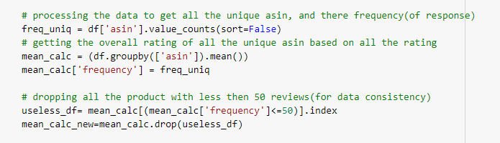
Data Preprocessing and Cleaning
We used the following code for required processing.

Slide 16
Data Preprocessing and Cleaning
In the above code we first found out the number of different products (asins) in the given table
Then we defined a new dataframe where we calculated the mean for all the values of different ratings for single product.
Lastly we dropped out the less significant values ( the overall average of ratings with reviews less than 50 ) of ratings.
When we plotted these plots we found out that there were some outliers in the distribution, in order to normalise the plots we removed these outliers by giving some upper bounds to the no. of reviews (frequency).
Here we assume that outliers are not affecting much of the mean value, as we have only 2-5 outlier points
Finally we get the new processed data.
Let the data processed here be called Processed_data1.

Slide 17
Data Preprocessing and Cleaning
In order to compare the a bigger part of sample population to a smaller unit, we cannot use the average ratings that we used in the Processed_data1 . Since there we considered that all the frequency of reviewers gave a same rating (which we considered equal to the average rating)
Therefore for comparing sample to a bigger population we consider the frequency of ratings i.e. no. of 1 star ratings, 2 star ratings, 3 star ratings, 4 star and 5 star ratings for all categories.
Since we cannot consider all categories together while processing the data so we separately calculated the frequency for all the ratings and in order to find the expected outcome we calculated percent of total reviews for this population of 10 categories.

Slide 18
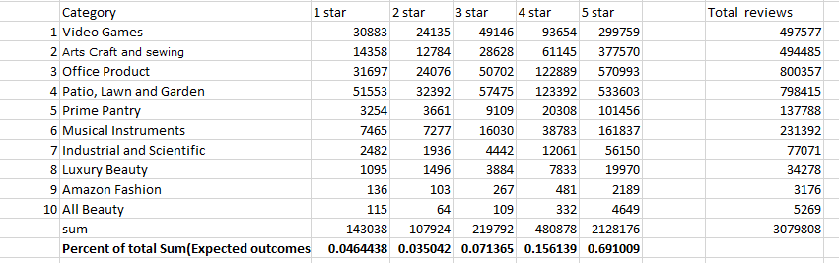
Data Preprocessing and Cleaning
Let this processed data be called Processed_data2

Slide 19
Data Visualisation
For visualising the Processed_data1 we used various types of graphing methods, for any two categories say Video Games and Art ,Craft and Sewing.
We considered making plots to represent the no. of ratings per product through bar plot then we represented the distribution of frequency over average ratings.
Lastly to get more precise idea about the required distribution we made a scatter plot of distribution of frequency over ratings it is in this plot that we recognise that the distribution of frequency over average ratings can be related to gaussian distribution.

Slide 20
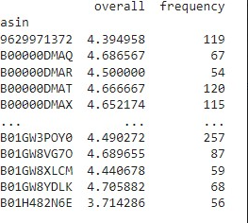
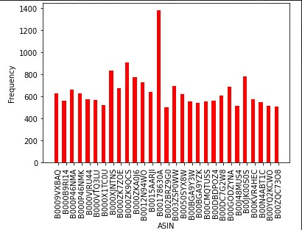
Data Visualisation
Frequency vs ASIN plot for Video Games category.
Here,
Frequency = Number of reviews
ASIN = Product ID

Slide 21
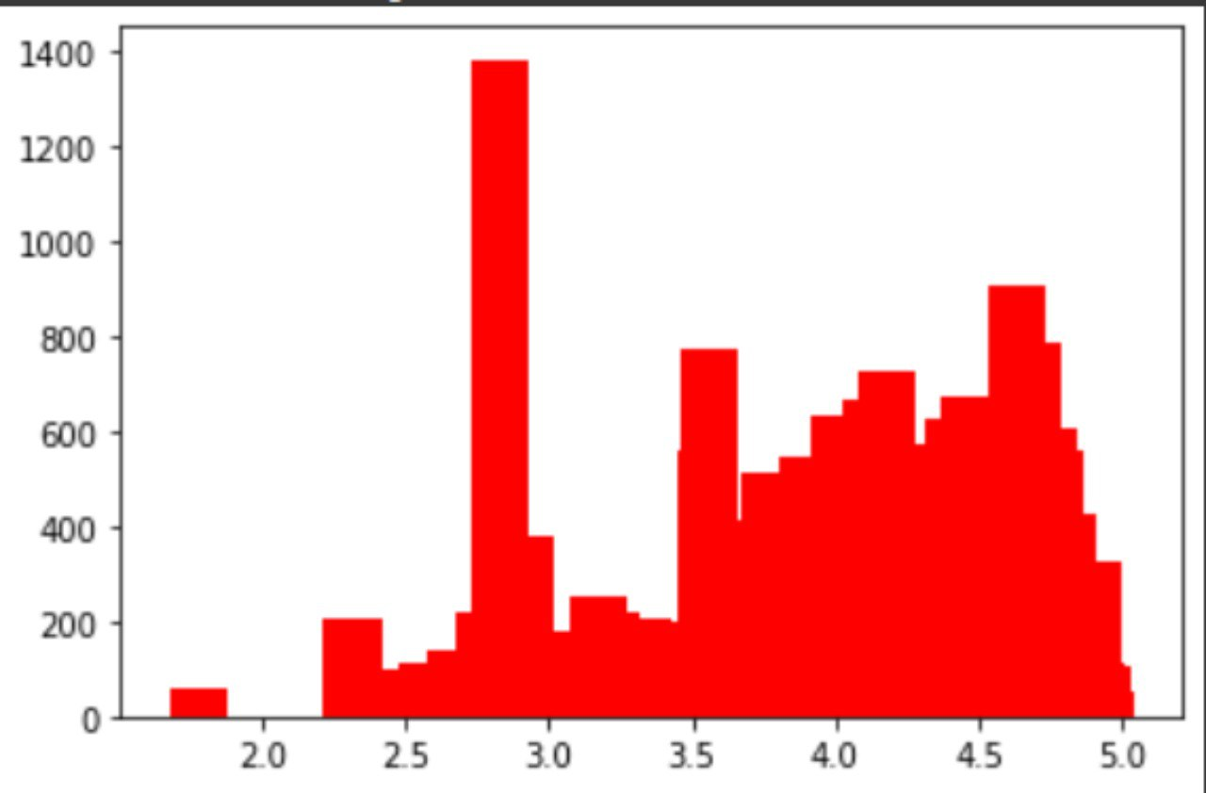
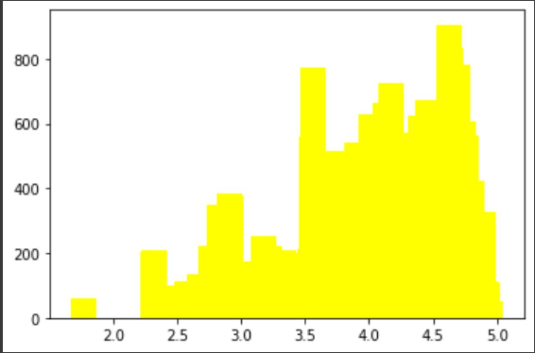
Data Visualisation
Bar plot of Video Game category with outliers.
Bar plot of Video Game category without outliers.

Slide 22
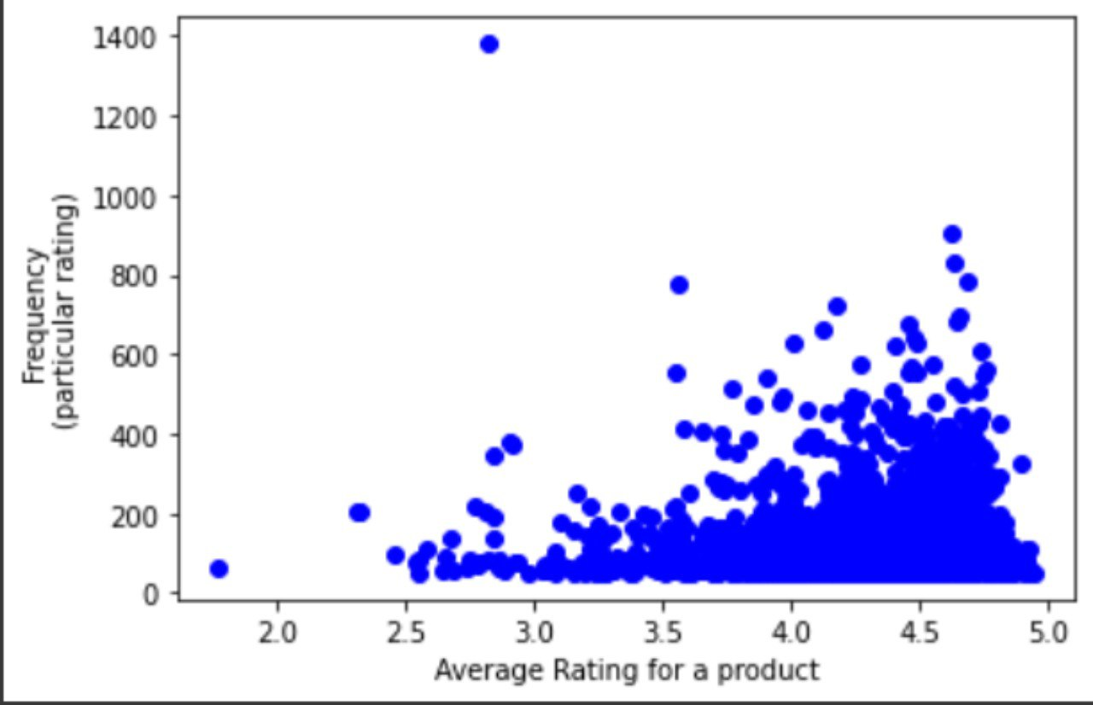
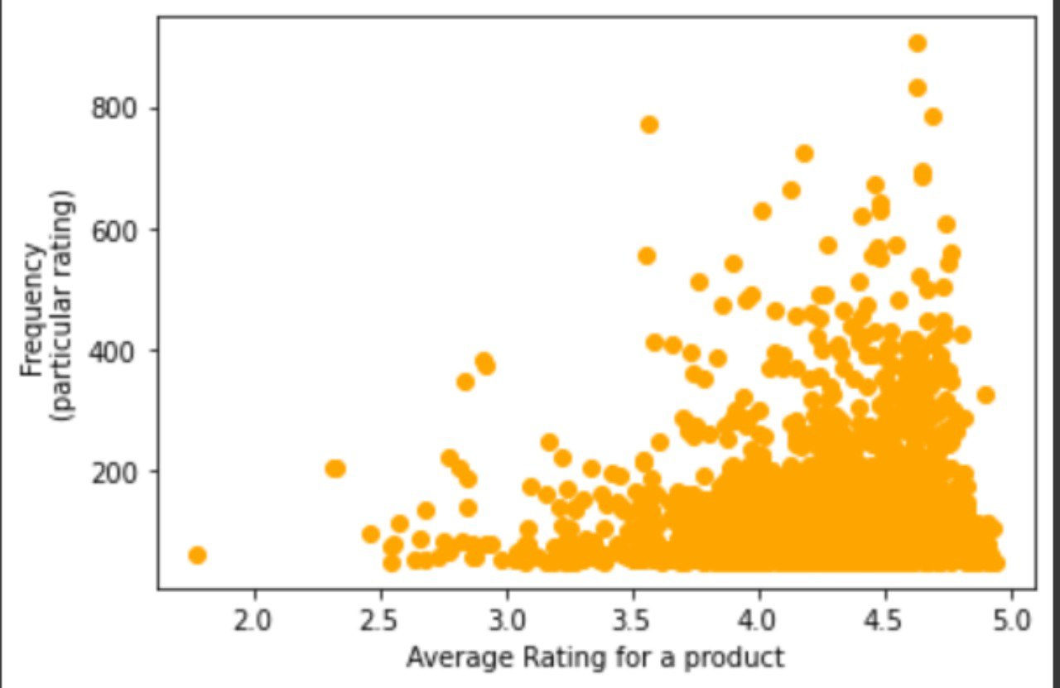
Data Visualisation
Scatter plot of Video Game category with outliers.
Scatter plot of Video Game category without outliers.

Slide 23
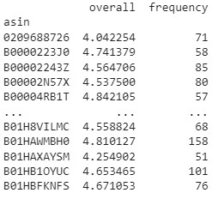
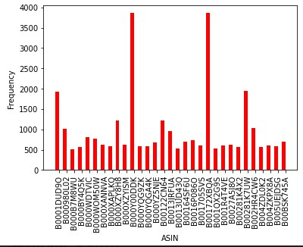
Data Visualisation
Frequency vs ASIN plot for Art, Craft and Sewing category.
Here,
Frequency = Number of reviews
ASIN = Product ID

Slide 24
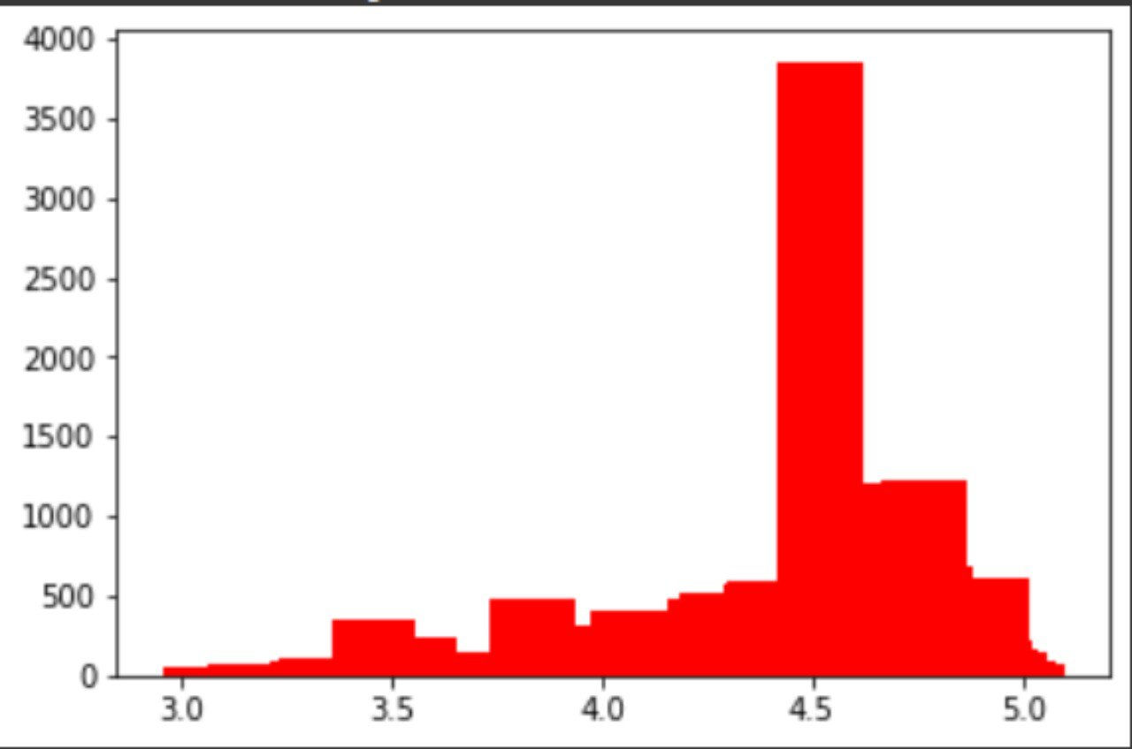
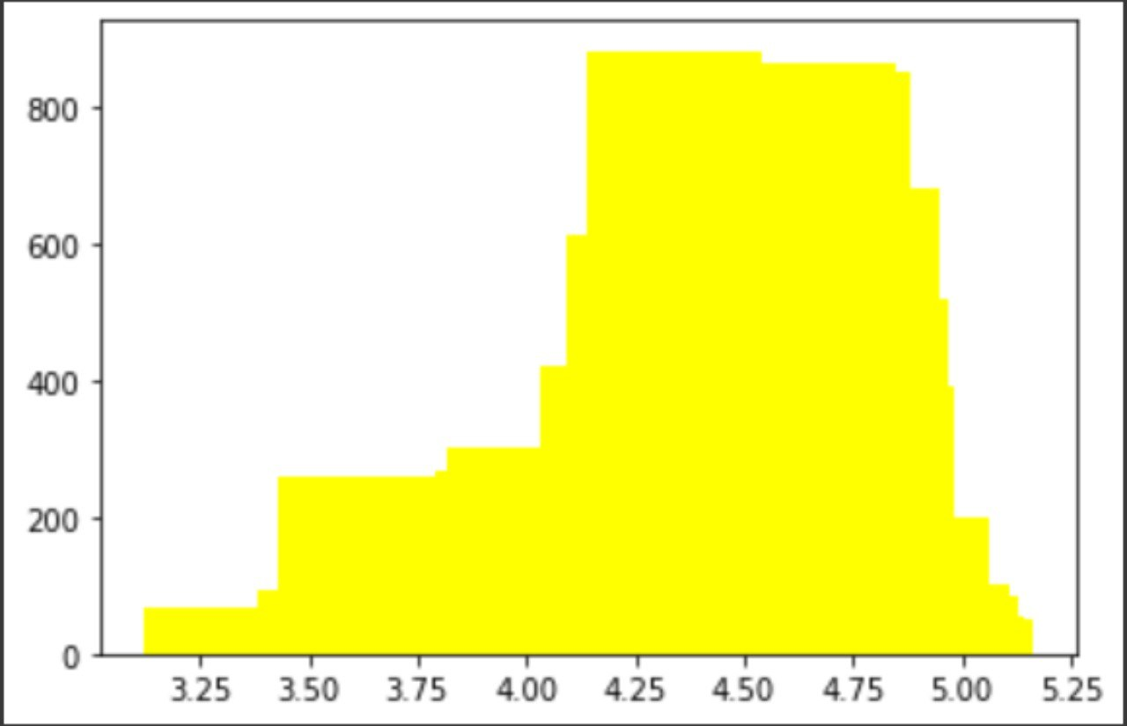
Data Visualisation
Bar plot of Art, Craft and Sewing category with outliers.
Bar plot of Art, Craft and Sewing category without outliers.

Slide 25
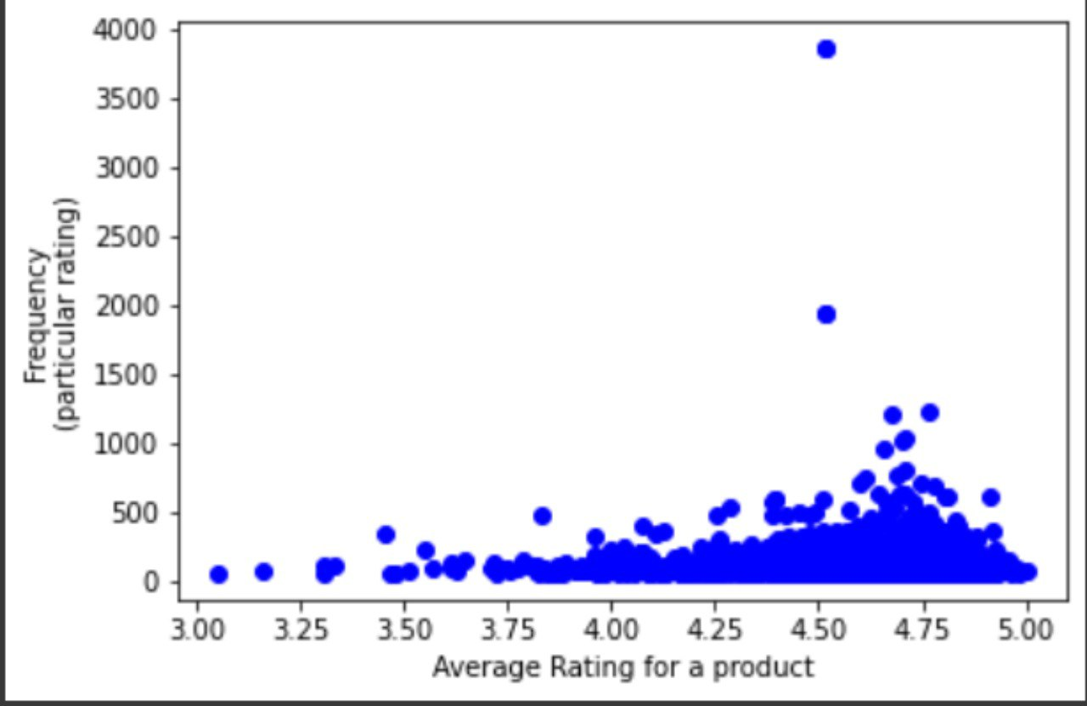
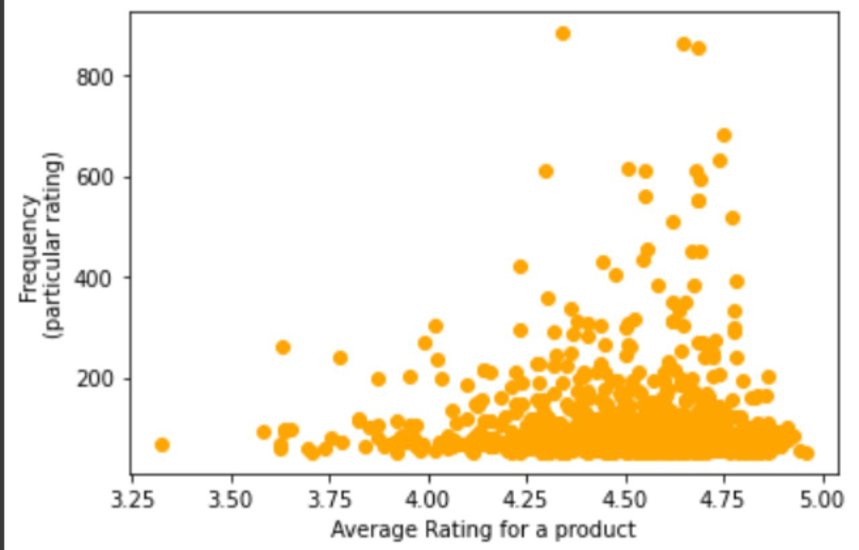
Data Visualisation
Scatter plot of Art, Craft and Sewing category with outliers.
Scatter plot of Art, Craft and Sewing category without outliers.

Slide 26
Data Visualisation
To visualise Processed_data2 we made pie charts for distribution of ratings over frequency for individual categories then for total sum, from the following table.
Here we see that most of the categories have more 5 star ratings than other ratings, and hence we are adding these distributions to get the expected value of the population of the data.

Slide 27
Data Visualisation

Slide 28
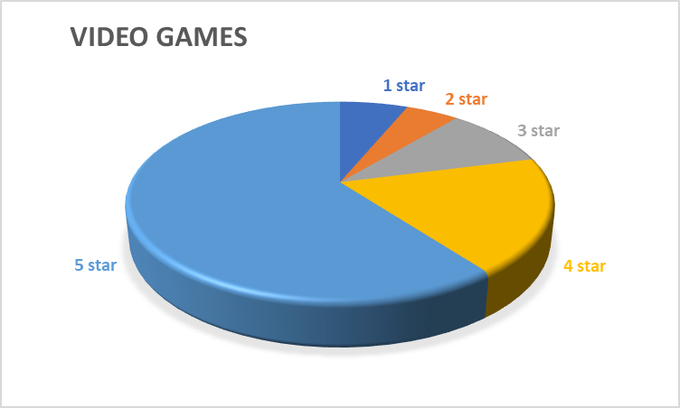
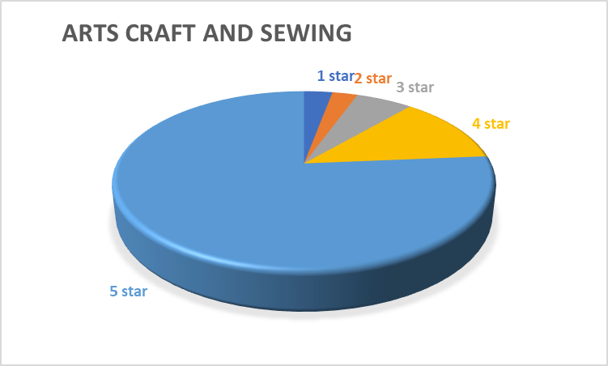
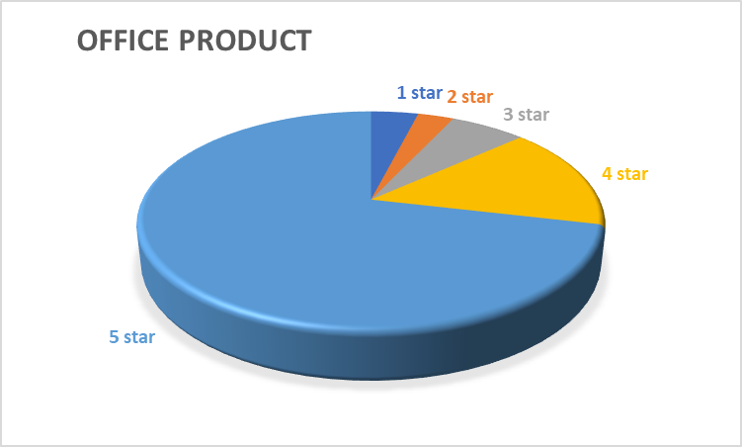
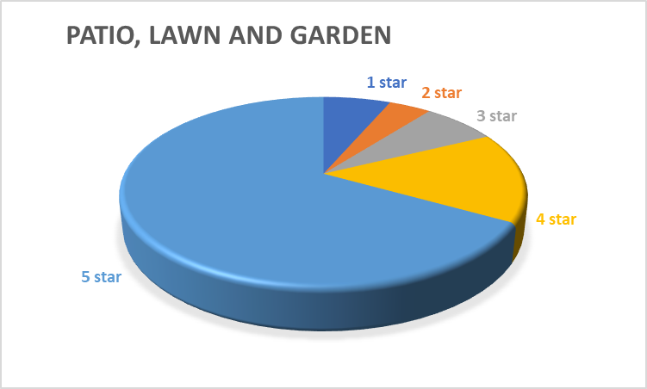

Data Visualisation

Slide 29

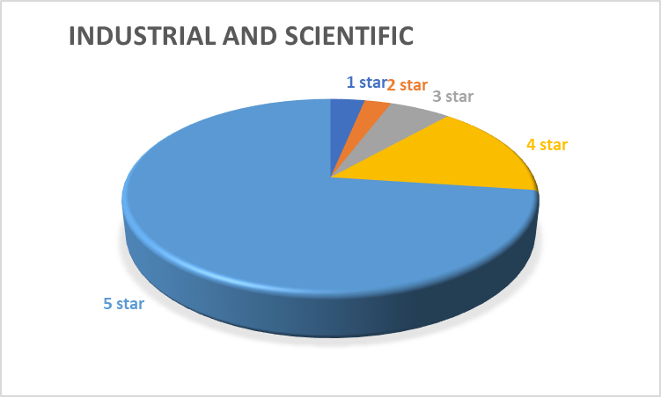
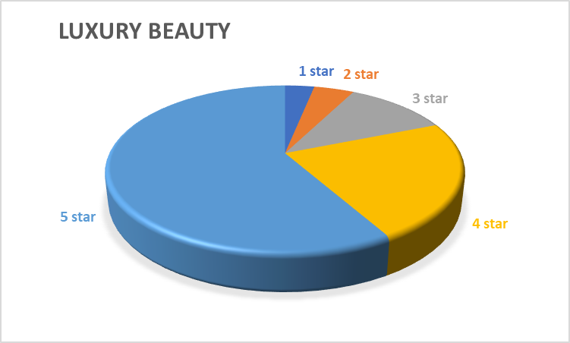

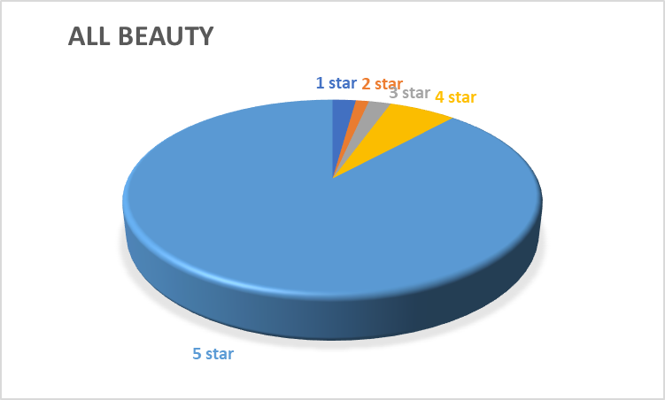
Data Visualisation

Slide 30

Data Visualisation
Now to calculate the expected value we calculated percent of all ratings for all 10 categories together.

Slide 31
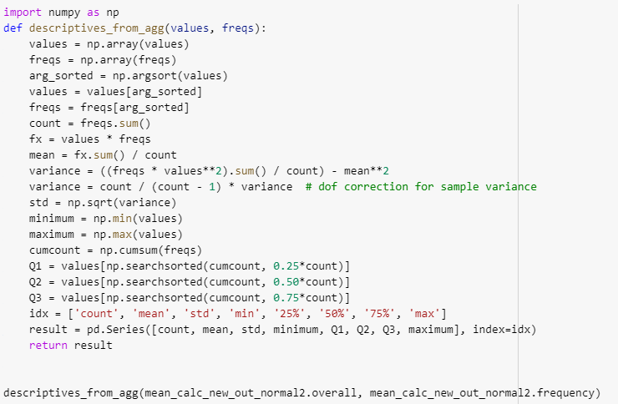
Data Statistics
Here we need to find the mean of frequency distribution table, therefore we cannot use direct .describe function, instead we made a new function to calculate the required statistical values.

Slide 32
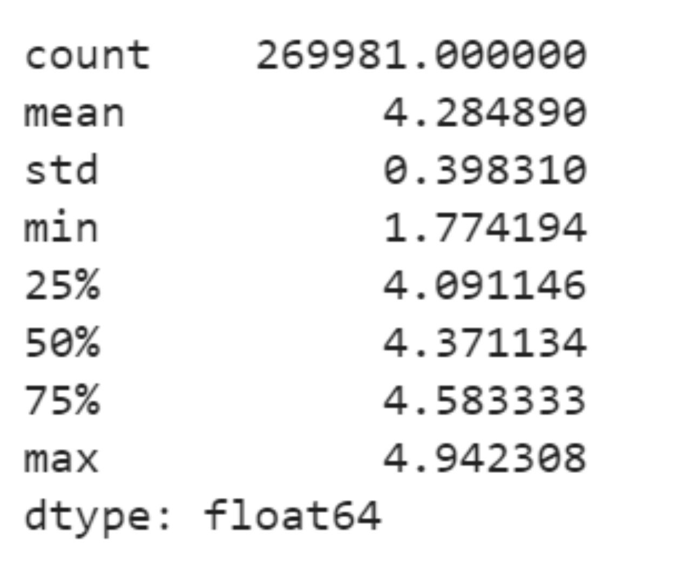
Data Statistics
Following are statistics for Video Games category for Processed_data1:
count represents number of reviews
mean represents Mean of the above distribution without outliers
std represents Standard Deviation of the above distribution without outliers

Slide 33
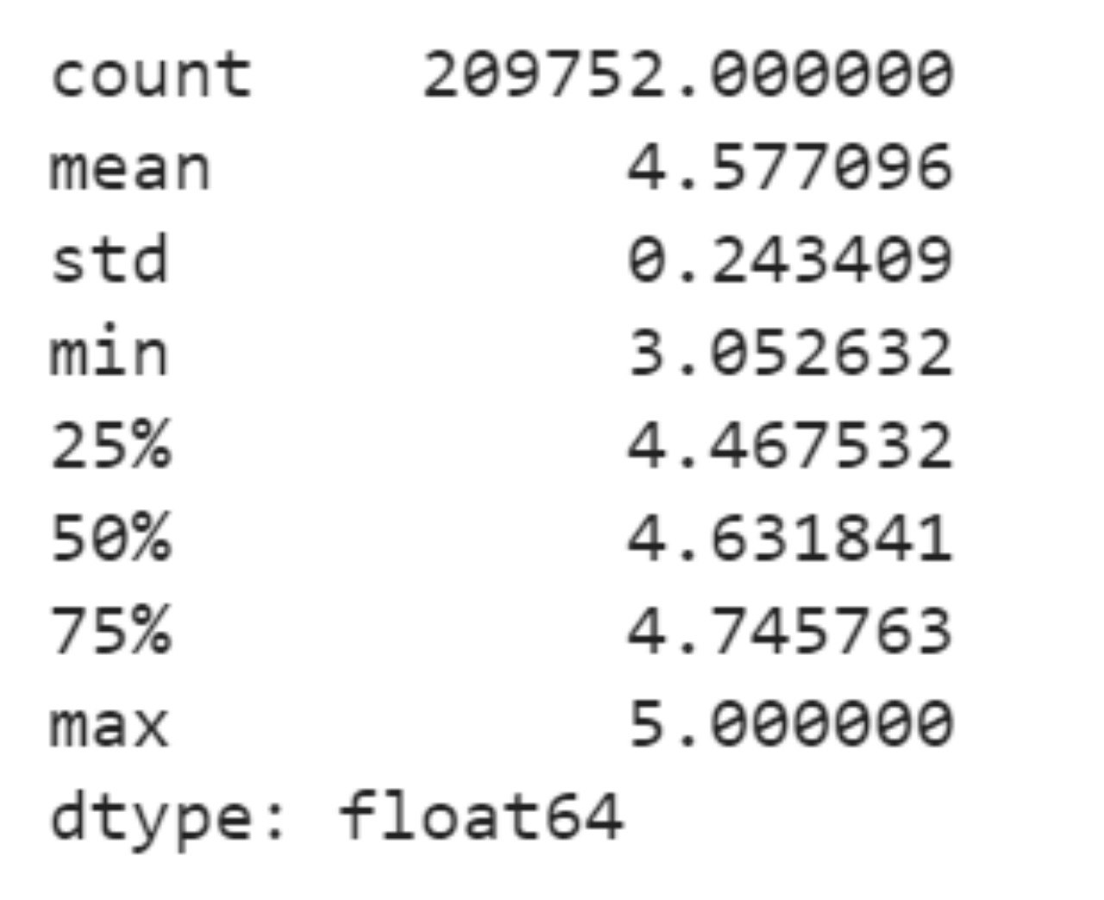
Data Statistics
Following are statistics for Art, Craft and Sewing category for Processed_data2:
count represents number of reviews
mean represents Mean of the above distribution without outliers
std represents Standard Deviation of the above distribution without outliers

Slide 34
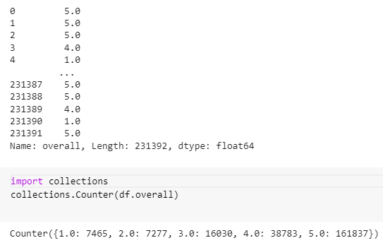
Data Statistics
For calculating Statistics of Processed_data2 we used a pre loaded library function collections.counter from collections library.
We stored the found values on excel and used excel function to find sum of all review ratings.

Slide 35
Data Statistics
For Processed_data2 we get the following statistics for expected values for Chi-Square Goodness-of-Fit Test by considering 10 categories as our population and we will consider one of the categories for the test .
Percent of Total Sum (Expected outcomes percent)
1 star -> 4.6441%
2 star -> 3.5042%
3 star -> 7.1365%
4 star -> 15.6139%
5 star -> 69.1006%
Total 1 star reviews -> 143029
Total 2 star reviews -> 107924
Total 3 star reviews -> 219792
Total 4 star reviews -> 480878
Total 5 star reviews -> 2128167
Total reviews -> 3079808

Slide 36
Hypothesis Testing
According to the data we collected we considered conducting two tests, one for trying to understand the similarities between two categories of rating or we can say similarities between two sample units of the population. Other test for understanding the similarities between distribution of a category (sample unit) and the population (sample frame of 10 categories) on the whole.
We will be using Two Sample Z test for the first comparison and Chi-Square Goodness-of-Fit Test for the second comparison.

Slide 37
Hypothesis Testing
For Processed_data1 we are conducting 2 sample Z test because the scatter plot we got after removing the outliers can be considered as a normal distribution.
We have a very large frequency which is greater than 30 and we have means and standard deviations of two samples hence we have satisfied the conditions for a Two sample Z test.
The test we check with α=0.05 with two tails

Slide 38
Hypothesis Testing
Statement For Hypothesis of Processed_data1:
H₀ : μ₁ = μ₂
H₁: μ₁ ≠ μ₂
Here μ₁ is the mean of one category 1 say Video Games and μ₂ is the mean of category 2 say Art, Craft and Sewing
Considering α=0.05 Z test will have with two tails since our alternative hypothesis states that the mean of two categories is not equal.

Slide 39
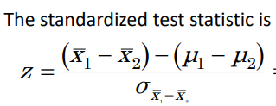
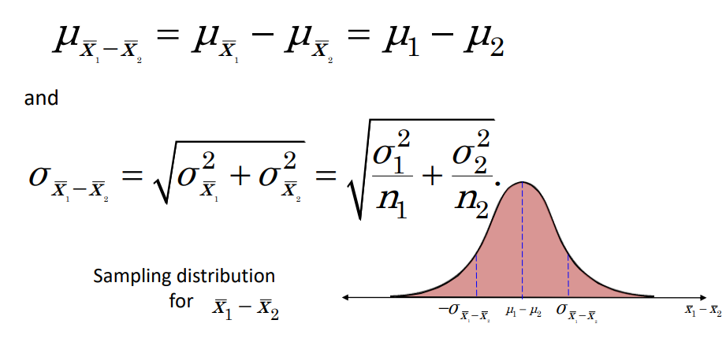
Hypothesis Testing
Formulae used for Two sample Z test
According to our α and two tails the value of the standardized test statistic should be in (-1.96,1.96) from Z table.

Slide 40
Hypothesis Testing
x̄₁= 4.284 σx̄₁=0.39831 n₁=269981
x̄₂= 4.577 σx̄₂= 0.24341 n₂=209752
σx̄₁-x̄₂ = 9.323*10⁻⁴
z = -314.27
Due to extremely small standard deviation and large sample size , we are getting an extremely high value for z.
As the value of z < -1.96 we can reject our null hypothesis.

Slide 41
Hypothesis Testing
For Processed_data2 we are conducting Chi-Square Goodness-of-Fit Test as we have categories from our data processing and for calculating the expected value we are using 10 categories as the population.
We will be using Amazon Fashion category, so that we can get calculations with smaller products which will be more precise.

Slide 42
Hypothesis Testing
Statement for hypothesis of Processed_data2
H₀ : The observed distribution of the category Amazon Fashion will be same as distribution of the whole population (in our case 10 categories).
H₁: The observed distribution of the category Amazon Fashion will not be same as distribution of the whole population (in our case 10 categories).
Here, there are 5 different types for frequency (1, 2, 3, 4 and 5 stars )therefore the value for degree of freedom of chi squared distribution here will be k-1 i.e. 5-1 = 4.
Taking α =0.1,the critical value is χ² = 13.277.

Slide 43
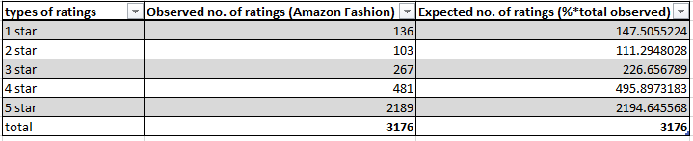
Hypothesis Testing
Following are the expected values and observed values for Amazon Fashion

Slide 44
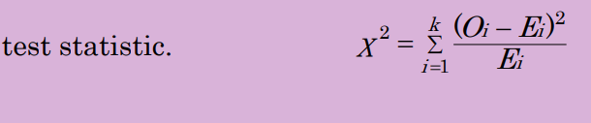
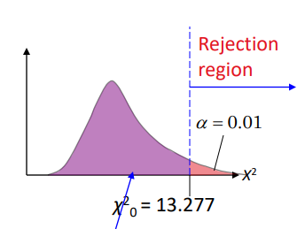
Hypothesis Testing
Formulae used
χ² =(136-147.5)²/147.5 + (103-111.29)²/111.29 + (267-226.66)²/226.66 + (481-495.9)²/495.9 + (2189-2194.64)²/2194.64
χ²= 9.1585
As the value of χ²<13.277 ,therefore our null hypothesis cannot be rejected.

Slide 45
Result
From the conducted tests we reject null hypothesis of the z test which states that distribution of two categories is similar and we cannot reject null hypothesis of Chi-Square test which states that the frequency distribution of each category is similar to the whole population .
Hence we can conclude that for reviews the frequency distribution of a single category can be similar to the population but each category will have a different distribution with respect to other category.

Slide 46
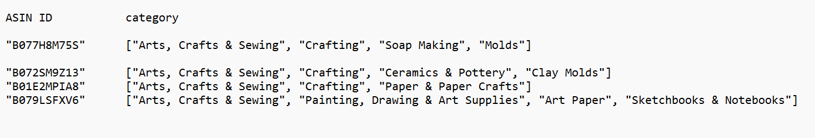
Some Ideas worth researching !!
Apart from the complete review data we also had some metadata available in the dataset which constituted of some peculiar information about products like an also_buy list and ranks of the products .Through this metadata it is possible to generate some valuable insight by doing some analysis
.
From comparing product and corresponding recommendation categories we can gain knowledge about the category of common products, buyers are buying. Same can be done for price range and other attributes of the product but in more depth by going into details of each parameter.

Slide 47
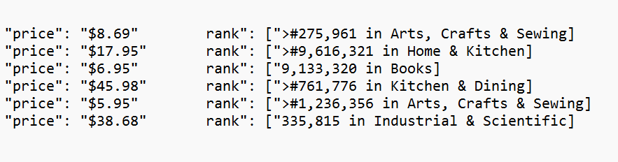
Some Ideas worth researching !!
The way in which the sales of different products of a category change with respect to their price is also a brilliant topic that can be studied in depth.The rank of a product is a good indicator weather a product is good in its category.

Slide 48
Thank You

