Slide 1
Tracking Solar Panel
Tracking solar panels are ones that follow the sun’s movement across the sky, keeping the incidence angle of the light as close to perpendicular as possible and therefore maximising efficiency of the panel.
The incidence angle of light hitting the panel is the main factor directly affecting its power output (excluding clearness index).
Compared with fixed panels, tracking ones can generate “as much as 10 to 25%” more (https://sinovoltaics.com/learning-center/csp/solar-tracker/).

Slide 2
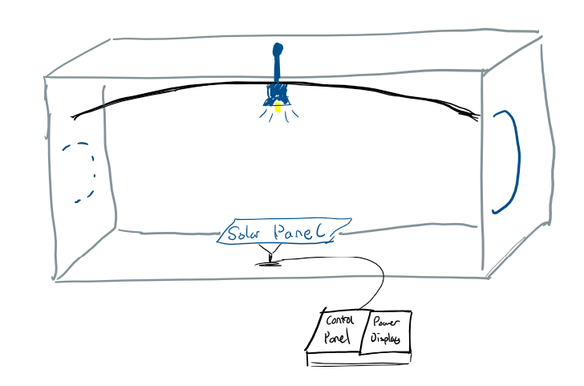
Vision for the DEMO
The demonstration will show what factors affect the power generation of a solar panel and the importance of the incidence angle.
The demo will consist of a tracking solar panel (using LDR), light source, control panel and power output information display.
The user will be able to move the light source and adjust the settings of both the light source and solar panel. They will also be able to take manual control of the tilt angle of the panel.
The user will learn how a tracking solar panel works and that it will have a higher efficiency across each day than a fixed panel and gain a better understanding on how an LDR sensor works.

