Slide 1
Right Pricing Big Mountain Resort
April 14, 2023

Slide 2
Overview
Big Mountain Resort is positioned as a premium resort offering in Montana and in the nation.
Ticket prices are based on the average ticket price for the market segment.
Is the average market ticket price the right benchmark for a premium offering?

Slide 3
Understanding the problem
Current Prices
Facilities
Revenue
Based on market average.
Reflect the pricing of the competition.
Not based on the actual facilities present at Big Mountain.
Big Mountain has some of the best facilities in the nation.
Facility offerings are not being used to determine the ticket price.
Basing ticket prices on the average for the market may be causing Big Mountain to set ticket prices too low.
Some facilities may not be cost effective under a more accurate pricing structure.

Slide 4
Project objective:
Use machine learning to better understand the relationship between ticket prices and facilities in the larger market.

Slide 5
Key Findings

Slide 6
Ticket prices are low for the facility offerings
Analysis shows that the current ticket prices charged by Big Mountain are low given the facilities currently in operation.
A small number of facility types drive most variation in ticket prices.
Facilities that are not key drivers of price can be targets for operating cost reductions.

Slide 7
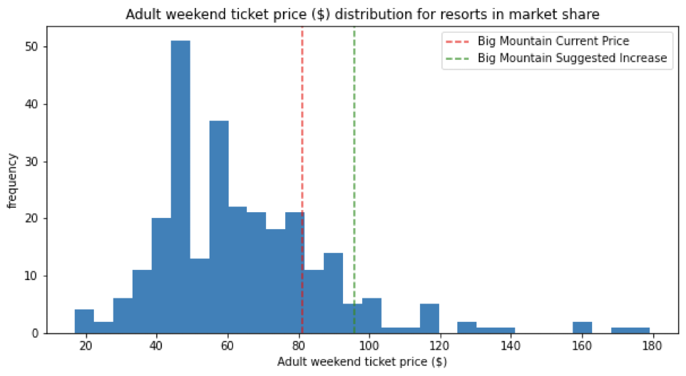
Suggested price increase results in $26M in additional sales
Next steps and implementation

Slide 8
Scenarios Tested and Results
Close up to 10 of the least-used runs
Potential cost savings with minimal effect on prices
No negative effect on prices from closing one run
Closing 3 runs has the same effect as closing 5
Change in modeled ticket prices is < $1 for 5 run closures
Add a new longest run and install an additional chair lift
New facilities support an increase in ticket prices of $1.99.
Increase in revenue of $3.5M
Increase offset by additional operating expenses

Slide 9
Scenarios Tested and Results
Add a new longest run, install a new chair lift, and add 2 acres of snow making
Model projects no additional benefit from adding snow making capacity.
Cost of installation for snow making is not offset by increased pricing
Increase longest run by 0.2 miles and add 4 acres of snow making
Model projects no change in ticket price from these changes.
Not a recommended scenario based on current analysis

Slide 10
Recommended Changes
Raise ticket prices: model indicates right pricing is $95.87
Close up to five of the least-used runs
Consider installing a new longest run with a new chair lift

Slide 11
Modeling Results and Analysis
Data
Key facilities and ticket price info for all US resorts in the market segment.
Data features include items such as:
Weekend ticket price (target value)
Number of lifts
Vertical drop
Number of runs
Snow making acreage
Etc.
Model Design
A random forest algorithm was chosen for the final model.
RF model advantages:
Lower error rate/ higher accuracy vs. linear regression.
Lower result variability
Better overall performance on test and training data

Slide 12
Modeling Results and Analysis
Key Feature Identification
A small number of facility/feature types were identified as key drivers of ticket price.
Key drivers:
Vertical Drop
Snow Making Acerage
Total Chairs
Number of Fast Quads
Number of Runs
Model Limitations
The model was based on available facility and price data only. More data would be beneficial.
Additional data might include:
Customer demographic info
Visitor numbers for competing resorts
Length of stay for competing resorts
Facility operating costs

Slide 13
Implementation
Next Steps
Consult with subject matter experts regarding the proposed changes
SME input areas:
Marketing
Operations
Finance (operating cost analysis)
Competitive intelligence
Customer feedback on existing facilities
Continuing Model Applications
Additional scenarios can be run using the existing model.
Continuing applications might include:
Running new scenarios for removing or adding facilities
Identifying facilities/features that don’t impact ticket prices and reducing expenditure on those items.

