Slide 1
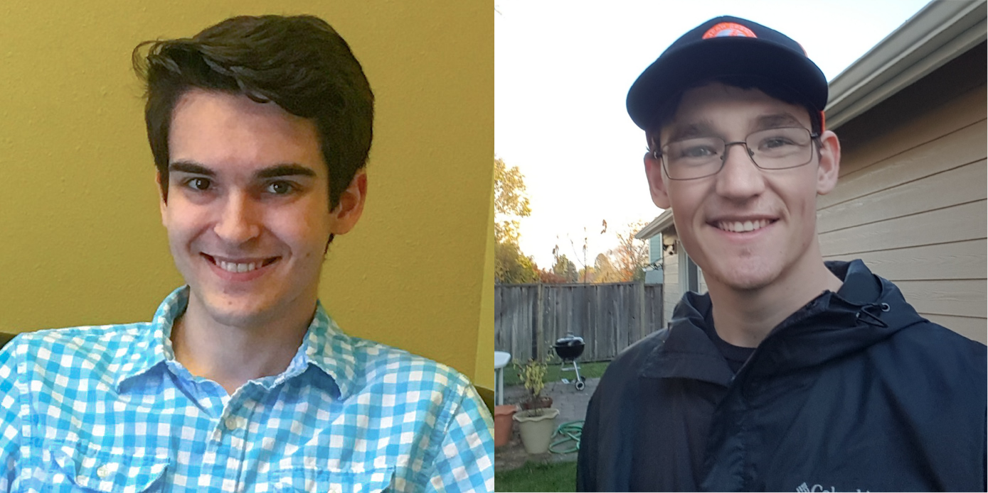
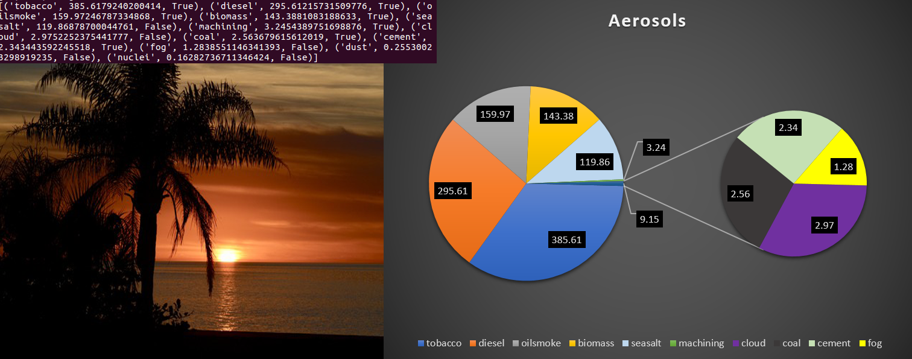
CS19
Aerolyzer
Description
Staring at particles of dust never looked so beautiful.
Aerolyzer is a mobile application that takes user submitted images, and through computer vision software, analyzes the colors of a sunset or sunrise in order to present information on air quality and aerosols in the atmosphere.
We did this using the OpenCV python library to single out the haze layer in the sky, and calculate the wavelengths of the color emitted from the sunset. Using this wavelength data, we are able to tell if the aerosols in the atmosphere are potentially harmful or not. Using Google geocoding API, we are able to get the images location through EXIF data to accurately give local aerosol information.
We chose to use OpenCV as opposed to larger computer vision libraries such as Tensorflow because we did not need many of the functions Tensorflow offers. OpenCV is a simple enough library to complete the task assigned.
The Aerolyzer Python library uses the EXIF data attached to an image when it's taken on a smart device. The EXIF data tells the library whether an image was taken during sunrise or sunset, where the image was taken, what the size of the image is, and whether the image has been changed since it was taken. Only after confirming that an images EXIF data is valid the computer vison functions receive the image.
Client and Team
Team members pictured from left to right:
Daniel Ross | rossda@oregonstate.edu
Logan Wingard | wingarlo@oregonstate.edu
Client:
Kim Whitehall
Fig.1 Raw output from color analysis on Fig.2 Fig.3 Pie Chart representation of color analysis on Fig.2
Fig.2 Original Sunset picture
Conclusion
Image analysis is a developing field in computer science that has become a lot more successful since the popularity of machine learning is on the rise. Our library utilized a basic machine learning algorithm to help isolate the horizon in an image, but we could’ve potentially spent much more time developing a filter that perfectly trimmed the haze layer out of an image. Our team opted instead to have the haze layer crop be a less specific filter so that our color analysis had more data to work with.
Our conversion from an image’s hue to the wavelength that produces that hue was key in our eventual output of the expected aerosols in the air. Having our team test multiple methods for color conversion improved our performance while maintaining accuracy. However the main restraint on the final accuracy is still speed, since ideally the color analysis would be run over the entire haze layer rather than a random sample.
Background
Results
The Aerolyzer project is aimed to provide users with information about what's in the air they breath. Aerosols can have lasting health effects or even cause more immediate issues for people with asthma.
About 10% of Aerosols are man made while the other 90% of aerosols are from natural sources, like volcanic eruptions, sea salt, or mineral dust. Natural Aerosols are generally larger particles than anthropogenic aerosols.
Since humans can't typically see aerosols with our naked eye, Aerolyzer analyzes the effect that aerosols have on sunrises and sunsets. When the sun is close to the horizon, the light from the sun has a higher likelihood to pass by or collide with aerosols. Aerosols can more effectively scatter light of shorter wavelengths which results in the more red light passing through.
The outcomes that were worked towards did not stray far to the actual results. Though many attempts were made to get accurate horizon detection and color analysis, the decided method was chosen for its accuracy, while sacrificing execution time.
This sacrifice in execution time is not in vain, however, as you can see from Fig.3 above, these are the predicted aerosols in the accompanying picture in Fig.2, measured in likelihood(not quantity).
The accuracy of the image classifier function was 68% accurate, which is 2% higher than the goal accuracy of 66%.

