Slide 1

What is a competitive price for Big Mountain Tickets? How does the price change as features are added or removed?

Slide 2
Recommendations 1. Big Mountain’s ticket price can be increased to as much as $95 to accommodate additional expenses. 2.This is well above the $0.88 increase in ticket price needed to pay the operating cost of the new chair lift. 3. Customers will pay more if the vertical drop is increased.

Slide 3
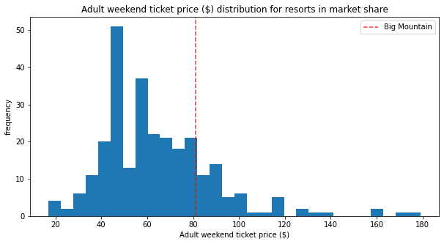
Ticket Prices Big Mountain’s peer’s charge $15 more.
Modeling result

Slide 4
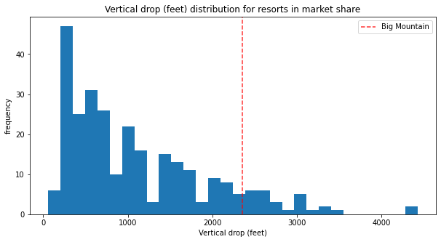
Vertical Drop Big Mountain’s vertical drop is one of the biggest but can be increased.

Slide 5
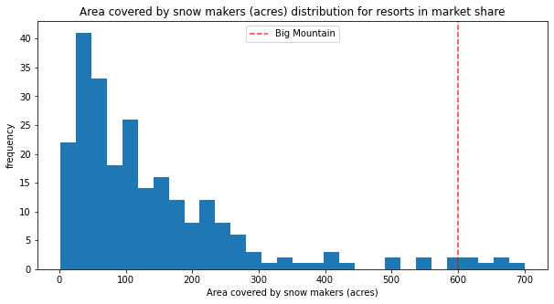
Snow making area Big Mountain’s snow making area is one of the largest.

Slide 6
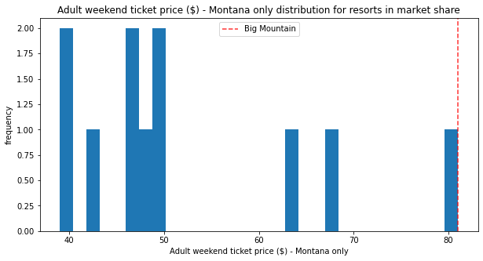
Montana ticket prices
One should be cautious about raising the price too high since Big Mountain’s price is the highest in Montana.
==

Slide 7
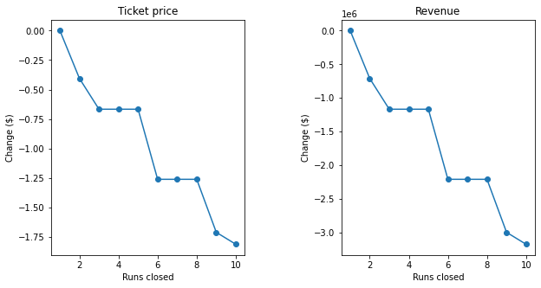
Ticket value vs removed runs
A single run can be removed without any change in price. Removing 10 runs reduces the market price of a single ticket by $1.80, still well below the market price difference.

Slide 8
Vertical Drop Adding length to the longest run does not alter the ticket price. Increasing the vertical drop by 150 feet increases the ticket price by $1.99, roughly the same value increase that is lost by cutting ten runs. Over the season, this could be expected to amount to an additional $3,474,638 dollars even if the number of attendees does not change.

Slide 9
Conclusion Big Mountain is a premium resort and can charge premium prices. Increasing the vertical drop adds the most value to the resort.

