Slide 1
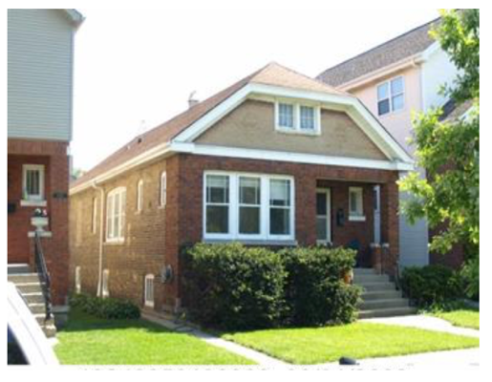
The Overvaluation of Bungalows in the Bell School Area of Chicago:
An exploration of bias in machine learning algorithms for property tax assessment
Ross Hyman

Slide 2

Property Tax
Percentage of the value of property (building + land)
Value of property (building +land) is the assessment
The assessment is determined from a machine learning regressor trained on home sales
Property is the only commonly taxed thing whose value must be determined from a machine learning algorithm
income, sales, interest, stocks, any traded commodity all have market values.
= $1
= $?
This Photo by Unknown Author is licensed under CC BY-SA

Slide 3
My Bias on Bias in Machine Learning Regressors
Estimating the price of things as the average price of comparable things overvalues the low-priced things and undervalues the high-priced things.

Slide 4
Example: Bell School Neighborhood of Chicago
Sale Date | Sale Price | Assessed Value | Assessed/Sale
9/9/21 | $445,000 | $660,000 | 148%
6/16/21 | $525,000 | $660,000 | 126%
7/25/18 | $510,000 | $630,000 | 124%
5/21/21 | $1,025,000 | $715,000 | 70%
7/29/19 | $950,000 | $1,080,000 | 114%
4/15/19 | $1,225,000 | $1,050,000 | 86%

Slide 5
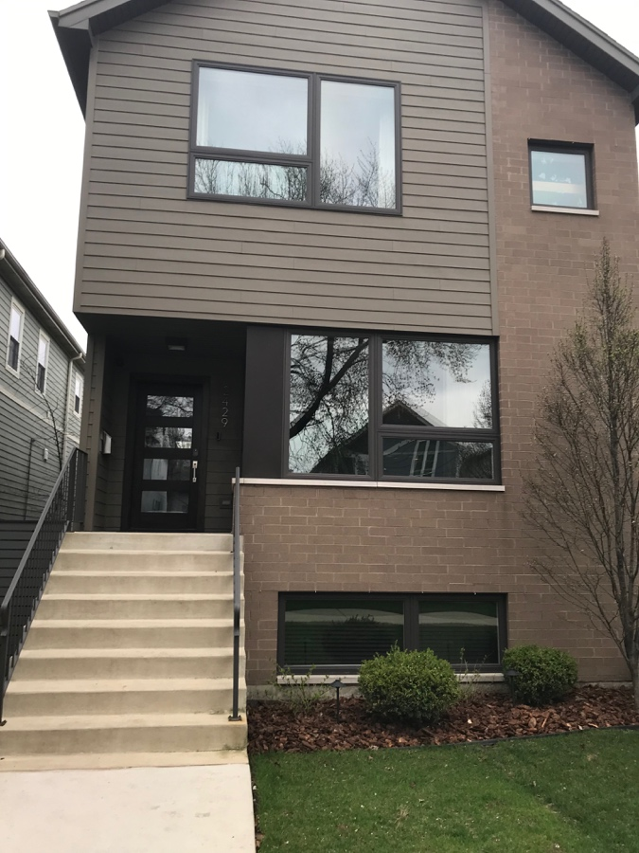
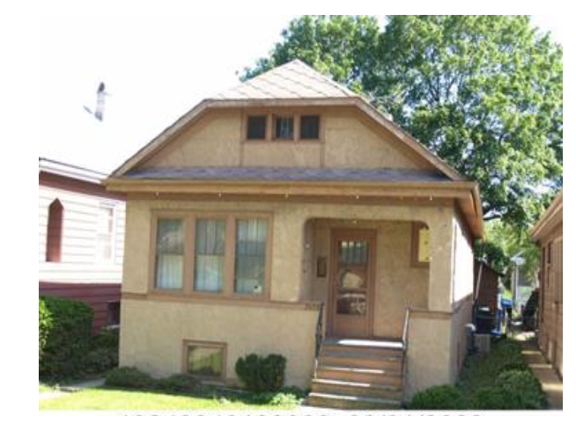
Gentrification

Slide 6
Model #1
Filter to just Bell School Neighborhood. Only 293 home sales.
Overvaluation of low-priced homes can be decreased by removing census tract level features.
Example: census tract median income

Slide 7
Data Source
The Assessor’s data set was downloaded from the Cook County Assessor’s data catalog at https://datacatalog.cookcountyil.gov/Property-Taxation/Archive-Cook-County-Assessor-s-Residential-Modelin/8f9d-wy2d
The Assessor also maintains a Gitlab repository at https://gitlab.com/ccao-data-science---modeling/models/ccao_res_avm

Slide 8
Cook County Assessor Metrics
Model Type | R² | RMSE | MAE | MAPE
Linear | 0.77 | $153,764 | $89,910 | 29%
LightGBM | 0.84 | $125,977 | $67,657 | 24%

Slide 9
Data Cleaning:
The home on the left sold for $1,050,000. It is listed with its former bungalow features on the right.

Slide 10
Model #2
Overvaluation of low-priced homes can be decreased by properly updating features when a house is torn down a new one built in its place.
Simulate this by removing questionable rows (old one-story homes selling for over $700,000

Slide 11
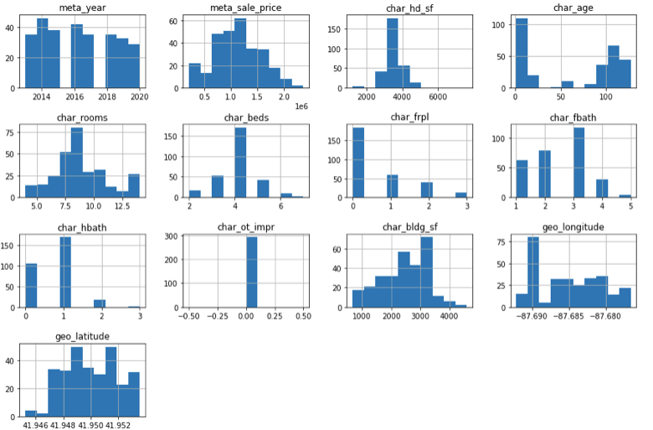
Exploratory Data Analysis

Slide 12
Model #3
Overvaluation of low-priced homes can be decreased by stratifying by age.
Two models are constructed: Old home model and the New home model

Slide 13
Not Stratified/Stratified
Model Type | R² | RMSE | MAE | MAPE
Linear | 0.6 / 0.7 | $290,606 /$238,215 | $213,838/ $174,463 | 21% / 17%
Random Forest | 0.67 / 0.77 | $265,565/ $208,382 | $165,065/ $143,301 | 16%/15%

Slide 14
Results
Cook County Assessment | Random Forrest without census tract features | Random Forrest without questionable data | Random Forrest Age Stratified
$720,000 | 771,642 | 721,817 | $537,821
$720,000 | 645,215 | 597,333 | $452,134
$730,000 | 736,963 | 695,532 | $528,915
$657,730 | 523,533 | 455,545 | $702,487
$660,000 | 466,899 | 407,165 | $472,955

Slide 15
Conclusions
Biased regression results occur in areas of rapid gentrification, where low-priced homes are torn down and replaced with high-priced homes.
Causes of the biased regression are averaging of low- and high-priced homes due to feature-sharing, and features not being properly updated.
Over-valuations can be reduced by removing averaging features, stratifying by age, and properly updating features when old homes are replaced with new homes.

