Slide 1
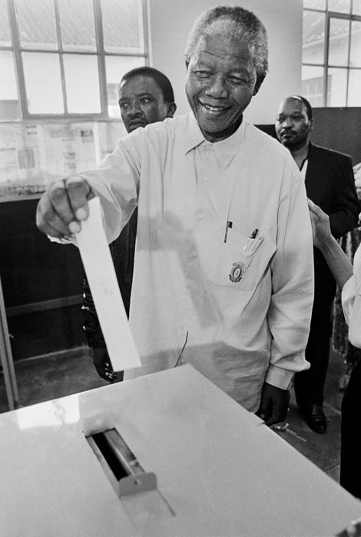
Impartial and Unbiased Apportionment
Meeting the ideal of one person one vote
Ross Hyman
Springboard, February 17, 2022

Slide 2
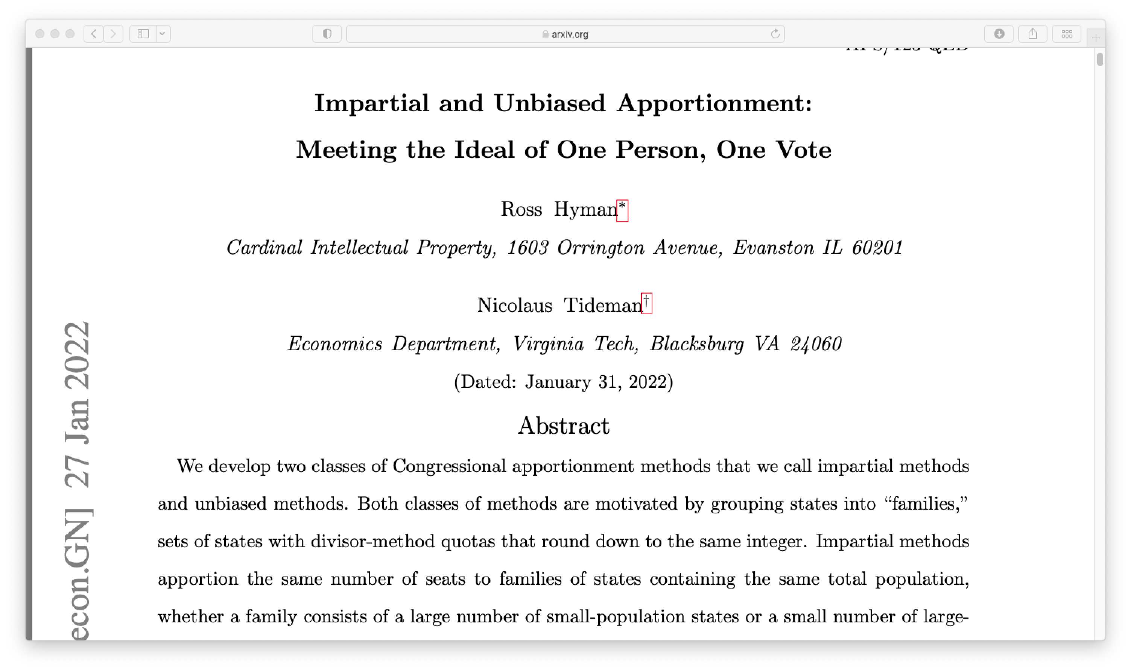
https://arxiv.org/abs/2201.11787
https://github.com/RossHyman/Springboard/blob/main/apportionment/Apportionment.ipynb

Slide 3
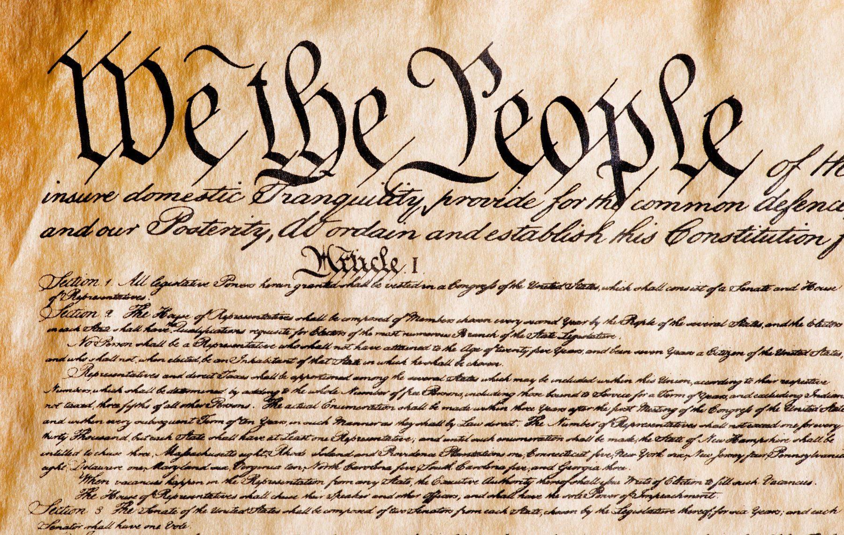
Congressional Apportionment
“Representatives and direct taxes shall be apportioned among the
several states which may be included within this union, according to
their respective numbers…”
- Article I, section 2 of the U.S. Constitution

Slide 4
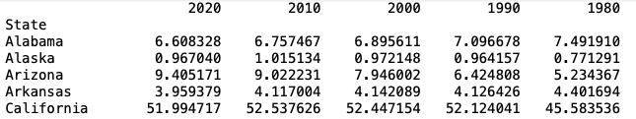

q = pop*435/pop_tot
.
.
.
These numbers are called quotas.

Slide 5
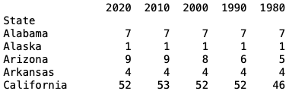
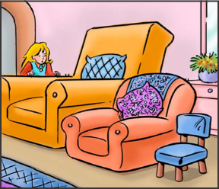

Conventional rounding at n+ ½
.
.
.
The total is not necessarily 435.

Slide 6
The Apportionment Problem
How do you you round a list of numbers so that the sum
of the rounded numbers equals the sum of the
unrounded numbers without introducing bias in favor of
small or large numbers?

Slide 7
Outline
History of apportionment methods and their problems
Unbiased apportionment: if states are drawn repeatedly from the same distribution, a family of states should be assigned the same number of seats on average regardless if they are rounded or not.
Impartial apportionment: For a single sample of states, a families of states with the same total population should be assigned the same number of seats regardless if a family contains a large number of small population states or a small number of large population states.

Slide 8

Neither impartial or unbiased Apportionment
Not even coming close to
Meeting the ideal of one person one vote
Ross Hyman
Springboard, February 17, 2022

Slide 9
Outline
History of apportionment methods and their problems
Unbiased apportionment: if states are drawn repeatedly from the same distribution, a family of states should be assigned the same number of seats on average regardless if they are rounded or not.
Impartial apportionment: For a single sample of states, a families of states with the same total population should be assigned the same number of seats regardless if a family contains a large number of small population states or a small number of large population states.

Slide 10


Problems with Hamilton’s Method
Alabama paradox: Increasing the total number of
seats can decrease the number of seats
apportioned to a state . First noticed for Alabama
in the 1880 apportionment.
New State paradox: Adding or removing a state with its allotted seats
changes the seats apportioned to other states. First noticed in 1907
when Oklahoma became a state.

Slide 11
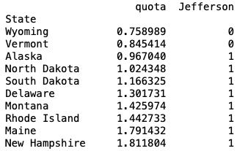

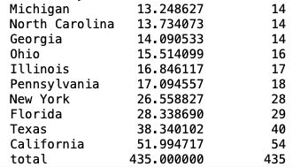
Problem with Jefferson’s Method
.
.
bias in favor of large population states: large population states tend to be apportioned more seats than their quota and small population states tend to be apportioned fewer.

Slide 12
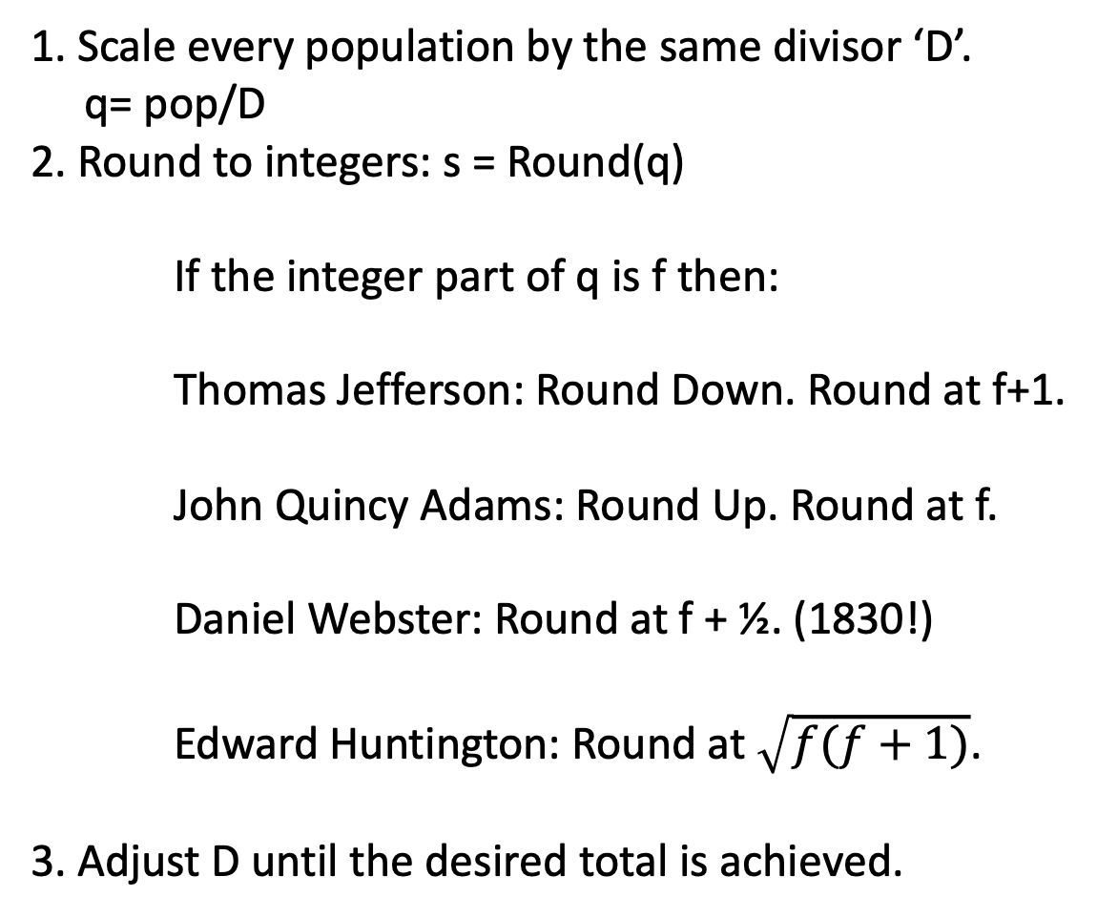
Divisor Methods (scaling a rounding at fixed rounding marks)
1. Scale every population by the same divisor ‘D’.
q= pop/D
2. Round to integers: s = Round(q)
If the integer part of q is f then:
Thomas Jefferson: Round Down. Round at f+1.
John Quincy Adams: Round Up. Round at f.
Daniel Webster: Round at f + ½. (1830!)
Edward Huntington: Round at $\sqrt{f(f+1)}$.
3. Adjust D until the desired total is achieved.

Slide 13
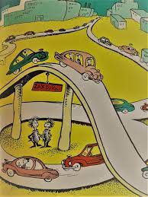
Divisor Methods (scaling a rounding at fixed rounding marks)
Immune to the Alabama paradox: rounding marks don’t move.
Immune to the New State paradox: rounding marks don’t move.
What about population size bias?

Slide 14
Outline
History apportionment methods and their problems
Unbiased apportionment: if states are drawn repeatedly from the same distribution, a family of states should be assigned the same number of seats on average regardless if they are rounded or not.
Impartial apportionment: For a single sample of states, a families of states with the same total population should be assigned the same number of seats regardless if a family contains a large number of small population states or a small number of large population states.

Slide 15
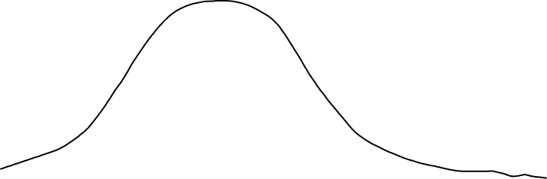
Thinking Statistically: Biased Apportionment
P(q)
A biased result from
minimizing the absolute
error |S-Q| !
1
1.5
2
2.5
3
3.5
4
4.5
5
5.5
6
6.5
7
More small population
states are round up.
q
More large population
states are rounded down

Slide 16
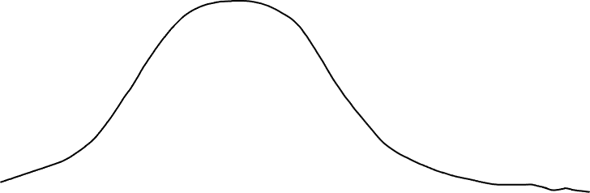
Thinking Statistically Unbiased Apportionment
P(q)
1
1.5
2
2.5
3
3.5
4
4.5
5
5.5
6
6.5
7
q

Slide 17
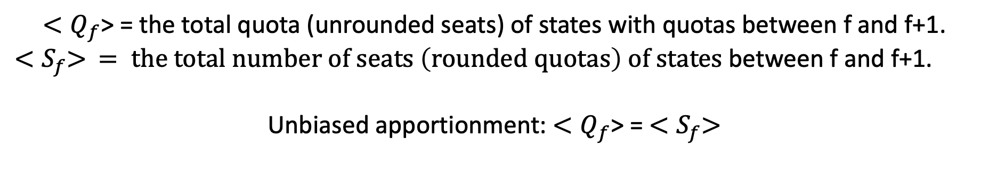
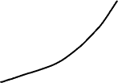
Unbiased Apportionment
r determined from theoretical distribution p(q)
p(q)
f
r
f+1
q
${<Q}_{f}$> = the total quota (unrounded seats) of states with quotas between f and f+1.
${<S}_{f}> = the total number of seats \left(rounded quotas\right) of states$ between f and f+1.
Unbiased apportionment: ${<Q}_{f}$> = ${<S}_{f}>$

Slide 18
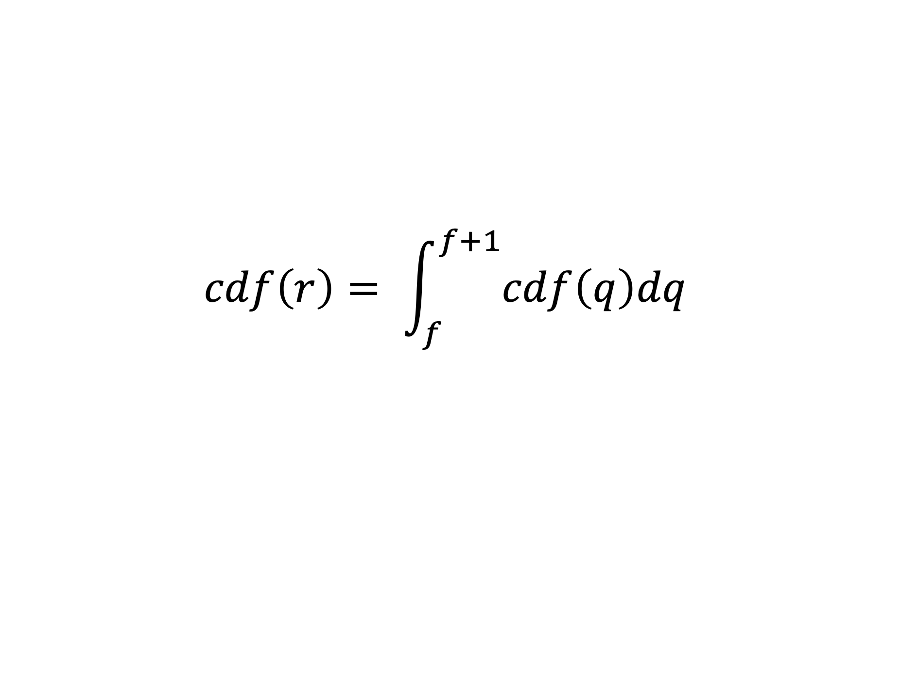
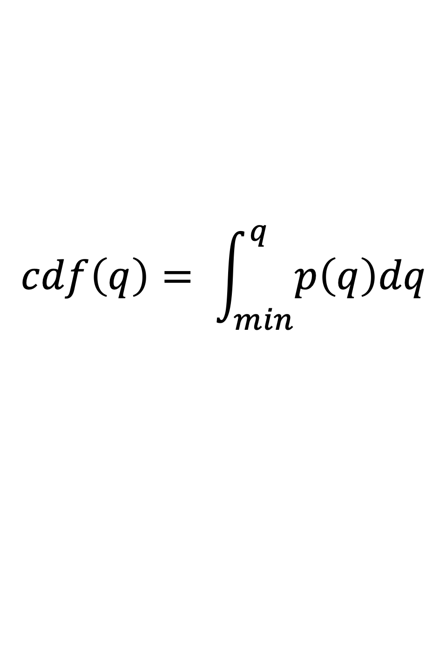
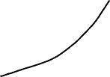
Unbiased Apportionment
P(q)
f
r
f+1
q
$$cdf\left(q\right)= \int_{min}^{q}{p\left(q\right)dq}$$
$$cdf\left(r\right)= \int_{f}^{f+1}{cdf\left(q\right)dq}$$

Slide 19
Unbiased Apportionment
P(q)
f
r
f+1
q
Immune to Alabama paradox: rounding marks don’t move faster than the distribution.
Immune to New State paradox: rounding
marks not dependent on sample.

Slide 20



Unbiased Apportionment Example
Power Law Distributions
P(q)
f
r
f+1
q
Rounding marks don’t move because power law distributions have no scale.

Slide 21
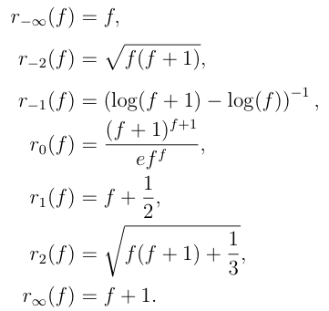
Unbiased Apportionment Example
Power Law Distribution Divisor Methods
Adams
Huntington
Webster
Jefferson
Webster is unbiased for the uniform distribution. Huntington is biased for the $q^{−3}$ distribution. They are
biased for every other distribution.

Slide 22
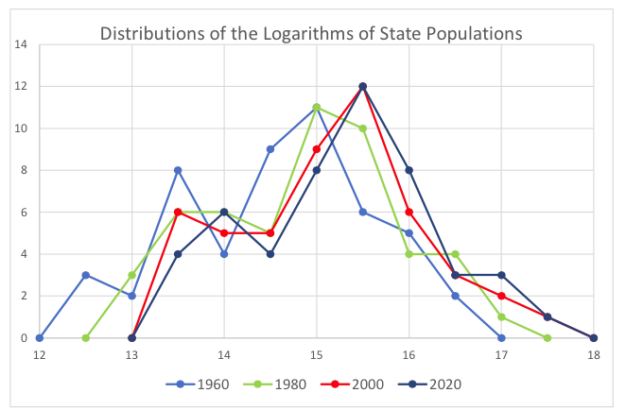
Unbiased Apportionment
Log Normal Distribution

Slide 23
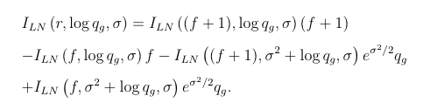
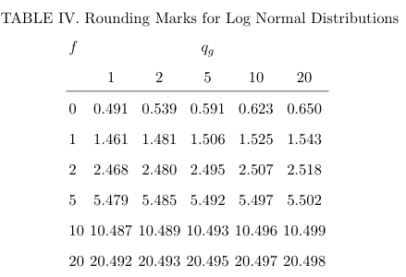
Unbiased Log Normal Apportionment

Slide 24
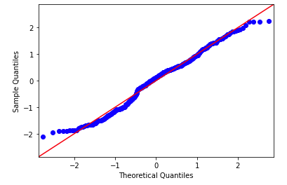
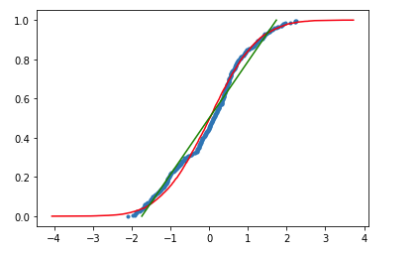
Log normal distribution
cdf
Log(pop)

Slide 25
Outline
History apportionment methods and their problems
Unbiased apportionment: For sets of states drawn repeatedly from the same distribution, a family of states should be assigned the same number of seats on average regardless if they are rounded or not.
Impartial apportionment: For a single sample of states, families of states with the same total population should be assigned the same number of seats regardless if a family contains a large number of small population states or a small number of large population states.

Slide 26

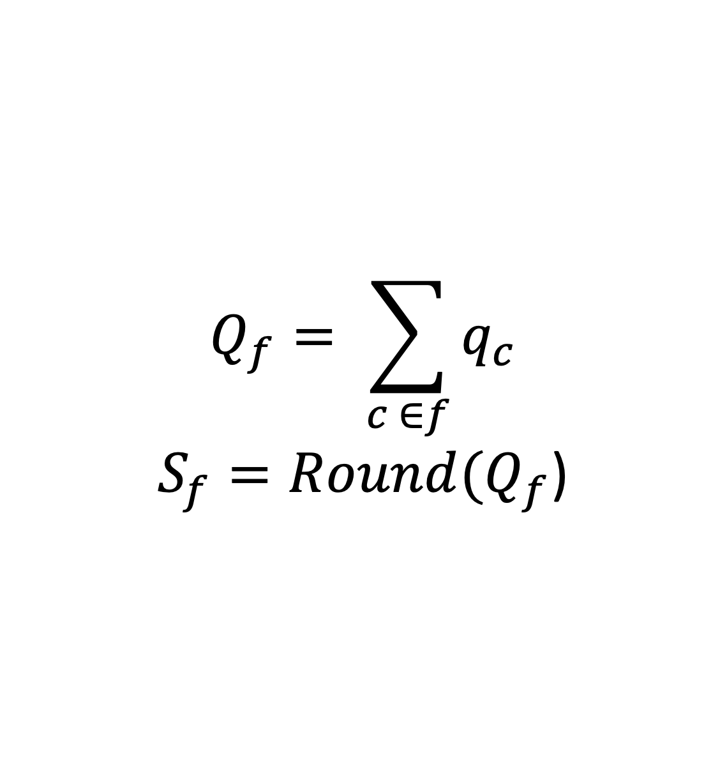

Impartial Apportionment
$Q_{4}$= 4.1 +4.3 +4.5+4.7+4.8 = 22.4
$S_{4}$ = 22
f
f+1
q
$$Q_{f}= \sum_{c ∈f}{q_{c}}$$
$S_{f}=Round(Q_{f}$)

Slide 27


Impartial Apportionment
rounding determined from sample
5
2
3
$Q_{2}$ = 2.6 + 2.7 = 5.3
$Q_{5}$ = 5.3
Impartial apportionment assigns the same number
seats to a large number of small population states
as it does to a small number of large population states
with the same total population.

Slide 28
Impartial Apportionment
rounding determined from sample
f
f+1
q
As D changes Q changes by integers.
For rounding at n+ ½ impartial
apportionment is immune to
the Alabama paradox.

Slide 29
Conclusions
Unbiased Apportionment
applicable to numbers repeatedly drawn from the same distribution.
the rounded and unrounded seat numbers for each family of states agree on average.
immune to the Alabama paradox and the New State paradox.
one unbiased apportionment method for each distribution.
Applying an unbiased method for one distribution for states drawn from a different distribution is biased.
Impartial Apportionment
applicable to any set of numbers.
7. apportions the same number of seats to families of states with equal total population.
8. immune to the Alabama paradox.
9. impossible for a method to be both impartial and immune to the New State paradox.
10. only unbiased in the limit of an infinite number of states.

Slide 30
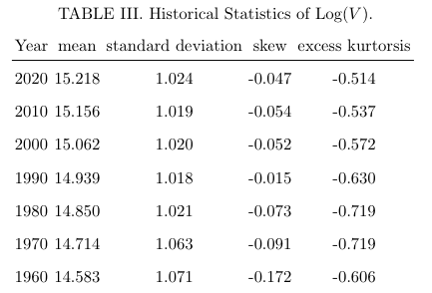
Unbiased Apportionment

Slide 31


ACNOWLEDGMENTS
I thank my collaborator Nic Tideman,
and my Springboard mentor Yuxuan Xin.

Slide 32
Warning:
Minimizing an error function that appears
unbiased can produce a biased result.

Slide 33
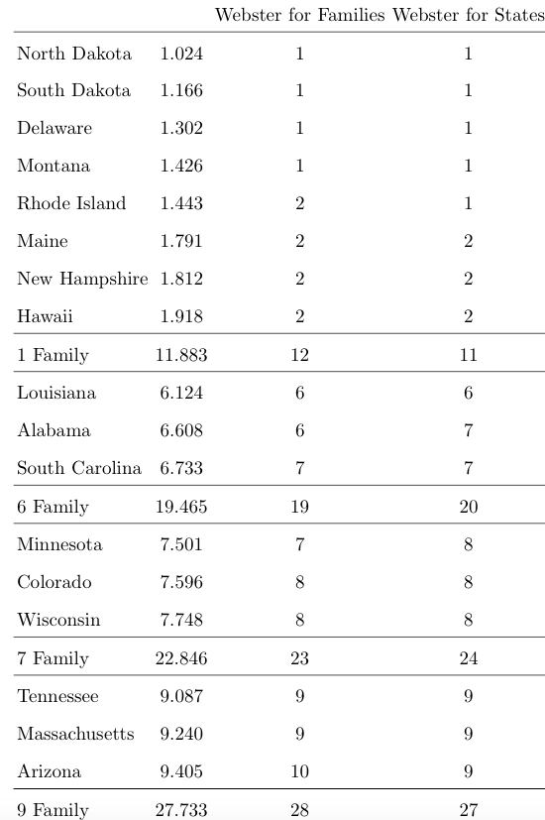
Apportionment Comparison

Slide 34
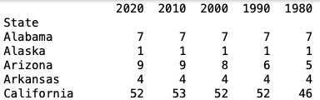

Hamilton’s Method
Round at N+r, adjusting r to get the desired total.
r > ½ to reduce the total and and r< ½ to increase
the total.
.
.
.

Slide 35
The Alabama Paradox
Increasing the total number of seats can decrease the number of seats
apportioned to a state . First noticed for Alabama in 1880 apportionment.
.
.
.
.
.
.
Rhode Island is apportioned 1 seat out of 435, 2 seats out of 436, but back down
to 1 seat out of 437.

Slide 36
.
.
Jefferson’s Method
Scale every population by the same divisor ‘D’
q = pop/D and round q down. Adjust D until the desired total is achieved.

Slide 37
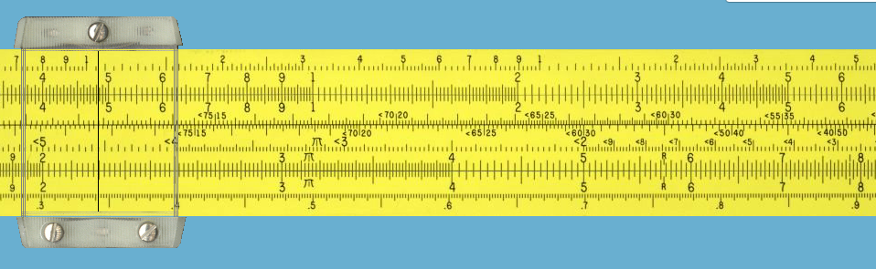
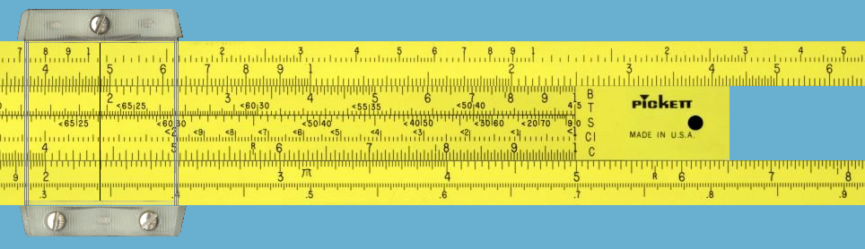
The Apportionment Slide Rule

Slide 38
The Divisor Method Slide Rule
Divisor methods are
Immune to the
Alabama paradox
and the new state
Paradox.
1 2 3 4 5 6
0.5 1.5. 2.5. 3.5. 4.5. 5.5. 6.5
Huntington geometric mean rounding is halfway between integers on a slide rule

Slide 39
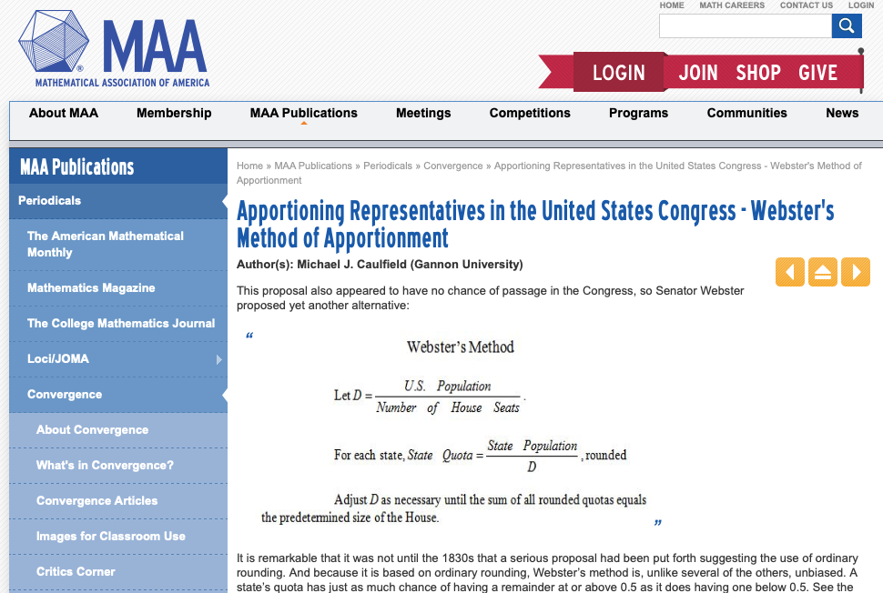

Slide 40
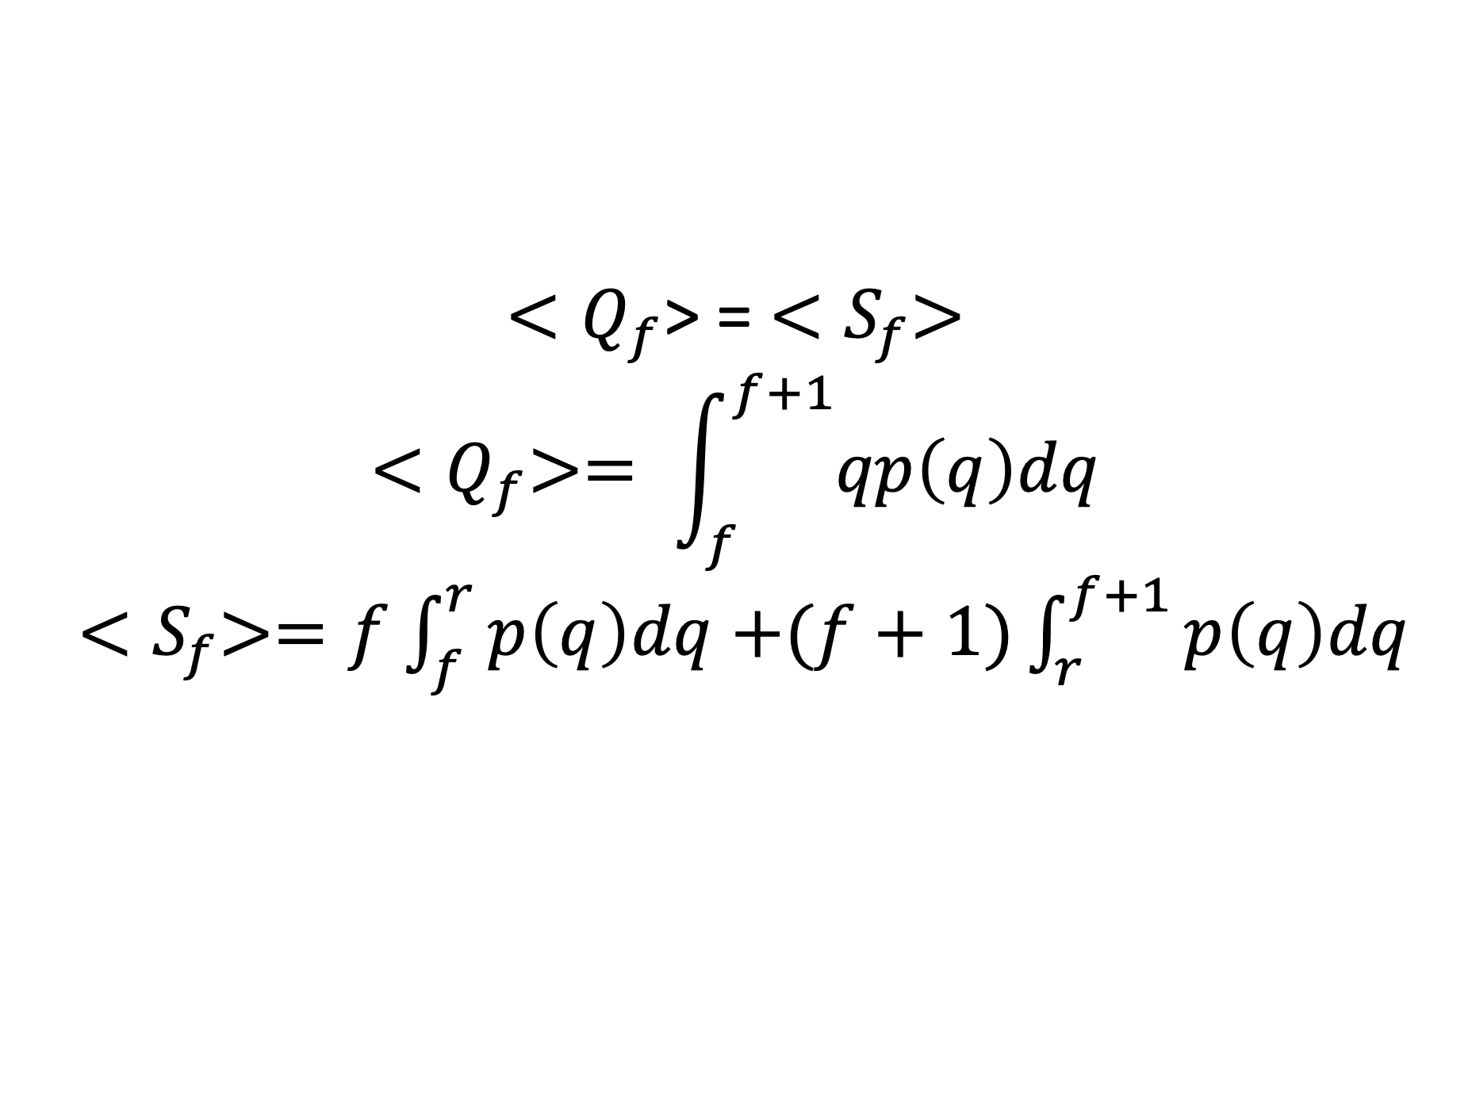
Unbiased Apportionment
r determined from theoretical distribution p(q)
p(q)
f
r
f+1
q
${<Q}_{f}$> = ${<S}_{f}>$
$${<Q}_{f}>= \int_{f}^{f+1}{qp\left(q\right)dq}$$
${<S}_{f}>=f\int_{f}^{r}{p\left(q\right)dq}$ $+(f+1)\int_{r}^{f+1}{p\left(q\right)dq}$

Slide 41
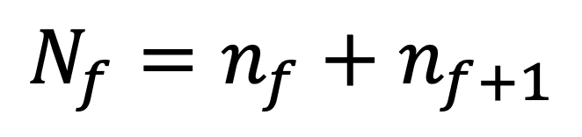



Impartial Apportionment
rounding determined from sample
$Q_{4}$= 4.1 +4.3 +4.5+4.7+4.8 = 22.4
$S_{4}$ = 22
22 = 4$n_{4}$ + 5 $n_{5}$
5 = $n_{4}$ + $n_{5}$
f
f+1
q
$$S_{f}=fn_{f}+(f+1)n_{f+1}$$
$$N_{f}=n_{f}+n_{f+1}$$

Slide 42
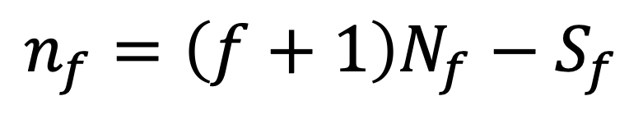
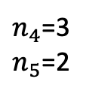
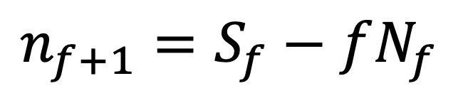
Impartial Apportionment
rounding determined from sample
$n_{4}$=3
$n_{5}$=2
f
f+1
q
$$n_{f}=\left(f+1\right)N_{f}−S_{f}$$
$$n_{f+1}=S_{f}−fN_{f}$$

