Slide 1
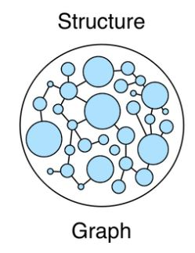
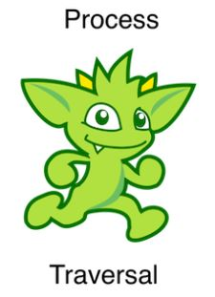
UI
Utterance
Node Code
Utterance
Luis
Intent
Request / Send Recipe Content
Clarification Request or Recipe ID
Intent or Clarification
Cosmos GraphDB
Ingest Recipe Data .Net

