Slide 1

The Effects of Effects on Constructivism
Liron Cohen Sofia Abreu Faro Ross Tate

Slide 2
Modeling Constructivism
Partial Combinatory Algebra
Models
Computation
Realizability Tripos
Models Higher-Order Logic
Realizability Topos
Models Extensional Type Theory

Slide 3
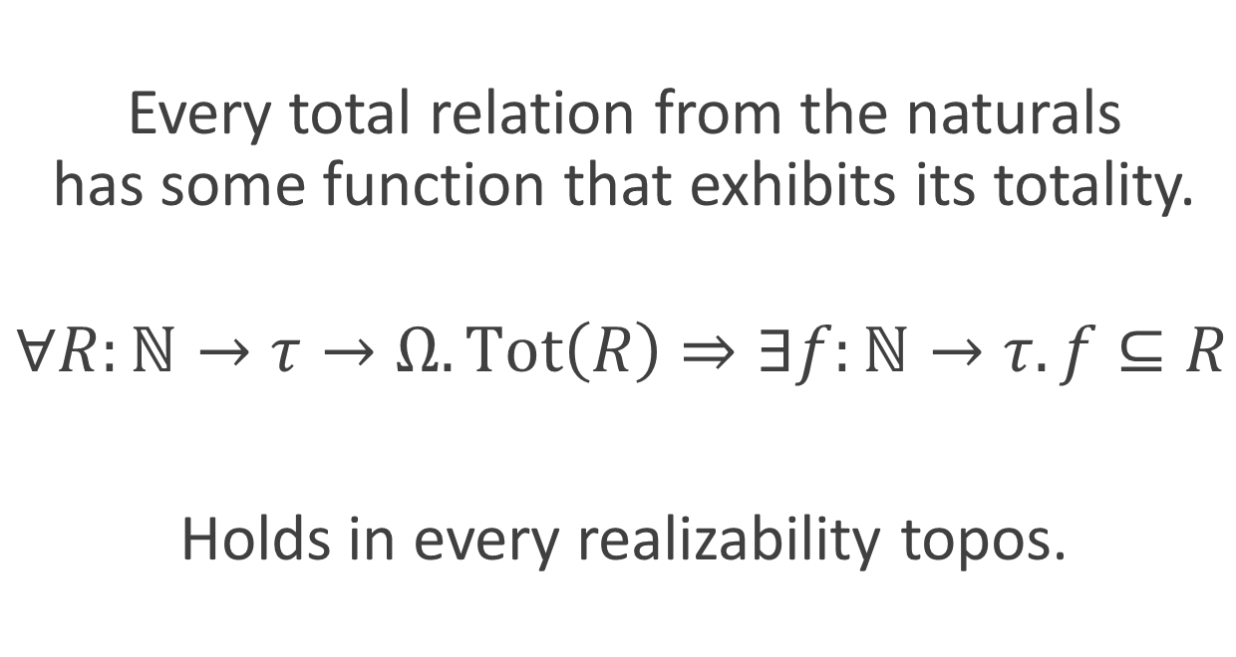

Countable Choice (CC)
Every total relation from the naturals has some function that exhibits its totality.
$∀R:ℕ→τ→Ω. \text{Tot}\left(R\right)⇒∃f:ℕ→τ. f⊆R$
Holds in every realizability topos.
Constructive Process

Slide 4
Non-Deterministic Constructivism

Slide 5
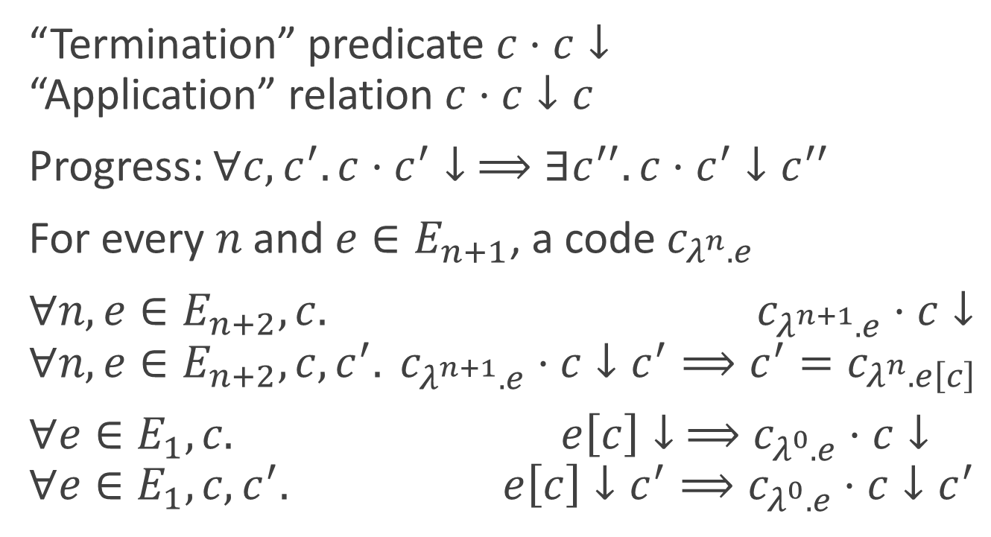
Relational Combinatory Algebra
“Termination” predicate $c⋅c↓$ “Application” relation $c⋅c↓c$
Progress: $∀c,c^{′}. c⋅c^{′}↓ ⟹∃c^{′′}. c⋅c^{′}↓c^{′′}$
$\text{For} \text{every} n \text{and} e∈E_{n+1}\text{, }\text{a} \text{code} c_{λ^{n}.e}$
$∀n,e∈E_{n+2}, c. c_{λ^{n+1}.e}⋅c↓$ $∀n,e∈E_{n+2}, c,c^{′}. c_{λ^{n+1}.e}⋅c↓c^{′}⟹c^{′}=c_{λ^{n}.e\left[c\right]}$
$∀e∈E_{1},c. e\left[c\right]↓ ⟹c_{λ^{0}.e}⋅c↓$ $∀e∈E_{1},c,c^{′}. e\left[c\right]↓c^{′}⟹c_{λ^{0}.e}⋅c↓c^{′}$

Slide 6
Constructive Toposes
Partial Combinatory Algebra
Realizability Tripos
Realizability Topos
Models
Computation
Models Higher-Order Logic
Models Extensional Type Theory

Slide 7




Constructive Toposes
Partial Combinatory Algebra
PCA Tripos
PCA Topos
Models
Computation
Models Higher-Order Logic
Models Extensional Type Theory

Slide 8
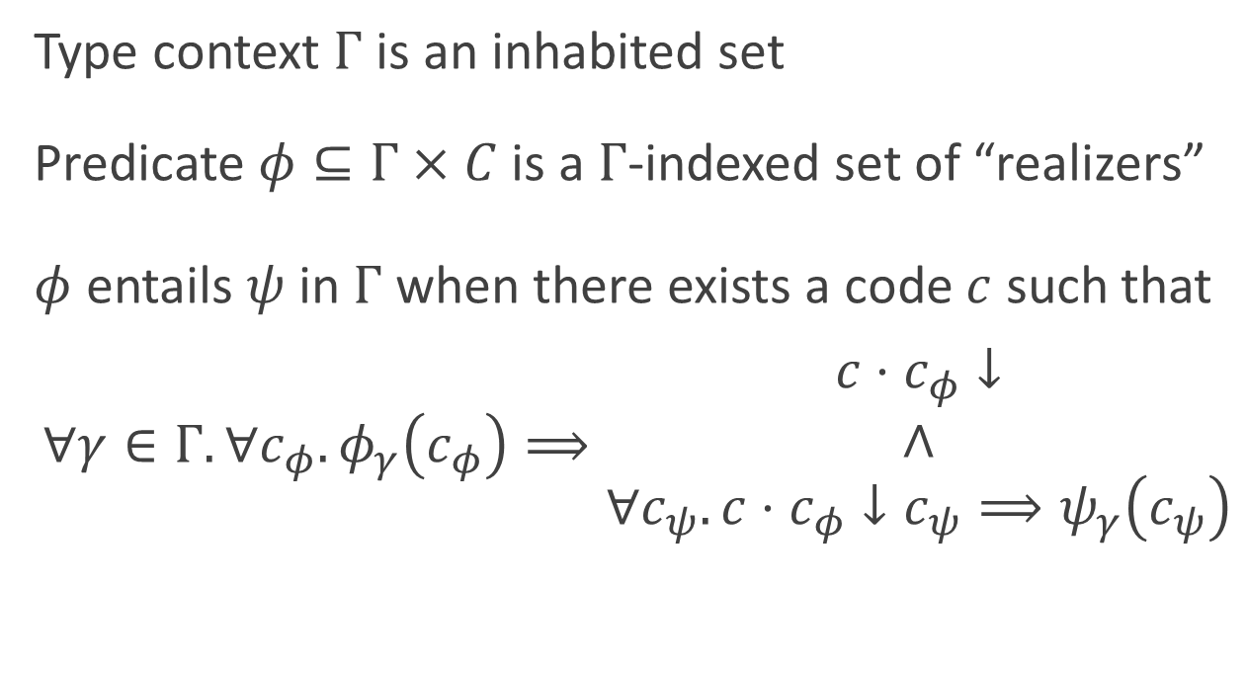
Higher-Order Logic for RCA
Type context $Γ$ is an inhabited set
Predicate $φ⊆Γ×C$ is a $Γ$-indexed set of “realizers”
$φ$ entails $ψ$ in $Γ$ when there exists a code $c$ such that
$∀γ∈Γ.∀c_{φ}. φ_{γ}\left(c_{φ}\right)⟹\begin{matrix}c⋅c_{φ}↓ \\ ∧ \\ ∀c_{ψ}. c⋅c_{φ}↓c_{ψ}⟹ψ_{γ}\left(c_{ψ}\right)\end{matrix}$

Slide 9
Non-Determinism Can Refute Countable Choice

Slide 10




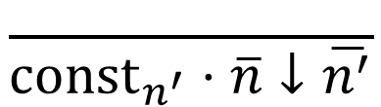
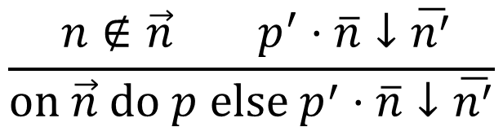

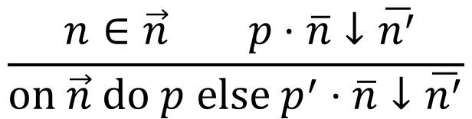
Flip RCA
$c∷=λ^{n}.E_{n+1}∣\overline{n}∣p$ $p∷={\text{const}}_{n}∣\text{succ}∣\text{on} \vec{n} \text{do} p \text{else} p^{′}∣\text{flip}$
$$\frac{ }{p⋅\overline{n}↓}$$
$$\frac{ }{{\text{const}}_{n^{′}}⋅\overline{n}↓\overline{n^{′}}}$$
$$\frac{ }{\text{succ}⋅\overline{n}↓\overline{n+1}}$$
$$\frac{ n∈\vec{n} p⋅\overline{n}↓\overline{n^{′}}}{\text{on} \vec{n} \text{do} p \text{else} p^{′}⋅\overline{n}↓\overline{n^{′}}}$$
$$\frac{ n∉\vec{n} p^{′}⋅\overline{n}↓\overline{n^{′}}}{\text{on} \vec{n} \text{do} p \text{else} p^{′}⋅\overline{n}↓\overline{n^{′}}}$$
$$\frac{ }{\text{flip}⋅\overline{n}↓\overline{0}}$$
$$\frac{ }{\text{flip}⋅\overline{n}↓\overline{1}}$$

Slide 11
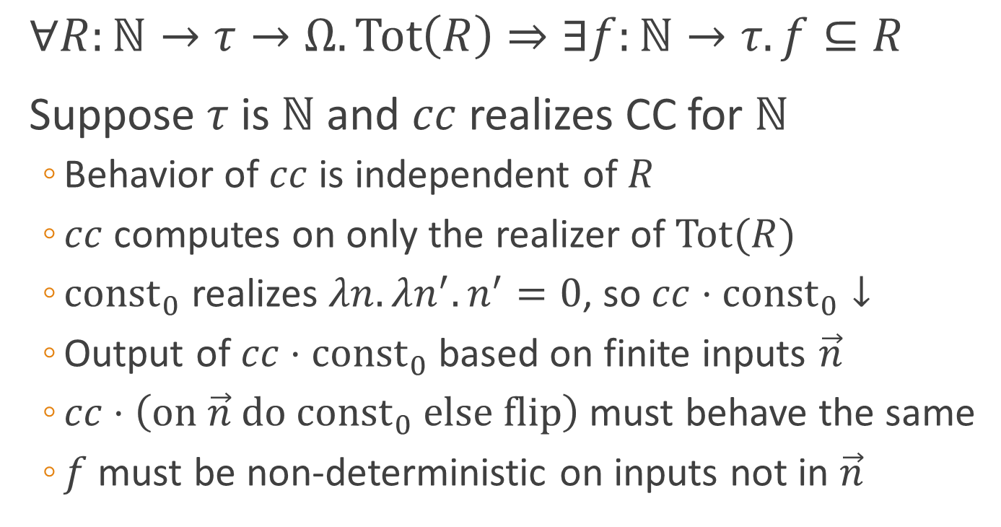
Refuting Countable Choice
$∀R:ℕ→τ→Ω. \text{Tot}\left(R\right)⇒∃f:ℕ→τ. f⊆R$
Suppose $τ$ is $ℕ$ and $cc$ realizes CC for $ℕ$
Behavior of $cc$ is independent of $R$
$cc$ computes on only the realizer of $\text{Tot}(R)$
${\text{const}}_{0}$ realizes $λn.λn^{′}.n^{′}=0$, so $cc⋅{\text{const}}_{0}↓$
Output of $cc⋅{\text{const}}_{0}$ based on finite inputs $\vec{n}$
$cc⋅\left(\text{on} \vec{n} \text{do} {\text{c}\text{onst}}_{0} \text{else} \text{flip}\right)$ must behave the same
$f$ must be non-deterministic on inputs not in $\vec{n}$
Contradiction

Slide 12
CC and Constructive Reals
Modulated Cauchy Reals
Cauchy Reals
Dedekind Reals
(Weak)
Countable
Choice

Slide 13
Stateful Constructivism

Slide 14
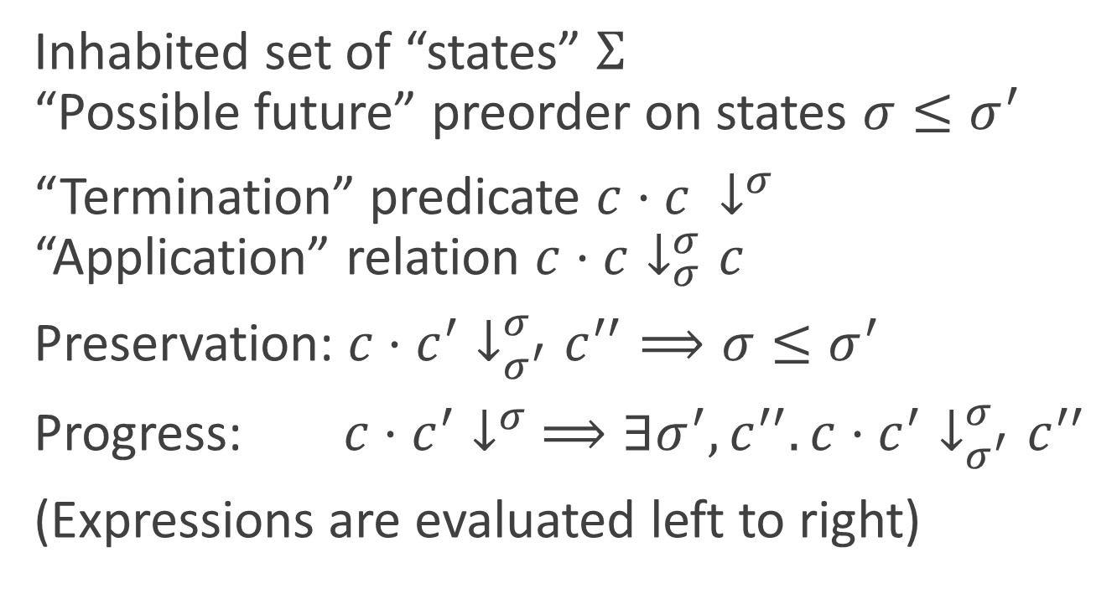
Stateful Combinatory Algebra
Inhabited set of “states” $Σ$ “Possible future” preorder on states $σ≤σ^{′}$
“Termination” predicate $c⋅c ↓^{σ}$ “Application” relation $c⋅c↓_{σ}^{σ}c$
Preservation: $c⋅c^{′}↓_{σ^{′}}^{σ}c^{′′}⟹σ≤σ^{′}$
Progress: $c⋅c^{′}↓^{σ} ⟹∃σ^{′},c^{′′}. c⋅c^{′}↓_{σ^{′}}^{σ}c^{′′}$
(Expressions are evaluated left to right)

Slide 15




Constructive Toposes
Partial Combinatory Algebra
PCA Tripos
PCA Topos
Models
Computation
Models Higher-Order Logic
Models Extensional Type Theory

Slide 16
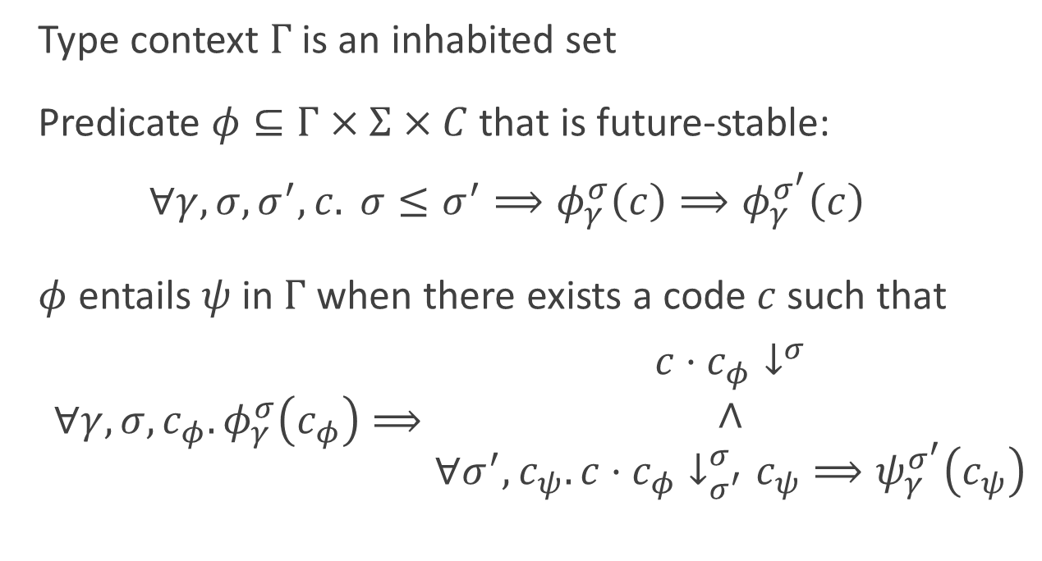
Higher-Order Logic for SCA
Type context $Γ$ is an inhabited set
Predicate $φ⊆Γ×Σ×C$ that is future-stable: $∀γ,σ,σ^{′},c. σ≤σ^{′}⟹φ_{γ}^{σ}\left(c\right)⟹φ_{γ}^{σ^{′}}\left(c\right)$
$φ$ entails $ψ$ in $Γ$ when there exists a code $c$ such that
$∀γ,σ,c_{φ}. φ_{γ}^{σ}\left(c_{φ}\right)⟹\begin{matrix}c⋅c_{φ}↓^{σ} \\ ∧ \\ ∀σ^{′},c_{ψ}. c⋅c_{φ}↓_{σ^{′}}^{σ}c_{ψ}⟹ψ_{γ}^{σ^{′}}\left(c_{ψ}\right)\end{matrix}$

Slide 17
State Can Restore Countable Choice

Slide 18
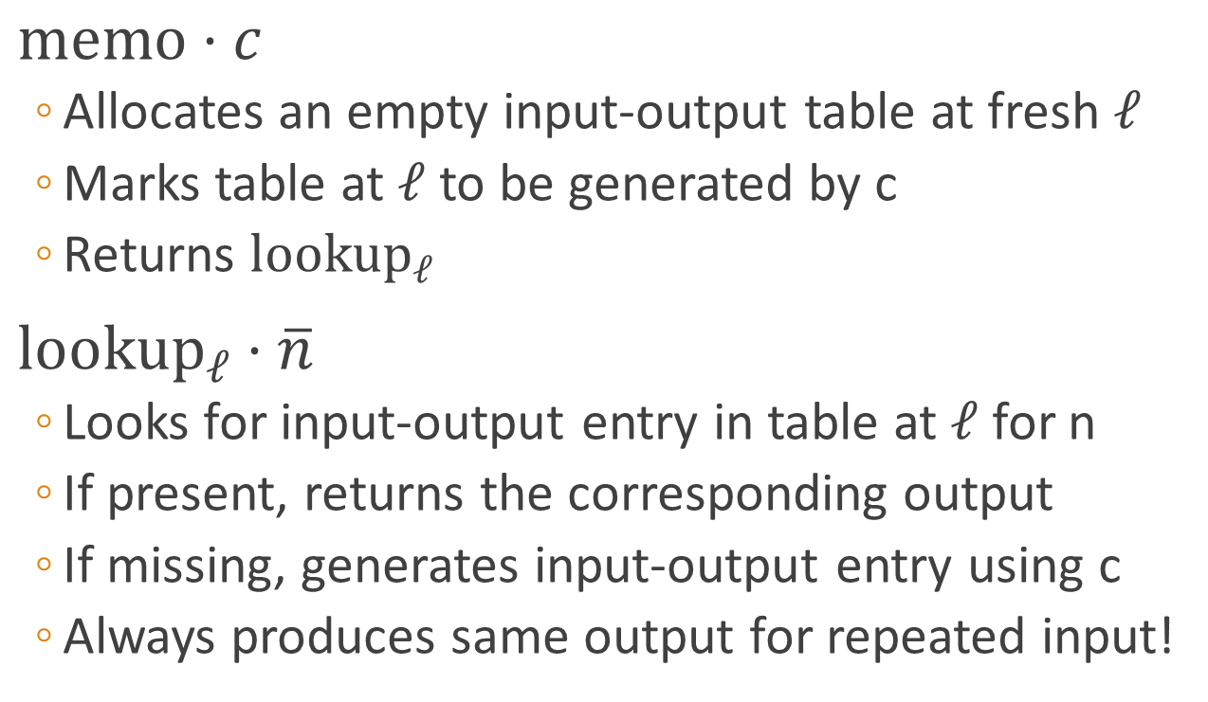
Memo SCA
$\text{memo}⋅c$
Allocates an empty input-output table at fresh $ℓ$
Marks table at $ℓ$ to be generated by c
Returns ${\text{lookup}}_{ℓ}$
${\text{lookup}}_{ℓ}⋅\overline{n}$
Looks for input-output entry in table at $ℓ$ for n
If present, returns the corresponding output
If missing, generates input-output entry using c
Always produces same output for repeated input!

Slide 19
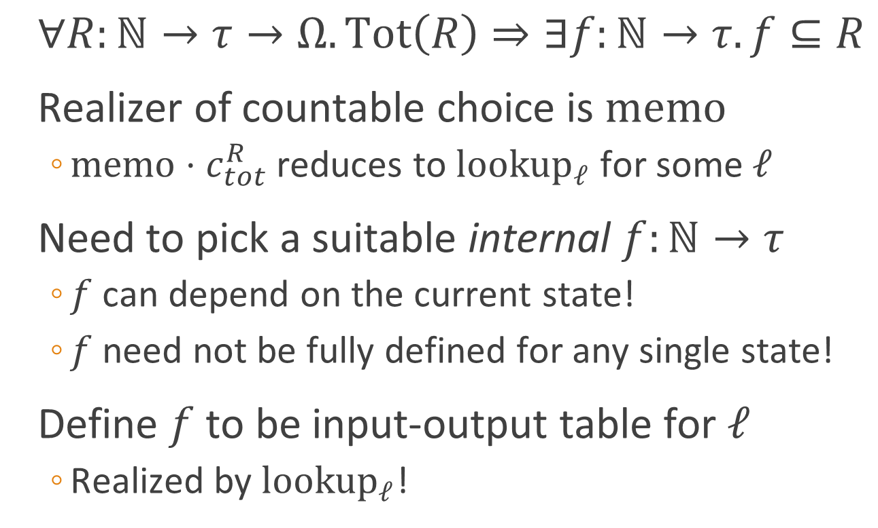
Restoring Countable Choice
$∀R:ℕ→τ→Ω. \text{Tot}\left(R\right)⇒∃f:ℕ→τ. f⊆R$
Realizer of countable choice is $\text{memo}$
$\text{memo}⋅c_{tot}^{R}$ reduces to ${\text{lookup}}_{ℓ}$ for some $ℓ$
Need to pick a suitable internal $f:ℕ→τ$
$f$ can depend on the current state!
$f$ need not be fully defined for any single state!
Define $f$ to be input-output table for $ℓ$
Realized by ${\text{lookup}}_{ℓ}$!

Slide 20
Raising Questions

Slide 21
Questions to Consider
Stability under effectful extensions?
New principles enabled by effects?
When are effects no longer constructive?
Effect-agnostic realizability of constructivism?

